Slide 1
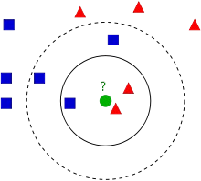
K-Nearest Neighbour

Slide 2
Nearest Neighbor Classifiers
Basic idea:
  If it walks like a duck, quacks like a duck, then it’s probably a duck
Compute Distance
Test Record
Training Records
Choose k of the “nearest” records

Slide 3
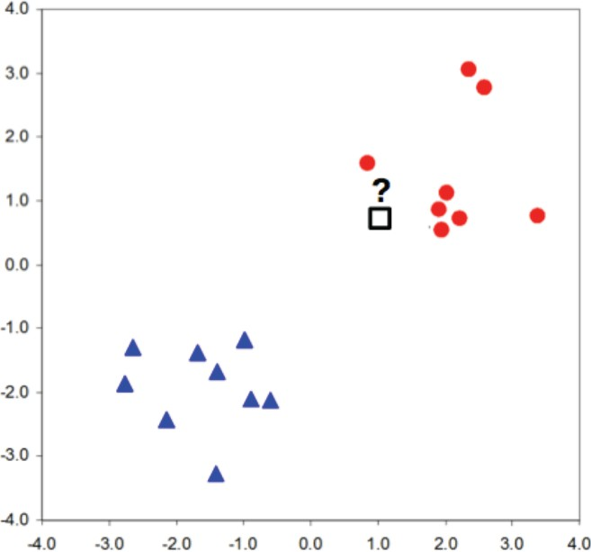


k-Nearest Neighbor (kNN) Algorithm
Idea:
- Two classes, two features
- We want to assign label to unknown data point?
- Label should be red.

Slide 4
k-Nearest Neighbor (kNN) Algorithm
Idea:
We have similar labels for similar features.
We classify new test point using similar training data points.
Algorithm overview:
Given some new test point x for which we need to predict the class y.
Find most similar data-points in the training data.
Classify x “like” these most similar data points.
Questions:
How do we determine the similarity?
How many similar training data points to consider?
How to resolve inconsistencies among the training data points?

Slide 5






k-Nearest Neighbor (kNN) Algorithm
1-Nearest Neighbor:
Simplest ML Classifier
Idea: Use the label of the closest known point
Label should be red.
Generalization:
Determine the label of k nearest neighbors and assign the most frequent label
Label should be red
Label should be blue
k=7
k=3

Slide 6
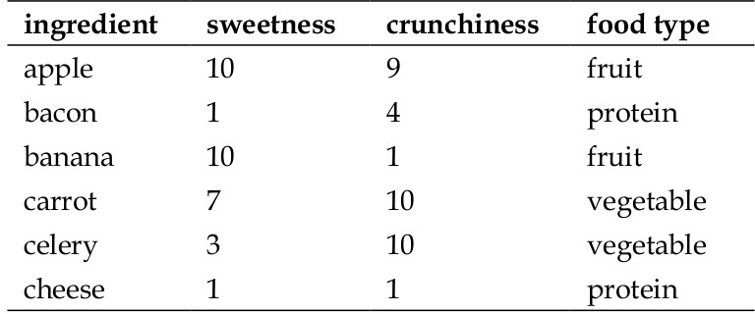
Example:
Reference: Machine Learning with R, Brett Lantz, Packt Publishing

Slide 7
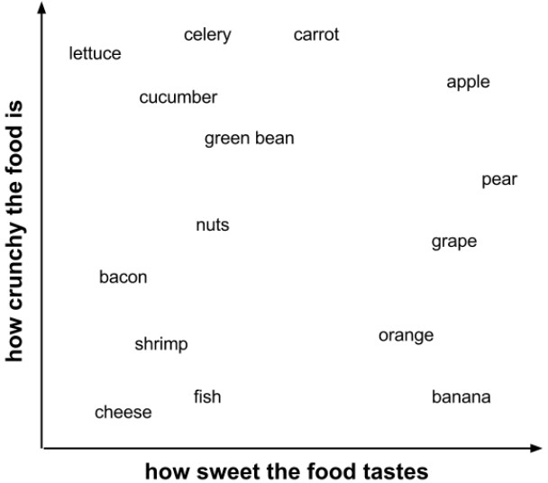
Example:

Slide 8
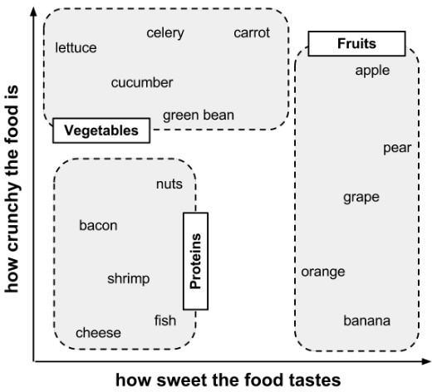
Example:

Slide 9
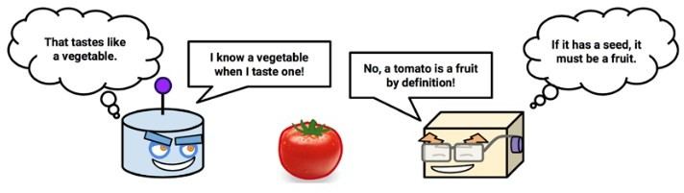
Classify me now!

Slide 10
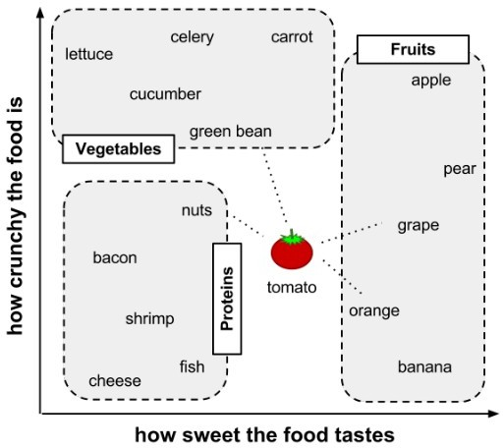
Example:

Slide 11
Calculating Distance
Locating the tomato's nearest neighbors requires a distance function, or a formula that measures the similarity between two instances.
There are many different ways to calculate distance.
Traditionally, the kNN algorithm uses Euclidean distance, which is the distance one would measure if you could use a ruler to connect two points, illustrated in the previous figure by the dotted lines connecting the tomato to its neighbors.

Slide 12
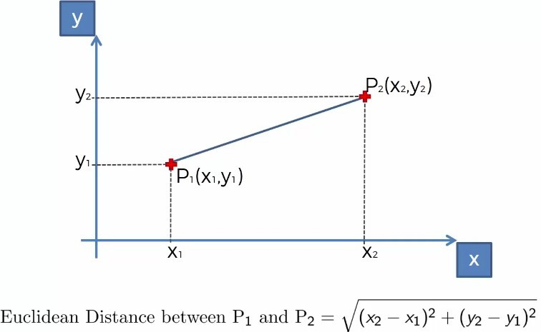
Calculating Distance
Reference: Super Data Science

Slide 13
Distance
•
Euclidean distance is specified by the following formula, where p and q are th examples to be compared, each having n features. The term p1 refers to the value of the first feature of example p, while q1 refers to the value of the first feature of example q:
•
The distance formula involves comparing the values of each feature. For example, to calculate the distance between the tomato (sweetness = 6, crunchiness = 4), and the green bean (sweetness = 3, crunchiness = 7), we can use the formula as follows:

Slide 14
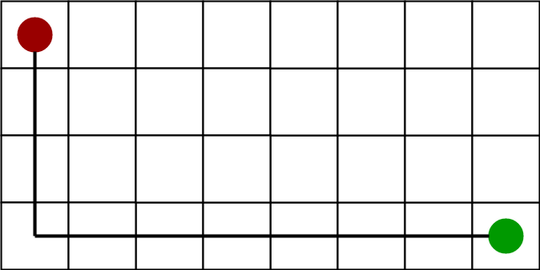
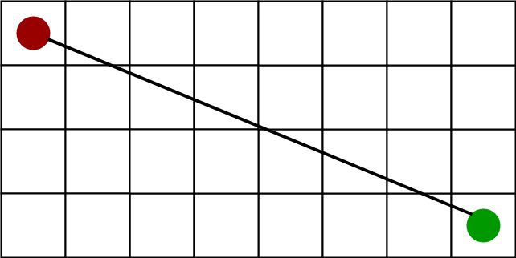
Distance
Manhattan Distance
Euclidean Distance

Slide 15
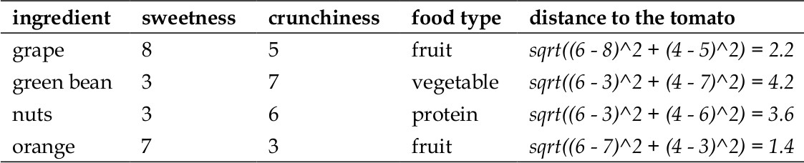
Closest Neighbors

Slide 16
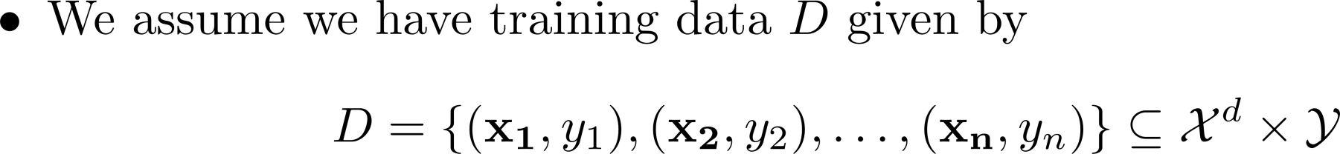
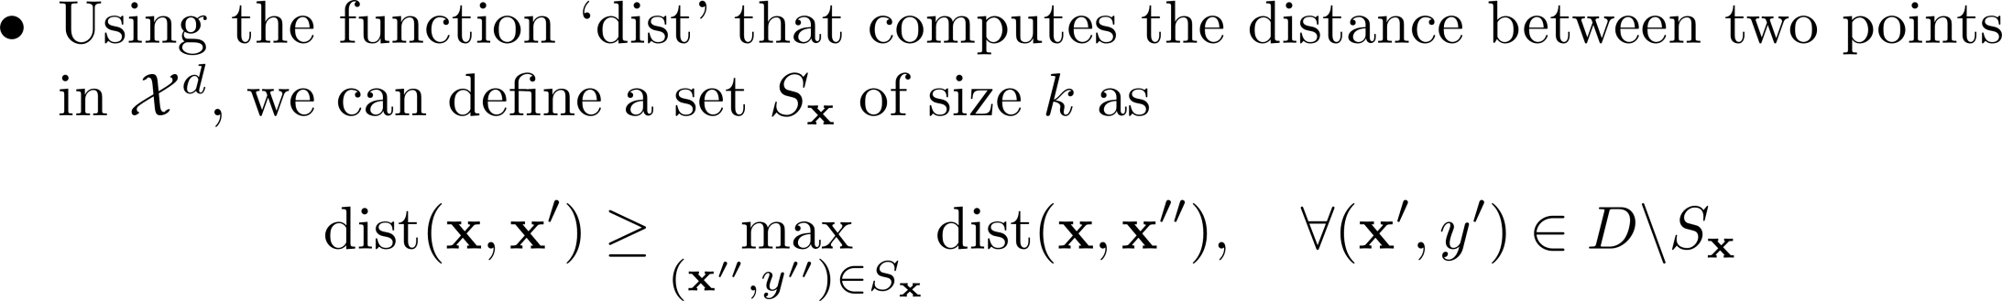
k-Nearest Neighbor (kNN) Algorithm
Formal Definition:
Interpretation:

Slide 17
k-Nearest Neighbor (kNN) Algorithm
Characteristics of kNN:
No assumptions about the distribution of the data
Non-parametric algorithm
  No parameters
Hyper-Parameters
  k (number of neighbors)
  Distance metric (to quantify similarity)

Slide 18
Choosing appropriate k
Deciding how many neighbors to use for kNN determines how well the mode will generalize to future data.
The balance between overfitting and underfitting the training data is a problem known as the bias- variance tradeoff.
Choosing a large k reduces the impact or variance caused by noisy data, but can bias the learner such that it runs the risk of ignoring small, but important patterns.

Slide 19
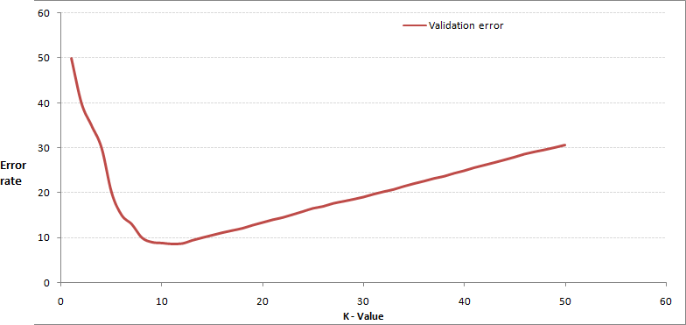
Choosing appropriate k

Slide 20
Choosing appropriate k
In practice, choosing k depends on the difficulty of the concept to be learned and the number of records in the training data.
Typically, k is set somewhere between 3 and 10. One common practice is to set k equal to the square root of the number of training examples.
In the classifier, we might set k = 4, because there were 15 example ingredients in the training data and the square root of 15 is 3.87.

Slide 21

Min-Max normalization
The traditional method of rescaling features for kNN is min- max normalization.
This process transforms a feature such that all of its values fall in a range between 0 and 1. The formula for normalizing a feature is as follows. Essentially, the formula subtracts the minimum of feature X from each value and divides by the range of X:
Normalized feature values can be interpreted as indicating how far, from 0 percent to 100 percent, the original value fell along the range between the original minimum and maximum.

Slide 22
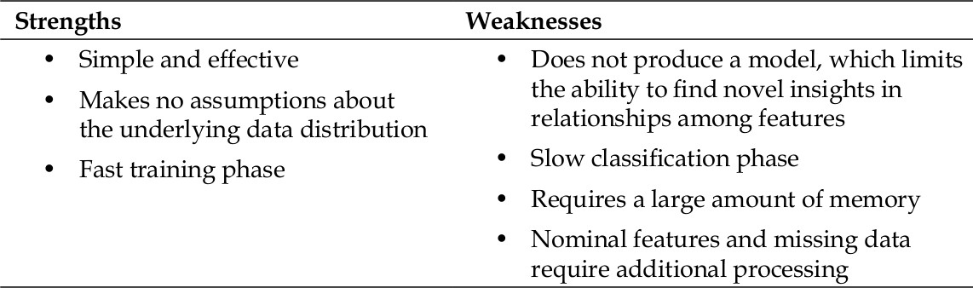
The kNN Algorithm

Slide 23
Python Packages needed
pandas
  Data Analytics
numpy
  Numerical Computing
matplotlib.pyplot
  Plotting graphs
sklearn
  Classification and Regression Classes

Slide 24
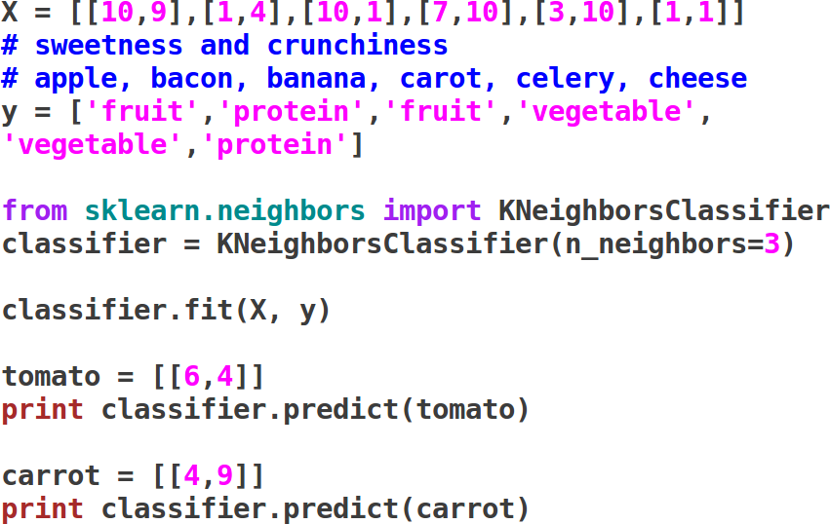
Sample Application

Slide 25
KNN – Classification : Dataset
The best small project to start with on a new tool is the classification of iris flowers (e.g. the iris dataset).
This is a good project because it is so well understood.
  Attributes are numeric so you have to figure out how to load and handle data.
  It is a classification problem, allowing you to practice with perhaps an easier type of supervised learning algorithm.
  It is a multi-class classification problem (multi-nominal) that may require some specialized handling.
  It only has 4 attributes and 150 rows, meaning it is small and easily fits into memory (and a screen or A4 page).
  All of the numeric attributes are in the same units and the same scale, not requiring any special scaling or transforms to get started.

Slide 26
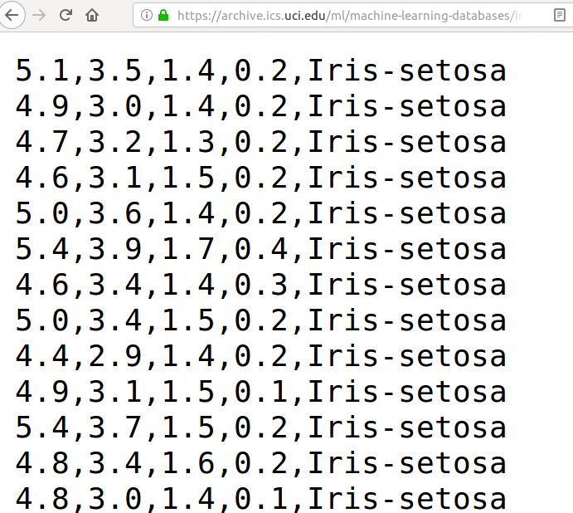
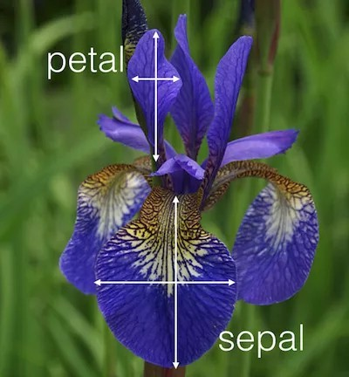
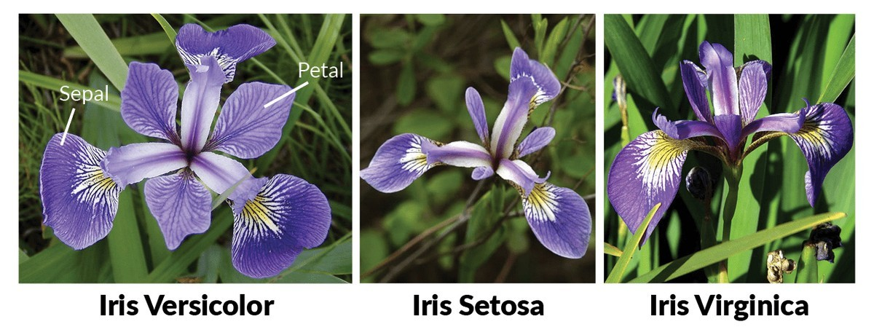
Dataset

Slide 27
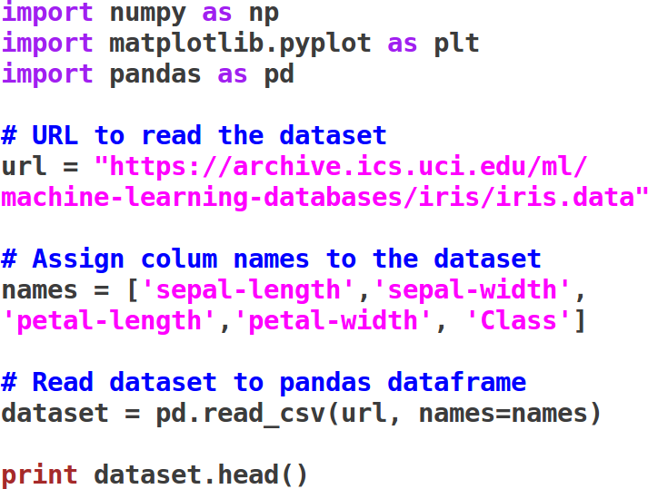
KNN – Classification : Dataset

Slide 28
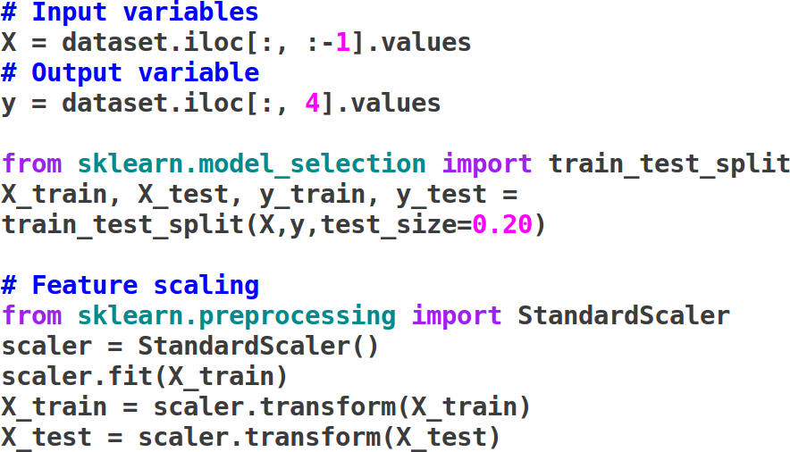
Pre-processing

Slide 29
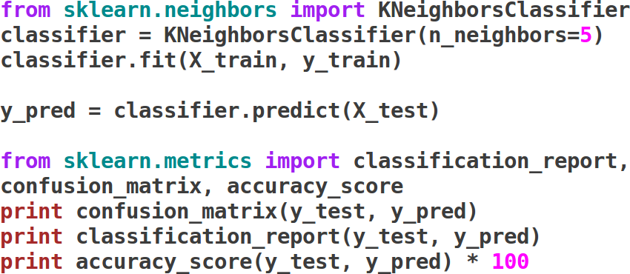
Characterize

Slide 30
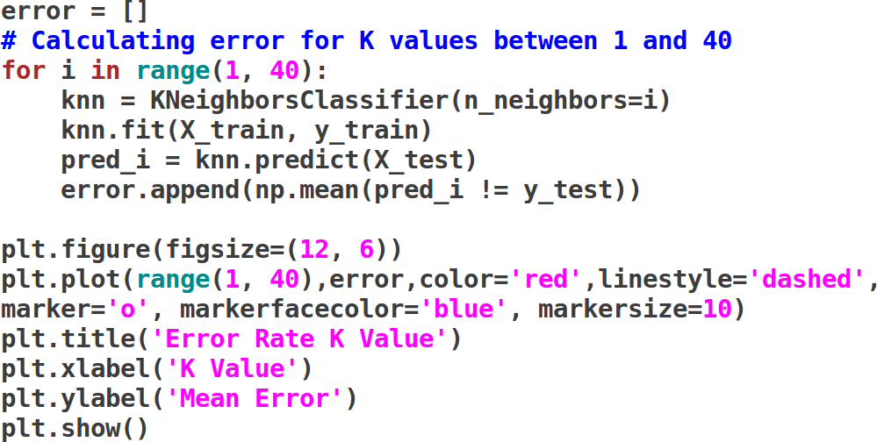
Finding error with changed k

Slide 31
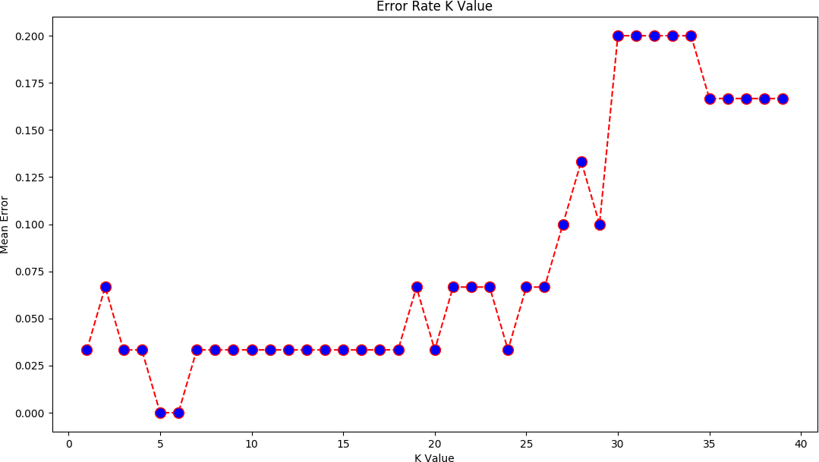
Error rate

Slide 32
Useful resources
•
•
•
•
•
•
•
•
•
www.mitu.co.in www.pythonprogramminglanguage.com www.scikit-learn.org www.towardsdatascience.com www.medium.com www.analyticsvidhya.com www.kaggle.com
www.stephacking.com www.github.com

