Slide 1
Ridge and Lasso Regression

Slide 2
Bias-Variance Tradeoff
• Low Bias, High Variance → Overfitting
• High Bias, Low Variance → Underfitting
• Regularization balances bias and variance to improve generalization.

Slide 3
Why Regularization?
• Prevents overfitting by adding a penalty on large coefficients.
• Helps model generalize better to unseen data.
• Two main techniques: Ridge (L2) and Lasso (L1).

Slide 4
What are Ridge and Lasso Regression?
Ridge Regression and Lasso Regression are two popular regularization techniques used to enhance the performance of linear regression models by penalizing large coefficients.

Slide 5
Ridge Regression (L2 Regularization):
Adds a penalty equal to the square of the magnitude of coefficients.
Encourages the model to keep all coefficients small but does not set any coefficients exactly to zero.
Useful when you have many features that contribute to the target variable.

Slide 6
Lasso Regression (L1 Regularization):
Adds a penalty equal to the absolute value of the magnitude of coefficients.
Can shrink some coefficients to exactly zero, effectively performing feature selection.
Useful when you suspect that only a subset of features is relevant.

Slide 7
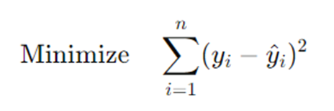
Mathematical Formulation of Ridge and Lasso
Standard Linear Regression:

Slide 8
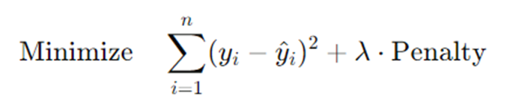
Regularized Regression:
where λ is the regularization parameter controlling the strength of the penalty.

Slide 9
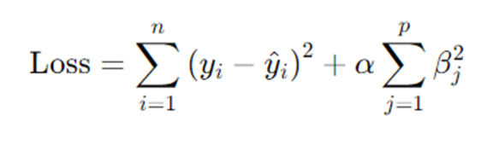
Ridge Regression (L2 Regularization)
Ridge regression adds a penalty term equal to the square of the magnitude of coefficients:
α: Regularization parameter controlling the strength of the penalty.
Larger α values increase the penalty, leading to smaller coefficients.

Slide 10
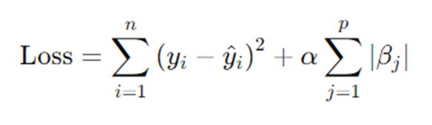
Lasso Regression (L1 Regularization)
Lasso regression adds a penalty term equal to the absolute value of the magnitude of coefficients:
Similar to Ridge, α controls the penalty strength.
Lasso can shrink some coefficients to exactly zero, enabling feature selection.

Slide 11
Choosing Between L1 and L2:
Use L1 (Lasso) When:
You have a high-dimensional dataset with many irrelevant features.
You need a model that is easy to interpret with fewer predictors.
Use L2 (Ridge) When:
You suspect multicollinearity among features.
You want to retain all features in the model for a more comprehensive analysis.

