Slide 1

Intuition
How Machine Learning is different from Traditional Programming?
Activity
Write a program (pseudo-code) to identify “cat” in an image
an
Rizw
Machine Learning

Slide 2
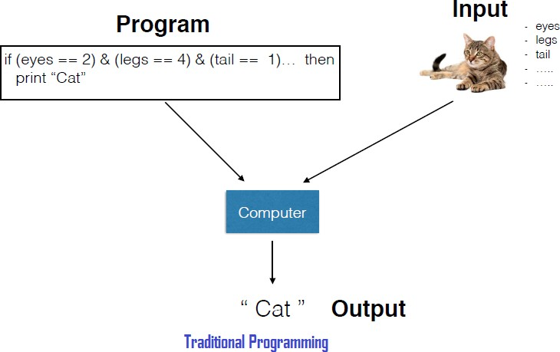
Intuition
How Machine Learning is different from Traditional Programming?
Traditional programing
for j = 1 to N do
detect color (image_{N} ) lots of code
end for
for j = 1 to N do
detect shape (image_{N} ) lots of code
end for
for j = 1 to N do detect fur (image_{N} ) lots of code
end for
.
.
Is this enough to recognize cat?
Machine Learning

Slide 3
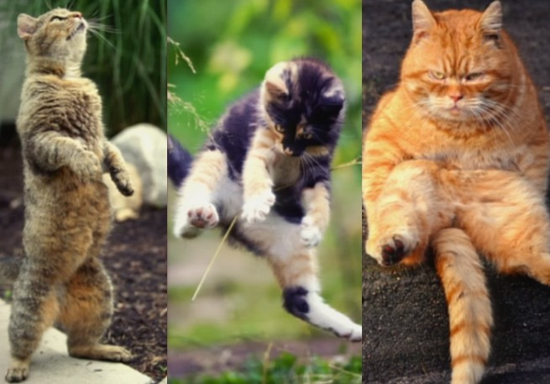
Intuition
How Machine Learning is different from Traditional Programming?
Can we manually write an algorithm (hard code) that caters all the variations?
Machine Learning

Slide 4
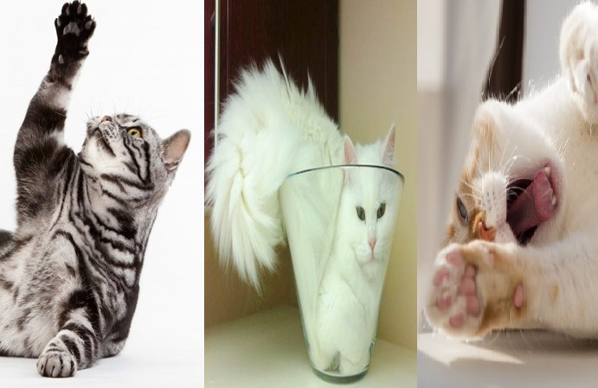
Intuition
How Machine Learning is different from Traditional Programming?
Can we manually write an algorithm (hard code) that caters all the variations?
Machine Learning

Slide 5
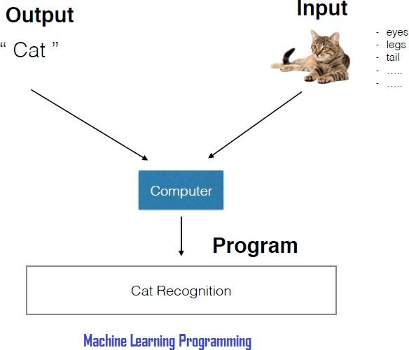
How Machine Learning is different from Traditional Programming?
Machine learning algorithms are algorithms that learn models from data
/ experience.
No need to formulate explicit rules.
Algorithm performance gets better with experience / data.
Machine Learning

Slide 6
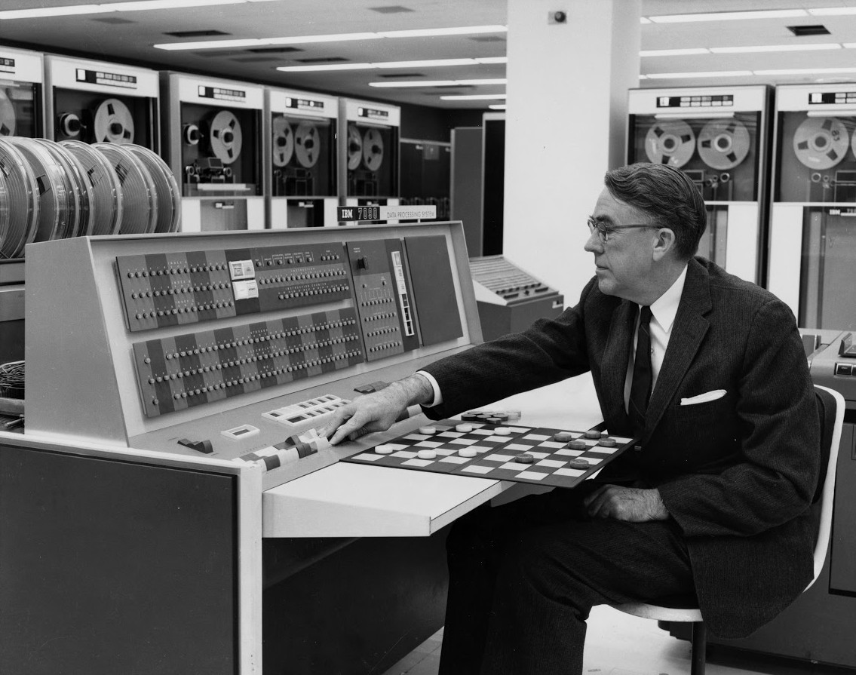
What?
What is Machine learning?
Machine Learning
Field of study that gives computers the ability to learn without being explicitly programmed.
an
Rizw
Arthur Samuel, 1959
Machine Learning

Slide 7
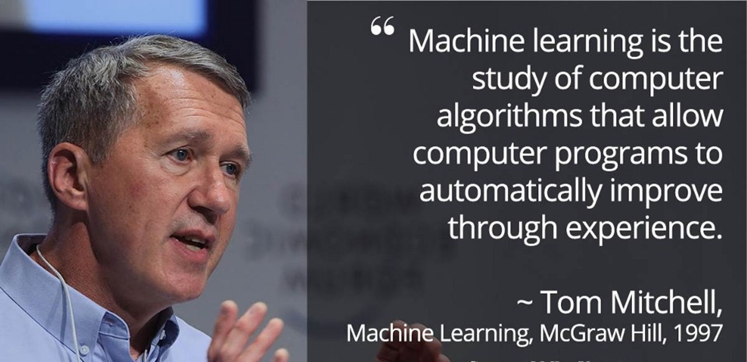
What?
Khan
A
an
Rizw
(c)Dr.
What is Machine learning?
Machine Learning

Slide 8
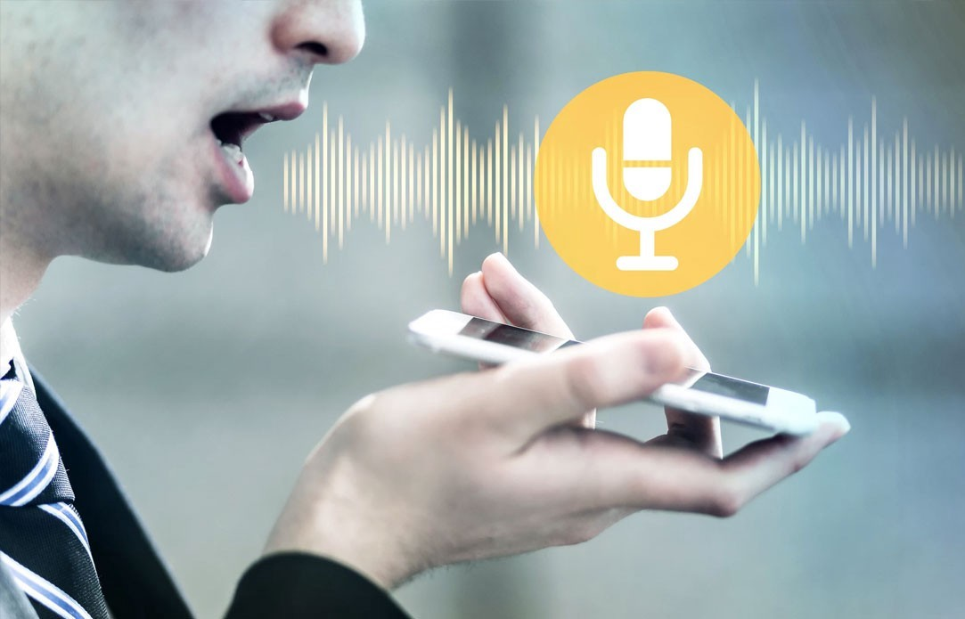
Why?
Why Machine Learning?
Machine Learning is used when:
Humans can’t explain their expertise:
speech recognition
Machine Learning

Slide 9
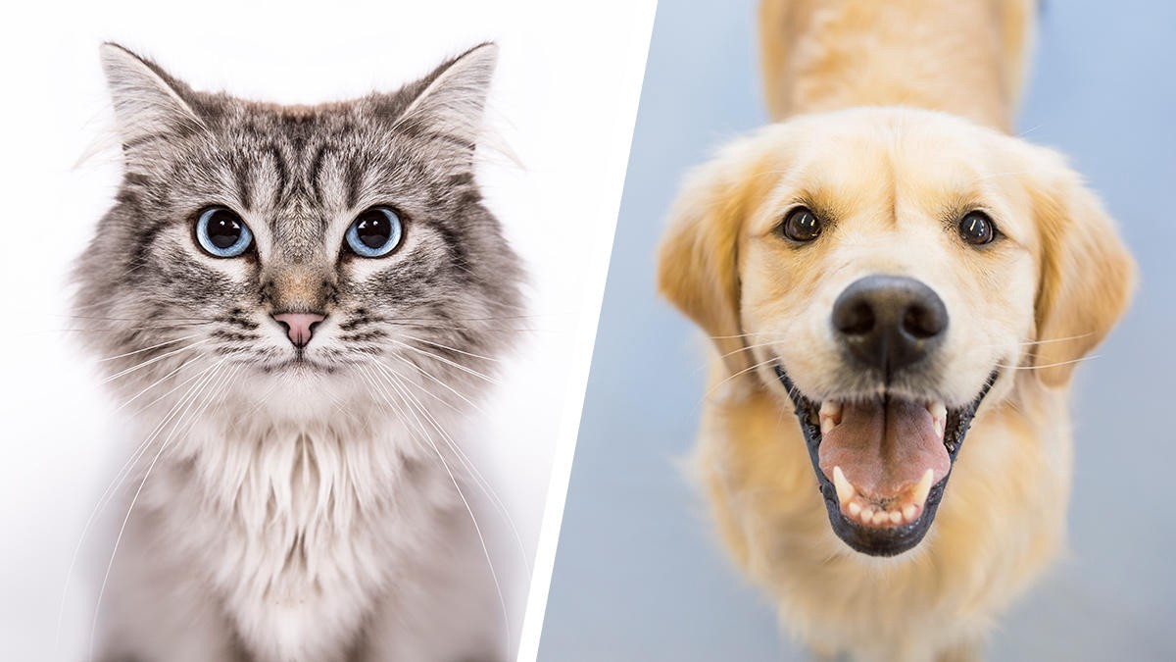
Why?
Why Machine Learning?
Machine Learning is used when:
Humans can’t explain their expertise:
speech recognition visual recognition
Machine Learning

Slide 10
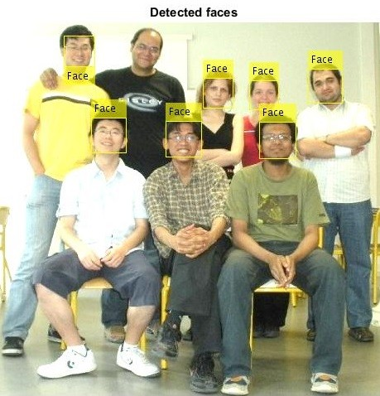
Why?
Why Machine Learning?
Machine Learning is used when:
Humans can’t explain their expertise:
speech recognition visual recognition
face detection, expressions recognition
Machine Learning

Slide 11
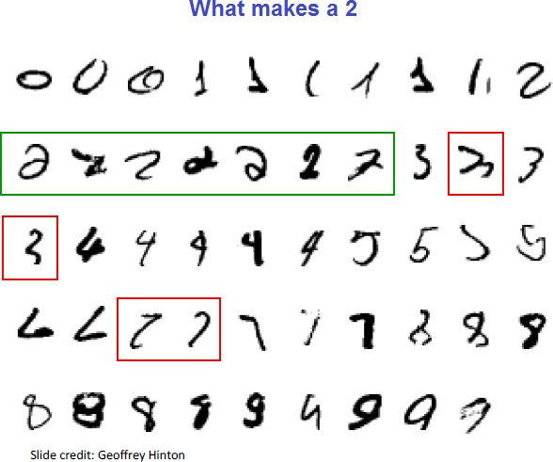
Why?
Why Machine Learning?
Machine Learning is used when:
Humans can’t explain their expertise:
speech recognition visual recognition
face detection, expressions recognition
hand writing recognition (pattern recog.) etc
Machine Learning

Slide 12
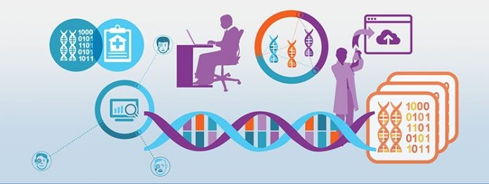
Why?
Why Machine Learning?
Machine Learning is used when:
Humans can’t explain their expertise:
speech recognition visual recognition
face detection, expressions recognition
hand writing recognition (pattern recog.) etc
Models must be customized (personalized medicine, personalized recommendations, home assistant)
Machine Learning

Slide 13
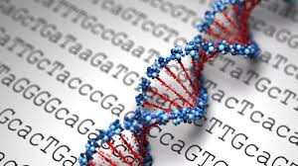
Why?
Why Machine Learning?
Machine Learning is used when:
Humans can’t explain their expertise:
speech recognition visual recognition
face detection, expressions recognition
hand writing recognition (pattern recog.) etc
Models must be customized (personalized medicine, personalized recommendations, home assistant)
Models are based on huge amounts of data
genomics stock prices
Machine Learning

Slide 14
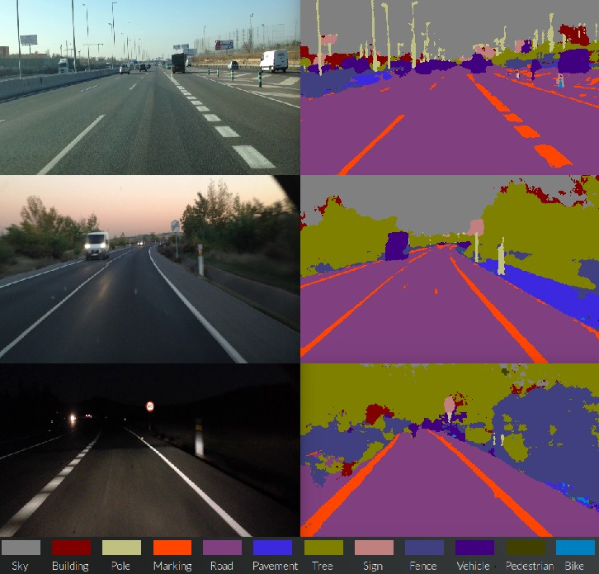
Why?
Why Machine Learning?
Machine Learning is used when:
Humans can’t explain their expertise:
speech recognition visual recognition
face detection, expressions recognition
hand writing recognition (pattern recog.) etc
Models must be customized (personalized medicine, personalized recommendations, home assistant)
Models are based on huge amounts of data
genomics stock prices
self driving cars etc.
Machine Learning

Slide 15
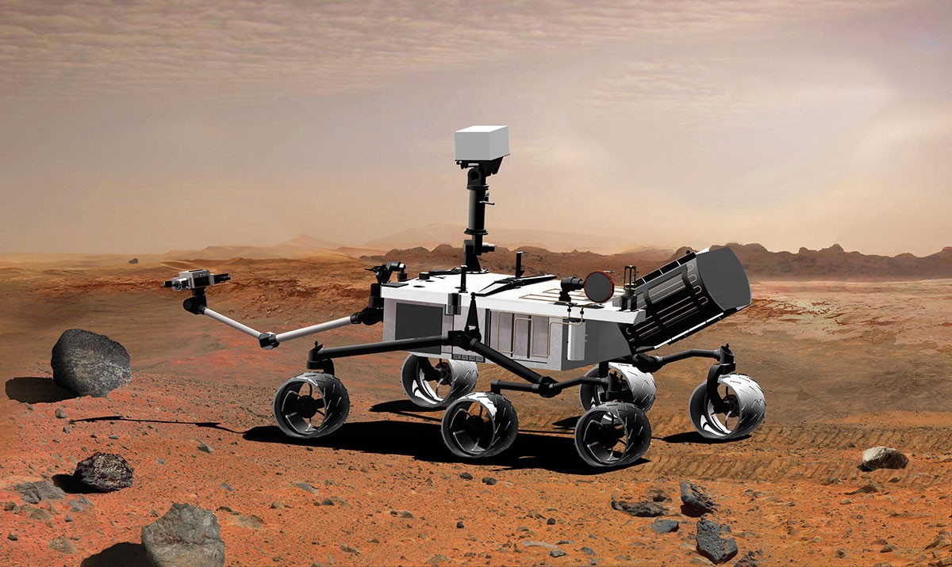
Why?
Why Machine Learning?
Machine Learning is used when:
Humans can’t explain their expertise:
speech recognition visual recognition
face detection, expressions recognition
hand writing recognition (pattern recog.) etc
Models must be customized (personalized medicine, personalized recommendations, home assistant)
Models are based on huge amounts of data
genomics stock prices
self driving cars etc.
Human expertise does not exist (Mars navigating)
Machine Learning

Slide 16
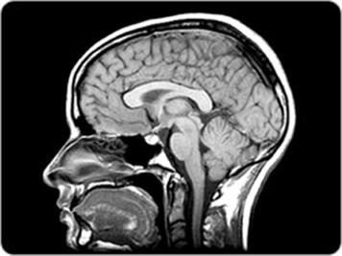
Why?
Why Machine Learning?
Machine Learning is used when:
Humans can’t explain their expertise:
speech recognition visual recognition
face detection, expressions recognition
hand writing recognition (pattern recog.) etc
Models must be customized (personalized medicine, personalized recommendations, home assistant)
Models are based on huge amounts of data
genomics stock prices
self driving cars etc.
Human expertise does not exist (Mars navigating)
Human capabilities needs to be augmented (medical diagnosis)

Slide 17
Why?
Why ML is growing?
ML Niche
Why ML is growing?
1. ML is preferred approach to: Medical imaging
Speech recognition Robotics Computer vision:
2. ML is preferred approach to all of the above problems and:
Improved ML algorithms
Availability of large volumes of datasets
1
2
3
4
5
Person identification Activity recognition Object detection Autonomus driving
....
...
Machine Learning
23 / 47

Slide 18
Why?
Why ML is growing?
ML Niche
Why ML is growing?
1. ML is preferred approach to: Medical imaging
Speech recognition Robotics Computer vision:
2. ML is preferred approach to all of the above problems and:
Improved ML algorithms
Availability of large volumes of datasets
Self customizing software i.e. Speech recognition or Spam filter
1
2
3
4
5
Person identification Activity recognition Object detection Autonomus driving
....
...
Machine Learning

Slide 19
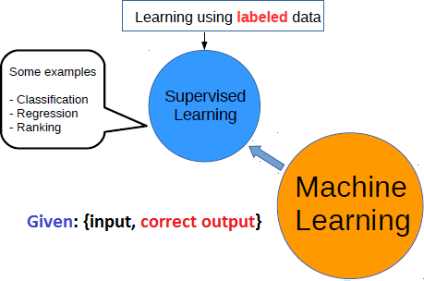
Introduction
Taxonomy of Machine learning
Machine Learning

Slide 20
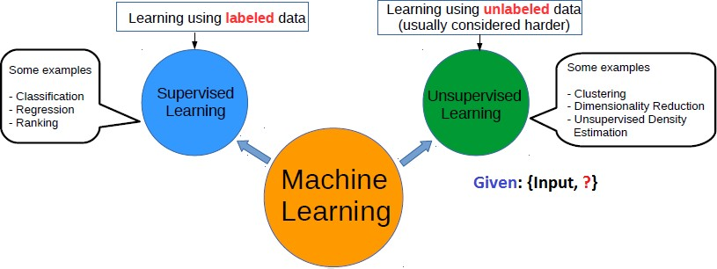
Introduction
Taxonomy of Machine learning
Machine Learning
25 / 47

Slide 21
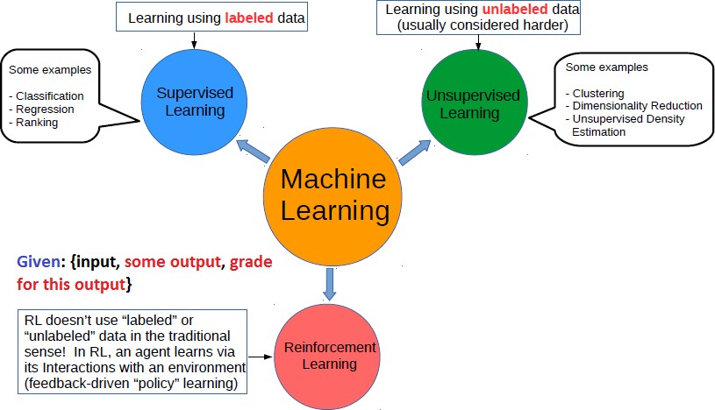
Introduction
Taxonomy of Machine learning
Machine Learning

Slide 22
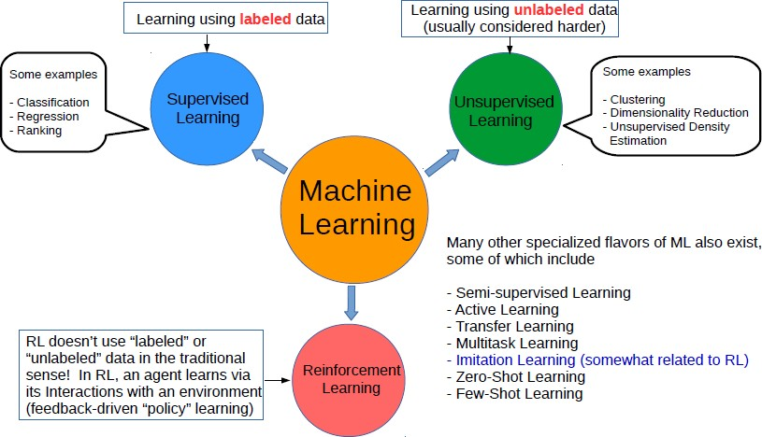
Introduction
Taxonomy of Machine learning
Machine Learning

Slide 23
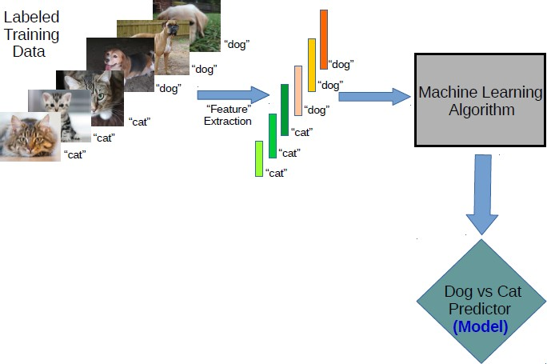
Supervised Learning
Khan
A
an
Rizw
(c)Dr.
Supervised Learning Workflow for classification
Machine Learning

Slide 24
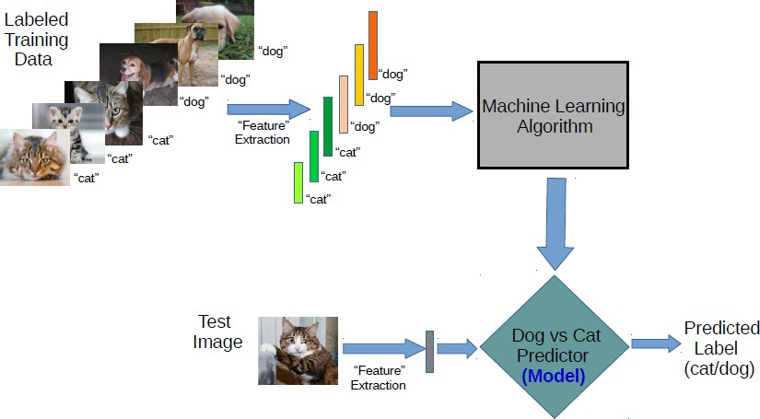
Supervised Learning
Supervised Learning Workflow for classification
Machine Learning

Slide 25
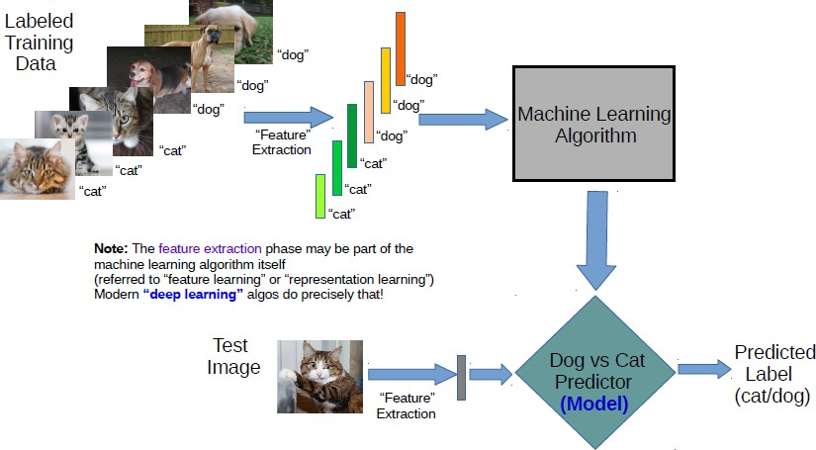
Supervised Learning
Khan
A
an
Rizw
(c)Dr.
Supervised Learning Workflow for classification
Machine Learning
26 / 47

Slide 26
Supervised Learning
Function approximation
Supervised learning is about function approximation
Problem Setting:
Set of possible instances X
Unknown target function f : X → Y
Set of function hypotheses H = {h|h : X → Y }
Input:
training examples {< x_{i}, y_{i} >}. For example x is an email and y is either Spam or No Spam.
Output:
Hypothesis h ∈ H that best approximates target function f . OR
a classification “rule” that can determine the class of any object from its attributes values.
Machine Learning

Slide 27
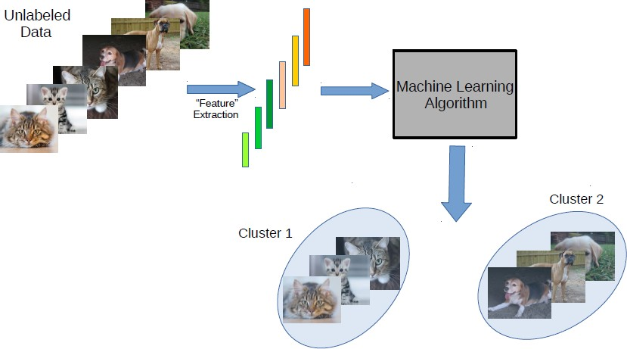
Big Picture Machine Learning Taxonomy Workflow Examples
Unsupervised Learning
Khan
A
an
Rizw
(c)Dr.
Unsupervised Learning Workflow for clustering
Machine Learning

Slide 28
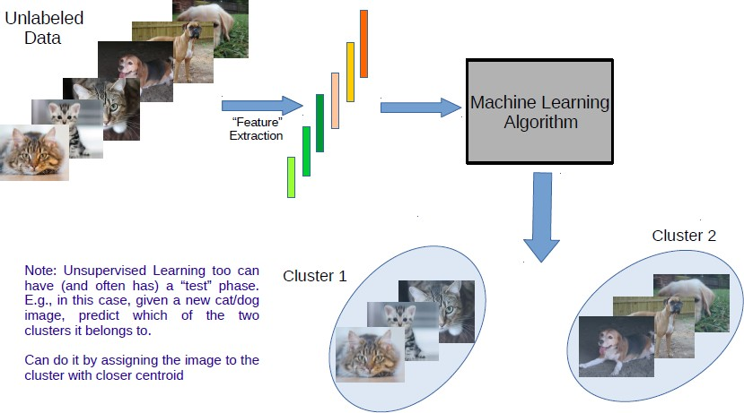
Unsupervised Learning
Khan
A
an
Rizw
(c)Dr.
Unsupervised Learning Workflow for clustering
Machine Learning

