Slide 1


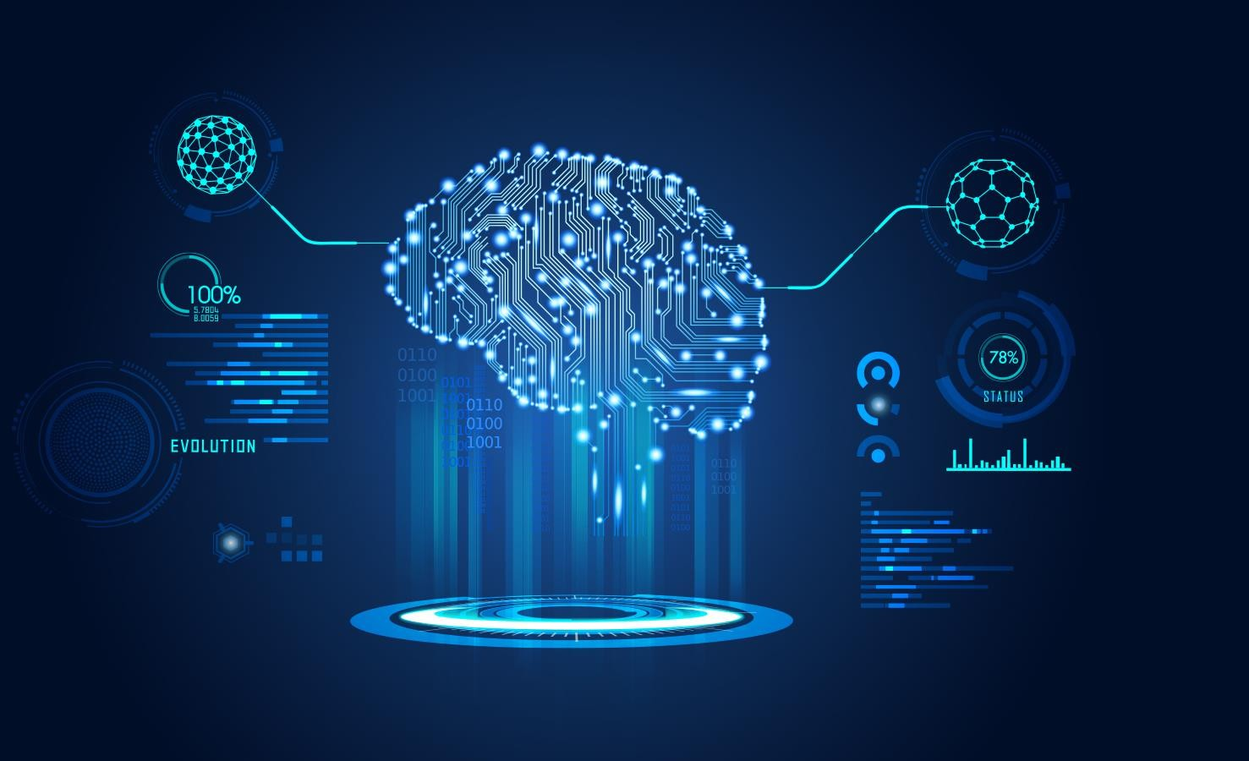
Machine Learning
Overview
ANWAR KHAN
University of Lahore

Slide 2
What is this course about?
Introductory course in Machine Learning (ML) – Fundamental topics in
Supervised learning
Unsupervised learning
Course Objectives:
To provide a thorough introduction to ML methods
To build mathematical foundations of ML and provide an appreciation for its applications
To provide experience in the implementation and evaluation of ML algorithms
To develop research interest in the theory and application of ML

Slide 3
Is this course a right choice for you?
Undergraduate students
Interested in pursuing AI, Deep Learning and/or Machine Learning in their
grad school
Interesting in pursuing a professional career focused on the development of Machine Learning solutions
Graduate students
Want to do fundamental research in the area of Machine Learning
Wish to apply Machine Learning in their research work

Slide 4
Course Prerequisites
Undergraduate students
Linear Algebra
Probability
Programming
Graduate students
Encouraged to revise Linear Algebra and Probability concepts (on-the-fly)
We expect all the students to have good programming skills (in C/Python/MATLAB)
Note on Assignment 0!

Slide 5
Course structure
Part 1: Fundamentals of Machine Learning (Scikit-Learn)
  Review of Python’s main scientific libraries: NumPy, pandas, and Matplotlib
  Steps in a typical machine learning project
  Learning by fitting a model to data and optimizing a cost function
  Challenges of using machine learning systems
Part 2: Neural Networks and Deep Learning (TensorFlow 2.0, Keras, and PyTorch)
  What neural nets are and what they are good for
  Building and training feedforward neural nets (basics and implementation)
  Convolutional nets for deep computer vision and recurrent neural nets (mainly fundamental concepts)

Slide 6

Modules
Course Overview, notation
Supervised Learning Setup
1- ML Overview
Weeks: 1,2
Components:
Programming Assignment 1: Intro to Python, Setting up Environment

Slide 7
Modules
Classification
KNN
Evaluation Metrics, Curse of Dimensionality
Multi-class Classification
2 - Classification
Weeks: 3,4
Components:
Programming Assignment 2: KNN based (Using Images)
Homework 1A

Slide 8
Modules
Linear Regression
Gradient Descent
Multi-variate Regression
Polynomial Regression
Bias-Variance Trade-off, Regularization
3 - Regression
Weeks: 4,5
Components:
Programming Assignment 3: Regression
Homework 1B

Slide 9
Modules
Logistic Regression
4 - Logistic Regression
Weeks: 6
Components:
Programming Assignment 4: Logistic Regression

Slide 10
Modules
Bayes Theorem
Naive Bayes Classification
5 – Bayesian Framework
Weeks: 7,8
Components:
Programming Assignment 5: Naïve Bayes Classifier (may be merged with Assignment 4)
Homework 2

Slide 11
Modules
Perceptron Algorithm
SVM
Neural Networks
6 – Perceptron, SVM and Neural Network
Weeks:
9,10,11,12
(Mid-Exam)
Components:
Programming Assignment 6: Neural Networks
Homework 3

Slide 12
Modules
Unsupervised Learning Overview
Clustering (k-means)
7 – Clustering
Weeks:
13,14
Components:
Homework 3

Slide 13

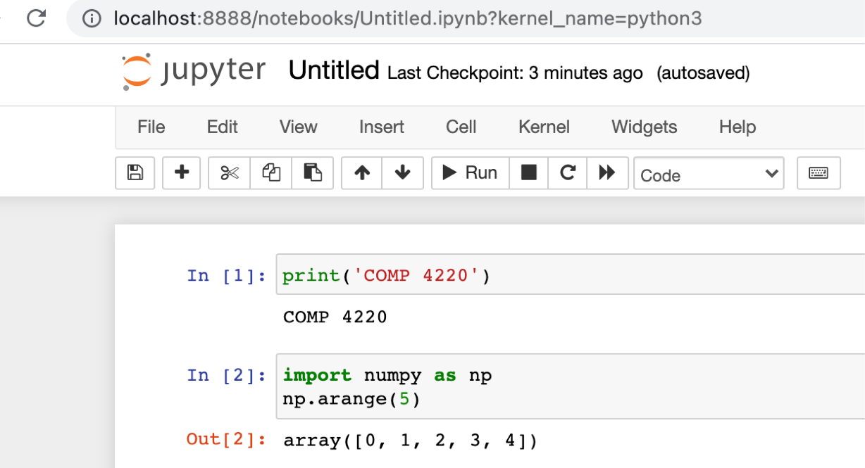
Anaconda
https://www.anaconda.com/

Slide 14
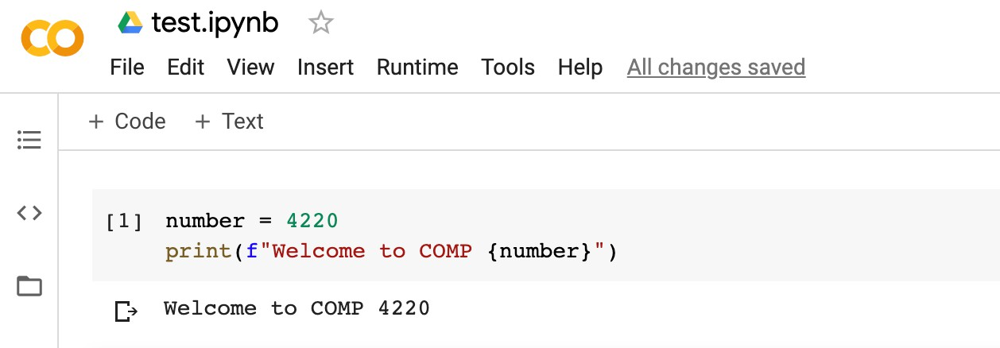
Google Colab
Google Colaboratory, or “Colab” for short, allows you to write and execute Python in your browser
  Zero configuration required
  Free access to GPUs and other computing resources
  Use terminal commands on Google Colab
https://drive.google.com (for the first time, select “Connect more apps”)

Slide 15
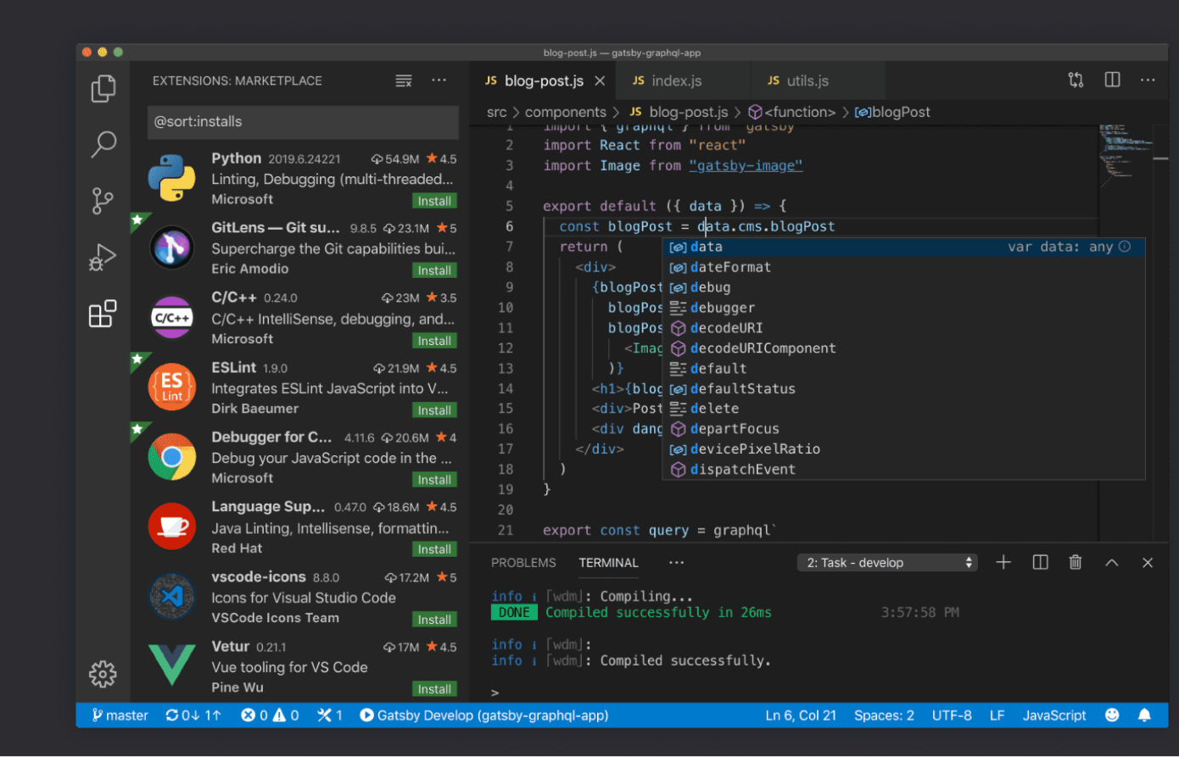

Visual Studio Code
Better alternative for “real” machine learning projects
  https://code.visualstudio.com/

Slide 16
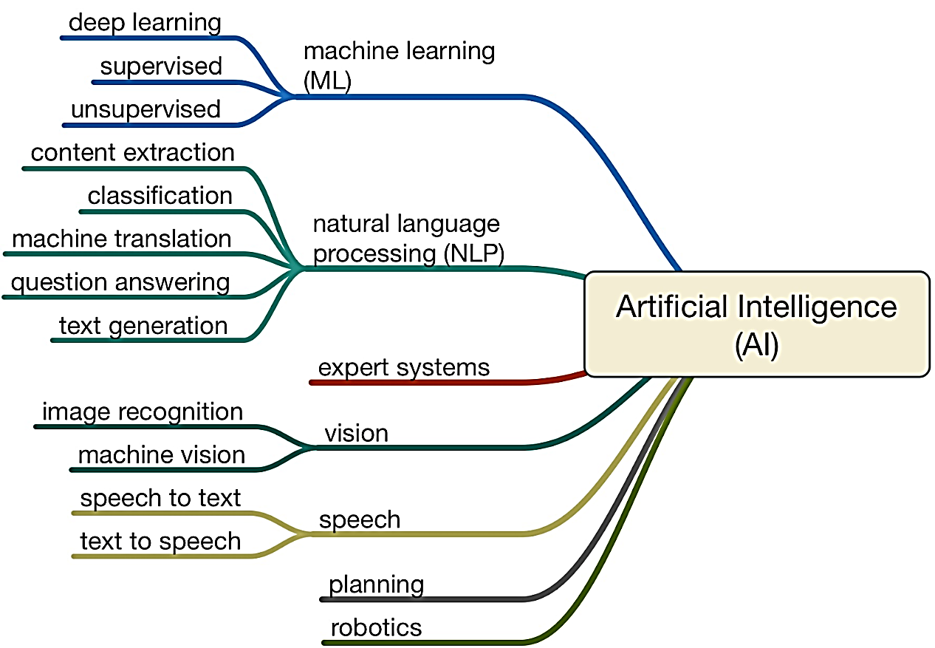
AI Umbrella

Slide 17
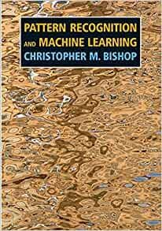
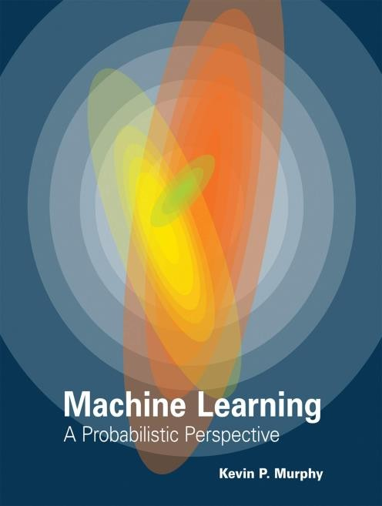
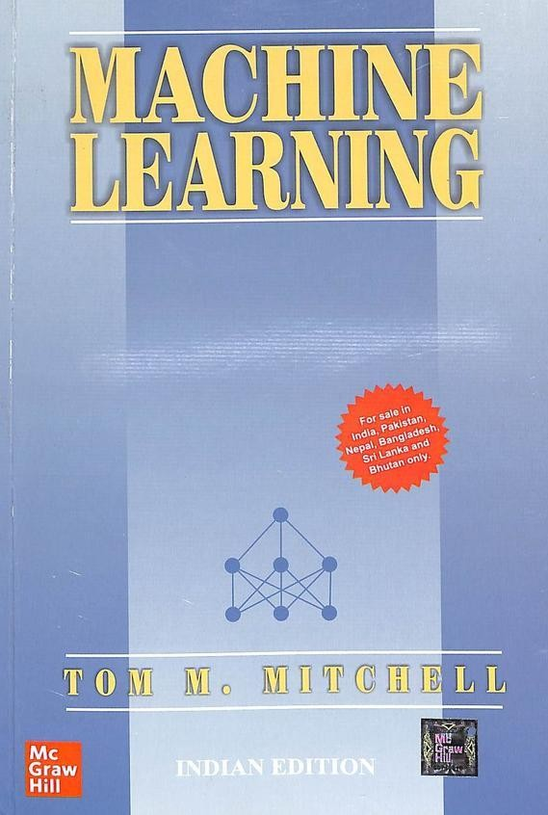
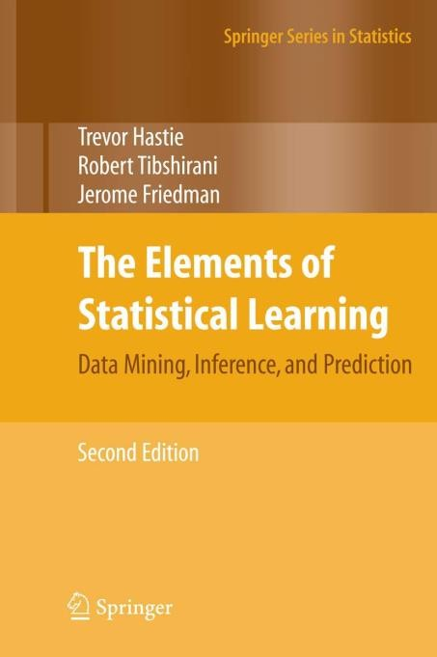
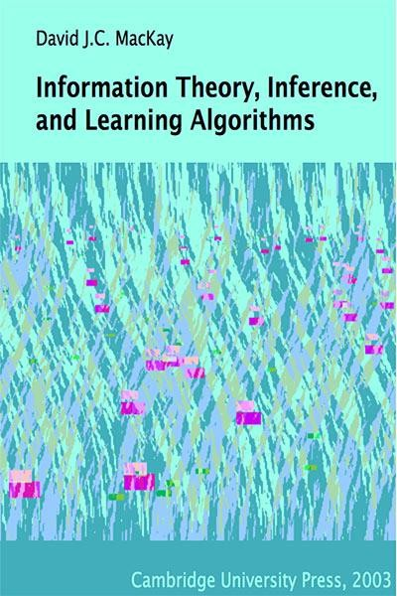
Suggested Reference Books
(CB) Pattern Recognition and Machine Learning, Christopher M. Bishop
(KM) Machine Learning: a Probabilistic Perspective, Kevin Murphy
(TM) Machine Learning, Tom Mitchell
(HTF) The Elements of Statistical Learning: Data mining, Inference, and Prediction, by Hastie, Tibshirani, Friedman
(DM) Information Theory, Inference, and Learning Algorithms, David Mackay

Slide 18
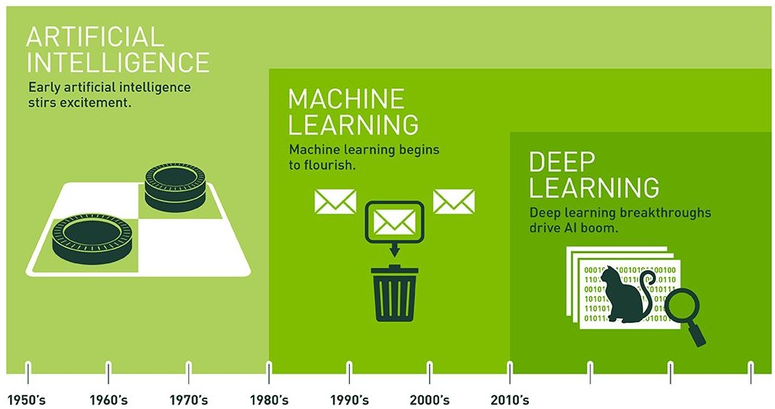
What is machine learning?
Artificial intelligence: The ability of a computer to perform tasks commonly associated with intelligent beings.
  Turing Test, 1950: “Are there imaginable digital computers which would do well in the
imitation game?”
Machine learning: “Field of study that gives computers the ability to learn without being explicitly programmed.” (Arthur Samuel, 1959)
Deep learning: A subfield of machine
learning concerned with algorithms inspired by the structure and function of the brain called artificial neural networks.

Slide 19
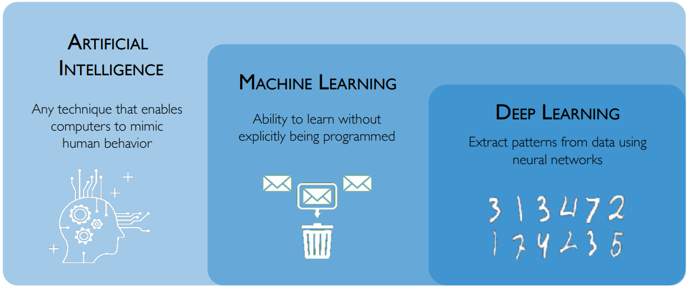
Machine learning in Artificial Intelligence
Notes:
Artificial Intelligence (AI) is the broad field aiming to create intelligent machines, Machine Learning (ML) is a subset of AI that enables systems to learn from data without explicit programming, and Deep Learning (DL) is a subset of ML that uses complex, layered neural networks to learn from vast amounts of data, particularly unstructured data like images and text.

Slide 20
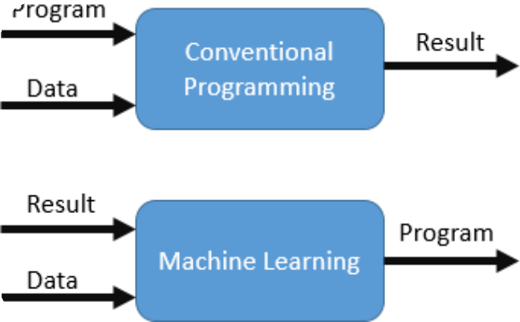
Traditional Programming vs Machine Learning
Traditional Programming
Approach: Write explicit rules and logic for specific tasks.
Input: Rules (logic) + Data → Output.
Key Focus: Programmer defines all possible scenarios.
Example:
  Use if-else statements to classify emails as spam or
not.
Machine Learning
Approach: Learn patterns from data to make predictions or decisions.
Input: Data + Output (labels) → Learns Rules (Model).
Key Focus: Relies on high-quality training data.
Example:
  Train a spam classifier with labeled examples of spam and non-spam emails.
Key Difference
Traditional Programming: flexibility.
Fixed rules; limited
Machine Learning: Adaptive rules; improves with more data.

Slide 21
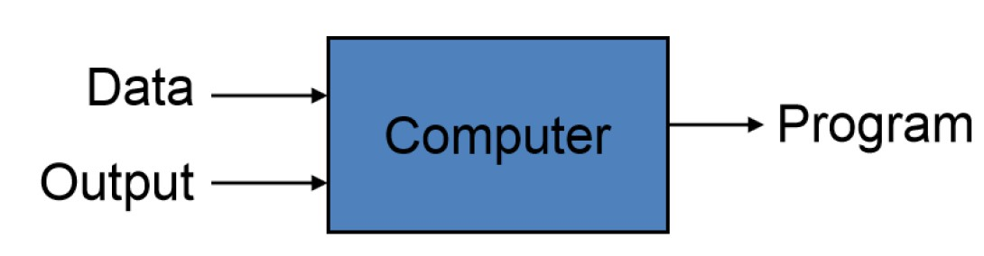
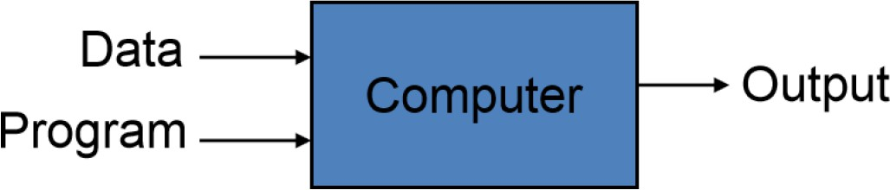
Machine Learning Overview
What is Machine Learning?
Automating the process of automation
Getting computers to program themselves
Traditional Programming
Machine Learning
Given examples (training data), make a machine learn system behavior or discover patterns

Slide 22
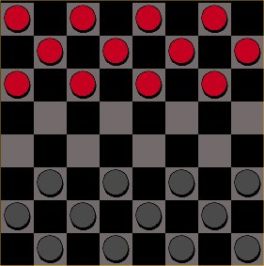
What is Machine Learning ?
Field of study that gives computer the ability to learn without being explicitly programmed (Arthur Samuel, 1956)
Study of algorithms that improve their performance P at some task T with experience E (Tom Mitchell, 1998)
T: Play checkers
P: % of games won
E: Playing against self
Well defined learning task: <P, T, E>

Slide 23
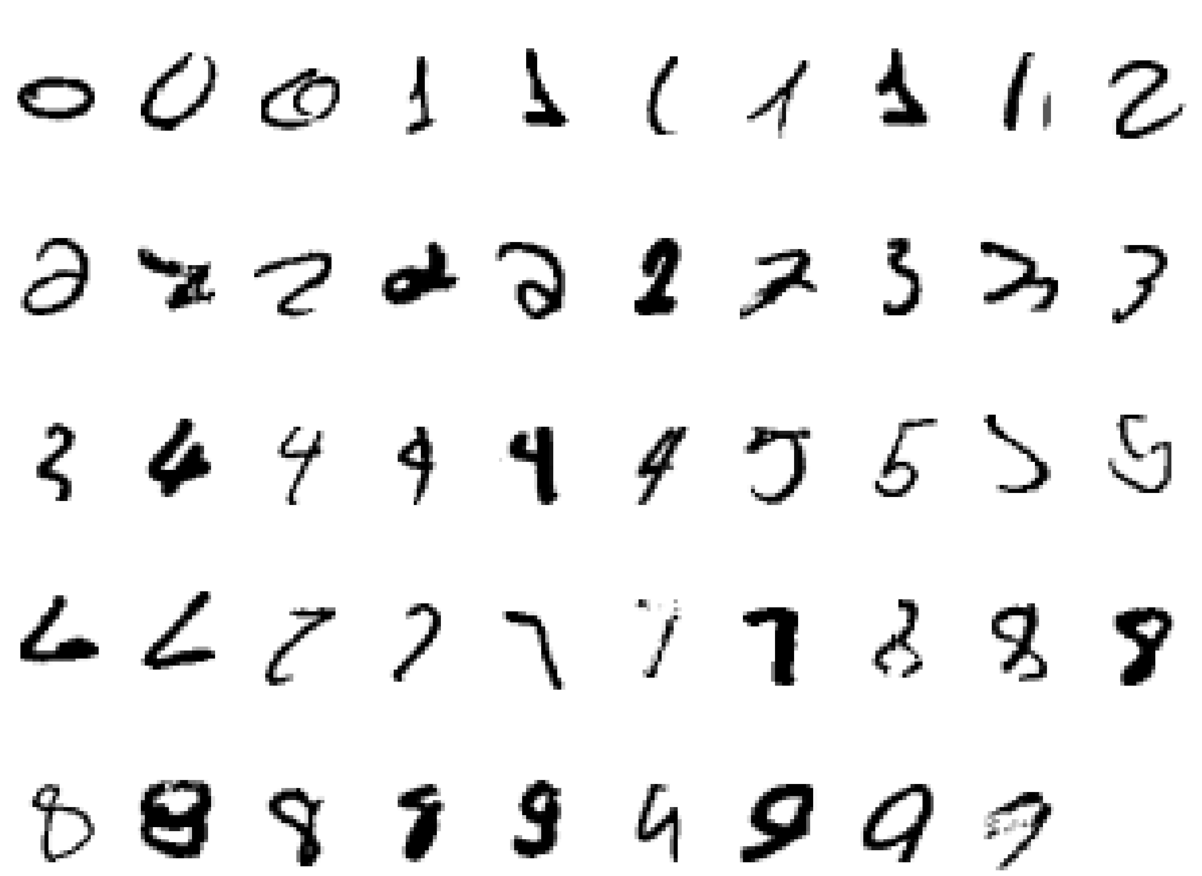
Well Defined Learning Task
Handwriting Recognition
  Task T: recognizing and classifying handwritten words within images
  Performance P: percent of words correctly classified
  Training experience E: a database of written words with given classification

Slide 24
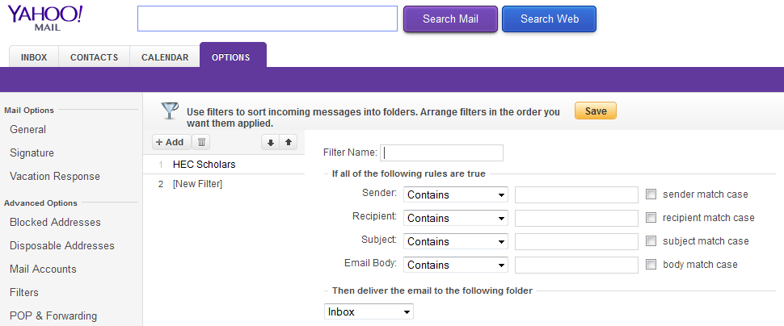
Question
Suppose your email program watches which email you do and do not mark as spam and based on that learn how to better filter spam. What is the task in this setting
  Classifying emails as spam or not spam
  The number of emails correctly classifying as spam/not spam
  Labelling emails as spam/ not spam
  Non of above: This is not a machine learning problem

Slide 25
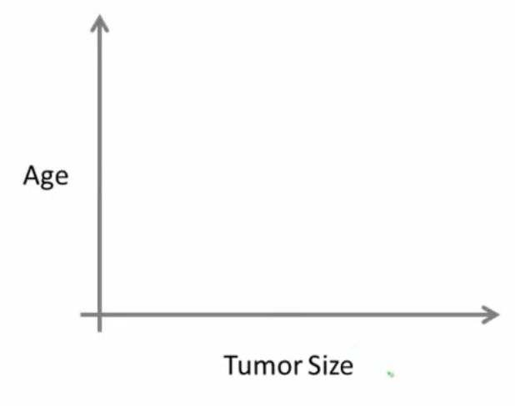
Supervised Learning
Breast Cancer: (Malignant, Benign)
Right answers are given for inputs
Classification refers to predict discrete valued output (e.g. 0 or 1)

Slide 26
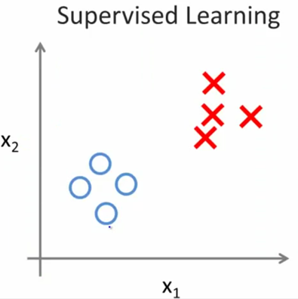
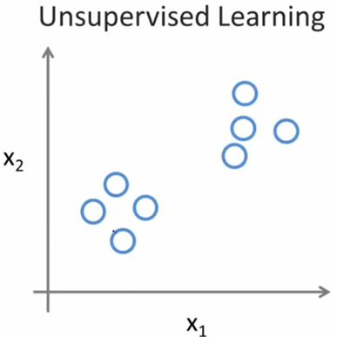
Unsupervised Learning

Slide 27
Question
Of following examples, which one you address using unsupervised learning algorithm?
  Given email labelled as spam/not spam, learn a spam filter
  Given a set of news articles on the web, group them into set of articles about the same story
  Given a database of customer data, automatically discover market segments and group customer into different market segments
  Given a database of patients diagnosed as either having diabetes or not, learn to classify a new patients as either having a diabetes or not.

Slide 28
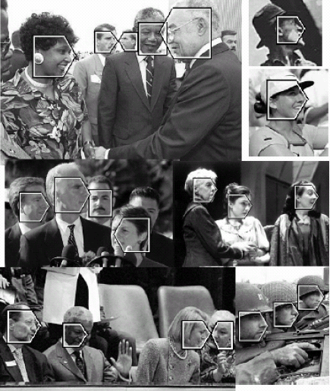
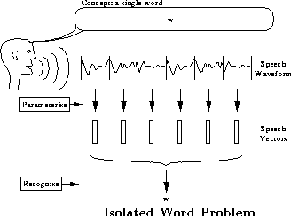
Why It Is Useful ?
ML learning provides best methods for developing particular kinds of software, in applications where:
  Application is too much complex for people to manually design the algorithm. For instance, soft- wares for sensor-based prediction tasks such as speech recognition and computer vision.

Slide 29
Why It Is Useful ? (Cont.)
ML learning provides best methods for developing particular kinds of software, in applications where:
  Application is too much complex for people to manually design the algorithm.
What makes a 2?

Slide 30
Why It Is Useful ? (Cont.)
ML learning provides best methods for developing particular kinds of software, in applications where:
  4. Using historical data to improve decisions (task is known as Data Mining), e.g. Medical record – medical knowledge, what kind of medical treatment is suitable for which patients in future.

Slide 31

How It Can be ?
Classification
  Image Classification: A Core Computer Vision Task
Machine Learning
Cat
Dog
Car
Truck
Person
.
.
.
Cat

Slide 32
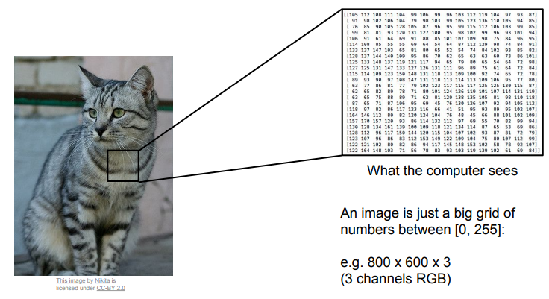
Semantic Gap
What you see

Slide 33
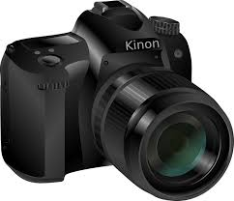
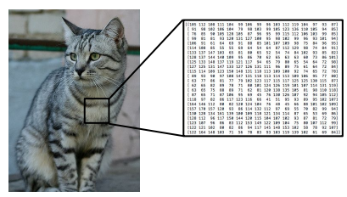
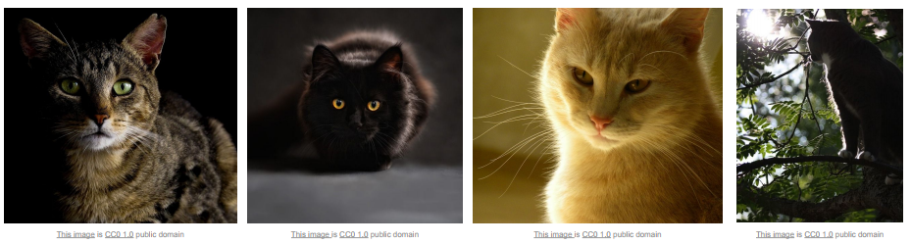
Why Not Hard-Coded ?
Viewpoint variation
Illumination

Slide 34
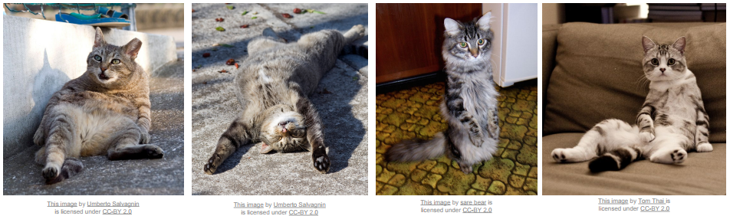
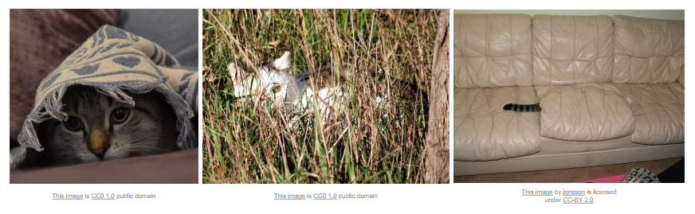
Why Not Hard-Coded ? (Cont.)
Deformation
Occlusion

Slide 35

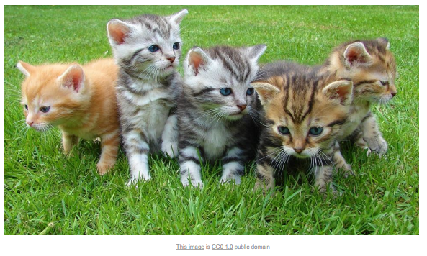
Why Not Hard-Coded ? (Cont.)
Background Clutter
Intra Class Variation

Slide 36
Machine Learning: Overview
Example Applications
Medical Diagnosis
Autonomous Driving
Information extraction
Computer/Machine Vision
Finance
Web Search
Robotics
Social networks
Production Industry
Logistics
Waste Management
[Your research/favorite area]

Slide 37

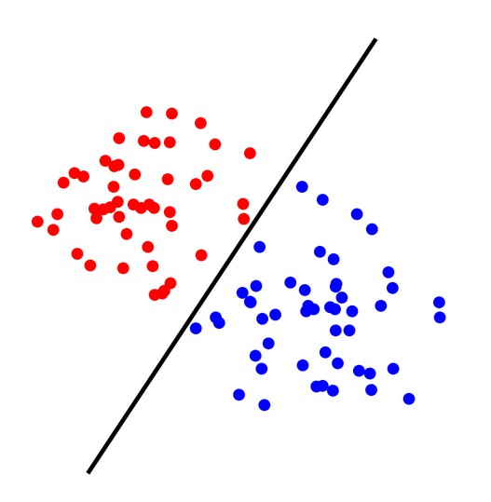
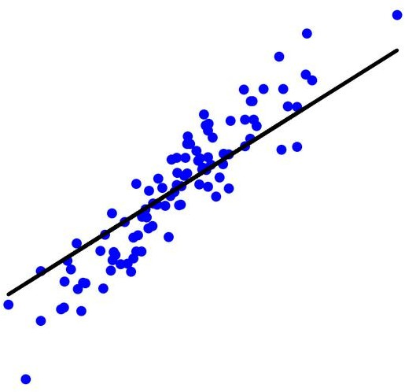
Machine Learning: Overview
Nature of ML Problems
1. Supervised Learning
The learning algorithm would receive a set of inputs along with the corresponding correct outputs to train a model
Training Data
All labeled data
Model
Prediction
Classification: Discrete Prediction
Given a data sample, predict its class
Regression: Quantitative Prediction on a continuous scale
Given a data sample, predict a numerical value

Slide 38
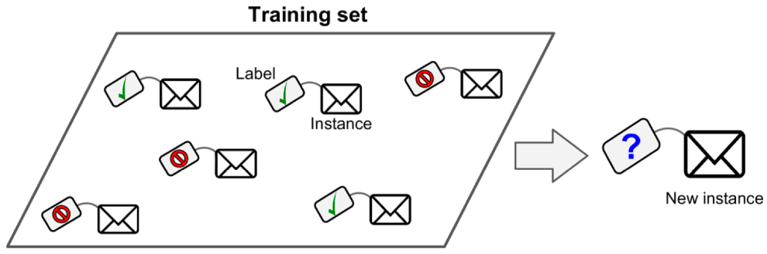
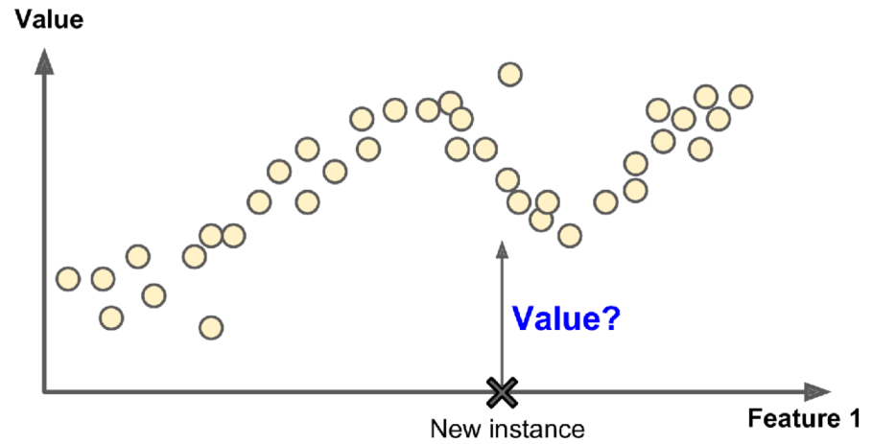
Types of machine learning
ML systems can be classified according to the amount and type of supervision
  Supervised learning: training set includes the desired solutions or labels
    Classification: labels are classes (e.g., spam or ham)
Regression: labels are numeric values (e.g., price of car)

Slide 39
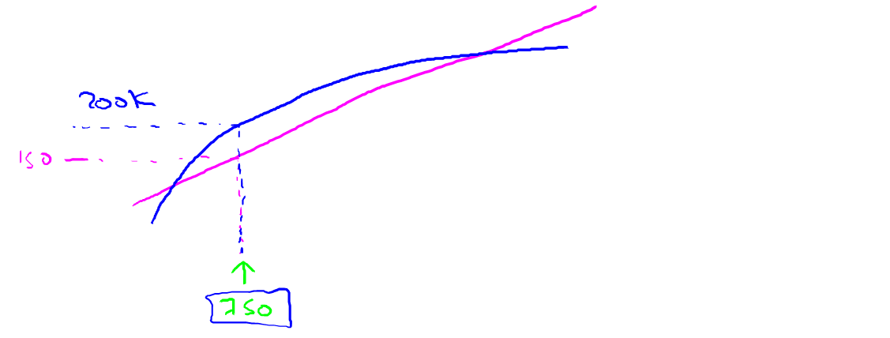

Housing price prediction
400
300
Price ($)
in 1000’s
200
100
0
0
500
1000 1500
Size in feet²
2000
2500
Supervised Learning
“right answers” given
Regression: Predict continuous valued output (price)

Slide 40
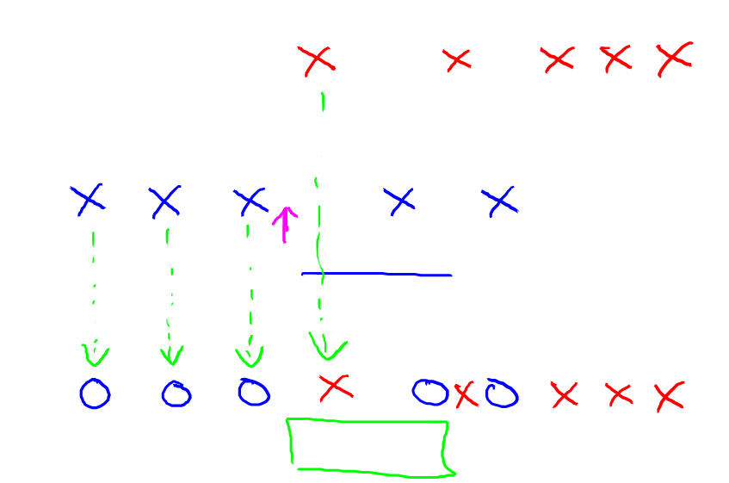
Breast cancer (malignant, benign)
Classification
1(Y)
Discrete valued
output (0 or 1)
Malignant?
0(N)
Tumor Size
Tumor Size

Slide 41

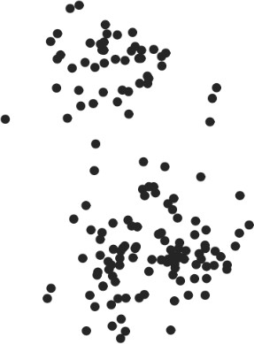
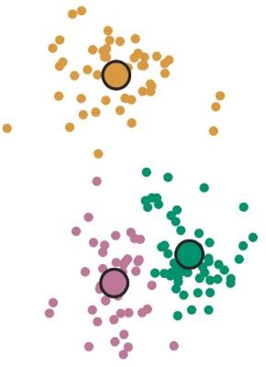
Machine Learning: Overview
Nature of ML Problems
2. Unsupervised Learning
The learning algorithm would receive unlabeled raw data to train a model and to find patterns in the data
Training Data
All unlabeled data
Model
Clustering

Slide 42
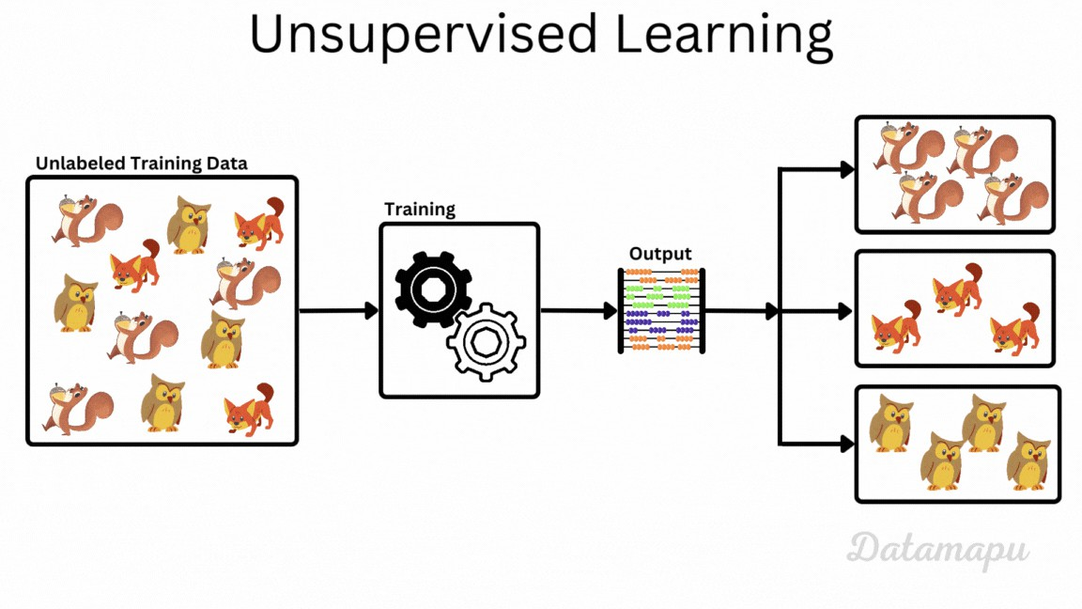
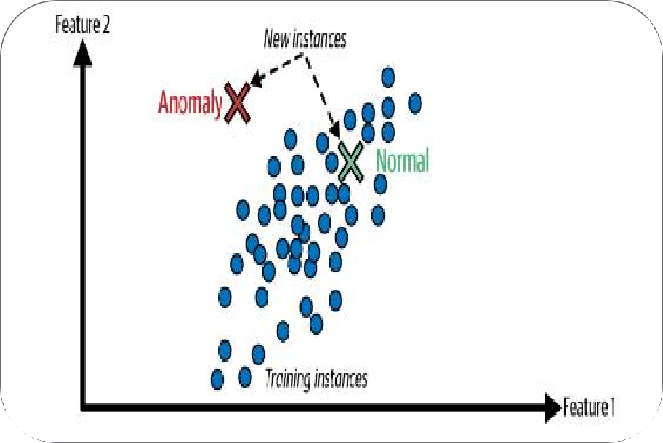
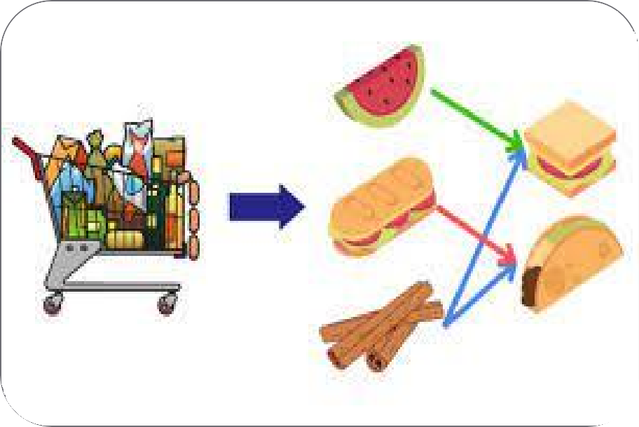
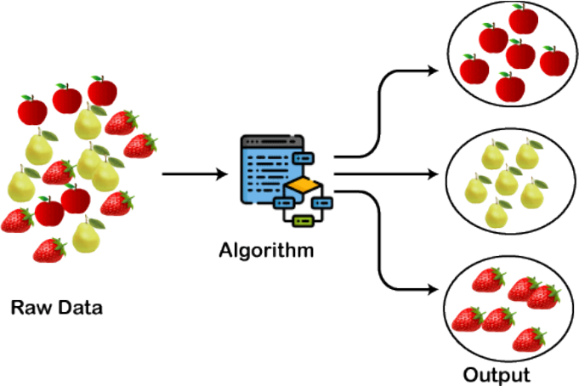
Types of Machine Learning
Unsupervised Learning
  Unsupervised Learning involves training a model on data
that does not have labeled responses.
  The model tries to find hidden patterns or intrinsic structures in the input data.
Common Tasks in Unsupervised Learning:
Clustering:
  Grouping similar data points together.
  For example, customer segmentation in marketing, where customers are grouped based on purchasing behavior.
Anomaly Detection:
  Identifying outliers or unusual data points that do not
conform to the expected pattern.
  For example, detecting fraudulent transactions in financial systems.
Association:
  Discovering rules that describe large portions of the data.
  For example, market basket analysis in retail, where associations between products bought together are identified.

Slide 43
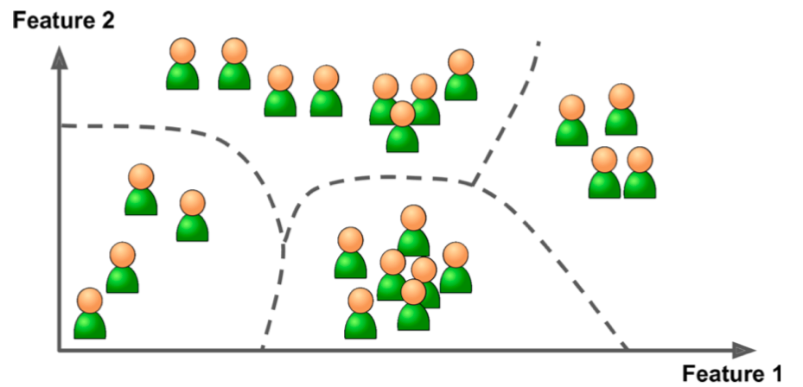
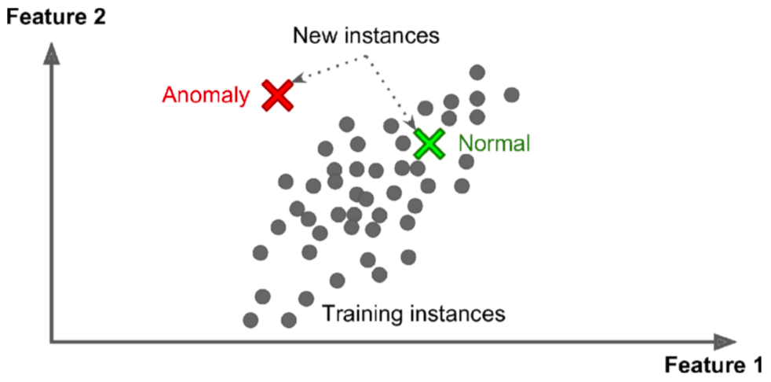
Types of machine learning
Unsupervised learning: ML system tries to learn without a teacher
  For example, based on the shopping history, detect groups of similar visitors
Another example is novelty detection: find new instances that look different

Slide 44

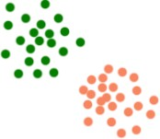
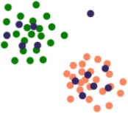
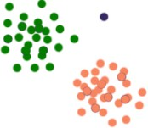
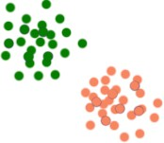
Machine Learning: Overview
Nature of ML Problems
Semi-supervised Learning
  The learning algorithm receives labeled and unlabeled raw data to train a model
  Main objective is to efficiently accommodate the unlabeled data
Training Data
Labeled
+
unlabeled Data
Data Modeling and Augmentation
Model
Anomaly
-> ignore it
Use labeled data to build a model
Place unlabeled data with model
Use the model to label the unlabeled data
Fit the model again with the combined data

Slide 45
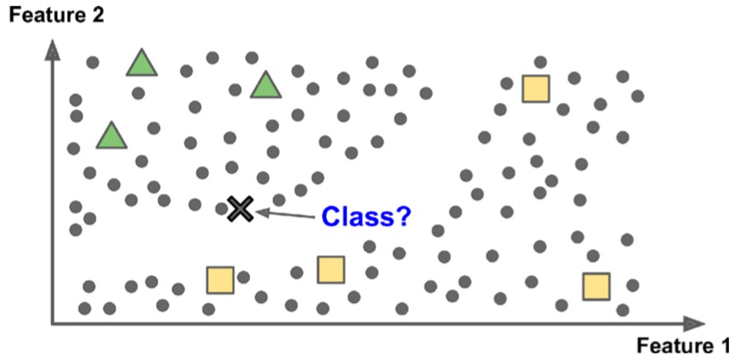
Types of machine learning
Semisupervised learning: plenty of unlabeled instances and few labeled
  Why? Labeling data is costly and time-consuming
Reinforcement learning: select and perform actions, and get rewards or penalties in return
  Find the best strategy known as policy to get the most reward

Slide 46
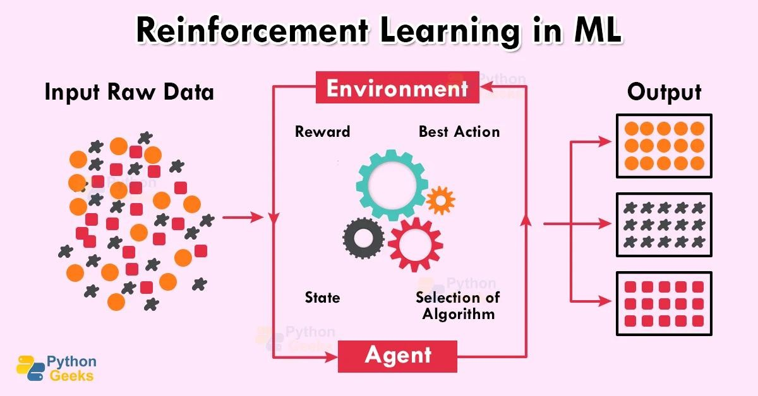


Types of Machine Learning
Reinforcement Learning
  Reinforcement Learning is a type of machine learning where an agent learns by interacting with an environment, not from fixed labeled data, but from trial and error.
  It involves training a model to make sequences of decisions by interacting with an environment.
  The model receives feedback in the form of rewards or penalties and learns to optimize its actions to maximize cumulative rewards.
Common Reinforcement Learning Tasks:
Game Playing:
  Training an AI to play games like Chess or Go, where the AI learns strategies through trial and error and feedback from wins or losses.
Robotics:
  Teaching robot to perform tasks such as walking, picking up objects, or navigating spaces, based on feedback from the environment.

Slide 47




Machine Learning: Overview
Typical Flow
Problem Nature Identification
Training Data Collection
Model Training
f (x)
Model Deployment
Model Validation

Slide 48

Types and Applications of Machine Learning

Slide 49

Machine Learning: Overview
Data Types
Tabulated Data
Each column is a feature and adds one dimension to the data
Number of columns define total number of features and hence data dimensionality
Ideally, these columns should contain different information -> uncorrelated

Slide 50





Machine Learning: Overview
Data Types
Feature 2
Feature 2
Feature 1
Features are correlated
Feature 1
Features are uncorrelated
Dimensionality Reduction
Find all those dimensions (features) which carry very less information and discard them

Slide 51

Challenges of machine learning
Insufficient quantity of training data
Non-representative and poor-quality training data
Irrelevant features: coming up with a good set of features

Slide 52

Challenges of machine learning
Overfitting the training data
  When the model is too complex relative to the amount and noisiness of data
How to alleviate this problem?
  Simplify the model
  Gather more training data
  Reduce noise and outliers (i.e., data preparation)

Slide 53

Example of reducing overfitting
Use a subset of data and regularization
  Regularization: balance between fitting the data perfectly and keeping the model simple enough
  Amount of regularization is controlled by a hyperparameter (must be set prior to learning and remains constant during training)
  Tuning hyperparameters is extremely important

Slide 54

Challenges of machine learning
Underfitting the training data
  When the model is too simple
How to solve this problem?
  Select a more powerful model
  Reduce constraints on the model such as regularization

Slide 55

Testing and validation
The only way to know how a model will generalize to new cases is to actually try it out on new cases
Split the available data into two sets: training set and testing set
  The error on the test set is called the generalization error or out-of-sample error
  If training error is low and generalization error is high, then overfitting occurs
How to choose suitable models and their hyperparameters?

Slide 56



Key Concepts
Algorithms and Models
Algorithms
  Step-by-step procedures or mathematical formulas used to process data and learn patterns.
  In machine learning, algorithms are the methods used to train models on data.
  Example: Linear Regression, Logistic Regression, Neural Networks.
Model
  The final outcome of a machine learning algorithm after being trained on data.
  A models can make predictions or decisions when given new data.
  Example: A trained model that predict house prices based on features like size, number of bedrooms, and location.

