Slide 1



Machine Learning EE514 – CS535
Logistic Regression: Overview, Loss Function, Gradient Descent

Slide 2
Outline
Logistic Regression
Loss/Cost Function
Logistic Regression Gradient Descent
Generative Vs Disscriminative

Slide 3
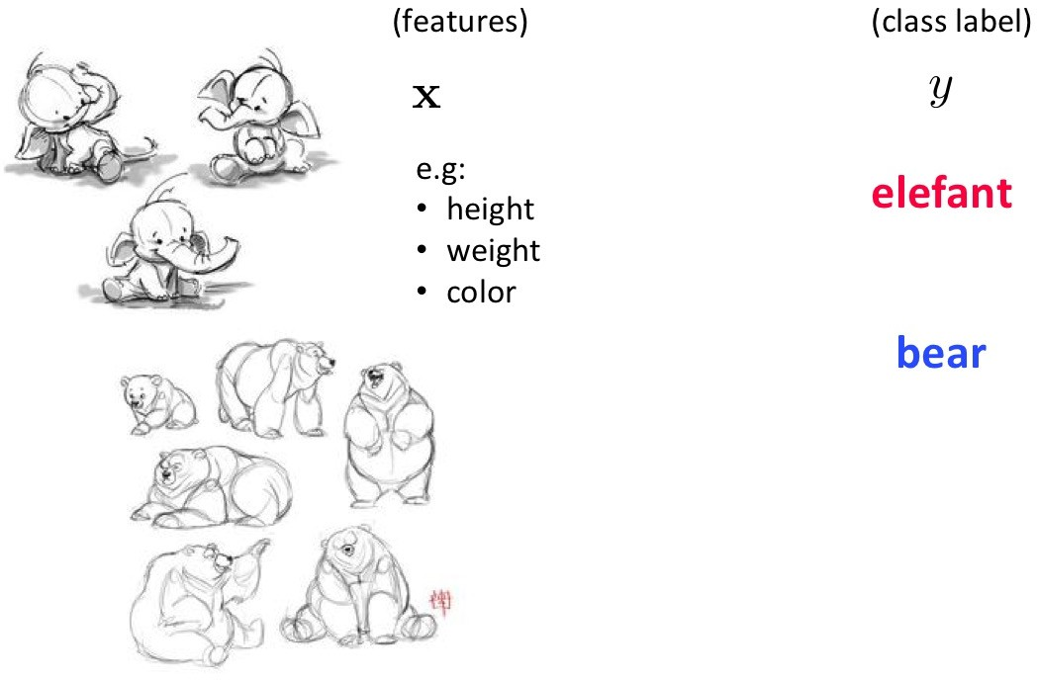
Given inputs x and classes y we can do classification in several ways. How?
Classification

Slide 4
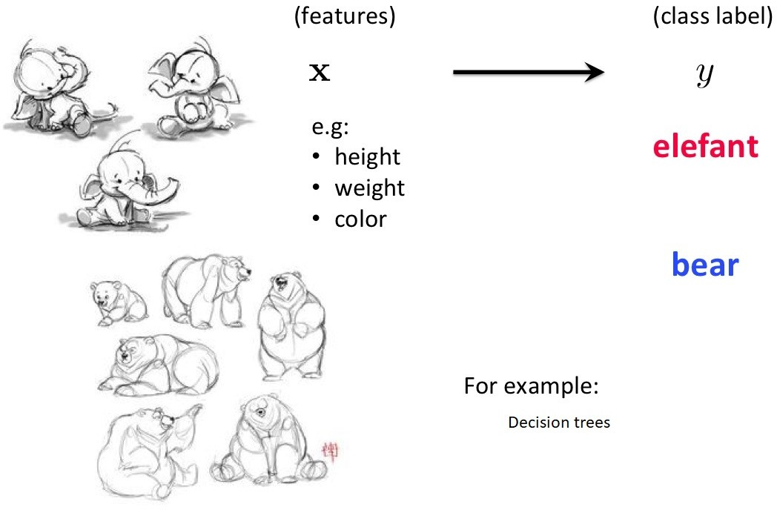
Discriminative Classifiers
Discriminative classifiers try to either:
⁾ learn mappings directly from the space of inputs X to class labels
{0, 1, 2, . . . , K }

Slide 5
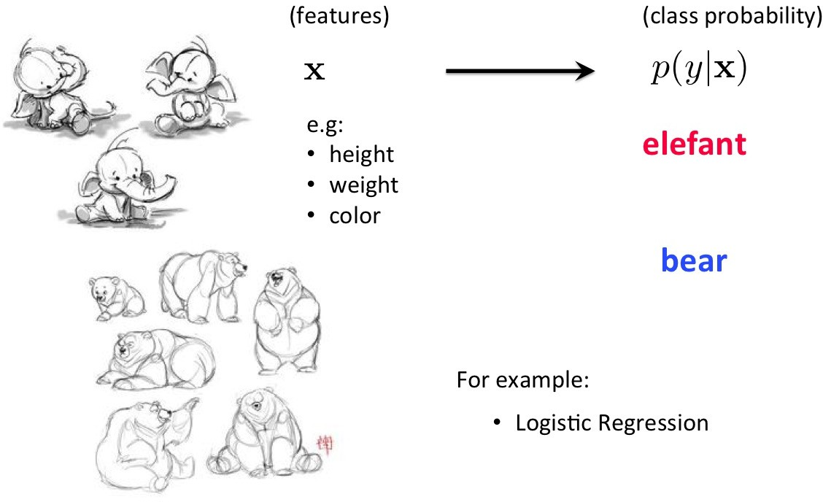
Discriminative Classifiers
Discriminative classifiers try to either:
⁾ or try to learn p(y |x) directly

Slide 6
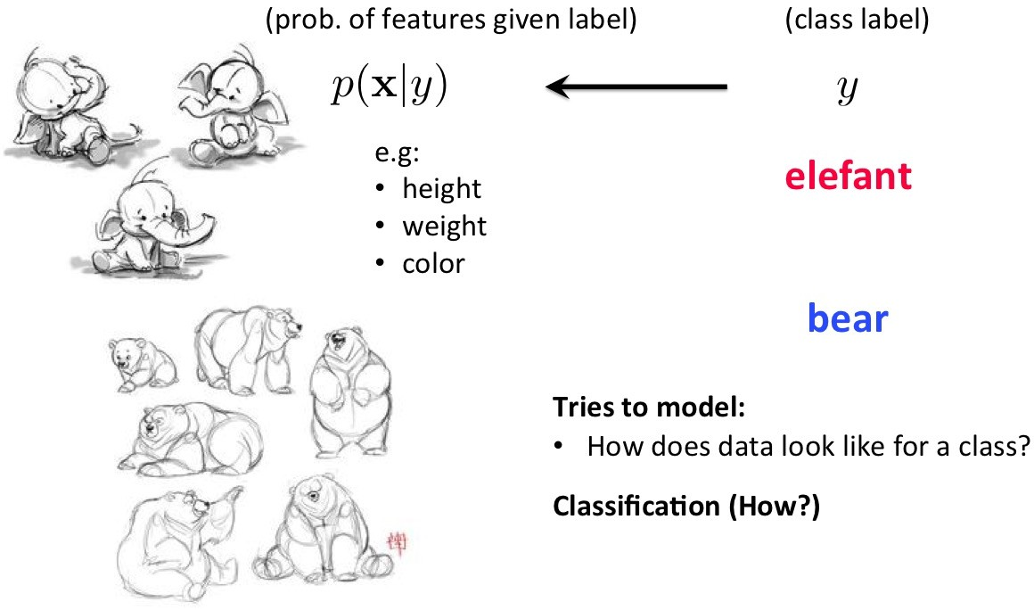
Generative Classifiers
How about this approach: build a model of “what data for a class looks like”
Generative classifiers try to model p(x, y ). If we know p(y ) we can easily compute p(x|y ).
Classification via Bayes rule (thus also called Bayes classifiers)

Slide 7
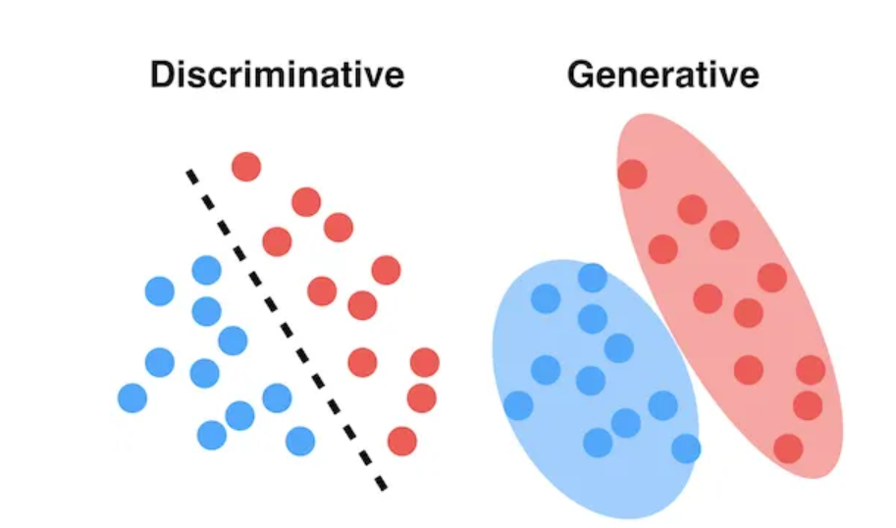
Generative vs Discriminative
Two approaches to classification:
Discriminative classifiers estimate parameters of decision boundary/class separator directly from labeled examples. Tries to solve: How do I separate the classes?
⁾ learn p(y |x) directly (logistic regression models)
⁾ learn mappings from inputs to classes (least-squares, decision trees)
Generative approach: model the distribution of inputs characteristic of the class (Bayes classifier). Tries to solve: What does each class ”look” like?
⁾ Build a model of p(x|y )
⁾ Apply Bayes Rule

Slide 8
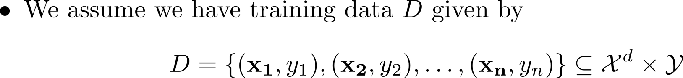
Classification
Recap:
Binary or Binomial Classification:
- Disease detection, spam email detection, fraudulent transaction, win/loss prediction, etc.
Multi-class (Multinomial) Classification:
Emotion Detection.
Vehicle Type, Make, model, of the vehicle from the images streamed by road cameras.
Speaker Identification from Speech Signal.
Sentiment Analysis (Categories: Positive, Negative, Neutral), Text Analysis.
Take an image of the sky and determine the pollution level (healthy, moderate, hazard).

Slide 9


Logistic Regression
Overview:
Logistic Regression: Discriminative Classifier
  Estimate P(y|x) directly from the data
‘Logistic regression’ is an algorithm to carry out classification.
  Name is misleading; the word ‘regression’ is due to the fact that the method attempts
to fit a linear model in the feature space.
Instead of predicting class, we compute the probability of instance being that class.
- A simple form of a neural network.

Slide 10
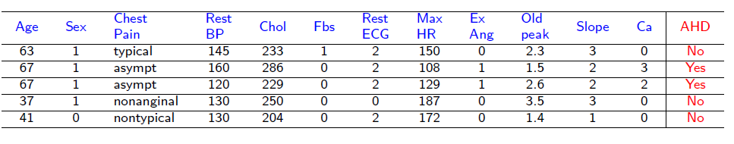
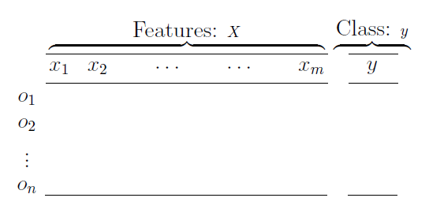
Logistic Regression
Logistic Regression is used if the response variable is categorical
It is a problem of classifying data points (described by one or more nominal or numerical predictors) into classes (a categorical response)

Slide 11



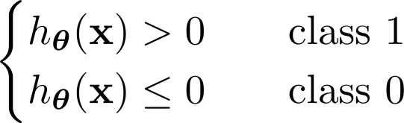








Logistic Regression
Model:
Consider a binary classification problem.
We have a multi-dimensional feature space (d features).
Features can be categorical (e.g., gender, ethnicity) or continuous (e.g., height, temperature).
Logistic regression model:
Real-valued output here!
Regression

Slide 12

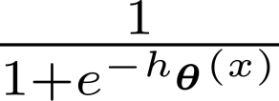

Logistic Regression
Model:
Consider a binary classification problem.
We have a multi-dimensional feature space (d features).
Features can be categorical (e.g., gender, ethnicity) or continuous (e.g., height, temperature).
Logistic regression model:
Logistic/Sigmoid function
Real-valued output here!
We want probability; between 0 and 1!
Activation function

Slide 13
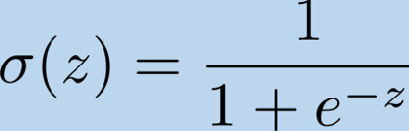
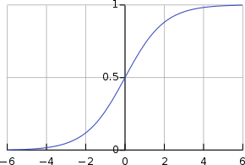

Logistic Regression
Logistic (Sigmoid) Function

Slide 14




Logistic Regression
Change in notation:
- Treat bias term as an input feature for notational convenience.
Linear function. Linear Regression.

Slide 15
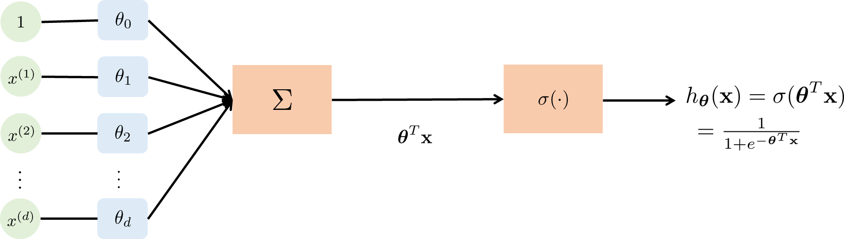
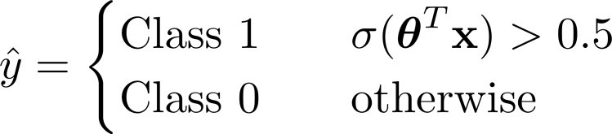
Logistic Regression
Classification:

Slide 16




Logistic Regression
Example:
- Disease prediction: Diagnose cancer given size of the tumor.

Slide 17
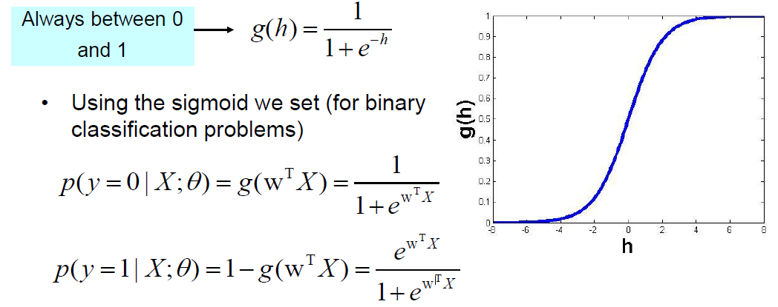
The sigmoid function
To classify using regression models we replace the linear function with the sigmoid function: p(y | X;Ɵ )

Slide 18
Logistic regression vs. Linear regression

Slide 19
Outline
Logistic Regression
Loss/Cost Function
Logistic Regression Gradient Descent

Slide 20


Logistic Regression
Model Training (Learning of Parameters):
Logistic regression model:
Objective: Given the training data, that is n training samples, we want to find the parameters of the model.
We first formulate the loss (cost, objective) function that we want to optimize.
We will employ gradient descent to solve the optimization problem.

Slide 21
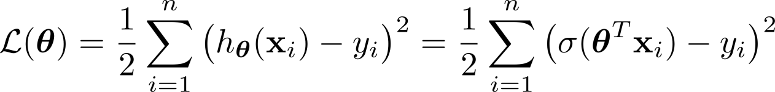
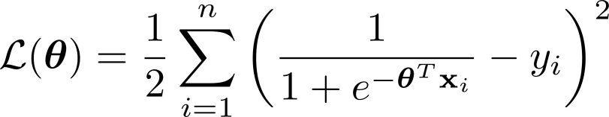
Logistic Regression
Loss/Cost Function:
- Candidate 1: Squared-error, the one we used in regression.
We wish to have a loss function that is differentiable and convex.
The squared-error is not a convex function due to sigmoid operation.
Due to non-convexity, we cannot numerically solve to find the global minima.
Furthermore, the hypothesis function is estimating probability and we do not use difference operation to determine the distance between the two probability distributions.

Slide 22
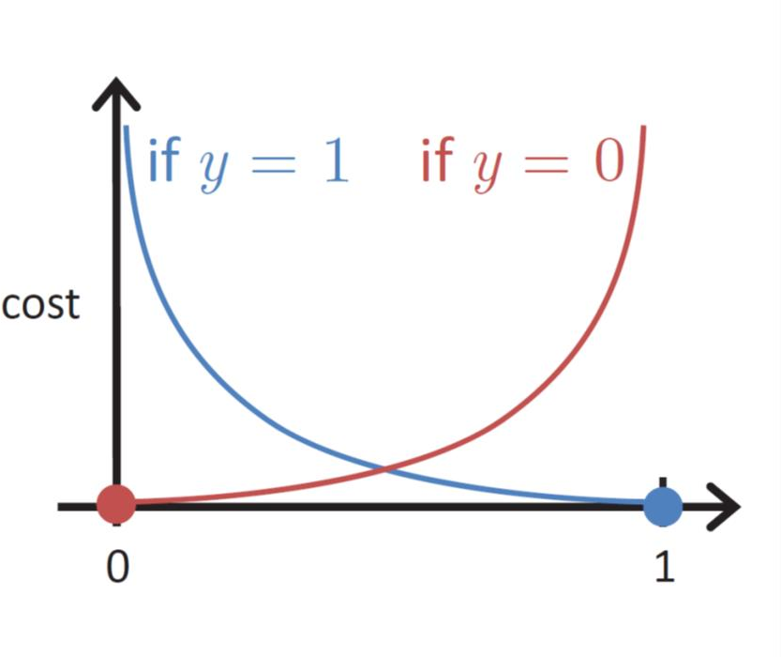
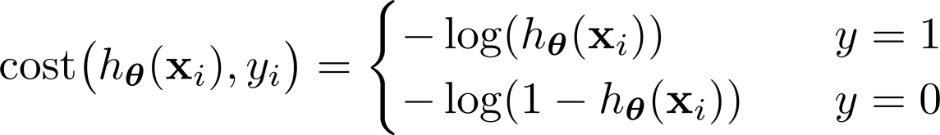


Logistic Regression
Loss/Cost Function:
Candidate 2: Cross entropy loss or Log loss function is used when classifier output is in terms of probability.
Idea: Cross-entropy loss increases when the predicted probability diverges from the actual label.
- If the actual class is 1 and the model predicts 0, we should highly penalize it and vice-versa.
Loss/cost function for single training example:
- Mismatch is penalized: larger mistakes get larger penalties

Slide 23
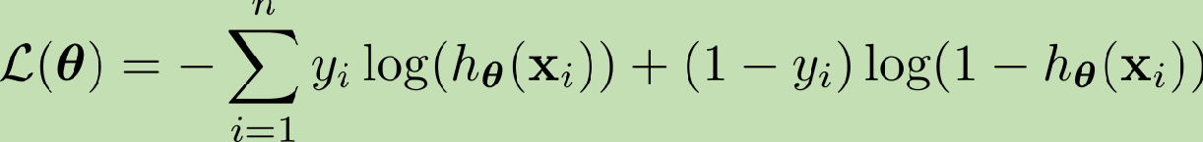
Logistic Regression
Loss/Cost Function:
- We can also express the loss/cost for one training sample as
- Using this formulation, we define the loss function:
Since cost for each sample penalizes mismatch, this loss function prefers the correct class label to be more likely.
Finding parameters that minimizes loss function or maximizes negative of the loss function is, in fact, maximum likelihood estimation (MLE). How?

Slide 24
Logistic Regression
Model Training (Learning of Parameters):
- We have following optimization problem in hand:
We do not attempt to find analytical solution.
We can use properties of convex functions, composition rules and concavity of log to show that the loss function is a convex function.
We use gradient descent to numerically solve the optimization problem.

Slide 25
Outline
Logistic Regression
Loss/Cost Function
Logistic Regression Gradient Descent

Slide 26
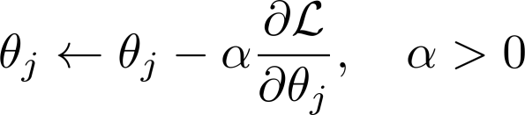


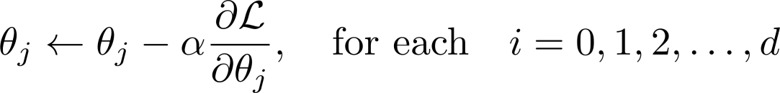

Logistic Regression
Gradient Descent:
Algorithm (we have seen this before): Overall:
Pseudo-code:
Note: Simultaneous update.

Slide 27

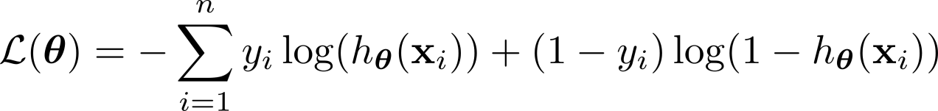
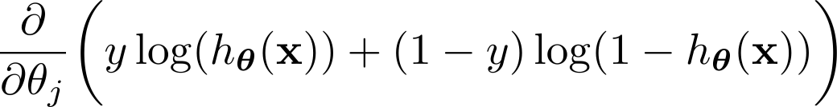
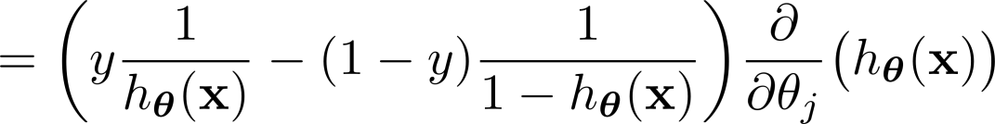
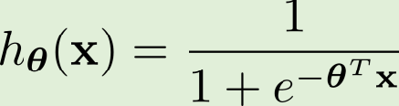
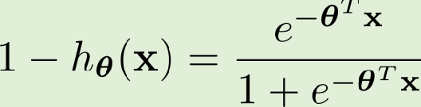


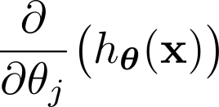
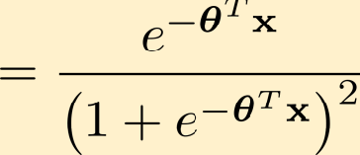
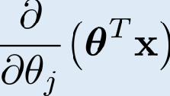
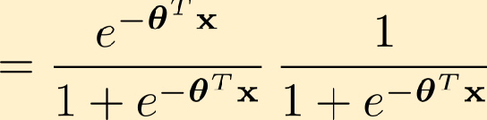



Logistic Regression
Gradient Descent Computation:

Slide 28

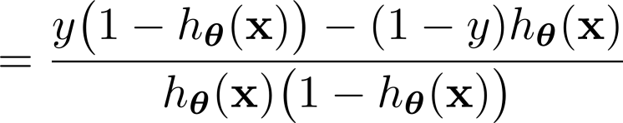




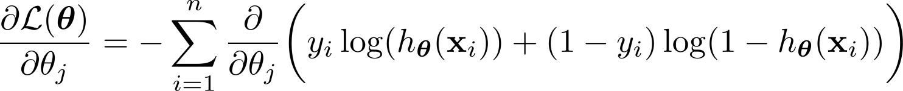
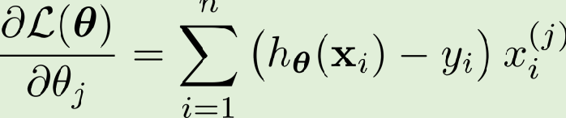
Logistic Regression
Gradient Descent Computation:
Overall:

