Slide 1



Machine Learning
Supervised Learning Overview, Formulation, Train-test Split
University of Lahore

Slide 2
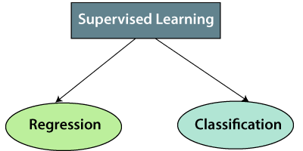
Types of supervised Machine learning Algorithms:
Supervised learning can be further divided into two types of problems:

Slide 3
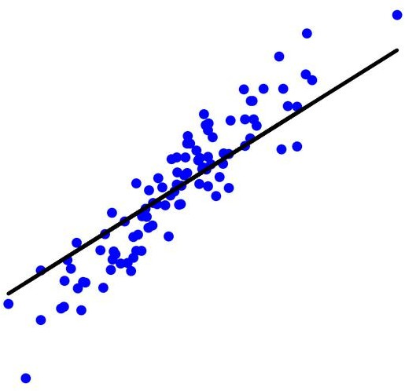
Supervised Learning
Regression
Regression: Quantitative Prediction on a continuous scale
Examples: Prediction of
Age of a person from his/her photo
Price of 10 Marla, 5-bedroom house in 2050
USD/PKR exchange rate after one week
Efficacy of Pfizer Covid vaccine
Average temperature/Rainfall during monsoon
Cumulative score in ML course
Probability of decrease in the electricity prices in Pakistan
No. of steps per day
What do all these problems have in common?
Continuous outputs
Predicting continuous outputs is called regression

Slide 4
Popular Regression algorithms
Linear Regression
Multi-Linear Regession
Polynomial Regression
Ridge Regression & Lasso Regression
Suport Vector Regression

Slide 5
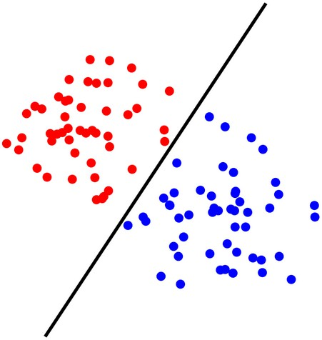
Supervised Learning
Classification
Classification: Given a data sample, predict its class (discrete)
Examples: Prediction of
Gender of a person using his/her photo or hand-writing style
Spam filtering
Object or face detection in a photo
We will be back on Campus on Feb 1
Temperature/Rainfall normal or abnormal during monsoon
Letter grade in ML course
Decrease expected in electricity prices in Pakistan next year
More than 10000 Steps taken today
What do all these problems have in common?
Discrete outputs: Categorical
Yes/No (Binary Classification)
Multi-class classification: multiple classes
Predicting a categorical output is called classification

Slide 6
Spam Filtering
Random Forest
Decision Trees
Logistic Regression
Support vector Machines

Slide 7
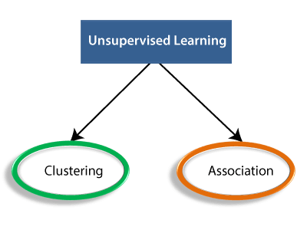
Types of Unsupervised Learning Algorithm:

Slide 8
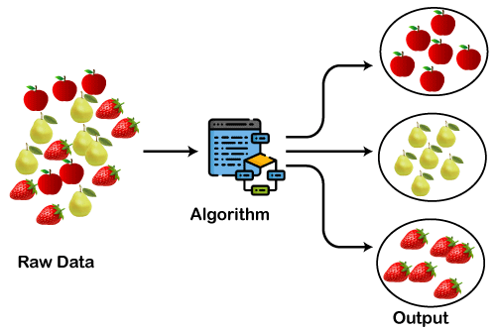
Clustering:
Clustering is a method of grouping the objects into clusters such that objects with most similarities remains into a group and has less or no similarities with the objects of another group. Cluster analysis finds the commonalities between the data objects and categorizes them as per the presence and absence of those commonalities.
The clustering technique can be widely used in various tasks. Some most common uses of this technique are:
  Market Segmentation
  Statistical data analysis
  Social network analysis
  Image segmentation
  Anomaly detection, etc.

Slide 9
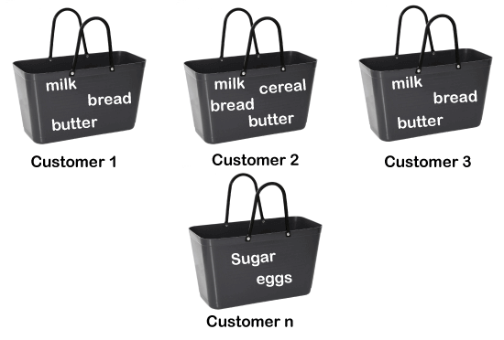
Association Rule learning:
An association rule is an unsupervised learning method which is used for finding the relationships between variables in the large database. It determines the set of items that occurs together in the dataset. Association rule makes marketing strategy more effective. Such as people who buy X item (suppose a bread) are also tend to purchase Y (Butter/Jam) item. A typical example of Association rule is Market Basket Analysis, Web usage mining.

Slide 10
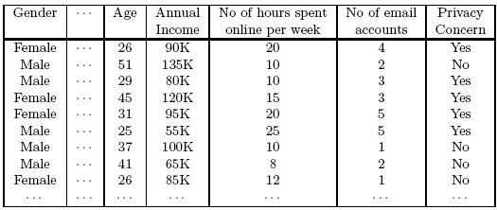
Example of Association Rule
Example of Association Rule:
{Gender=Male, Age ∈ [21,30)} → {No of hours online ≥ 10}

Slide 11
Association rule learning can be divided into three types of algorithms:
Apriori
Eclat
F-P Growth Algorithm

Slide 12
Apriori Algorithm
This algorithm uses frequent datasets to generate association rules. It is designed to work on the databases that contain transactions. This algorithm uses a breadth-first search and Hash Tree to calculate the itemset efficiently.
It is mainly used for market basket analysis and helps to understand the products that can be bought together. It can also be used in the healthcare field to find drug reactions for patients.

Slide 13
Eclat Algorithm
Eclat algorithm stands for Equivalence Class Transformation. This algorithm uses a depth-first search technique to find frequent itemsets in a transaction database. It performs faster execution than Apriori Algorithm.

Slide 14
F-P Growth Algorithm
The F-P growth algorithm stands for Frequent Pattern, and it is the improved version of the Apriori Algorithm. It represents the database in the form of a tree structure that is known as a frequent pattern or tree. The purpose of this frequent tree is to extract the most frequent patterns.

Slide 15
Unsupervised Learning algorithms:
K-means clustering
KNN (k-nearest neighbors)
Hierarchal clustering
Anomaly detection
Neural Networks
Principle Component Analysis
Independent Component Analysis
Apriori algorithm
Singular value decomposition

Slide 16
Supervised Learning Setup
In these regression or classification problems, we have
Inputs – referred to as Features
Output – referred to as Label
Training data – (input, output) for which the output is known and is used for training a model by ML algorithm
A Loss, an objective or a cost function – determines how well a trined model approximates the training data
Test data – (input, output) for which the output is known and is used for the evaluation of the performance of the trained model

Slide 17
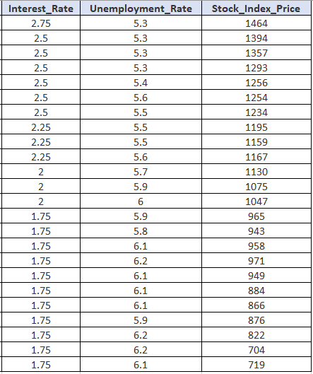
Supervised Learning Setup
Example
Predict Stock Index Price
Features (Input)
Labels (Output)
Training data
?
?
?

Slide 18
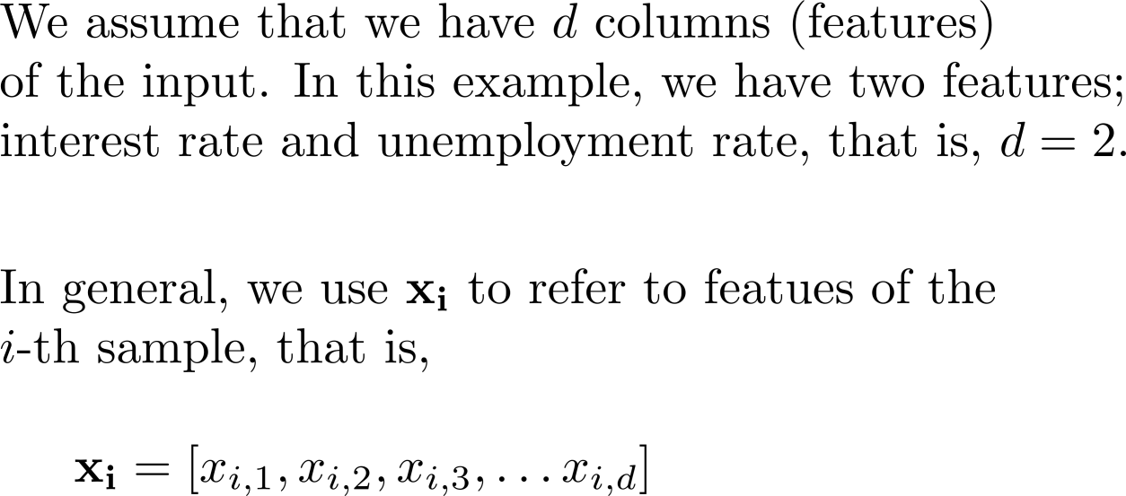
Supervised Learning Setup
Formulation
?
?
?

Slide 19
Supervised Learning Setup
Formulation
Regression:
Classification:

Slide 20

Supervised Learning Setup
Example
Data of 200 Patients:
Age of the patient
Cholesterol levels
Glucose levels
BMI
Height
Heart Rate
Calories intake
No. of steps taken
Model (h)
Prediction of Oxygen Saturation

Slide 21
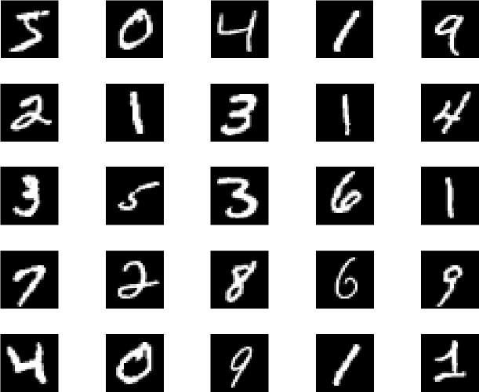
Supervised Learning Setup
Example
Model (h)
Prediction
MNIST Data:
Each sample 28x28 pixel image
60,000 training data
10,000 testing data

Slide 22

Supervised Learning Setup
Q: How do we evaluate the performance? A:
But, how do the algorithm knew that the predictions are wrong?
Cost function/ loss function tell it
Loss Function

Slide 23
Loss Function
Loss functions are used to quantify how well or bad a model can reproduce the values of the training set.
The appropriate loss function depends on the type of problems and the algorithm we use.
Let's denote with y^ the prediction of the model and y the true value.

Slide 24
Types of Loss function
Cost functions can be of various types depending on the problem. However, mainly it is of three types, which are as follows:
  Regression Cost Function
  Binary Classification cost Functions
  Multi-class Classification Cost Function.

Slide 25
1. Regression Cost Function
Regression models are used to make a prediction for the continuous variables such as the price of houses, weather prediction, loan predictions, etc. When a cost function is used with Regression, it is known as the "Regression Cost Function." In this, the cost function is calculated as the error based on the distance, such as:
Error= Actual Output-Predicted output

Slide 26
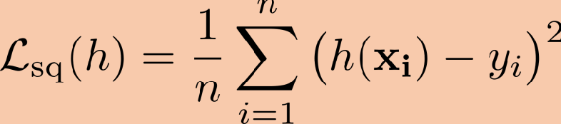
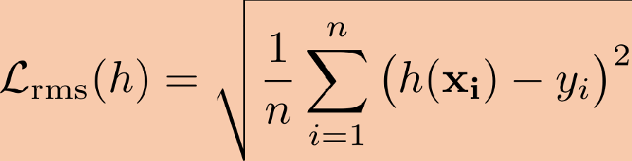
Supervised Learning Setup
Squared Loss Function:
Squared loss is defined as (also referred to as mean-square error, MSE )
Interpretation:
Again note normalization by the number of samples.
Loss is always nonnegative.
Loss grows quadratically with the absolute error amount in each sample.
Root Mean Squared Error (RMSE):
RMSE is just square root of squared loss function:

Slide 27
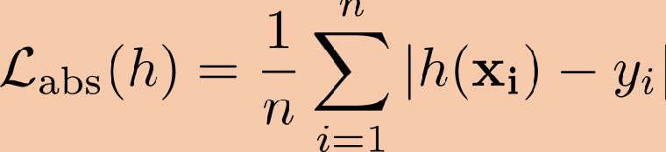
Supervised Learning Setup
Absolute Loss Function:
Absolute loss is defined as
Interpretation:
Loss grows linearly with the absolute of the error in each prediction.
Used in regression and suited for noisy data.
* All of the losses are non-negative

Slide 28
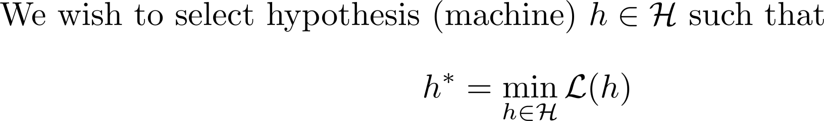
Supervised Learning Setup
Learning
(Optimization problem)
Recall
Q: How can we ensure that hypothesis h will give low loss on the input not in D?

Slide 29
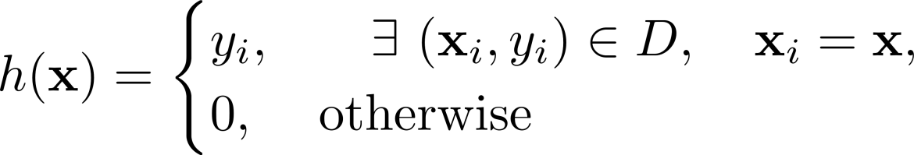
Supervised Learning Setup
Interpretation:
0% loss error on the training data (Model is fit to every data point in D).
Large error for some input not in D
First glimpse of overfitting.
Revisit:
Q: How can we ensure that hypothesis h will give low loss on the input not in D?
A: Train/Test Split

Slide 30
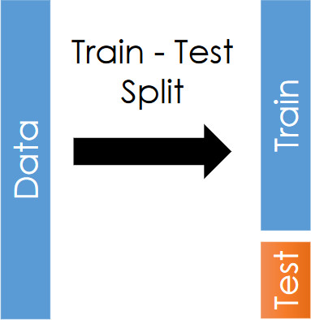
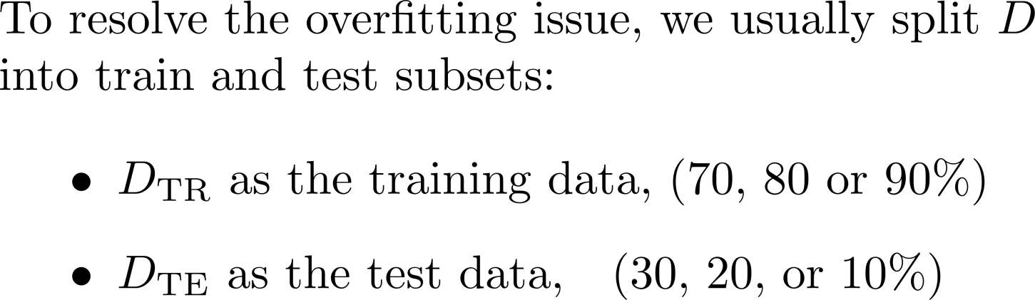
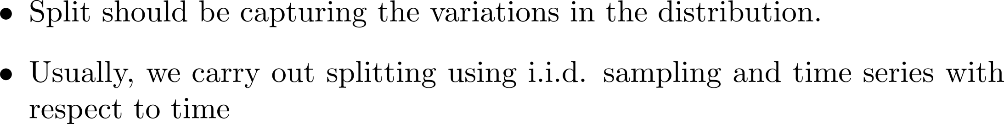
Supervised Learning Setup
Generalization: The Train-Test Split
How to carry out splitting?
You can only use the test dataset once after deciding on the model using training dataset

Slide 31
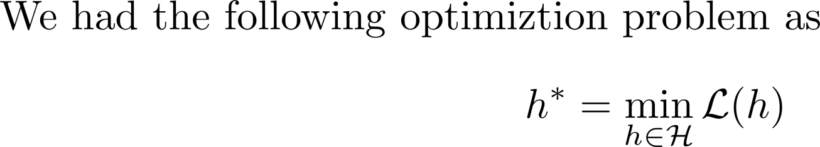
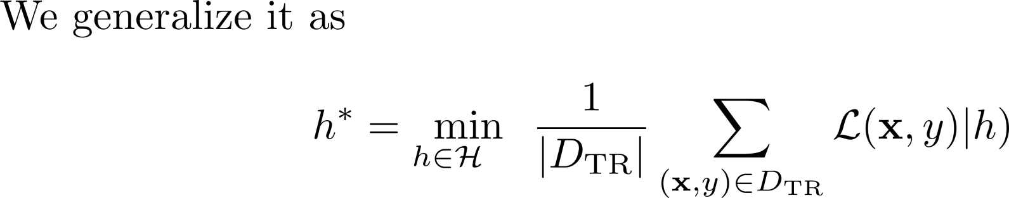
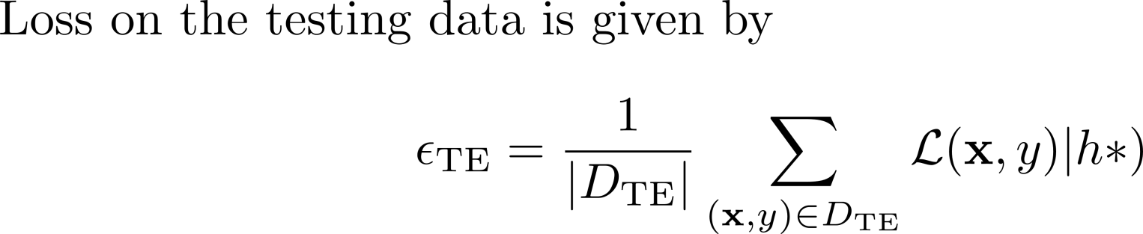
Supervised Learning Setup
Learning (Revisit after train-test split)
Evaluation

Slide 32
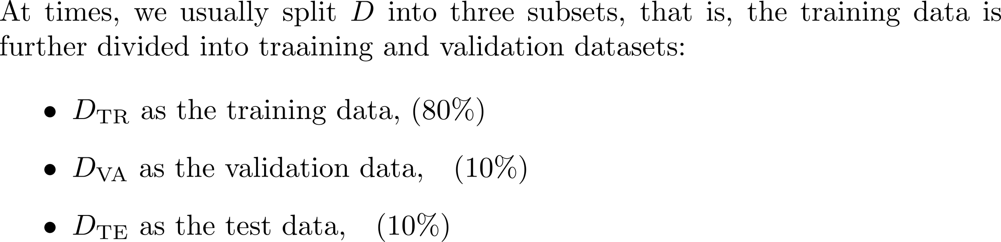
Supervised Learning Setup
Generalization: The Train-Test Split
Q: Idea:
Validation data is used evaluate the loss for a function h that is determined using the learning on the training data-set. If the loss on validation data is high for a given h, the hypothesis or model needs to be changed.

Slide 33
Supervised Learning Setup
Generalization: The Train-Test Split
More explanation* to better understand the difference between validation and test data:
Training set: A set of examples used for learning, that is to fit the parameters of the hypothesis (model).
Validation set: A set of examples used to tune the hyper-parameters of the hypothesis function, for example to choose the number of hidden units in a neural network OR the order of polynomial approximating the data.
Test set: A set of examples used only to assess the performance of a fully-specified model or hypothesis.
Adapted from *Brian Ripley, Pattern Recognition and Neural Networks, 1996

Slide 34
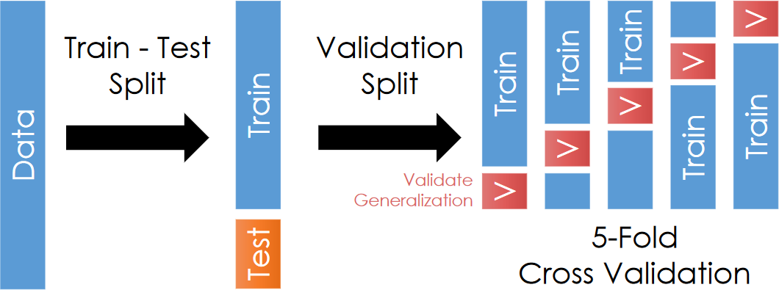
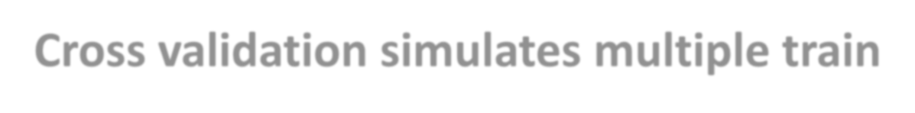

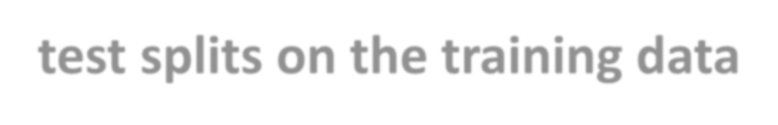
Supervised Learning Setup
Generalization: The Train-Test Split (Example)

