Slide 1
Introduction
Intuition
Cost Function and Gradient Descent
LR with GD
Python
Polynomial Regression
Tasks
Machine Learning Regression
Regression

Slide 2
Introduction Intuition Cost Function and Gradient Descent LR with GD Python Polynomial Regression Tasks
Reference Books
Reference Books
Reference books for this Module:
Chapter 1 & 3: Pattern Recognition and Machine Learning, Christopher M. Bishop, Springer Books, latest edition.
Regression
4 / 65

Slide 3
Introduction Intuition Cost Function and Gradient Descent LR with GD Python Polynomial Regression Tasks
Reference Books
Reference Books
Reference books for this Module:
Chapter 1 & 3: Pattern Recognition and Machine Learning, Christopher M. Bishop, Springer Books, latest edition.
Chapter 8: Machine Learning, Tom MITCHELL, McGraw Hill, latest edition.
Regression
4 / 65

Slide 4
Introduction Intuition Cost Function and Gradient Descent LR with GD Python Polynomial Regression Tasks
Intuition
Simple linear regression
Simple linear Regression
Simple linear regression is type of regression algorithms that models the relationship between a dependent variable and a single independent variable.
The relationship shown by a single linear regression model is linear or sloped straight line, hence it is called simple linear regression.
Regression
7 / 65

Slide 5
Introduction Intuition Cost Function and Gradient Descent LR with GD Python Polynomial Regression Tasks
Intuition
Objective?
Model the relationship between the two variable:- such as the relationship between income &expenditure, experience &salary etc.
Forecasting new observation:-such as weather forecasting according to the temperature ,revenue of a company according to the investment in a year ,etc.
Regression
7 / 65

Slide 6
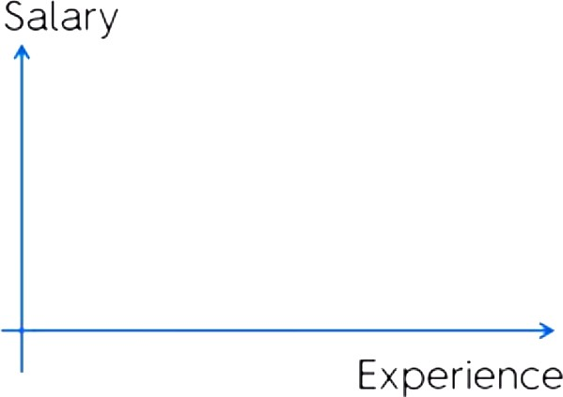
Introduction Intuition Cost Function and Gradient Descent LR with GD Python Polynomial Regression Tasks
Intuition
What?
REGRESSION is mapping of continuous inputs to continuous outputs.
(c)Dr. Rizwan A
Regression
7 / 65

Slide 7
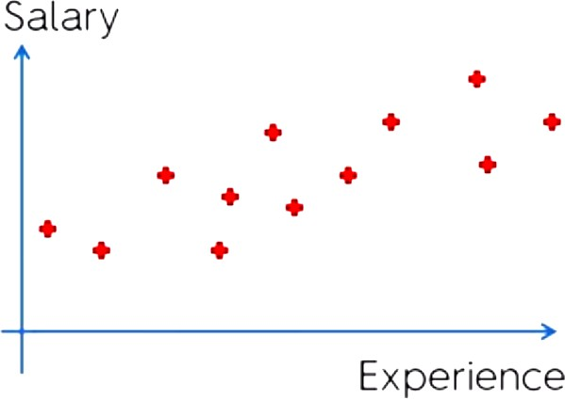
Introduction Intuition Cost Function and Gradient Descent LR with GD Python Polynomial Regression Tasks
Intuition
What?
REGRESSION is mapping of continuous inputs to continuous outputs.
(c)Dr. Rizwan A
Regression
7 / 65

Slide 8
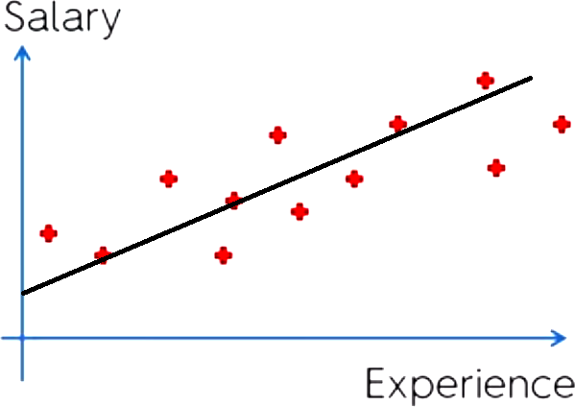
Introduction Intuition Cost Function and Gradient Descent LR with GD Python Polynomial Regression Tasks
Intuition
What?
REGRESSION is mapping of continuous inputs to continuous outputs.
(c)Dr. Rizwan A
Regression
7 / 65

Slide 9
Introduction Intuition Cost Function and Gradient Descent LR with GD Python Polynomial Regression Tasks
Intuition
Why?
Why
Why “regression” is called “regression” in machine learning?
¹http://www.stat.ucla.edu/~nchristo/statistics100C/history_regression.pdf
Regression
8 / 65

Slide 10
Introduction Intuition Cost Function and Gradient Descent LR with GD Python Polynomial Regression Tasks
Intuition
Why?
Why
Why “regression” is called “regression” in machine learning?
As per dictionary
“Regression” means to return to a previous and less advanced or worse state
¹http://www.stat.ucla.edu/~nchristo/statistics100C/history_regression.pdf
Regression
8 / 65

Slide 11
Introduction Intuition Cost Function and Gradient Descent LR with GD Python Polynomial Regression Tasks
Intuition
Why?
Why
Why “regression” is called “regression” in machine learning?
As per dictionary
“Regression” means to return to a previous and less advanced or worse state
Read Paper: Galton, Regression Towards Mediocrity in Hereditary Stature, 1886¹.
¹http://www.stat.ucla.edu/~nchristo/statistics100C/history_regression.pdf
Regression
8 / 65

Slide 12
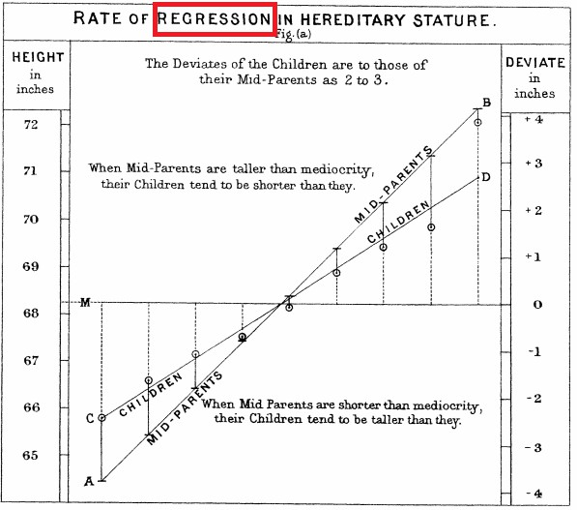
Introduction Intuition Cost Function and Gradient Descent LR with GD Python Polynomial Regression Tasks
Intuition
Why?
According to psychoanalyst Sigmund Freud, regression is a defense mechanism leading to the temporary or long-term reversion of the ego to an earlier stage of development rather than handling unacceptable impulses in a more adaptive way.
²http://www.stat.ucla.edu/~nchristo/statistics100C/history_regression.pdf
Regression
9 / 65

Slide 13
Introduction Intuition Cost Function and Gradient Descent LR with GD Python Polynomial Regression Tasks
Intuition
Why?
According to psychoanalyst Sigmund Freud, regression is a defense mechanism leading to the temporary or long-term reversion of the ego to an earlier stage of development rather than handling unacceptable impulses in a more adaptive way.
In machine learning the usage of word “regression” is linked to article by “Galton”. In this article “Galton” showed that average height of population regresses towards the mean.
²http://www.stat.ucla.edu/~nchristo/statistics100C/history_regression.pdf
Regression
9 / 65

Slide 14
Introduction Intuition Cost Function and Gradient Descent LR with GD Python Polynomial Regression Tasks
Intuition
Why?
According to psychoanalyst Sigmund Freud, regression is a defense mechanism leading to the temporary or long-term reversion of the ego to an earlier stage of development rather than handling unacceptable impulses in a more adaptive way.
In machine learning the usage of word “regression” is linked to article by “Galton”. In this article “Galton” showed that average height of population regresses towards the mean.
So, this relationship b/w height of parent and
children is linear with m < 1 or ≈ ² . From here
3
this term is used in ML as tech. to find mathematical relationship b/w quantities.
Image from article: Galton, Regression Towards Mediocrity in Hereditary Stature, 1886².
²http://www.stat.ucla.edu/~nchristo/statistics100C/history_regression.pdf
Regression
9 / 65

Slide 15
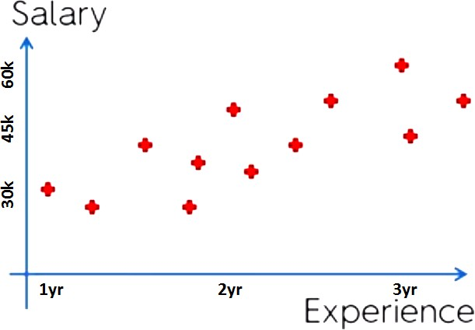
Introduction Intuition Cost Function and Gradient Descent LR with GD Python Polynomial Regression Tasks
Toy Example
Toy Example
Dataset:
Experience (Yrs) | Salary
1 | 30k
1.3 | 33k
1.8 | 36k
2 | 45k
3.3 | 65k
.. | ..
Problem Setting:
Set of real-valued instances X
Unknown target function f : X → Y
Input:
“n” training examples {< xi, yi >}. For example x is experience and y is salary of a person.
Output:
Function f : X → Y .
Regression
10 / 65

Slide 16
Introduction Intuition Cost Function and Gradient Descent LR with GD Python Polynomial Regression Tasks
Toy Example
Toy Example
Dataset:
Experience (Yrs) | Salary
1 | 30k
1.3 | 33k
1.8 | 36k
2 | 45k
3.3 | 65k
.. | ..
Problem Setting:
Set of real-valued instances X
Unknown target function f : X → Y
Input:
“n” training examples {< xi, yi >}. For example x is experience and y is salary of a person.
Output:
Function f : X → Y .
What would be the salary for a person with experience of 2.5 years?
Regression
10 / 65

Slide 17
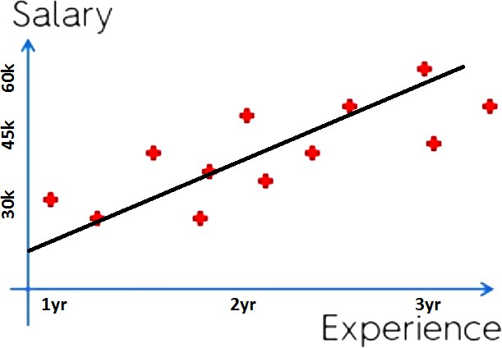
Introduction Intuition Cost Function and Gradient Descent LR with GD Python Polynomial Regression Tasks
Toy Example
How?
Model relationship between inputs and outputs using linear function i.e.
y = mx + c.
For more complex problem this can be extended to non-linear function as well.
This example is of linear regression with one variable or univariate linear regression.
How do we find best fit line? y = mx + c
¹ Calculus
² Random Search
³ Brute force
Regression
11 / 65

Slide 18
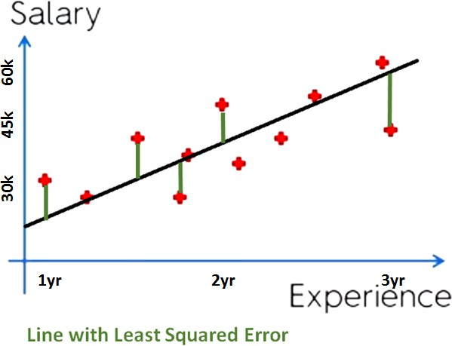
Introduction Intuition Cost Function and Gradient Descent LR with GD Python Polynomial Regression Tasks
Toy Example
How?
Model relationship between inputs and outputs using linear function i.e.
y = mx + c.
For more complex problem this can be extended to non-linear function as well.
This example is of linear regression with one variable or univariate linear regression.
How do we find best fit line? y = mx + c
¹ Calculus
² Random Search
³ Brute force
Best line will be the one that minimizes the error between line and the data points.
Regression
11 / 65

Slide 19
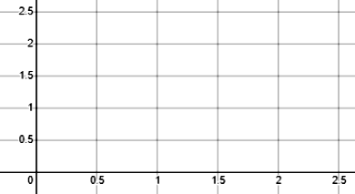
Introduction Intuition Cost Function and Gradient Descent LR with GD Python Polynomial Regression Tasks
Toy Example
Effect of Parameters
Hypothesis = mx + c
Choices of parameters:
Rizwan
c = 1.5
m = 0
c = 0
m = 0.5
c = 1
m = 0.5
Regression
12 / 65

Slide 20
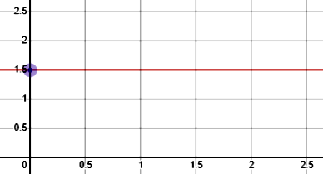
Introduction Intuition Cost Function and Gradient Descent LR with GD Python Polynomial Regression Tasks
Toy Example
Effect of Parameters
Hypothesis = mx + c
Choices of parameters:
c = 1.5
m = 0
c = 0
m = 0.5
c = 1
m = 0.5
Regression
12 / 65

Slide 21
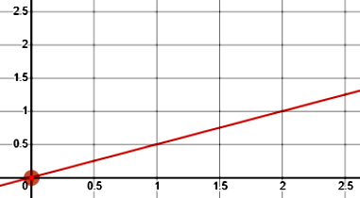
Introduction Intuition Cost Function and Gradient Descent LR with GD Python Polynomial Regression Tasks
Toy Example
Effect of Parameters
Hypothesis = mx + c
Choices of parameters:
Rizwan
c = 1.5
m = 0
c = 0
m = 0.5
c = 1
m = 0.5
Regression
12 / 65

Slide 22
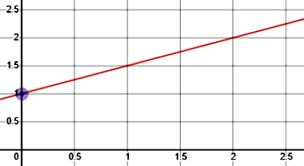
Introduction Intuition Cost Function and Gradient Descent LR with GD Python Polynomial Regression Tasks
Toy Example
Effect of Parameters
Hypothesis = mx + c
Choices of parameters:
Rizwan
c = 1.5
m = 0
c = 0
m = 0.5
c = 1
m = 0.5
Regression
12 / 65

Slide 23
Introduction Intuition Cost Function and Gradient Descent LR with GD Python Polynomial Regression Tasks
Toy Example
Effect of Parameters
Hypothesis = mx + c
Choices of parameters:
c = 1.5
m = 0
f (x) = 1.5
c = 0
m = 0.5
f (x) = 0.5 x
c = 1
m = 0.5
f (x) = 0.5 x + 1
Regression

Slide 24
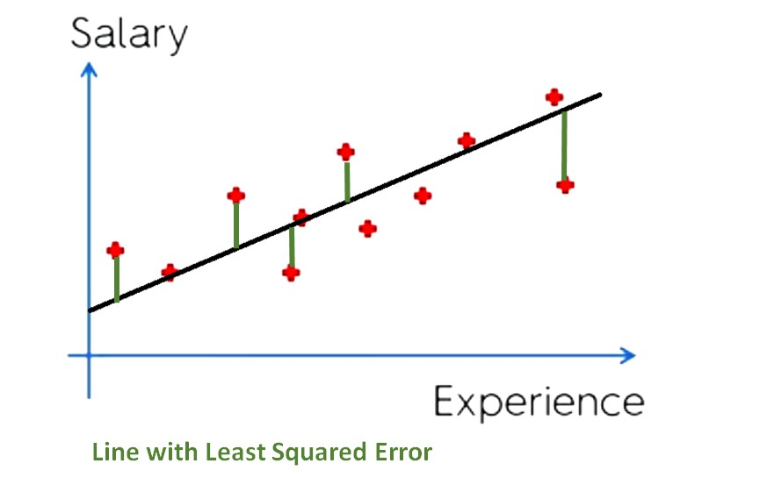
Introduction Intuition Cost Function and Gradient Descent LR with GD Python Polynomial Regression Tasks
Cost Function Intuition
Cost function
Define cost function to find best line for the dataset.
Dataset:
Experience (Yrs) | Salary
1 | 30k
1.3 | 33k
1.8 | 36k
2 | 45k
3.3 | 65k
.. | ..
Hypothesis = mx + c
How to choose m and c, which are parameters of the model.
Regression

Slide 25
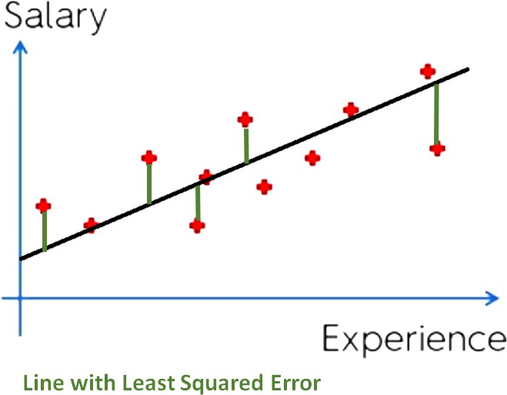
Introduction Intuition Cost Function and Gradient Descent LR with GD Python Polynomial Regression Tasks
Cost Function Intuition
Cost function
Choose m and c such that value of hypothesis (h = mx + c) becomes as close as possible to training data < x_{i}, y_{i} >.
Regression
20 / 65

Slide 26
Introduction Intuition Cost Function and Gradient Descent LR with GD Python Polynomial Regression Tasks
Cost Function Intuition
Cost function
let’s formalize this:
n
2
argmin (yˆ − y )
(8)
Σ
i i
m,c
i=1
Where yˆ_{i} = predicted value, y_{i} is actual value and n is total number of training samples.
1
n
2
J(m, c) = argmin (yˆ_{i} − y_{i})
(9)
2n
Σ
m,c
i=1
where yˆ_{i} = mx_{i} + c and J(m, c) is cost / loss function.
Choose m and c such that value of hypothesis (h = mx + c) becomes as close as possible to training data < x_{i}, y_{i} >.
Regression
20 / 65

Slide 27
Introduction Intuition Cost Function and Gradient Descent LR with GD Python Polynomial Regression Tasks
Cost Function Intuition
Cost function
let’s formalize this:
n
argmin (yˆ − y )
2
(8)
Σ
i i
m,c
i=1
Where yˆ_{i} = predicted value, y_{i} is actual value and n is total number of training samples.
1
n
2
J(m, c) = argmin (yˆ_{i} − y_{i})
(9)
Σ
2n
m,c
i=1
where yˆ_{i} = mx_{i} + c and J(m, c) is cost / loss function.
Aim to find values of m,c that minimizes cost function J(m, c) (squared error function).
Choose m and c such that value of hypothesis (h = mx + c) becomes as close as possible to training data < x_{i}, y_{i} >.
Regression
20 / 65

Slide 28
Introduction Intuition Cost Function and Gradient Descent LR with GD Python Polynomial Regression Tasks
Cost function in 2D
Visualize Cost function in 2D
Hypothesis:
h_{x} = mx + c
Parameters:
m and c
Cost function:
J(m, c) =
To visualize cost function J in 2D (one parameter and predicted value), set
c = 0 , so h_{x} = mx. Thus goal becomes
argmin J(m)
m
By setting c = 0 means we are only considering line from origin with some slope m
1 2n
n
Σ
(yˆ − y )
2
i i
i=1
Goal:
argmin J(m, c)
m,c
Regression

Slide 29
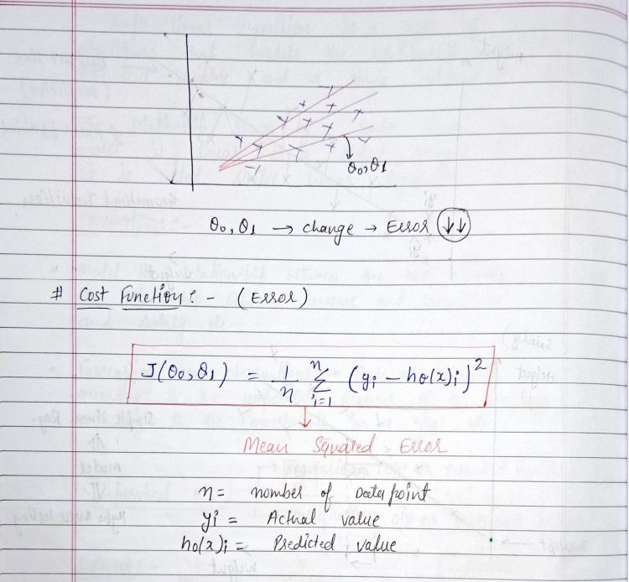
Introduction Intuition Cost Function and Gradient Descent LR with GD Python Polynomial Regression Tasks
Mathematical calculation
Regression

Slide 30
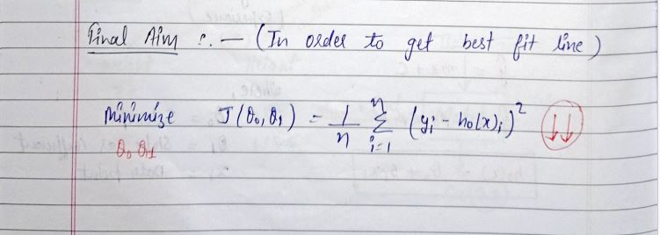
Introduction Intuition Cost Function and Gradient Descent LR with GD Python Polynomial Regression Tasks
Regression

Slide 31
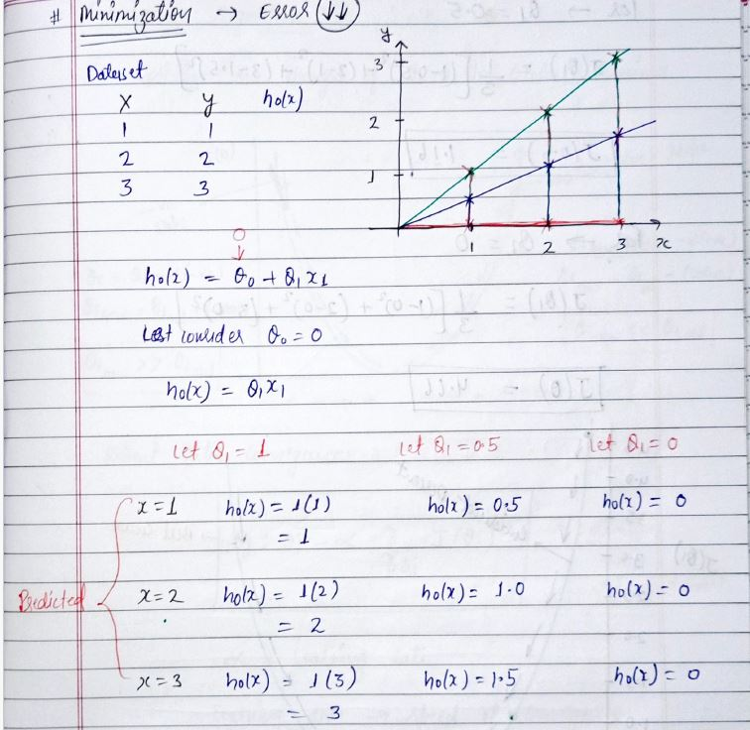
Introduction Intuition Cost Function and Gradient Descent LR with GD Python Polynomial Regression Tasks
Regression

Slide 32
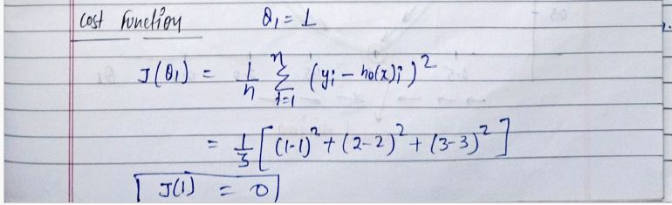
Introduction Intuition Cost Function and Gradient Descent LR with GD Python Polynomial Regression Tasks
Regression

Slide 33
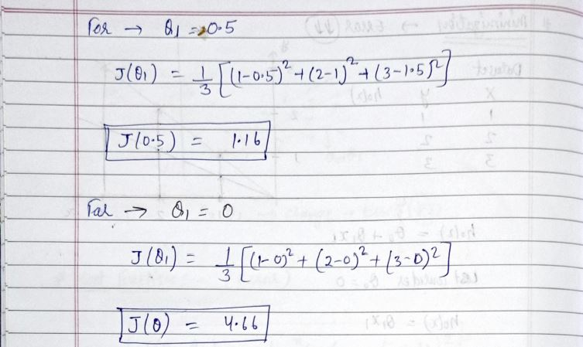
Introduction Intuition Cost Function and Gradient Descent LR with GD Python Polynomial Regression Tasks
Regression

Slide 34
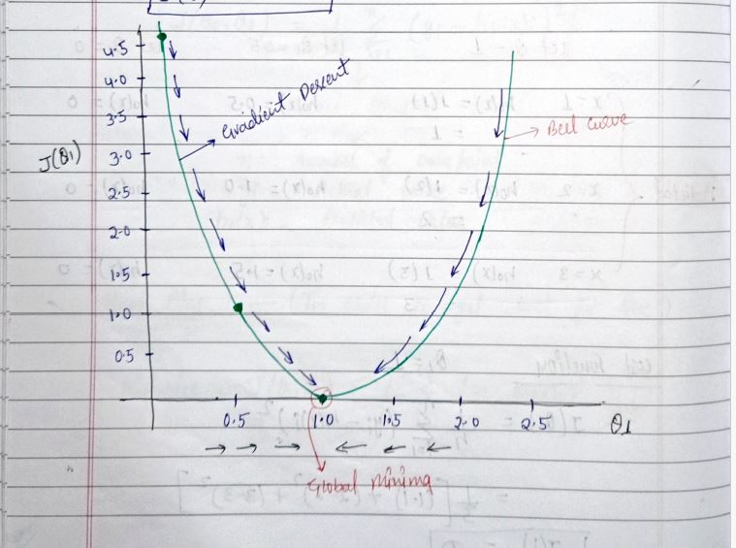
Introduction Intuition Cost Function and Gradient Descent LR with GD Python Polynomial Regression Tasks
Regression

Slide 35
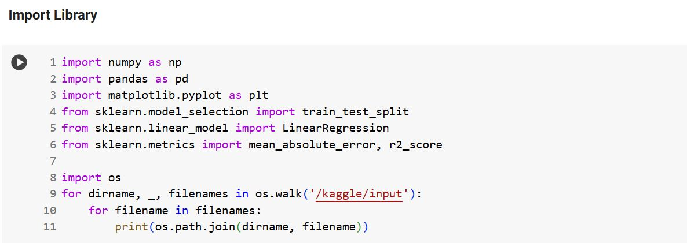
Introduction Intuition Cost Function and Gradient Descent LR with GD Python Polynomial Regression Tasks
Regression

Slide 36
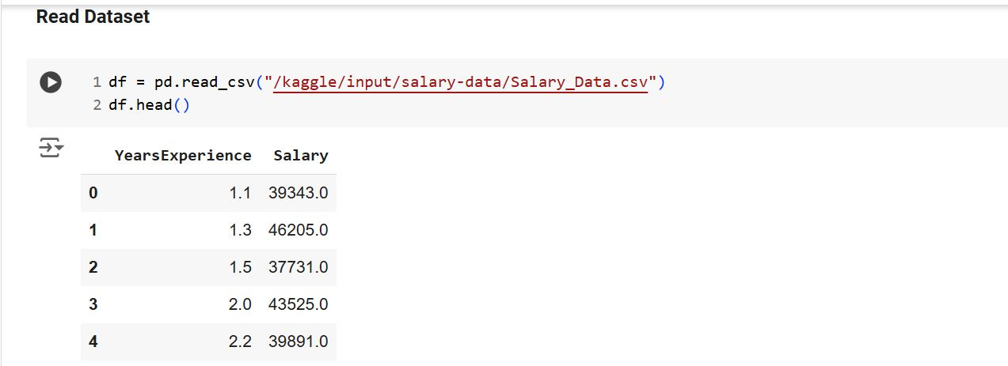
Introduction Intuition Cost Function and Gradient Descent LR with GD Python Polynomial Regression Tasks
Regression

Slide 37
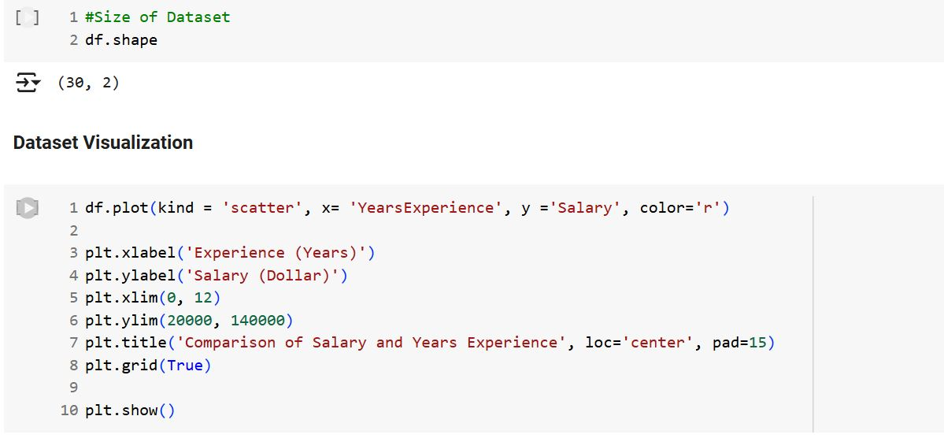
Introduction Intuition Cost Function and Gradient Descent LR with GD Python Polynomial Regression Tasks
Regression

Slide 38
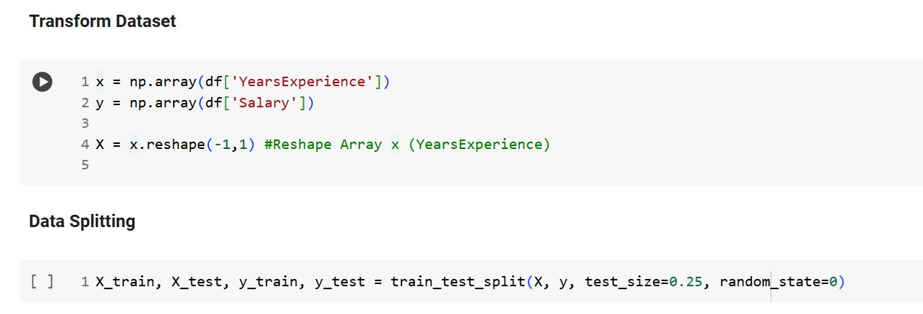
Introduction Intuition Cost Function and Gradient Descent LR with GD Python Polynomial Regression Tasks
Regression

Slide 39
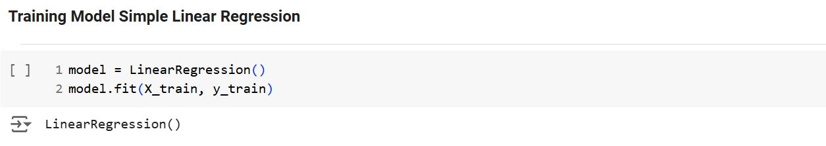
Introduction Intuition Cost Function and Gradient Descent LR with GD Python Polynomial Regression Tasks
Regression

Slide 40
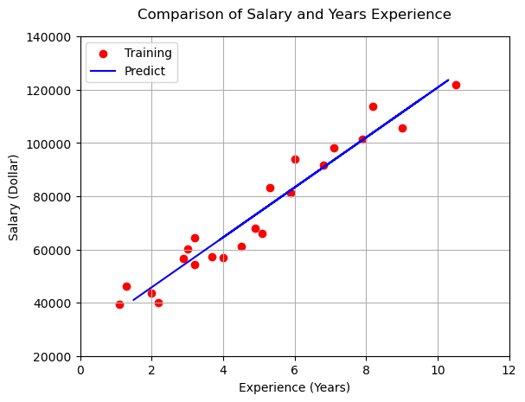
Introduction Intuition Cost Function and Gradient Descent LR with GD Python Polynomial Regression Tasks
Regression

Slide 41
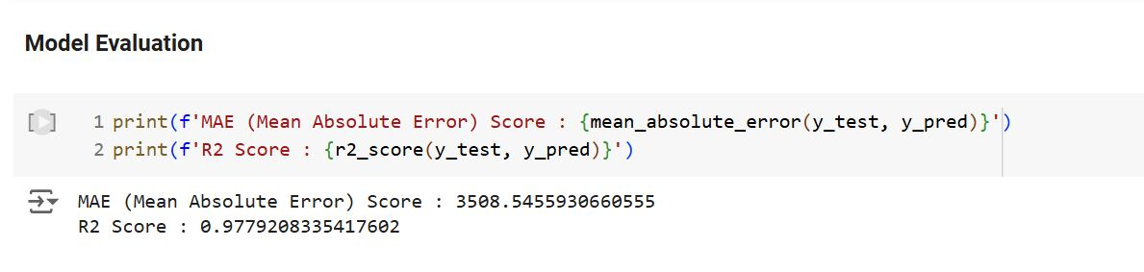
Introduction Intuition Cost Function and Gradient Descent LR with GD Python Polynomial Regression Tasks
Regression

Slide 42
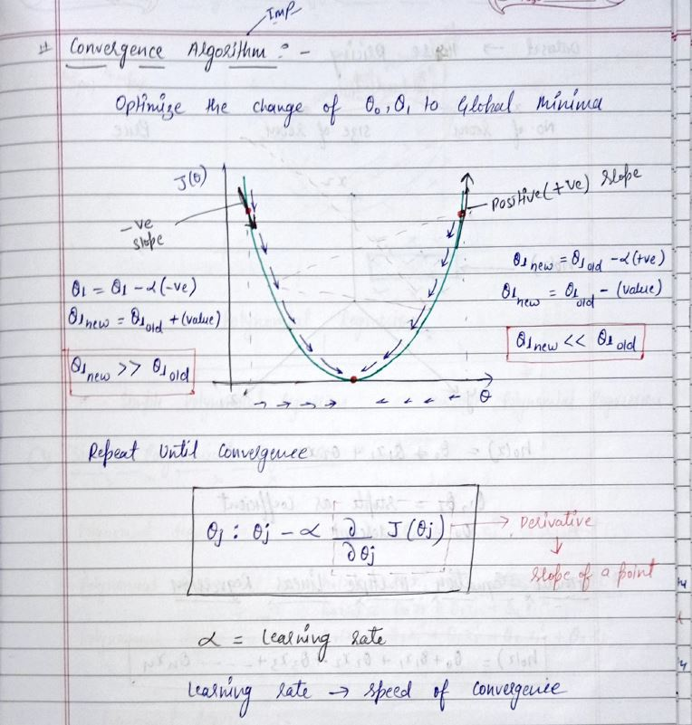
Introduction Intuition Cost Function and Gradient Descent LR with GD Python Polynomial Regression Tasks
Regression

Slide 43
Introduction Intuition Cost Function and Gradient Descent LR with GD Python Polynomial Regression Tasks
Linear Regression with GD
Regression with Gradient Descent
Putting together GD and cost function to perform regression.
Linear Regression Model:
hypothesis: h = mx + c
Cost function:
1
n
J(m, c) = argmin (
yˆ − y )
2
2n
Σ
i i
m,c
i=1
where yˆ_{i} = mx_{i} + c and J(m, c) is cost / loss function.
Regression
36 / 65

Slide 44
Introduction Intuition Cost Function and Gradient Descent LR with GD Python Polynomial Regression Tasks
Linear Regression with GD
Regression with Gradient Descent
Putting together GD and cost function to perform regression.
Linear Regression Model:
hypothesis: h = mx + c
Cost function:
1
n
J(m, c) = argmin (
yˆ − y )
2
2n
Σ
i i
m,c
i=1
where yˆ_{i} = mx_{i} + c and J(m, c) is cost / loss function.
Gradient Descent Algorithm:
repeat until convergence {
∂
_{ϴi} := _{ϴ i} − α J(_{ϴ 1}, _{ϴ 2}) }
∂ _{ϴ i}
(for i=1 and i=2)
Regression
36 / 65

Slide 45
Introduction Intuition Cost Function and Gradient Descent LR with GD Python Polynomial Regression Tasks
Linear Regression with GD
Regression with Gradient Descent
Putting together GD and cost function to perform regression.
Linear Regression Model:
hypothesis: h = mx + c
Cost function:
1
n
J(m, c) = argmin (
yˆ − y )
2
2n
Σ
i i
m,c
i=1
where yˆ_{i} = mx_{i} + c and J(m, c) is cost / loss function.
Gradient Descent Algorithm:
repeat until convergence {
∂
_{ϴ i} := _{ϴ i} − α J(_{ϴ 1}, _{ϴ 2}) }
∂ _{ϴ i}
(for i=1 and i=2)
Linear Regression with GD
Apply gradient descent algorithm to minimize cost function J. argmin_{m,c} J(m, c)
Regression
36 / 65

Slide 46
Introduction Intuition Cost Function and Gradient Descent LR with GD Python Polynomial Regression Tasks
Linear Regression with GD
Regression with Gradient Descent
Solving for: ∂ J(_{ϴ 1}, _{ϴ 2}) and (i=1 and i=2):
∂wi
∂ ∂ 1
∂_{ϴ}
n
J(w , w ) =
Σ
(yˆ − y )
2
i j
∂_{i} 2n
i i
i=1
(13)
∂ 1
n
=
((m.x_{i} + c) − y )²
Σ
i
∂ _{ϴ i} 2n
i=1
There are two cases (in our scenario i = 1 : _{ϴ 1} or c and i = 2 : _{ϴ 2} or m):
Regression
37 / 65

Slide 47
Introduction Intuition Cost Function and Gradient Descent LR with GD Python Polynomial Regression Tasks
Linear Regression with GD
Regression with Gradient Descent
Solving for: ∂ J(_{ϴ 1}, _{ϴ 2}) and (i=1 and i=2):
∂wi
∂ ∂ 1
∂ _{ϴ i}
n
J(w , w ) =
(yˆ − y )
2
i j
∂w_{i} 2n
Σ
i i
i=1
(13)
∂ 1
n
=
((m.x_{i} + c) − y )²
Σ
i
∂w_{i} 2n
i=1
There are two cases (in our scenario i = 1 : _{ϴ 1} or c and i = 2 : _{ϴ 2} or m):
∂
1
_{ϴ} = c, J(
m, c):
1
∂c
∂
∂c
1
n
J(m, c) =
Σ
(yˆ − y )
(14)
n
i=1
i i
Regression
37 / 65

Slide 48
Introduction Intuition Cost Function and Gradient Descent LR with GD Python Polynomial Regression Tasks
Linear Regression with GD
Regression with Gradient Descent
Solving for: ∂ J(_{ϴ 1}, _{ϴ 2}) and (i=1 and i=2):
∂wi
n
∂ ∂ 1
∂ _{ϴ i}
Σ
J(w , w ) =
(yˆ − y )
2
i j
∂w_{i} 2n
i i
i=1
(13)
n
∂ 1
Σ
=
((m.x_{i} + c) − y )²
∂ _{ϴ i} 2n
i=1
i
There are two cases (in our scenario i = 1 : _{ϴ 1} or c and i = 2 : _{ϴ 2} or m):
∂
1
_{ϴ} = c, J(
m, c):
1
∂c
n
∂
∂c
1
Σ
J(m, c) =
(yˆ − y )
(14)
n
i=1
i i
2
_{ϴ 2} = m, ∂ J(m, c):
∂m
Σ
∂
1
n
J(m, c) =
(yˆ_{i} − y_{i}) · x_{i}
(15)
∂m n
Regression
37 / 65

Slide 49
Introduction Intuition Cost Function and Gradient Descent LR with GD Python Polynomial Regression Tasks
Linear Regression with GD
Regression with Gradient Descent
Convergence
Plug back equations 14 and 15 into gradient descent algorithm
repeat until convergence {
∂
_{ϴi} := _{ϴ i} − α J(_{ϴ i}, _{ϴ j} ) }
∂w_{i}
repeat until convergence {
1
n
c := c − α (yˆ_{i} − y_{i})
n
Σ
i=1
1
n
(16)
m := m − α (
yˆ − y ) · x
n
Σ
i i i
i=1
}
Regression

Slide 50
Introduction Intuition Cost Function and Gradient Descent LR with GD Python Polynomial Regression Tasks
Linear Regression with Multiple Variables
Regression (multivariate / multi-variables) with Gradient Descent
Hypothesis for multi-variables:
h = θ₀ + θ₁x¹ + θ₂x² + θ₃x³ + · · · + θ_{d}x^{d}
(17)
Parameters of the model: θ₀, θ₁, · · · , θ_{d}
Cost function:
1
n
J(θ , θ , · · · , θ ) = argmin (
yˆ − y )
2
0 1 d
Σ
i i
2n θ₀ ,θ₁,··· ,θ_{d}
i=1
Gradient Descent:
Regression
40 / 65

Slide 51
Introduction Intuition Cost Function and Gradient Descent LR with GD Python Polynomial Regression Tasks
Linear Regression with Multiple Variables
Regression (multivariate / multi-variables) with Gradient Descent
Hypothesis for multi-variables:
h = θ₀ + θ₁x¹ + θ₂x² + θ₃x³ + · · · + θ_{d}x^{d}
(17)
Parameters of the model: θ₀, θ₁, · · · , θ_{d}
Cost function:
1
n
J(θ , θ , · · · , θ ) = argmin (
yˆ − y )
2
0 1 d
Σ
i i
2n θ₀ ,θ₁,··· ,θ_{d}
i=1
Gradient Descent:
repeat until convergence {
∂
θ_{j} := θ_{j} − α J(θ₀, θ₁, · · · , θ_{d})
∂θ_{j}
} (simultaneously update for every j = 0, 1, · · · , d)
Regression
40 / 65

Slide 52
Introduction Intuition Cost Function and Gradient Descent LR with GD Python Polynomial Regression Tasks
Linear Regression with Multiple Variables
Regression (multivariate / multi-variables) with Gradient Descent
Previously when d = 1
repeat until convergence {
1
n
θ := θ − α (
yˆ − y )
0 0
Σ
i i
n
i=1
1
n
θ := θ − α (
yˆ − y ) · x
1
1 1
n
Σ
i i i
i=1
}
Regression

Slide 53
Introduction Intuition Cost Function and Gradient Descent LR with GD Python Polynomial Regression Tasks
Linear Regression with Multiple Variables
Regression (multivariate / multi-variables) with Gradient Descent
Generally (GD algorithm) for any given d dimensional vector (d ≥ 1)
Regression
42 / 65

Slide 54
Introduction Intuition Cost Function and Gradient Descent LR with GD Python Polynomial Regression Tasks
Linear Regression with Multiple Variables
Regression (multivariate / multi-variables) with Gradient Descent
Generally (GD algorithm) for any given d dimensional vector (d ≥ 1)
1
n
repeat until convergence { θ₀ := θ₀ − α (yˆ_{i} − y_{i})
n
i=1
Σ
1
n
θ := θ − α (
yˆ − y ) · x
1
1 1
Σ
i i i
n
i=1
(18)
1
n
θ₂ := θ₂ − α (
yˆ − y ) · x
2
n
Σ
i i i
i=1
. . . }
Regression
42 / 65

Slide 55
Introduction Intuition Cost Function and Gradient Descent LR with GD Python Polynomial Regression Tasks
Variants of Gradient Descent
Variants of GD
GD algorithm that we have just seen is called Batch Gradient Descent. Most common used GD algorithms are breifly explained below:
1
Batch Gradient Descent is when we sum up over all examples on each iteration when performing the updates to the parameters.
Advantages
1 Fixed learning rate during training.
2 It has straight trajectory towards the minimum and it is guaranteed to converge to global optimum (for convex functions).
3 It has unbiased estimate of gradients.
4 It can benefit from the vectorization
Disadvantages
1 Slow (especially for large datasets), as it goes over all examples.
2 Each step of learning happens after going over all examples (think of outliers in dataset).
Regression
45 / 65

Slide 56
Introduction Intuition Cost Function and Gradient Descent LR with GD Python Polynomial Regression Tasks
Variants of Gradient Descent
Variants of GD
Stochastic Gradient Descent (SGD): Instead of going through all examples, Stochastic Gradient Descent (SGD) performs parameters update on each example < x_{i}, y_{i} >.
Therefore, learning happens on every example.
Advantages
2
1 It is easier to fit into memory (single training sample being processed at a time).
2 It is computationally fast (For larger datasets it can converge faster).
3 Due to frequent updates, the steps taken towards the minima of the loss / cost function have oscillations which can help getting out of local minimums of the loss function.
Disadvantages
1 Due to frequent updates, the steps taken towards the minima are very noisy. This can often lead the gradient descent into sub-optimum directions.
2 It loses the advantage of vectorized operations as it deals with only a single example at a time.
Regression

Slide 57
Introduction Intuition Cost Function and Gradient Descent LR with GD Python Polynomial Regression Tasks
Variants of Gradient Descent
Variants of Gradient Descent
Mini-Batch Gradient Descent: This is a mixture of both stochastic and batch gradient descent. The training set is divided into multiple groups called batches. Each batch has a number of training samples in it. For example, assume training set has 100 training examples which is divided into 5 batches with each batch containing 20 training examples.
Advantages
3
1 Easily fits in the memory.
2 It is computationally efficient.
3 Benefit from vectorization.
Disadvantages
1 Due to the noise, the learning steps have more oscillations and requires adding learning-decay to decrease the learning rate as we become closer to the minimum.
Regression

Slide 58
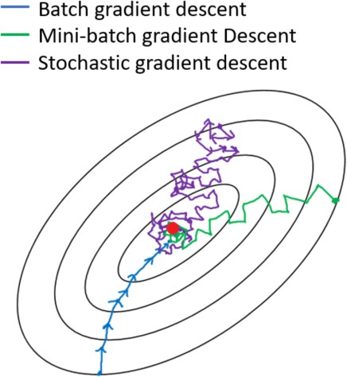
Introduction Intuition Cost Function and Gradient Descent LR with GD Python Polynomial Regression Tasks
Variants of Gradient Descent
Variants of Gradient Descent: Visualization
1
Batch Gradient Descent, slow but unbiased estimate of gradients.
Stochastic Gradient Descent (SGD), fast but frequent updates causes noisy steps.
Mini-Batch Gradient Descent, computationally efficient but due to the noise the learning steps have more oscillations.
2
3
Regression

Slide 59
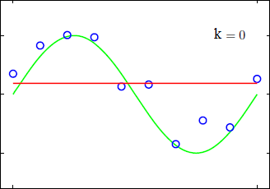
Introduction Intuition Cost Function and Gradient Descent LR with GD Python Polynomial Regression Tasks
Polynomial Regression
Polynomial Regression
Polynomial regression fits a nonlinear relationship between independent variable x and the dependent variable y.
k = 0 Constant (Constant line (average of output values), not a good fit. Under-fitting)
1
Regression
56 / 65

Slide 60
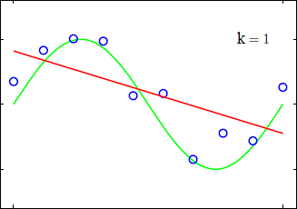
Introduction Intuition Cost Function and Gradient Descent LR with GD Python Polynomial Regression Tasks
Polynomial Regression
Polynomial Regression
Polynomial regression fits a nonlinear relationship between independent variable x and the dependent variable y.
k = 0 Constant (Constant line (average of output values), not a good fit. Under-fitting)
k = 1 Straight Line (Linear regression, not a good fit. Under-fitting)
1
2
Regression
56 / 65

Slide 61
Introduction Intuition Cost Function and Gradient Descent LR with GD Python Polynomial Regression Tasks
Polynomial Regression
Polynomial Regression
Polynomial regression fits a nonlinear relationship between independent variable x and the dependent variable y.
k = 0 Constant (Constant line (average of output values), not a good fit. Under-fitting)
k = 1 Straight Line (Linear regression, not a good fit. Under-fitting)
1
2
Under-fitting
Linear regression is under-fitting the data (high-bias).
Regression
56 / 65

Slide 62
Introduction Intuition Cost Function and Gradient Descent LR with GD Python Polynomial Regression Tasks
Polynomial Regression
Polynomial Regression
- To overcome under-fitting, we need to increase the complexity of the model.
Regression
57 / 65

Slide 63
Introduction Intuition Cost Function and Gradient Descent LR with GD Python Polynomial Regression Tasks
Polynomial Regression
Polynomial Regression
To overcome under-fitting, we need to increase the complexity of the model.
To generate a higher order equation, can add powers of the original features as new features. The linear model h = θ₀ + θ₁x
can be transformed to h = θ₀ + θ₁x + θ₂x²(x − squared)
Regression
57 / 65

Slide 64
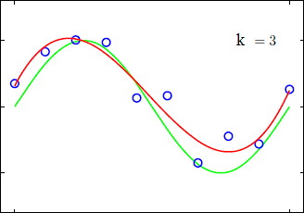
Introduction Intuition Cost Function and Gradient Descent LR with GD Python Polynomial Regression Tasks
Polynomial Regression
Polynomial Regression
To overcome under-fitting, we need to increase the complexity of the model.
To generate a higher order equation, can add powers of the original features as new features. The linear model h = θ₀ + θ₁x
can be transformed to h = θ₀ + θ₁x + θ₂x²(x − squared)
k = 2 Parabola
k = 3 Cubic (Polynomial function, fits nicely)
1
2
Regression
57 / 65

Slide 65
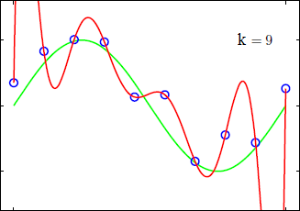
Introduction Intuition Cost Function and Gradient Descent LR with GD Python Polynomial Regression Tasks
Polynomial Regression
Polynomial Regression
To overcome under-fitting, we need to increase the complexity of the model.
To generate a higher order equation, can add powers of the original features as new features. The linear model h = θ₀ + θ₁x
can be transformed to h = θ₀ + θ₁x + θ₂x²(x − squared)
k = 2 Parabola
k = 3 Cubic (Polynomial function, fits nicely)
k = 9 9th degree polynomial. Over-fitting
1
2
3
Regression
57 / 65

Slide 66
Introduction Intuition Cost Function and Gradient Descent LR with GD Python Polynomial Regression Tasks
Polynomial Regression
Polynomial Regression
To overcome under-fitting, we need to increase the complexity of the model.
To generate a higher order equation, can add powers of the original features as new features. The linear model h = θ₀ + θ₁x
can be transformed to h = θ₀ + θ₁x + θ₂x²(x − squared)
k = 2 Parabola
k = 3 Cubic (Polynomial function, fits nicely)
k = 9 9th degree polynomial. Over-fitting
1
2
3
General form for Polynomial Regression:
h(θ) = θ₀ + θ₁x + θ₂x² + · · · + θ_{k}x^{k}
(19)
Regression
57 / 65

Slide 67
Introduction Intuition Cost Function and Gradient Descent LR with GD Python Polynomial Regression Tasks
Normal Equation method
Solving for Polynomial Regression
Find coefficients w, for cubic regression, number of samples = n
Equation: _{ϴ 0} + _{ϴ 1}x + _{ϴ 2}x² + _{ϴ 3}x³ ≈ y
Regression
58 / 65

Slide 68
Introduction Intuition Cost Function and Gradient Descent LR with GD Python Polynomial Regression Tasks
Normal Equation method
Solving for Polynomial Regression
Find coefficients w, for cubic regression, number of samples = n
Equation: _{ϴ 0} + _{ϴ 1}x + _{ϴ 2}x² + _{ϴ 3}x³ ≈ y
Write this in matrix format:
Regression
58 / 65

Slide 69
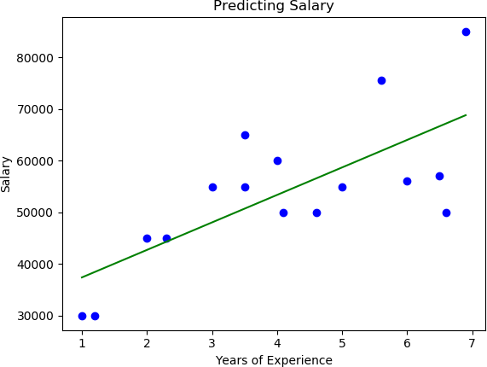
Introduction Intuition Cost Function and Gradient Descent LR with GD Python Polynomial Regression Tasks
Polynomial Regression Example
Polynomial Regression Example
¹ Polynomial Degree 1
Regression
60 / 65

Slide 70
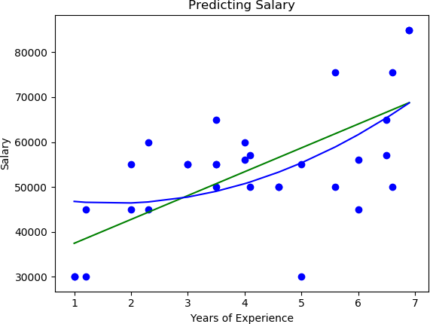
Introduction Intuition Cost Function and Gradient Descent LR with GD Python Polynomial Regression Tasks
Polynomial Regression Example
Polynomial Regression Example
¹ Polynomial Degree 1
² Polynomial Degree 2
Regression
60 / 65

Slide 71
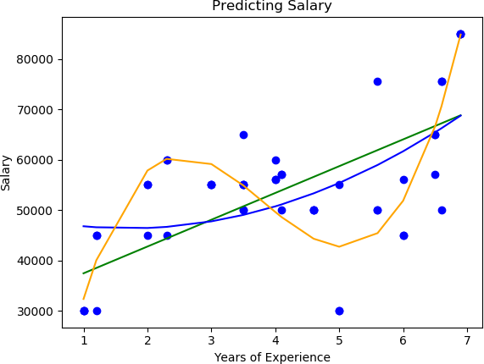
Introduction Intuition Cost Function and Gradient Descent LR with GD Python Polynomial Regression Tasks
Polynomial Regression Example
Polynomial Regression Example
¹ Polynomial Degree 1
² Polynomial Degree 2
³ Polynomial Degree 3
Regression
60 / 65

Slide 72
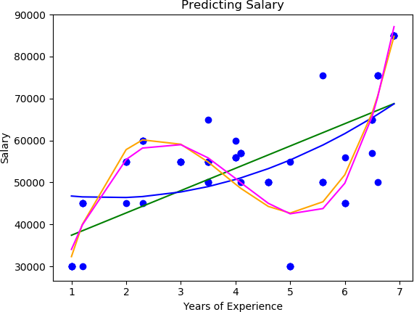
Introduction Intuition Cost Function and Gradient Descent LR with GD Python Polynomial Regression Tasks
Polynomial Regression Example
Polynomial Regression Example
¹ Polynomial Degree 1
² Polynomial Degree 2
³ Polynomial Degree 3
⁴ Polynomial Degree 4
Regression
60 / 65

Slide 73
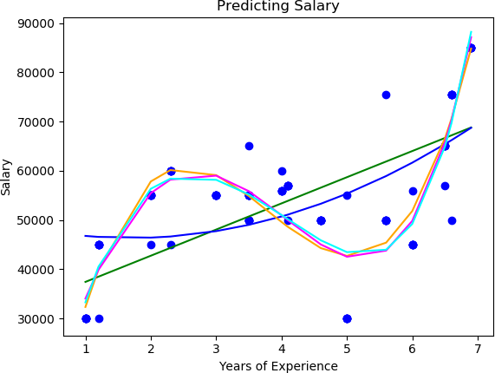
Introduction Intuition Cost Function and Gradient Descent LR with GD Python Polynomial Regression Tasks
Polynomial Regression Example
Polynomial Regression Example
¹ Polynomial Degree 1
² Polynomial Degree 2
³ Polynomial Degree 3
⁴ Polynomial Degree 4
⁵ Polynomial Degree 5
Regression
60 / 65

Slide 74
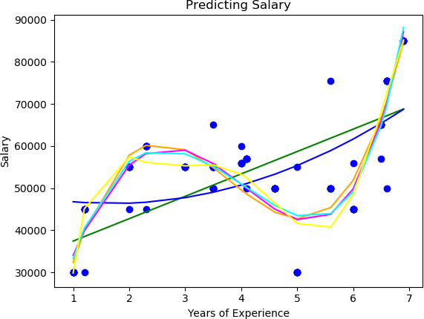
Introduction Intuition Cost Function and Gradient Descent LR with GD Python Polynomial Regression Tasks
Polynomial Regression Example
Polynomial Regression Example
¹ Polynomial Degree 1
² Polynomial Degree 2
³ Polynomial Degree 3
⁴ Polynomial Degree 4
⁵ Polynomial Degree 5
⁶ Polynomial Degree 6
Regression
60 / 65

Slide 75
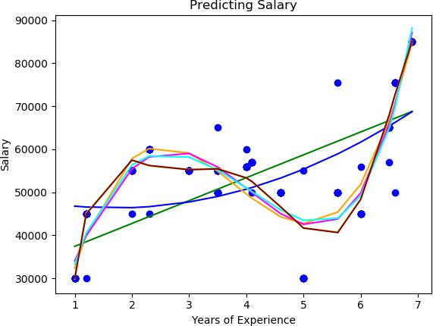
Introduction Intuition Cost Function and Gradient Descent LR with GD Python Polynomial Regression Tasks
Polynomial Regression Example
Polynomial Regression Example
¹ Polynomial Degree 1
² Polynomial Degree 2
³ Polynomial Degree 3
⁴ Polynomial Degree 4
⁵ Polynomial Degree 5
⁶ Polynomial Degree 6
⁷ Polynomial Degree 7
Regression
60 / 65

Slide 76
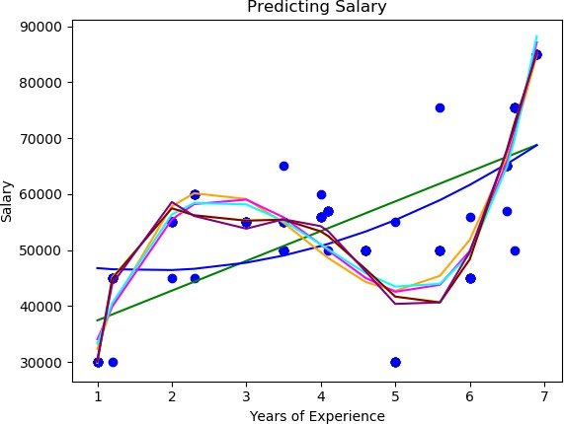
Introduction Intuition Cost Function and Gradient Descent LR with GD Python Polynomial Regression Tasks
Polynomial Regression Example
Polynomial Regression Example
¹ Polynomial Degree 1
² Polynomial Degree 2
³ Polynomial Degree 3
⁴ Polynomial Degree 4
⁵ Polynomial Degree 5
⁶ Polynomial Degree 6
⁷ Polynomial Degree 7
⁸ Polynomial Degree 8
Regression
60 / 65

Slide 77
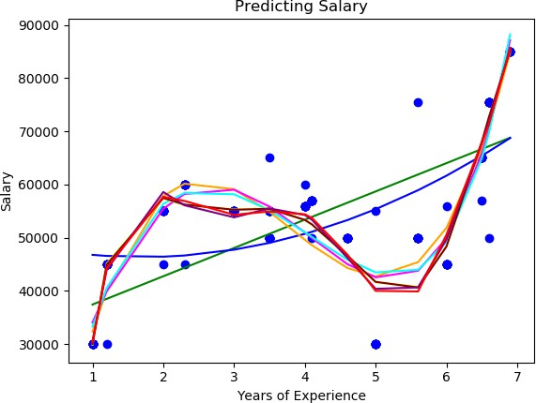
Introduction Intuition Cost Function and Gradient Descent LR with GD Python Polynomial Regression Tasks
Polynomial Regression Example
Polynomial Regression Example
¹ Polynomial Degree 1
² Polynomial Degree 2
³ Polynomial Degree 3
⁴ Polynomial Degree 4
⁵ Polynomial Degree 5
⁶ Polynomial Degree 6
⁷ Polynomial Degree 7
⁸ Polynomial Degree 8
⁹ Polynomial Degree 9
Regression
60 / 65

Slide 78
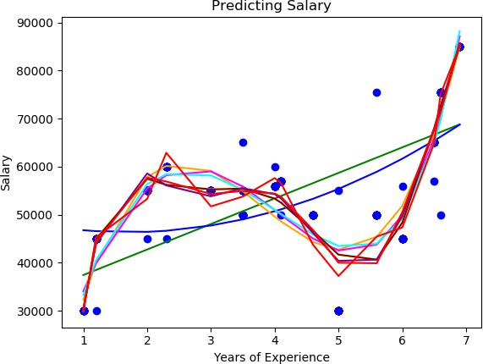
Introduction Intuition Cost Function and Gradient Descent LR with GD Python Polynomial Regression Tasks
Polynomial Regression Example
Polynomial Regression Example
¹ Polynomial Degree 1
² Polynomial Degree 2
³ Polynomial Degree 3
⁴ Polynomial Degree 4
⁵ Polynomial Degree 5
⁶ Polynomial Degree 6
⁷ Polynomial Degree 7
⁸ Polynomial Degree 8
⁹ Polynomial Degree 9
¹⁰ Polynomial Degree 10
Regression
60 / 65

Slide 79
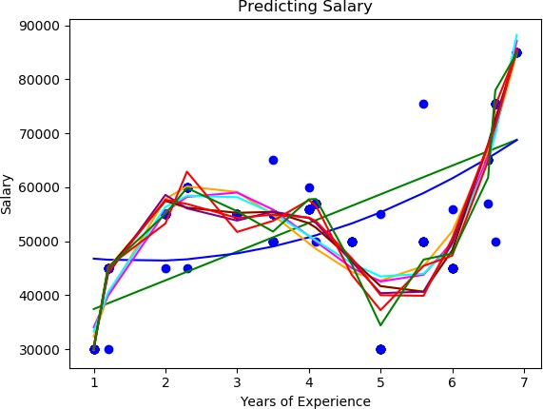
Introduction Intuition Cost Function and Gradient Descent LR with GD Python Polynomial Regression Tasks
Polynomial Regression Example
Polynomial Regression Example
¹ Polynomial Degree 1
² Polynomial Degree 2
³ Polynomial Degree 3
⁴ Polynomial Degree 4
⁵ Polynomial Degree 5
⁶ Polynomial Degree 6
⁷ Polynomial Degree 7
⁸ Polynomial Degree 8
⁹ Polynomial Degree 9
¹⁰ Polynomial Degree 10
¹¹ Polynomial Degree 11
Regression
60 / 65

Slide 80
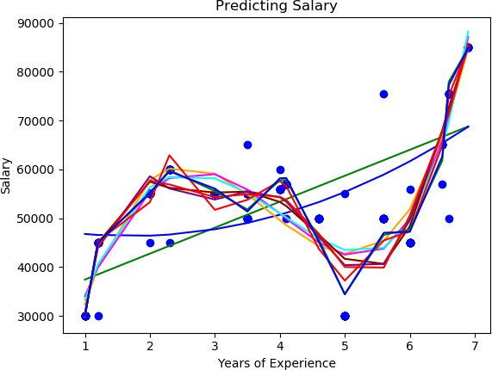
Introduction Intuition Cost Function and Gradient Descent LR with GD Python Polynomial Regression Tasks
Polynomial Regression Example
Polynomial Regression Example
¹ Polynomial Degree 1
² Polynomial Degree 2
³ Polynomial Degree 3
⁴ Polynomial Degree 4
⁵ Polynomial Degree 5
⁶ Polynomial Degree 6
⁷ Polynomial Degree 7
⁸ Polynomial Degree 8
⁹ Polynomial Degree 9
¹⁰ Polynomial Degree 10
¹¹ Polynomial Degree 11
¹² Polynomial Degree 12
Regression
60 / 65

Slide 81
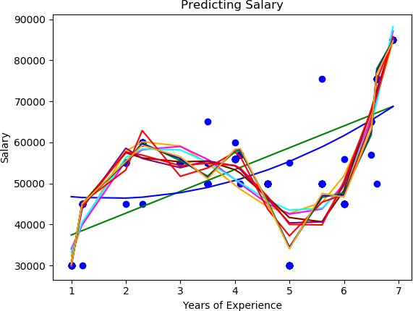
Introduction Intuition Cost Function and Gradient Descent LR with GD Python Polynomial Regression Tasks
Polynomial Regression Example
Polynomial Regression Example
¹ Polynomial Degree 1
² Polynomial Degree 2
³ Polynomial Degree 3
⁴ Polynomial Degree 4
⁵ Polynomial Degree 5
⁶ Polynomial Degree 6
⁷ Polynomial Degree 7
⁸ Polynomial Degree 8
⁹ Polynomial Degree 9
¹⁰ Polynomial Degree 10
¹¹ Polynomial Degree 11
¹² Polynomial Degree 12
¹³ Polynomial Degree 13
Regression
60 / 65

Slide 82
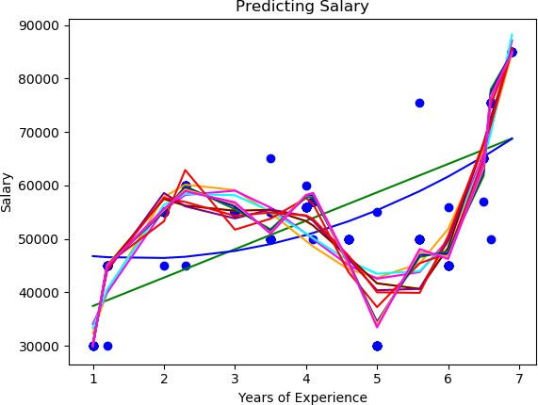
Introduction Intuition Cost Function and Gradient Descent LR with GD Python Polynomial Regression Tasks
Polynomial Regression Example
Polynomial Regression Example
¹ Polynomial Degree 1
² Polynomial Degree 2
³ Polynomial Degree 3
⁴ Polynomial Degree 4
⁵ Polynomial Degree 5
⁶ Polynomial Degree 6
⁷ Polynomial Degree 7
⁸ Polynomial Degree 8
⁹ Polynomial Degree 9
¹⁰ Polynomial Degree 10
¹¹ Polynomial Degree 11
¹² Polynomial Degree 12
¹³ Polynomial Degree 13
¹⁴ Polynomial Degree 14
Regression
60 / 65

Slide 83
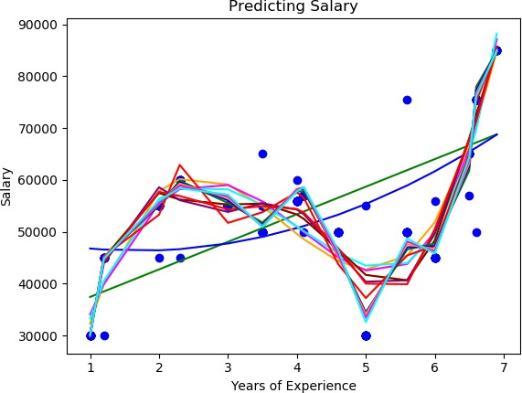
Introduction Intuition Cost Function and Gradient Descent LR with GD Python Polynomial Regression Tasks
Polynomial Regression Example
Polynomial Regression Example
¹ Polynomial Degree 1
² Polynomial Degree 2
³ Polynomial Degree 3
⁴ Polynomial Degree 4
⁵ Polynomial Degree 5
⁶ Polynomial Degree 6
⁷ Polynomial Degree 7
⁸ Polynomial Degree 8
⁹ Polynomial Degree 9
¹⁰ Polynomial Degree 10
¹¹ Polynomial Degree 11
¹² Polynomial Degree 12
¹³ Polynomial Degree 13
¹⁴ Polynomial Degree 14
¹⁵ Polynomial Degree 15
Regression

Slide 84
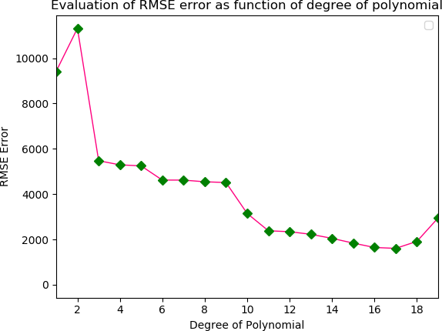
Introduction Intuition Cost Function and Gradient Descent LR with GD Python Polynomial Regression Tasks
Polynomial Regression Example
Polynomial Regression Example: RMSE
Regression

Slide 85
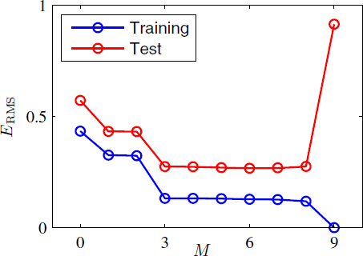
Introduction Intuition Cost Function and Gradient Descent LR with GD Python Polynomial Regression Tasks
Polynomial Regression Example
Best Fit
Regression

