Slide 1
Helaal and Saleeb
Anwar Labib 37-4549
Daniel Erian 37-3089
Abdelrahman Tarek 37-8080
Zeyad Zaky 37-0521

Slide 2
Members Contribution
Anwar Labib: Data preparation and preprocessing
Zeyad Zaky & Daniel Ashraf: Data analysis and visualization
Abdelrahman Tarek: Machine Learning Algorithm

Slide 3
Research question
How many goals will FC Barcelona score in a certain match?
Attributes we are interested in: date, opponent team and home/away match
We chose FC Barcelona because it is a team known for its attacking capabilities and its loved by billions around the world

Slide 4
Data preparation & preprocessing
date | home_team_api_id | away_team_api_id | home_team_goal | away_team_goal
2008-08-17 00:00:00 | 9987 | 9993 | 0 | 1
2015-09-23 00:00:00 | 10192 | 9931 | 4 | 3
date | opponent_team_id(one hot encoded) | barca_goals | home_away
0 | One hot encoded | 6 | 1
1 | One hot encoded | 3 | 1

Slide 5
Data Analysis and visualizations
Total Goals | 849
Total Matches Played | 304
Mean | 2.8
Standard Deviation | 1.7

Slide 6
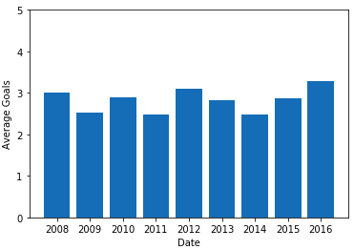
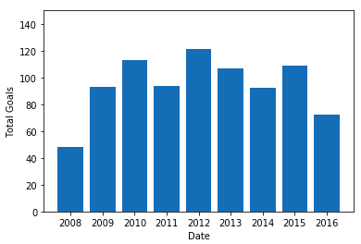
Data Analysis and visualizations
Date Attribute

Slide 7
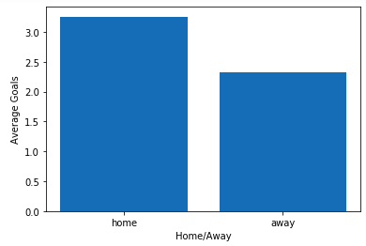
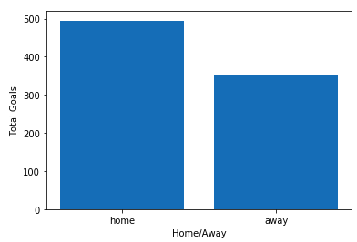
Data Analysis and visualizations
Home/Away Attribute

Slide 8
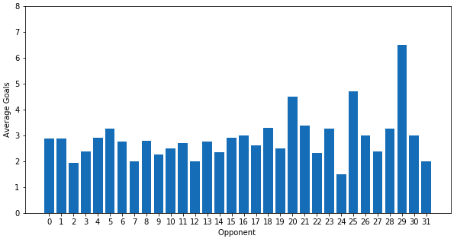
Data Analysis and visualizations
Opponent Attribute

Slide 9
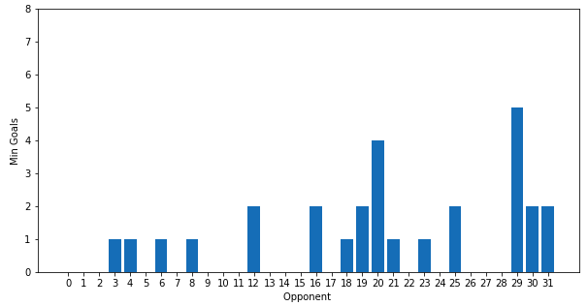
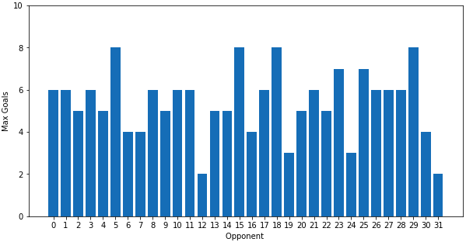
Data Analysis and visualizations
Opponent Attribute

Slide 10
Machine Learning Algorithm
Sklearn library was used to train and test the model. We used a Linear regression model.
Accuracy of 23% to predict the number of goals exactly
Accuracy of 49% to predict the number of goals with error margin of 1
Note that it is very hard to predict the number of goals a team will score especially for FC Barcelona.

Slide 11
Conclusion
FC Barcelona is a unique team that scores many goals.
All the attributes mentioned (date, opponent team & home/away) affect the number of goals scored
Using the mentioned attribute, we can train a machine learning model to predict the number of goals that will be scored.

