Slide 1
"StrategicTicTacToe: AI-Infused Tactical Gameplay"
Harshitha Sampath
Anwar Rashid Shaik
Sivaji Reddy Raju

Slide 2
Introduction
we'll kick things off by highlighting the crucial role of libraries in our implementation.
These libraries form the foundation for introducing randomness, managing Jupyter Notebook displays, and enabling powerful visualization and numerical operations in our Tic-Tac-Toe reinforcement learning project.

Slide 3
List of the libraries used
random: Guides agent exploration, injecting variability into decision-making.
clear_output: Vital for maintaining a clean and updated Tic-Tac-Toe board display.
matplotlib and numpy: Empower us to visualize and understand the agent's learning progress through insightful plots and numerical operations.

Slide 4
Building Player Classes
Parent Player Class:
Explain the show_board method for vividly displaying the current board state.
HumanPlayer Class:
Highlight the significance of user input.
Emphasize the absence of training for the human player.
AIPlayer Class:
Delve into the epsilon-greedy Q-learning policy.
Introducing methods like available_moves for identifying empty cells and make_move for decision-making.

Slide 5

Game Environment - Tic-Tac-Toe
Anwar Rashid Shaik

Slide 6

TicTacToe Class: Game Initialization
Purpose:
Defines the game environment for Tic-Tac-Toe.
Manages player turns, markers, and rewards.
Markers and Rewards:
`BLANK`, `AI_PLAYER`, `HUMAN_PLAYER` represent board symbols.
`REWARD_WIN`, `REWARD_LOSE`, `REWARD_TIE` determine game outcomes.
Initialization:
Two players are assigned randomly.
Starting player chosen randomly.
Board initialized with empty cells.

Slide 7

Game Play: Iterative Turns
Turn Alternation:
Players take turns, starting with a randomly selected player.
AI and Human players are identified.
Outcome Check:
Checks for win, lose, or tie conditions after each move.
Determines the winner or if the game ended in a tie.
Reward Distribution:
Allocates rewards based on the game outcome.
Influences the learning process of AI players.

Slide 8
Game Termination: Conditions
Winning Conditions:
Checks rows, columns, and diagonals for three identical markers.
Declares the game as won if conditions are met.
Tie Condition:
If the board is full and no winner, declares a tie.
Ends the game and displays the final outcome.
Player Interaction:
Manages player moves and interactions during the game.
Supports training rewards for AI players.

Slide 9
Training AI Players: Simulating Strategic Duels
Objective:
Train two AI players through strategic gameplay, fostering learning and adaptability
Training Examples:
TRAINING_EXAMPLES: 10,000 games.
TRAINING_EPSILON_1: 0.2 for AI Player 1.
TRAINING_EPSILON_2: 0.3 for AI Player 2.
Player Initialization:
Create two instances of the AIPlayer class, representing strategic competitors.
Set exploration parameters (EPSILON) for each player.

Slide 10
Training AI Players: Simulating Strategic Duels
Training Process:
Iterate through the training examples, simulating games between AI Player 1 and AI Player 2 using the TicTacToe environment.
Each game contributes to the adaptive learning process of both players.
Outcome:
As the training progresses, players dynamically adjust strategies, with AI Player 2 exploring suboptimal actions more frequently.
Conclusion:
Announce the completion of training, setting the stage for the evolved and strategic AI players.

Slide 11
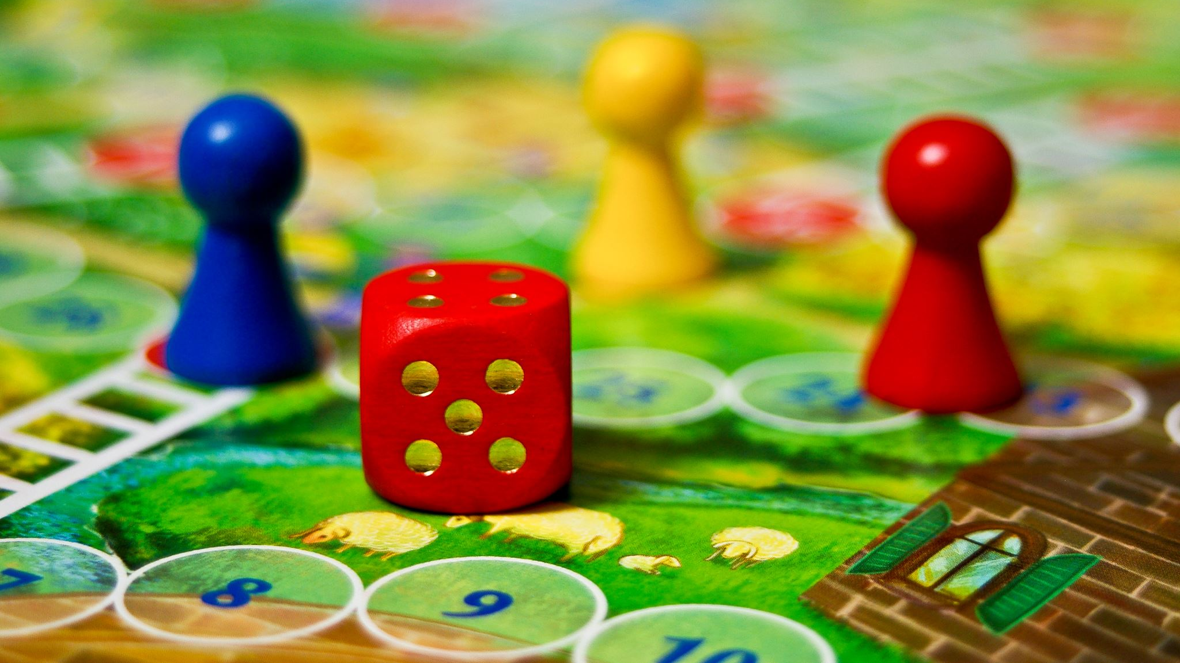
Game Play
Sivaji Reddy Raju

Slide 12
Ready to Play
After the AI's training phase, the exploration parameter (EPSILON) is set to 0.
This adjustment ensures that the AI makes decisions based on its learned optimal strategies without exploring new moves during actual gameplay.
Instances of the HumanPlayer and TrainedAIPlayer classes are created.
human_player represents the player controlled by a human.
ai_player_1 represents the AI player that has undergone training.

Slide 13
Ready to Play
A Tic Tac Toe game instance (game) is created with the trained AI player (ai_player_1) and the human player (human_player).
This step sets the stage for a game where the AI plays against a human opponent.
The play() method initiates the gameplay loop.
Players (AI and human) take turns making moves until the game reaches a conclusion.
The adjustment made to the AI's exploration ensures it plays optimally based on its training.

Slide 14
CONCLUSION
Introduced the TicTacToe class, defining markers, rewards, and the game initialization process.
Described turn alternation and outlined conditions for ending the game.
Explored the seamless integration of a trained AI player for optimal gameplay.
Adjusted the AI's exploration parameter to 0 for strategic decision-making post-training.
Encouraged users to play against the trained AI for skill improvement and a challenging experience.
Encouraged independent exploration of the codebase beyond the presentation.
Provided resources for continued learning and expansion of the project.

