Slide 1
NutriCoach
An AI-powered copilot that helps consumers understand about food ingredients
By Anwesha Chakraborty, and Koustav Chatterjee

Slide 2
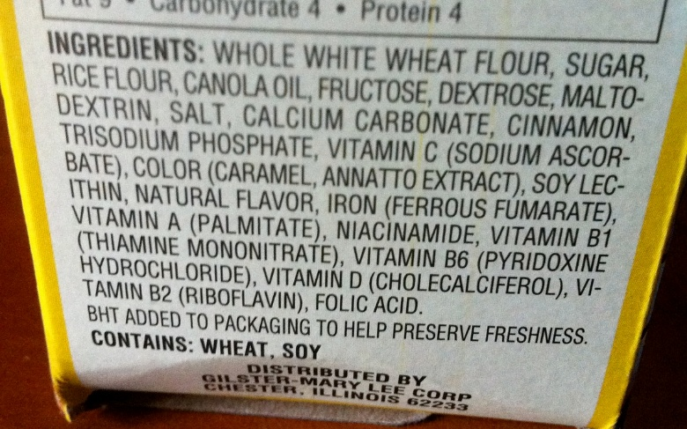
Problem Statement
Ingredient lists on the back of products are hard to understand.
Consumers want a quick lookup tool that will tell about a product and whether they should buy it or not.
Traditional AI-powered apps expects a lot of input from consumers to make them understand about ingredients and often times just repeat what is already written.

Slide 3
Our proposed solution: NutriCoach
With NutriCoach, consumers only have to upload an image of the ingredients list.
From the list, our model gives insights about the product.
It expects no personal data from consumers making it trust-worthy unlike a lot other apps.
NutriCoach does the thinking for the user like a copilot, so consumers don’t have to spend time typing trying to explain what they want.

Slide 4
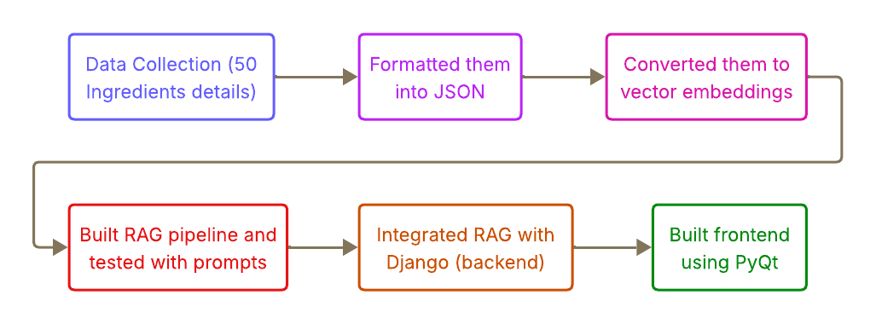
Whole workflow of our solution

Slide 5
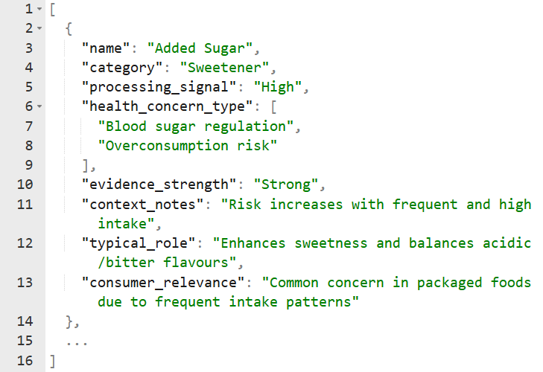
Data Collection
Various ingredients details were collected from Open Food Facts.
They were formatted them into JSON structure.
This is our data corpus which will be turned into vector embeddings.

Slide 6
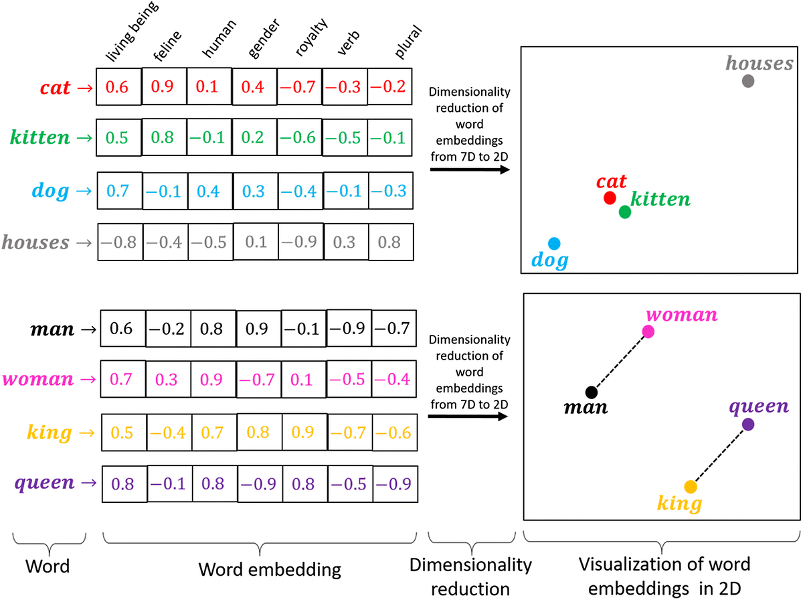
Vector Embeddings
Each ingredient is converted to numerical format (list of numbers).
all-MiniLM-L6-v2 embedding model was used to convert text to numerical embeddings.
Vector embeddings are numerical representation of complex data with similar data points closer to each other.
These embeddings will help us with easy retrieval at any time.

Slide 7
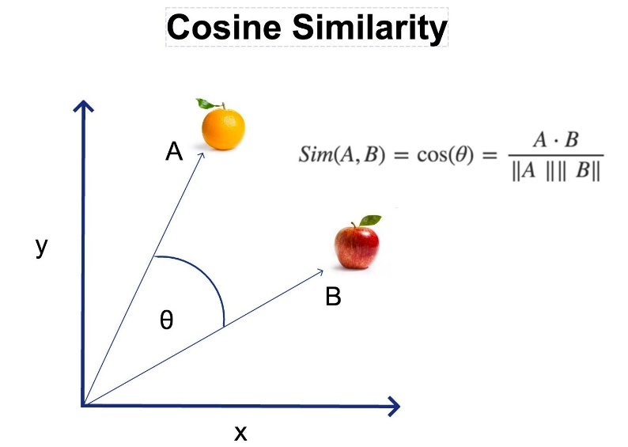
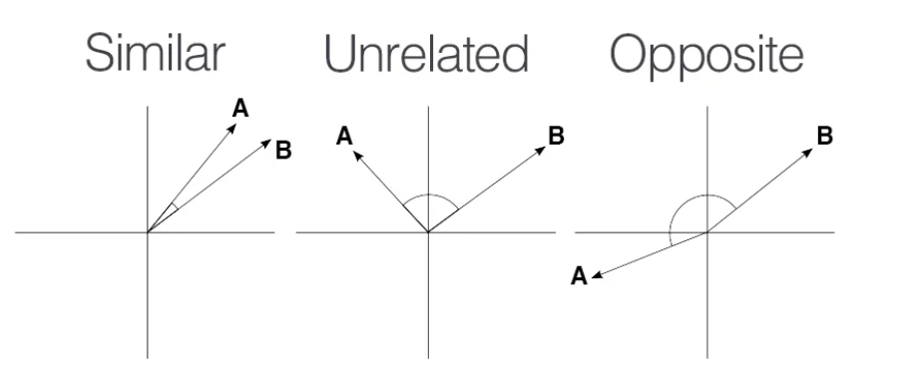
Retrieval (Similarity Search)
Retrieval is the process of finding and bringing back relevant information or data from a large collection when given a query or context.
Consumer pastes their ingredient list and it becomes user query.
Cosine similarity is used to compare and find similarities between user query and our vector embeddings.
The top k similar embeddings are retrieved. These are our context.

Slide 8
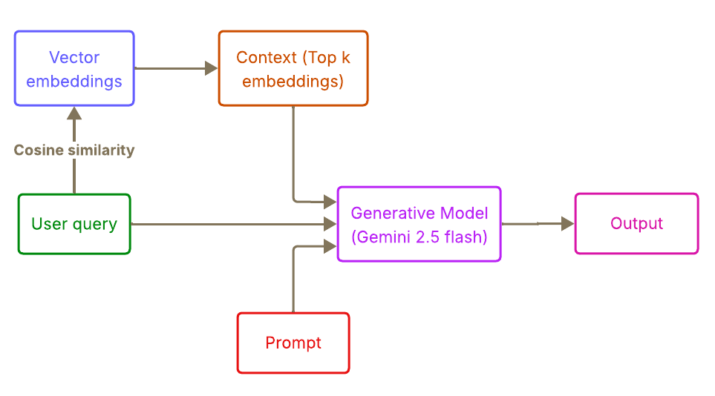
Generation
Gemini’s 2.5-flash model is used for the text generation.
The user query and the context both are sent to the model.
The model answers only based on the context, if the context is insufficient, the model says so.
This makes NutriCoach trustworthy because it can communicate uncertainty well.

Slide 9
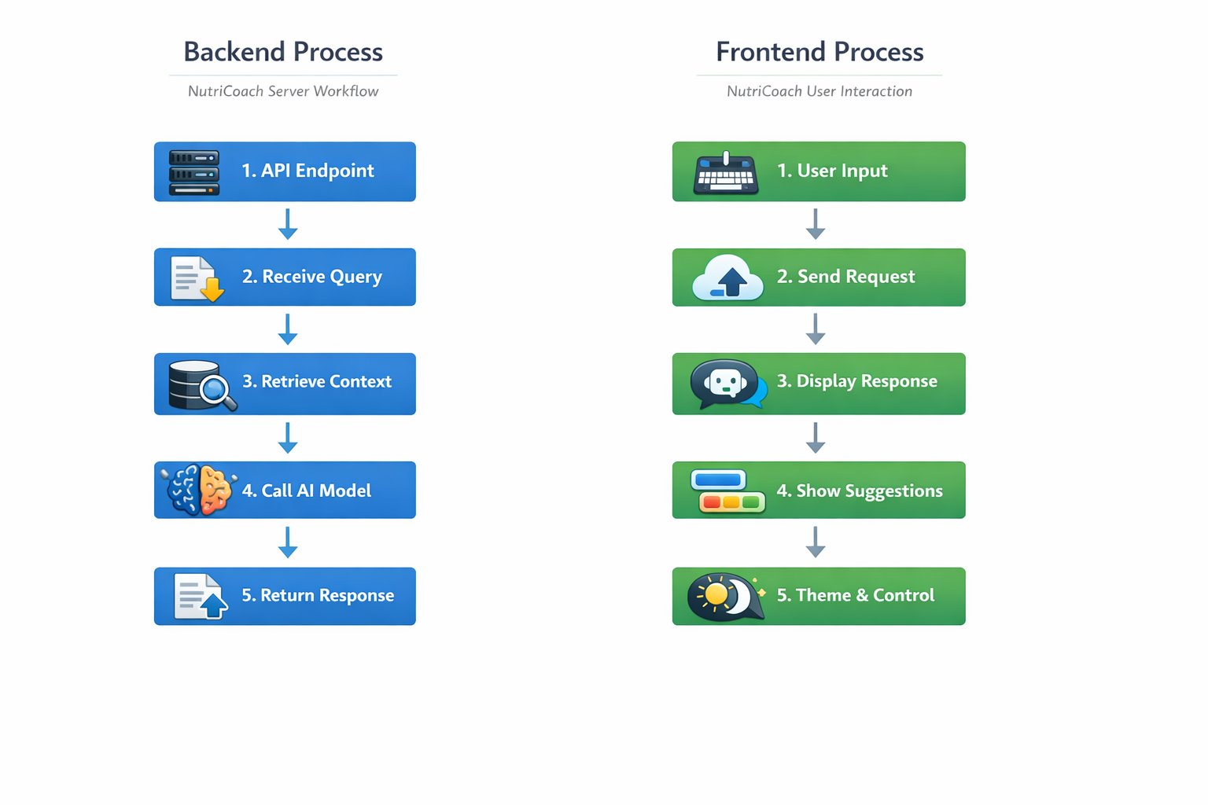
Backend with Django
Django server exposes a POST API Endpoint (/analyze/)
User query received as JSON, and relevant context retrieved, and prompt built
Gemini Model called with structured prompt
Response parsed into summary, details and uncertainty
Structured JSON returned to Frontend

Slide 10
Frontend with PyQt5
User Input captured, and POST request sent to backend
Responses displayed in chat view along with follow-up suggestions
Follow-up clicks trigger new responses dynamically
Features like image attachment and provision of dark/light mode for chat view

Slide 11
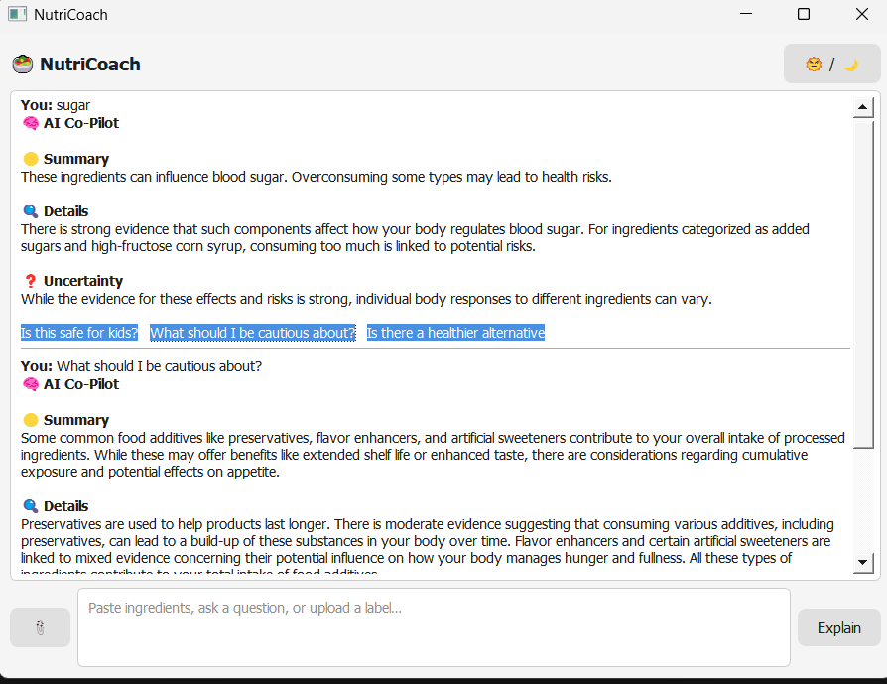
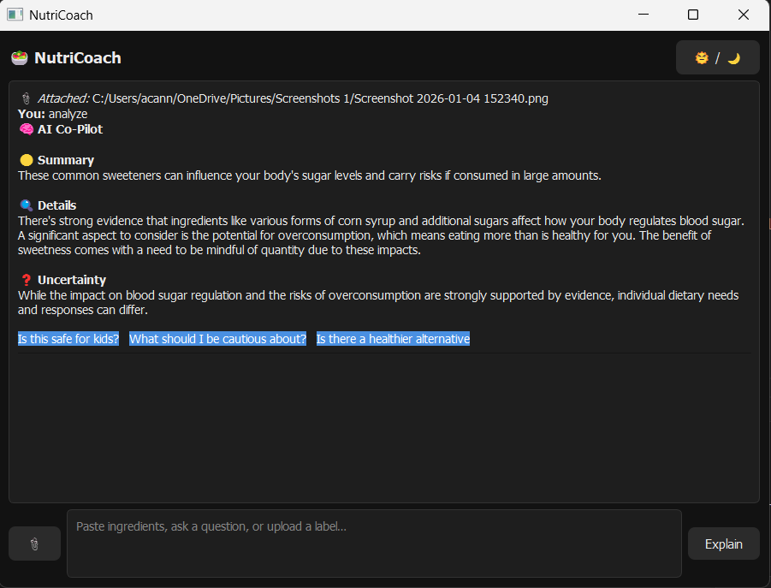
Demonstration

Slide 12
Conclusion
In conclusion, NutriCoach helps consumers analyze and understand ingredients from product labels.
Our model is different from other AI-powered apps that only repeat ingredient lists and fail to help consumers understand them.
We can integrate this model with mobile camera, from which then users can scan product’s labels at the time of purchasing.

Slide 13
References
Open Food Facts website - https://world.openfoodfacts.org/
Hugging Face website - https://huggingface.co/

Slide 14
THANK YOU

