Slide 1




School of Computer Science and Engineering
Department of Computer Science and Engineering
Carbon Emission Prediction for Data Centers Using Deep RNN (Optimised by Ninja OA)
Submitted by:
Anwesha Singh
23FE10CSE00299
Supervised by:
Dr Shishir Singh Chauhan
November 2025

Slide 2

Outline
Introduction
Literature Review
Problem Statement
Objectives
Proposed Methodology
Results and Analysis
Future Work
References

Slide 3


Introduction
Growing Digital Infrastructure
Data Centers are the backbone to modern digital economy. They support blooming technologies like cloud computing, AI, IoT, and digital services.
India’s data center industry is expanding rapidly at compound annual growth rate (CAGR) of approximately 15%
Environmental Impact
Data centers consume 1-2% of global electricity.
Data centers are projected to reach 3.2% of global CO₂ emissions by the end of 2025.
The environmental footprint of these centers is significantly contributing to Carbon dioxide emissions.

Slide 4
Introduction
Need for smart prediction system
The complex nature of data center workloads demand real-time monitoring and prediction capabilities.
Proactive energy management strategies enables by accurate carbon emission forecasting.
Role of AI in Sustainability
AI, especially deep learning offers powerful tools for deciphering complex, non-linear patterns inherent in time-series sensor data from data centers.
Advanced DL-driven time-series forecasting facilitates timely and reliable predictions of carbon emissions.

Slide 5



Problem Statement
Scope of the Study
Conventional carbon footprint estimation methods are inaccurate and fail to capture dynamic, time-evolving power consumption patterns in data centers. Despite the availability of advanced deep learning architectures and optimization frameworks, accurate, real-time prediction of carbon emissions in data centers remains challenging because of high dimensional sensor data, complex temporal dynamics, and difficulty of hypermeter tuning. Manual hyperparameter tuning is inefficient and suboptimal. Hence, a real-time, scalable, and accurate predictive system is essential for optimizing energy use and minimizing carbon emissions in data centers.
Developing an DL-driven predictive model to estimate and optimize carbon emissions in data centers using sensor data.
Relevance of the Study
Address immediate need for sustainable energy management at rapidly growing data centers, supporting environmental and energy goals.

Slide 6

Literature Review
Technology Foundations
Ninja Optimization Algorithm (NiOA): Metaheuristic inspired by tactical ninja behaviour for hyperparameter optimization
TensorFlow/Keras: Deep learning implementation
Time-series Analysis: Sequence modeling techniques
LSTM Networks: Long Short-Term Memory for temporal dependencies
Similar Related Works
Ghorbal et al. (2025): DPRNN with NiOA for CO₂ prediction (R² = 0.9736)
Yassen et al. (2025): NiOA for renewable energy forecasting
Google DeepMind (2016): Reinforcement learning for 40% cooling energy reduction
Architectural Foundations
Stacked RNNs/LSTMs: Hierarchical temporal pattern capture
Bidirectional Processing: Forward and backward context
Batch Normalization and Dropout: Regularization techniques to stabilize training and reduce overfitting in deep recurrent networks.
Optimization Techniques
Automated Search: NiOA to discover optimal configurations
Adaptive Exploration-Exploitation: Balancing broad search with focused refinement
Real-time Constraints: Low-latency prediction requirements

Slide 7
Objectives
Preprocess, scale, and engineer features from multi-sensor data center datasets for time series forecasting
Design and implement a stacked, bidirectional Long Short-Term Memory recurrent neural network capable of capturing complex temporal dependencies
Implement automated hyperparameter optimization using Ninja Optimization Algorithm to eliminate manual human intervention
Evaluate the optimized model's performance against baseline approaches (Optuna) and analyze convergence behavior, generalization ability, and prediction accuracy
Interpret results, discuss implications for sustainable data center operations, and outline future directions

Slide 8

Proposed Methodology
Data Pipeline
Data Collection: Multi-sensor measurements (voltage, current, power, temperature, CPU/GPU metrics, ESP32, RAM usage)
Preprocessing: Missing value handling (forward fill), outlier removal (z- score threshold <3), feature scaling (StandardScaler), encoding
Feature Engineering: Time-based features, lag variables, domain-specific metrics
Sequence Creation: Time-series windows for temporal modeling (10 timesteps → predict next timestep)
Model Architecture
Input Layer: Sequence of sensor measurements (10 timesteps × 26 features)
Bidirectional Stacked LSTM Core: Bidirectional LSTM (Layer 1), Stacked LSTM units with dropout regularization (Layer 2-3), Batch Normalization, Global Max Pooling for salient feature extraction
Enhancement Layers: Dropout (0.3-0.6), batch normalization, Dense layers (64 → 25 → 1).
Output Layer: Carbon emission prediction for next timestep.
Training Strategy
Data Split: 70% training, 15% validation, 15% testing
Training Configuration: Hypermeter search(30 epoch/trial, patience= 5), Final model training(200 epoch, patience= 15), Learning rate reduction on plateau(factor=0.2, patience=7)
Metrics: MAE, RMSE, R², Training and Validation loss curves for convergence analysis)
Regularization: Dropout, batch normalization for generalization
Ninja Optimization Algorithm
Algorithm:
Population Initialisation (12 agents with random hyperparameter configurations),
Fitness Evaluation (Train LSTM model, compute validation loss),
Exploration Phase (Early Iterations),
Exploitation Phase (Later Iterations),
Adaptive Phase Selection (Dynamic balance mimicking tactical ninja behaviour),
Greedy Selection (Retain improvements only)

Slide 9

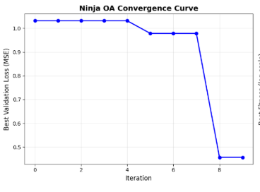
Model Performance (Best so far)
Dataset Overview
Size: 74,230 timestamped records from operational data centers
Features: 26 variables including electrical, thermal, and computational metrics
Preprocessing: Removed 769 outliers, handled missing values
Metric | Validation | Test
MAE | 1.2128 | 1.7302
RMSE | 1.2237 | 1.7357
Ninja Optimization Results
Hypermeter | Bast Value
LSTM layers | 3
Units per Layer | 128
Dropout rate | 0.5246
Optimizer | Adamw
Learning Rate | 1.671*10^-4
Batch Size | 32
Sequence Preparation
Training Sequences: 51,951 × 10 × 26
Validation Sequences: 11,124 × 10 × 26
Test Sequences: 11,125 × 10 × 26
Best Validation Loss: 0.455692

Slide 10

Results and Analysis
Architectural Benefits
Bidirectional LSTM: improvement in temporal context capture
Stacked Layers: Enhanced hierarchical pattern recognition
Advanced Pooling: Better sequence summarization
Convergence Behavior
Monotonic fitness decrease over 12 iterations
Rapid improvements in exploration phase (iterations 0-6)
Incremental refinements in exploitation phase (iterations 7-12)
Efficient search validated by convergence curve
Training Efficiency
Convergence: Approximately 16 epochs with early stopping for final model
Total training time: approx. 18 hours for complete hyperparameter search
Efficient resource utilization with GPU acceleration
Training Dynamics
Steady convergence with minimal fluctuations
Stable learning throughout epochs
Effective regularization via dropout and batch normalization
Lower validation errors maintained consistently

Slide 11
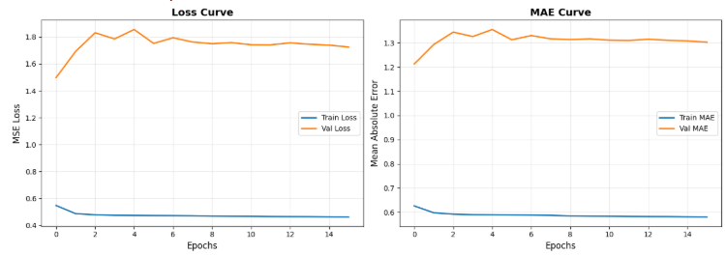
Results and Analysis
Observations
NiOA model maintains consistently lower validation errors throughout training
Baseline model shows higher variance in validation loss
NiOA demonstrates superior generalization capability
Training-validation gap narrower for NiOA (less overfitting)
Loss Curves

Slide 12
Future Directions
Dual-Path Architecture: Parallel branches for short-term and long-term patterns
Attention Mechanisms: Learn which timesteps are most important for predictions
Transfer Learning: Fine-tune on different facilities without retraining from scratch
Ensemble Methods: Combine multiple models for robustness
Explainability: Interpret which features drive predictions (SHAP values, attention weights)

Slide 13

References
Ben Ghorbal, A., et al. (2025). Predicting carbon dioxide emissions using deep learning and Ninja metaheuristic optimization algorithm. Scientific Reports, 15, Article 86251.​
Yassen, M. A., et al. (2025). Renewable energy forecasting using optimized quantum temporal model based on Ninja optimization algorithm. Scientific Reports, 15, Article 97109.​
Ben Ghorbal, A., et al. (2025). Sustainable soil organic carbon prediction using machine learning and the ninja optimization algorithm. Frontiers in Environmental Science, 13, Article 1630762.
Hochreiter, S., & Schmidhuber, J. (1997). Long short-term memory. Neural Computation, 9(8), 1735-1780.
Graves, A., & Schmidhuber, J. (2005). Framewise phoneme classification with bidirectional LSTM networks. Proceedings of IEEE ICASSP, 5, V-877.
El-Kenawy, El-Sayed M., et al. "Nioa: A novel metaheuristic algorithm modeled on the stealth and precision of Japanese ninjas." Journal of Artificial Intelligence in Engineering Practice 1.2 (2024): 17-35.

Slide 14

Thank You
Questions & Discussion

