Slide 1


NATURAL LANGUAGE PROCESSING
Assignment
Completed by:
Oshika Sharma (23FE10CSE00145)
Anweshs Singh (23FE10CSE00299)
Section: D

Slide 2
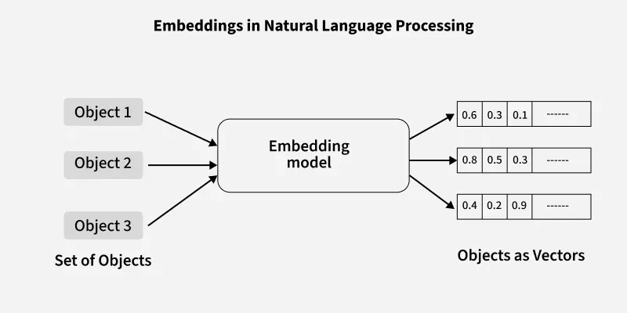
01
WORD EMBEDDING SIMILARITY
How can machines mathematically compute similarities between concepts, identify categories, and solve word analogies?
How can we represent words numerically and measure how similar two words are?
Word Embeddings (words → vectors):
Operate on distributional hypothesis: word used in similar contexts tend to have similar meanings.
Word2Vec model (pre-trained model):
Maps each word into a dense and continuous vector space (here, a 300 dimensional space).
Cosine Similarity:
To determine, how similar two words (v1 and v2) are (measure angle between their respective vectors):
Cosine Similarity = v1 . v2 / |v1| |v2|
Dimensionality Reduction (PCA):
To plot word relationship on 2D scatter plot, 300 dimensions reduced to 2D using PCA.
WORKFLOW
Step 1: Load pretrained model.
Step 2: Similarity function
Step 3: Testing basic word pairs
Step 4: Category-based Analysis
Step 5: Vecctor Arithmetic (semantic search and analogies)
Step 6: Dimensionality Reduction and 2D plotting

Slide 3
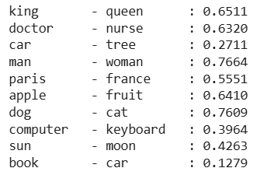
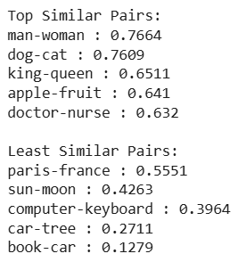
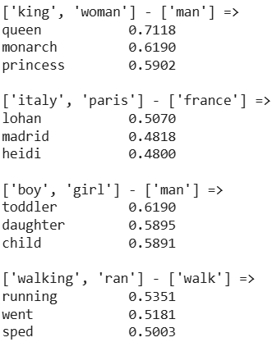
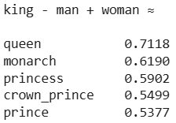
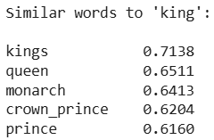

KEY FINDINGS AND ANALYSIS
Basic Similarity Testing
Word Analogies (Vector Arithmetic)
Score:
High → related
low → unrelated
Relationships encoded as
vectors.

Slide 4
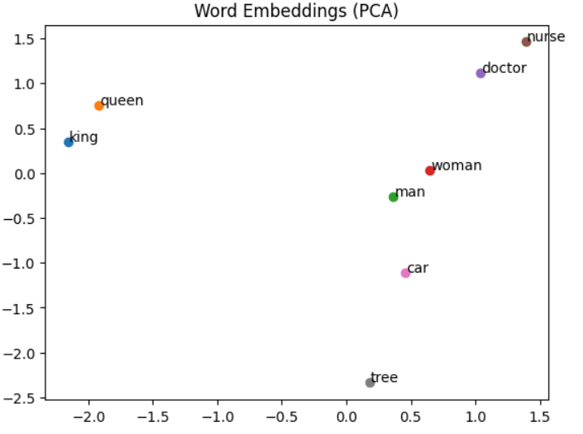
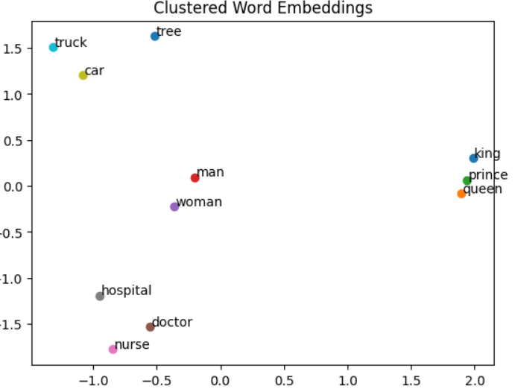
VISUALIZATIONS
Similar words cluster together.
-eg. king, queen, prince are close
car, tree far apart

Slide 5
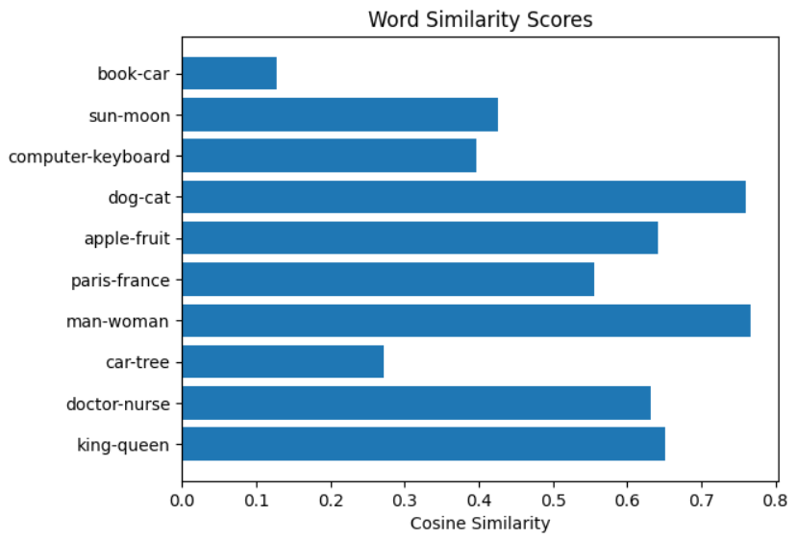
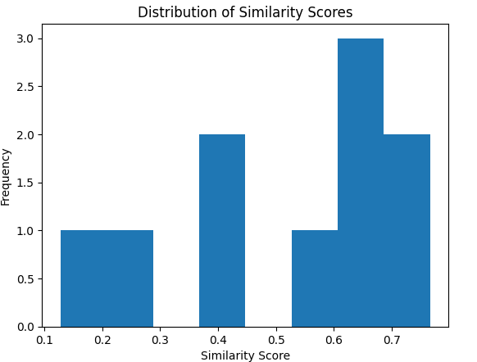
DISTRIBUTION PLOTS
Most similarities between 0.3- 0.7
i.e. Most words share some context
Completely unrelated words are rare.

Slide 6
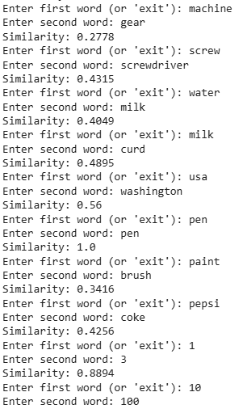
TEST CASES
Model captures multiple relationship types.
Interesting observations:
Numbers appear in similar context (1-3 → 0.8894)
Words2Vec treats words individually; cannot understand phrases
(machine-learning → 0.058)
Challenges
Vocabulary limitations
Case sensitivity
No phrase understanding
Context-based, not dictionary based

Slide 7
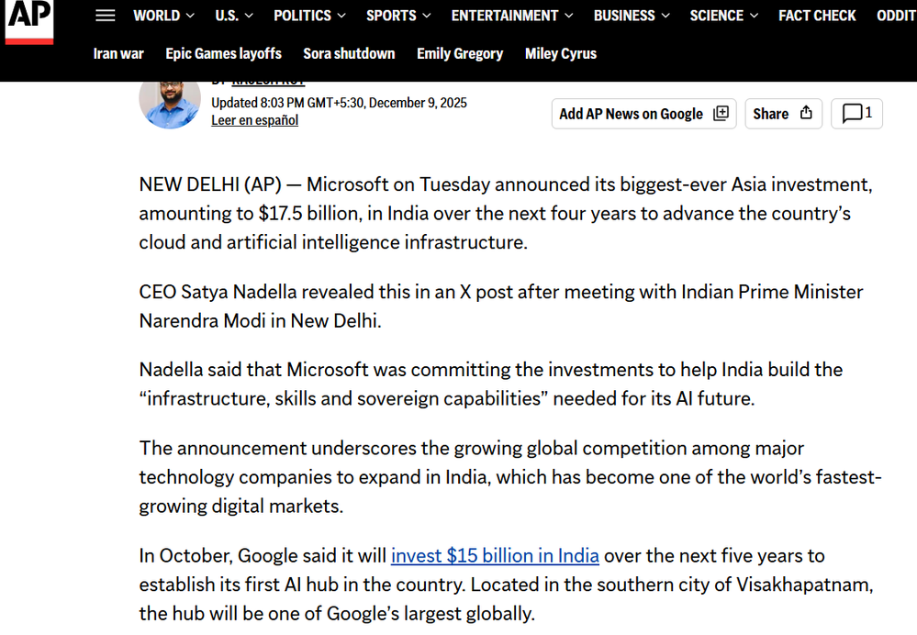
02
NAMED ENTITY RECOGNITION
A brief overview of the task: Extracting Persons, Organizations, and Locations from a Microsoft/India news article using NLTK Library
Step 1: Tokenization
Step 2: POS Tagging (Required before NER)
Step 3: Named Entity Chunking

Slide 8
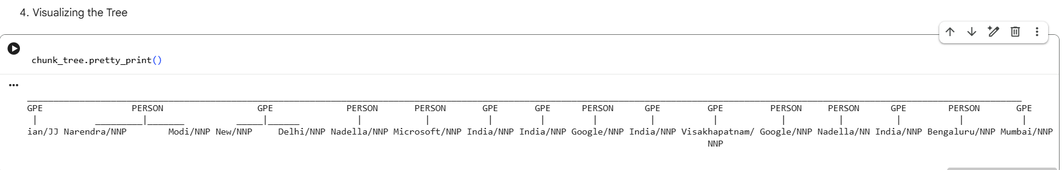
BASE RESULTS
Note: NLTK was designed for teaching and research, not for high-accuracy production apps. Its NER module hasn't been significantly updated in years, which is why it thinks "Google" is a Person

Slide 9
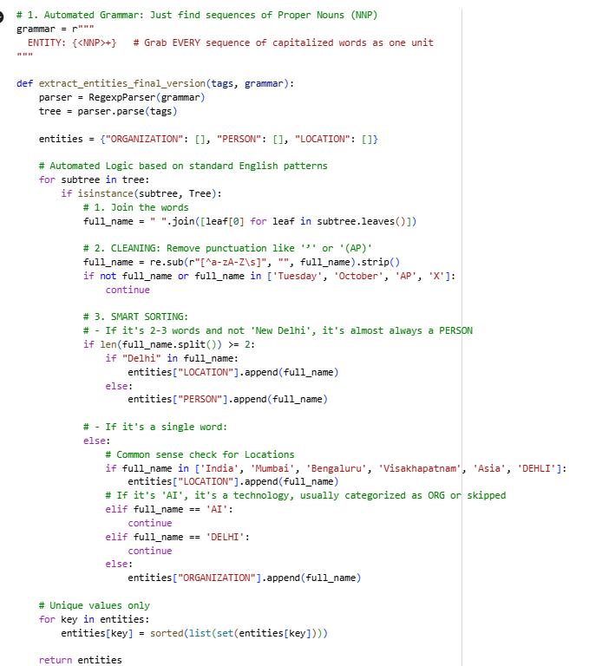
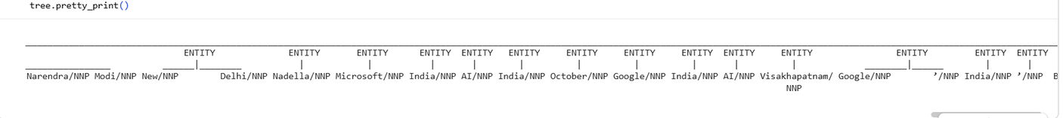
APPLIED REGEX RULES
Regular Expressions are powerful text patterns used to find, match, and manipulate specific sequences of characters within larger texts. In our task, we defined a 'grammar' using regex to instruct NLTK on how to recognize patterns for Persons, Organizations, and Titles based on their part-of-speech tags
Results:
Tree Visualisation:

Slide 10
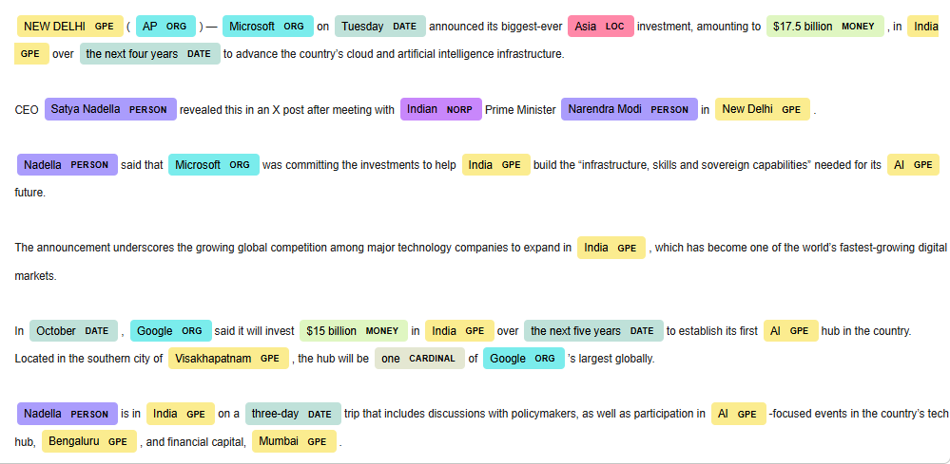
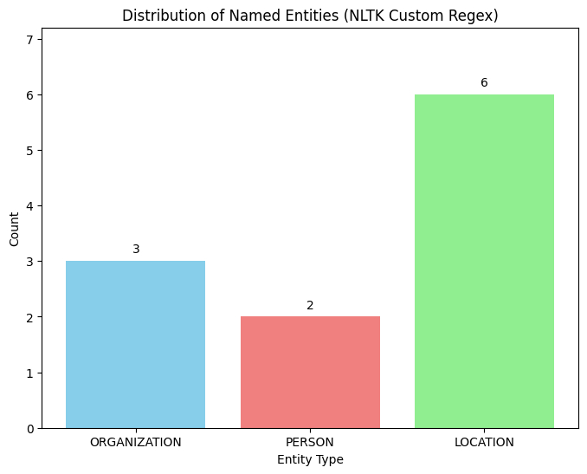
VISUALISATION
Using DisplaCy SpaCy Builtin Tool
Distribution Bar Graph

Slide 11
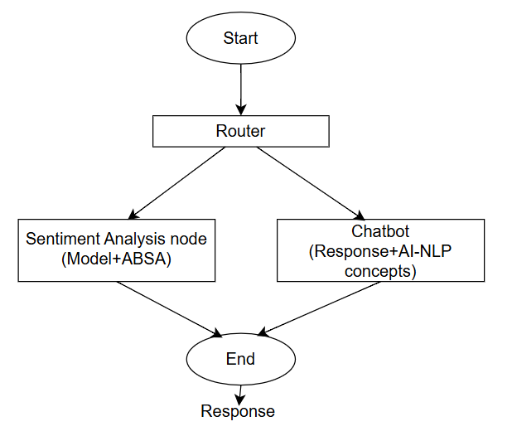
HYBRID CHATBOT AND ASPECT-BASED SENTIMENT ANALYSIS ARCHITECTURE
Conversational AI and Opinion Mining for Product Reviews
A hybrid architecture that acts as single entry point for user text.
It routes queries to chatbot and ABSA module as required, and handles both conversational intents and complex sentiment reviews.
Let’s talk about each module in detail.
Sentiment Analysis & Aspect-Based Sentiment Analysis (ABSA)- Anwesha Singh
Chatbot on NLP concepts and AI applications - Oshika Sharma

Slide 12
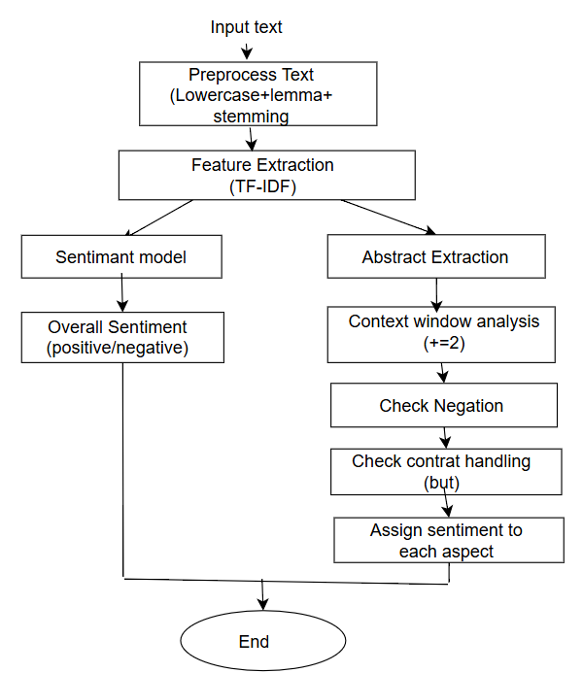
03
SECTION 1: SENTIMENT ANALYSIS & ASPECT-BASED SENTIMENT ANALYSIS (ABSA)
Part of Hybrid Chatbot System
NLP-Based Opinion Mining
Focus: E-commerce Product Reviews
Input → Router
Problem:
Fine grained opinions.
Mixed sentiments in same sentence.
Single label for entire text, ignores multiple opinions, and feature-specific feedback.
Need Aspect-Based Sentiment Analysis (ABSA)
Concepts to know:
Sentiment Analysis: Technique to determine polarity/emotion of the text. Types: Document-level, Sentence-level, Aspect-level (ABSA)
ABSA: Sentiment for each aspect, more fine grained and accurate analysis. Works well for E-commerce review analysis, and Customer feedback monitoring

Slide 13
DATASET
Flipkart Product Review Dataset
I. PREPROCESSING
III. SENTIMENT CLASSIFICATION MODEL
Lowercasing
Stopword Removal
Puctuation Removal
Lemmatization
Reduces noise and dimensionality
Model used: Multinomial Naive Bayes
Output: Positive/ Negative
II. FEATURE EXTRACTION (TF-IDF)
IV. ABSA MODEL
Text → Numerical Vectors
TF : word frequency in document
IDF : rarity of word across corpus (importance to rare nut meaningfull words
TF-IDF = TF × IDF
Custom rule-based system
Instead of heavy Deep learning models, as they cause hallucinations and overfitting with small datasets

Slide 14
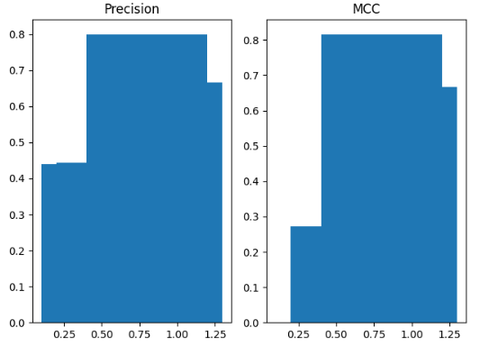
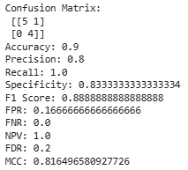
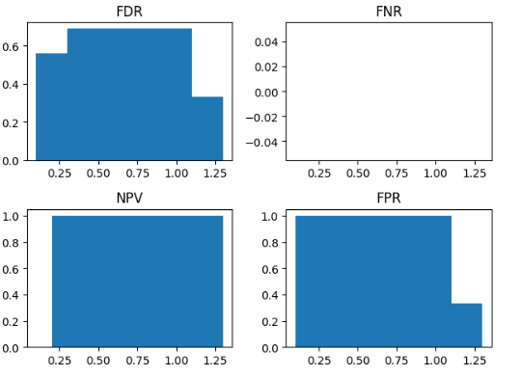
OUTPUTS WITHOUT ABSA
Using Multinomial Naive-Bayes

Slide 15
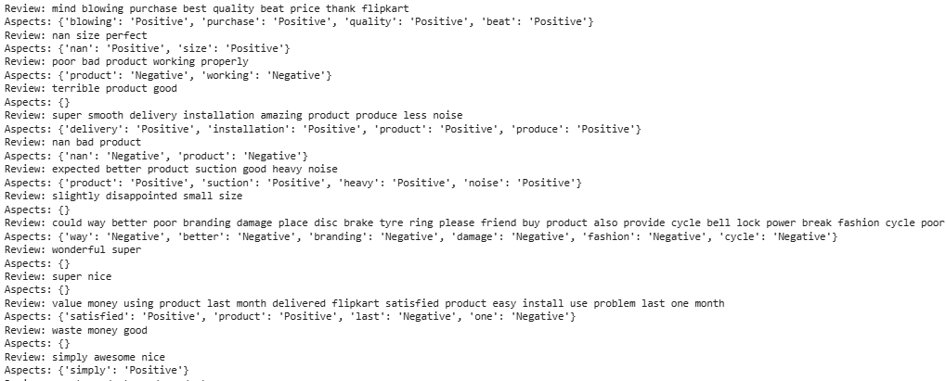
ASPECT-BASED SENTIMENT ANALYSIS (ABSA)
Identify product features
Context Window Analysis
Window size = ±2 words
Takes context of previous and upcoming words, to ensure correct sentiment analysis.
Negation and Contrast handling
Sentiment flip due to: not, don’t, didn’t
Detect word: ‘but’; prevents sentiment mixing.
eg. Cooling good but noise high.
Final ABSA output
Produces Aspect-wise sentiment

Slide 16
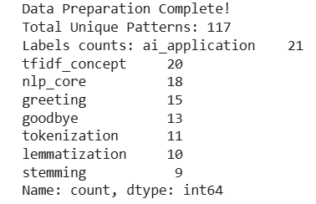
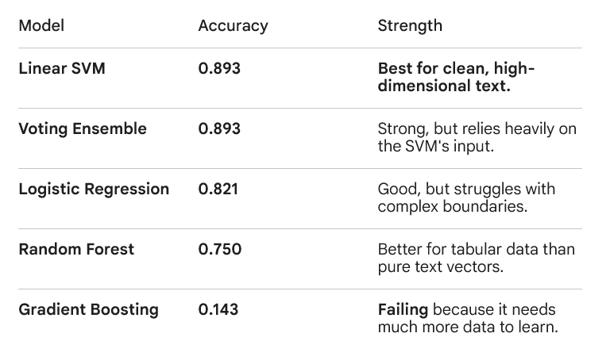

04
SECTION 2: CHATBOT ON NLP CONCEPTS AND AI APPLICATIONS
Dataset : Intent Based Coolection
STEP 1 : DATA ENGINEERING & INTENT MAPPING
STEP 4: TF-IDF VECTORIZATION
Step 2 : Hybrid Preprocessing:
1. Get Lemmas (e.g., 'better' → 'good') via spaCy
2. Get Stems (e.g., 'segmentation' → 'segment') via NLTK
STEP 5: TRAIN MODEL (STRATIFIED SPLIT)
Step 3 : Data Prepration
0.917

Slide 17
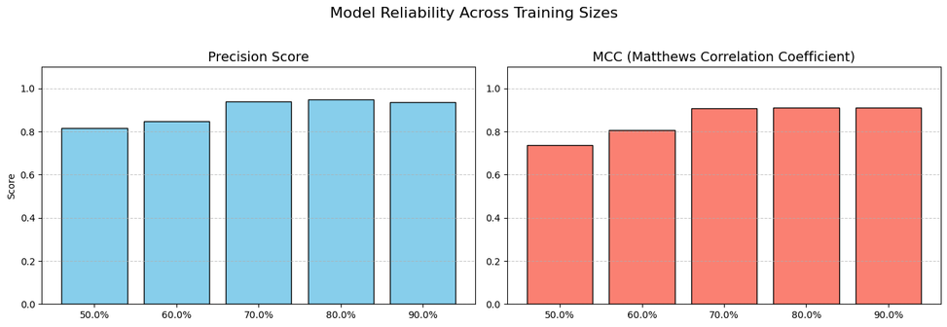
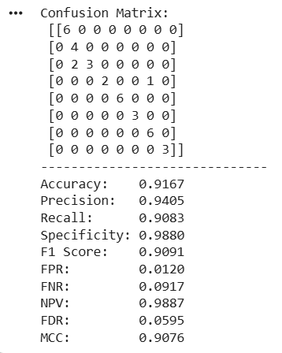
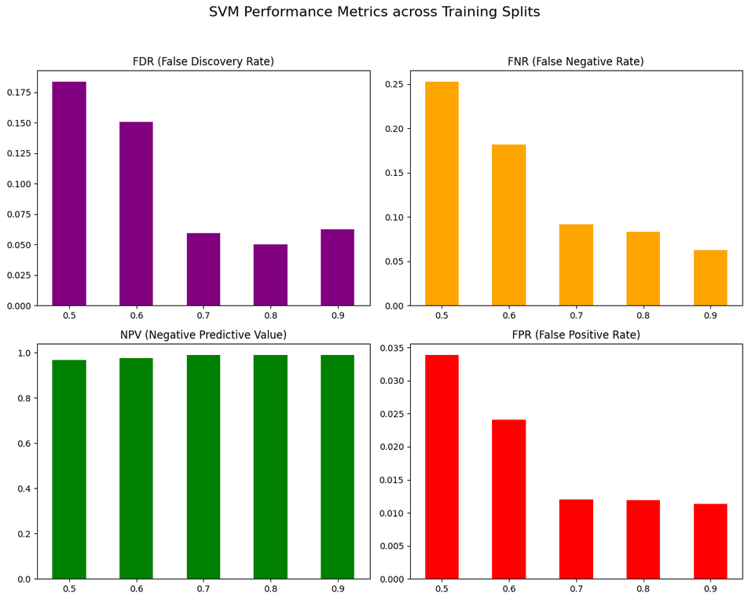
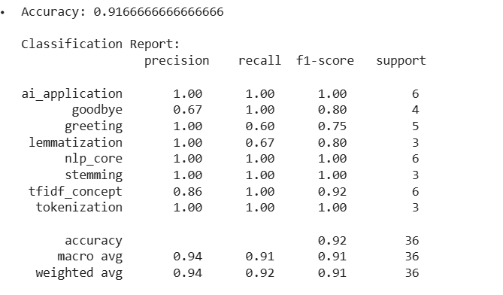
EVALUATION

Slide 18
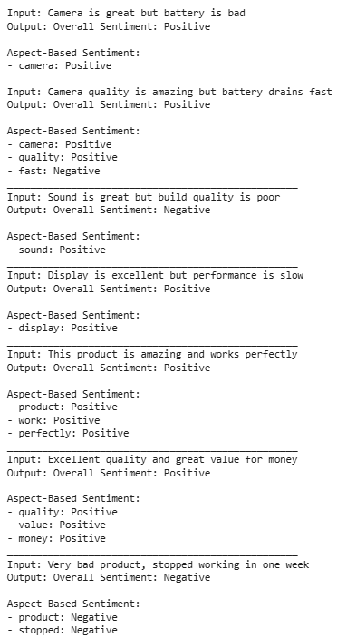
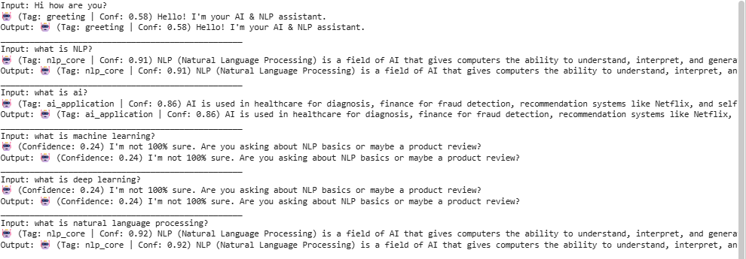
HYBRID CHATBOT AND ASPECT-BASED SENTIMENT ANALYSIS ARCHITECTURE
Conversational AI and Opinion Mining for Product Reviews

Slide 19
THANK YOU
Anwesha & Oshika !!
we did a lot of efforts

