Slide 1
Transferring Talos/Kubernetes OCI Images over Helm-DTN and µD3TN
Evaluation under LEO, Lunar and Mars contact conditions
OCI packaging • AAP2/BPv7 • TCPCL • persistent store-and-forward • digest verification
Anwesha — experiment progress presentation

Slide 2
Experiment motivation
Why image delivery is required before the Space-side cluster can use its dependencies
• A disconnected Space-side environment cannot depend on continuous access to public registries.
• Talos/Kubernetes nodes require networking, DNS, control-plane, node-agent and sandbox images.
• Long-delay or intermittent links break assumptions made by ordinary always-connected registry workflows.
• The research question: can the existing OCI/AAP2/µD3TN route preserve and deliver an image after contact returns?
Goal: evaluate the existing transfer implementation — not build a Kubernetes cluster and not rewrite the sender/receiver.
Helm-DTN / µD3TN OCI image-transfer evaluation • live snapshot 2026-09-27 • 2

Slide 3
Scope and requirements
What was evaluated and what was deliberately excluded
In scope | Out of scope
Identify required cluster images | Create/install the Kubernetes cluster
Transfer through the existing route | Rewrite OCI packaging or AAP2
10 repetitions per condition | Invent or repair missing measurements
CPU, RSS, payload, duration, throughput | Claim local results as spacecraft performance
Normal/contact-loss recovery + digests | Claim Mars propagation unless delay was applied
Helm-DTN / µD3TN OCI image-transfer evaluation • live snapshot 2026-09-27 • 3

Slide 4
Why the existing Helm-DTN route?
Helm deploys/configures the environment; it does not copy the image
• Reuses the project’s already implemented sender, receiver, OCI layout, AAP2 and digest-verification path.
• Provides a repeatable µD3TN deployment/routing environment instead of a one-off transport setup.
• Uses BPv7 bundles so application delivery is separated from one continuous end-to-end connection.
• Keeps registry compatibility: the receiver reconstructs OCI content and pushes it into the Space-side registry.
• Avoids adding another external image-transfer library; evaluation remains focused on the existing design.
Helm-DTN / µD3TN OCI image-transfer evaluation • live snapshot 2026-09-27 • 4

Slide 5
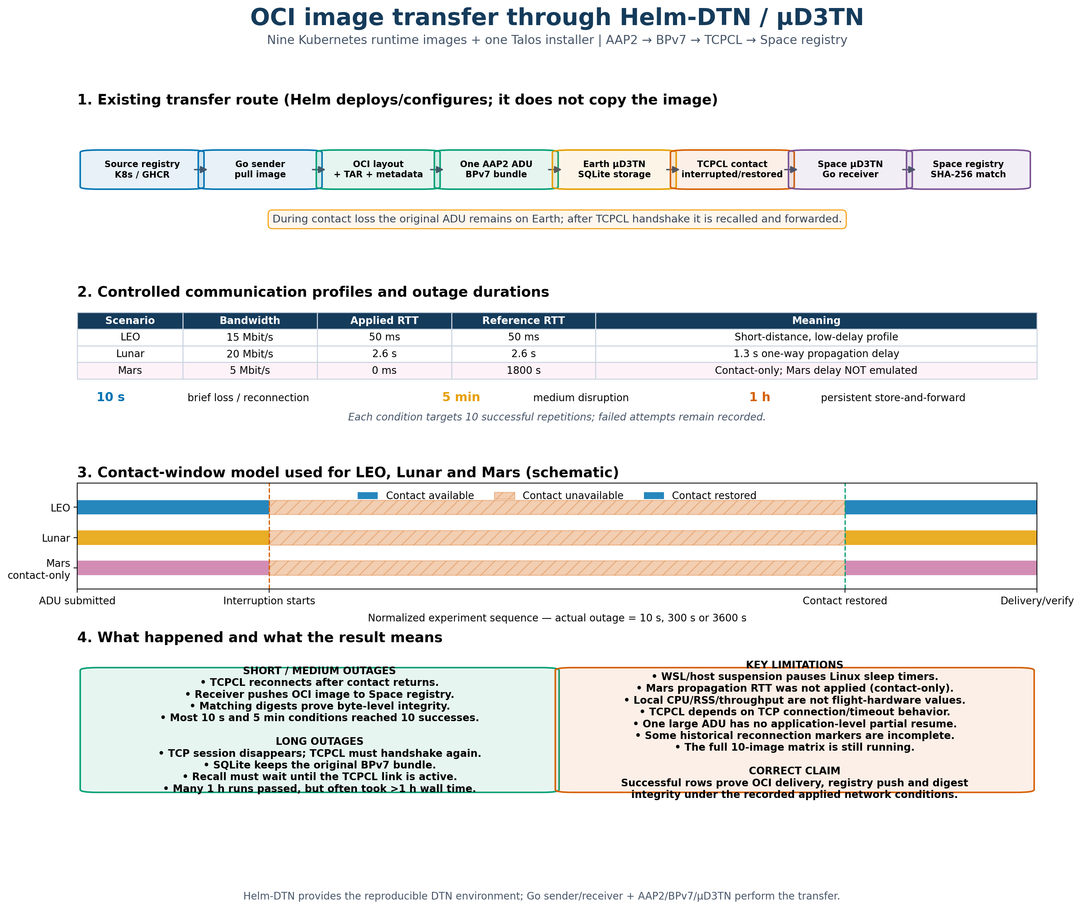
End-to-end transfer architecture
One OCI TAR payload is submitted as one AAP2 ADU
Helm-DTN / µD3TN OCI image-transfer evaluation • live snapshot 2026-09-27 • 5

Slide 6
Image sources and selection
Nine Kubernetes runtime images plus one Talos installer image
Image | Source registry | Purpose
flannel:v0.27.4 | ghcr.io/siderolabs | Pod CNI/networking
coredns:v1.13.2 | registry.k8s.io | Cluster DNS
etcd:v3.6.7 | registry.k8s.io | Cluster state
kube-apiserver:v1.35.0 | registry.k8s.io | Kubernetes API
controller-manager:v1.35.0 | registry.k8s.io | Controllers
scheduler:v1.35.0 | registry.k8s.io | Pod scheduling
kube-proxy:v1.35.0 | registry.k8s.io | Service networking
kubelet:v1.35.0 | ghcr.io/siderolabs | Node agent
pause:3.10 | registry.k8s.io | Pod sandbox
installer:v1.12.4 | ghcr.io/siderolabs | Talos install/upgrade
Helm-DTN / µD3TN OCI image-transfer evaluation • live snapshot 2026-09-27 • 6

Slide 7
Experimental method and evidence
The same measurement contract is used for every run
• Pull image → OCI layout → TAR + metadata → one AAP2 ADU.
• Temporarily interrupt only the Earth-to-Space µD3TN/TCPCL path.
• Keep sender/receiver alive; restore contact and observe delayed delivery.
• Push to the Space registry and compare source/destination SHA-256 digests.
• Record payload, timestamps, duration, CPU, RSS, throughput, interruption, reconnection, success and error.
• Store one detailed log per run and one row per attempt in the combined CSV.
Helm-DTN / µD3TN OCI image-transfer evaluation • live snapshot 2026-09-27 • 7

Slide 8
Why LEO, Lunar and Mars?
Controlled profiles represent increasingly difficult communication conditions
Scenario | Bandwidth | Applied RTT | Reference RTT | Interpretation
LEO | 15 Mbit/s | 50 ms | 50 ms | Low-delay orbital profile
Lunar | 20 Mbit/s | 2.6 s | 2.6 s | 1.3 s one-way delay
Mars | 5 Mbit/s | 0 ms | 1800 s | Contact-only; Mars delay not emulated
Bandwidth ≠ RTT
Capacity depends on link budget, power, antennas and coding. RTT mainly reflects propagation distance.
Mars limitation
5 Mbit/s + contact disruption were applied. A literal 900 s one-way delay was not.
Helm-DTN / µD3TN OCI image-transfer evaluation • live snapshot 2026-09-27 • 8

Slide 9
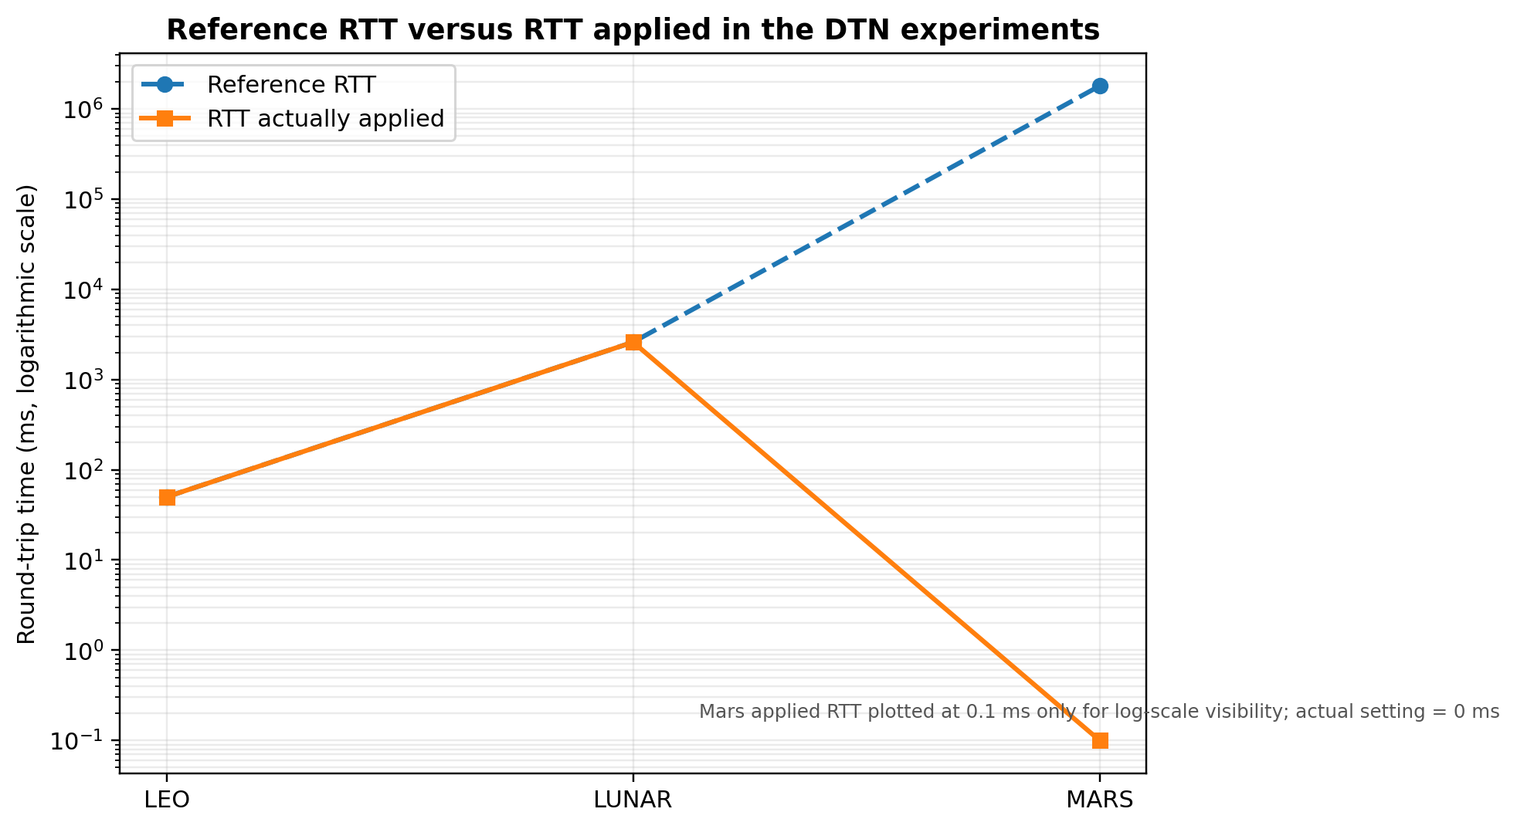
Reference RTT versus RTT actually applied
A graph must never substitute a reference value for an applied measurement
Helm-DTN / µD3TN OCI image-transfer evaluation • live snapshot 2026-09-27 • 9

Slide 10
Contact-window experiment
Same contact logic for LEO, Lunar and Mars; outage = 10 s, 5 min or 1 h
CONTACT ON
CONTACT OFF — bundle retained at Earth
RESTORED
LEO
ADU submitted
10 s / 300 s / 3600 s interruption
TCPCL + delivery
LUNAR
ADU submitted
10 s / 300 s / 3600 s interruption
TCPCL + delivery
MARS contact-only
ADU submitted
10 s / 300 s / 3600 s interruption
TCPCL + delivery
This is a controlled experimental contact window—not a real satellite pass, lunar visibility schedule or DSN Mars schedule.
Helm-DTN / µD3TN OCI image-transfer evaluation • live snapshot 2026-09-27 • 10

Slide 11
Current result coverage
Live matrix snapshot; unfinished images must not be presented as completed
Image | Recorded attempts | Digest-verified successes | Status
flannel | 93 | 89 | complete/mostly complete
coredns | 90 | 90 | complete/mostly complete
etcd | 90 | 89 | complete/mostly complete
kube-apiserver | 56 | 56 | in progress
kube-controller-manager | 0 | 0 | not reached
kube-scheduler | 0 | 0 | not reached
kube-proxy | 0 | 0 | not reached
kubelet | 0 | 0 | not reached
pause | 0 | 0 | not reached
talos-installer | 0 | 0 | not reached
Helm-DTN / µD3TN OCI image-transfer evaluation • live snapshot 2026-09-27 • 11

Slide 12
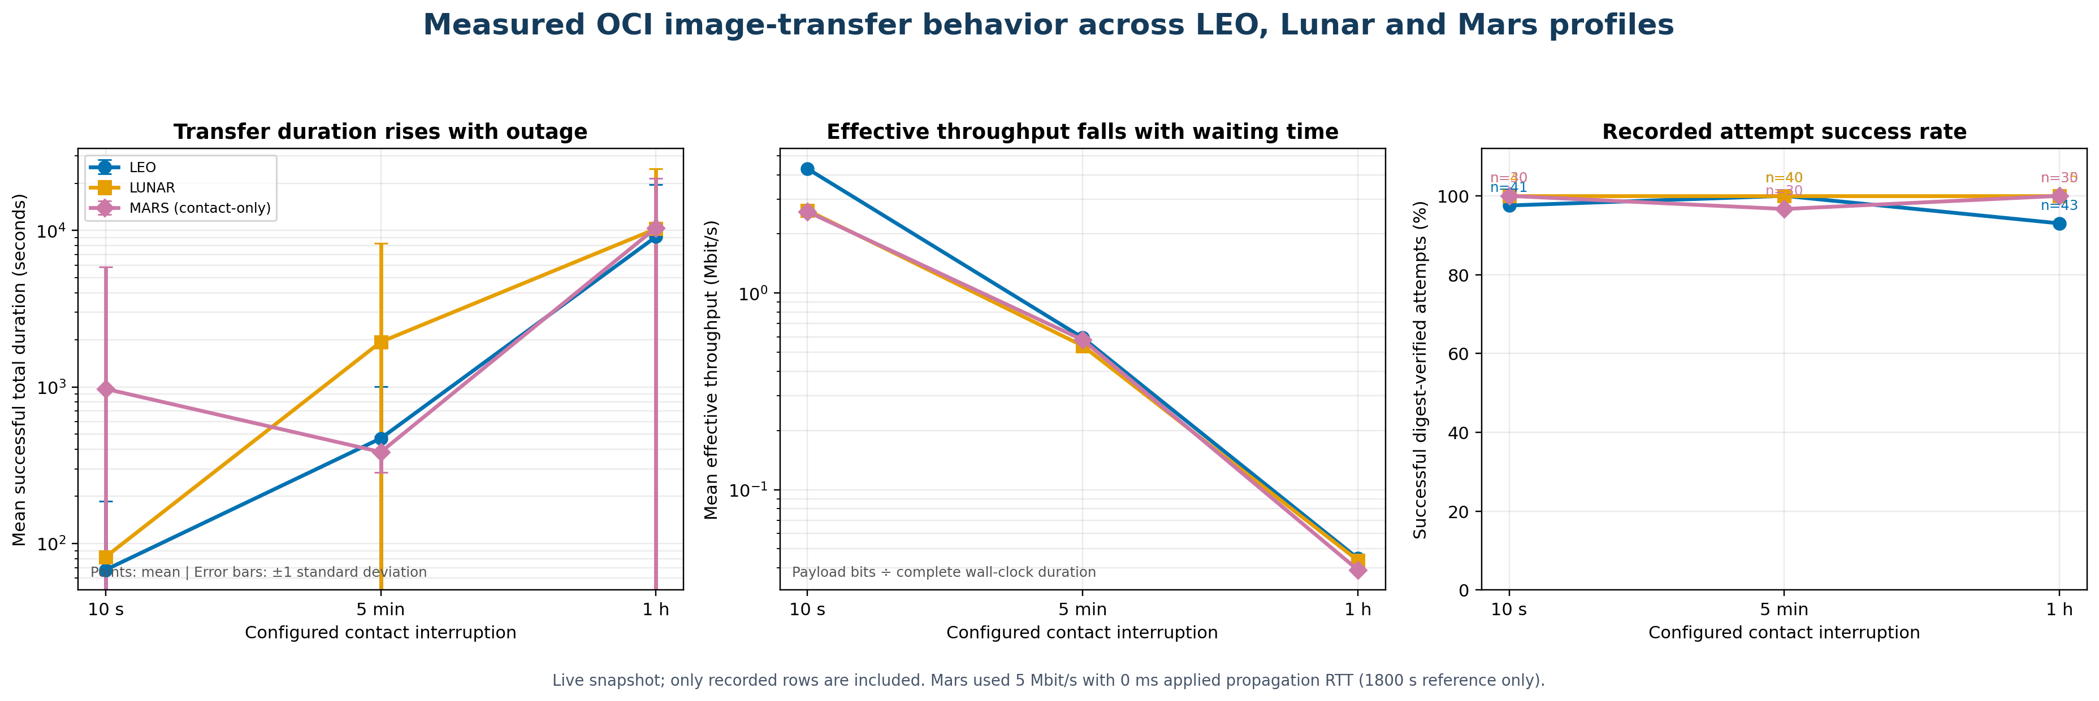
What the measured trends show
Duration rises and effective throughput falls as the outage becomes longer
Helm-DTN / µD3TN OCI image-transfer evaluation • live snapshot 2026-09-27 • 12

Slide 13
Why do the curves rise and fall?
Interruption waiting time dominates the complete wall-clock measurement
Observation | Cause | Correct interpretation
Duration rises | Bundle waits for contact restoration | Expected DTN delay, plus recovery overhead
Throughput falls | Payload ÷ total wall-clock duration | Not necessarily lower active-link capacity
High error bars | WSL suspension and variable reconnection | Operational variability, not image corruption
Digests match | Receiver verifies/pushes original OCI content | Integrity succeeded after delivery
Longer total time can coexist with a successful digest: DTN optimizes eventual delivery, not low latency.
Helm-DTN / µD3TN OCI image-transfer evaluation • live snapshot 2026-09-27 • 13

Slide 14
TCPCL: when it is good—and when it is not
TCPCL is the transport convergence layer, not the persistent DTN store
Works well when… | Becomes difficult when…
An IP path currently exists | The contact disappears for a long time
RTT is within TCP/handshake timeout limits | RTT is extreme, e.g. literal Mars delay
The session remains stable | Host/network suspension breaks timers and connections
The link becomes active before recall | A stored bundle is recalled before handshake completion
Observed fix: configure contact → wait 15 s for TCPCL handshake → recall the SQLite bundle.
Helm-DTN / µD3TN OCI image-transfer evaluation • live snapshot 2026-09-27 • 14

Slide 15
What persistent DTN changed
The original ADU survives contact loss without restarting the sender
1
Sender submits once
2
Earth stores bundle
3
Contact unavailable
4
TCPCL reconnects
5
Stored bundle recalled
6
Registry + digest verified
Learning: DTN store-and-forward provides eventual delivery across disruption; TCPCL alone does not provide custody/persistence.
Helm-DTN / µD3TN OCI image-transfer evaluation • live snapshot 2026-09-27 • 15

Slide 16
Limitations, requirements and next steps
What can be claimed now—and what requires a separate experiment
Current limitation | Requirement / next step
WSL pauses sleep timers | Use an always-on Linux host or absolute wall-clock scheduler
Mars applied RTT = 0 ms | Tune timeouts and run a separate 900 s one-way-delay experiment
Local CPU/RSS values | Repeat on representative edge/space hardware
One large ADU | Evaluate fragmentation/chunking and partial resume
Asymmetric links not modeled | Apply distinct forward/return bandwidth profiles
Matrix still running | Finish ten images, regenerate summaries, freeze final dataset
Do not claim physical Mars propagation performance from the current contact-only Mars results.
Helm-DTN / µD3TN OCI image-transfer evaluation • live snapshot 2026-09-27 • 16

Slide 17
Conclusion
What the experiment demonstrates so far
• The existing Helm-DTN/µD3TN OCI route can deliver cluster images and preserve digest integrity.
• Short and medium outages usually recover through TCPCL reconnection.
• Long outages require persistent Earth-side storage and handshake-aware bundle recall.
• LEO and Lunar results include applied propagation RTT; Mars results are contact/bandwidth recovery only.
• The most important operational issue is WSL suspension extending configured one-hour interruptions.
Core message: the system prioritizes eventual, integrity-verified delivery across disrupted contact—not minimum latency.
Helm-DTN / µD3TN OCI image-transfer evaluation • live snapshot 2026-09-27 • 17

Slide 18
Evidence and references
Repository artifacts used to build this presentation
• Raw results: experiments/store-forward/results/persistent_store_forward_results.csv
• Detailed logs: experiments/store-forward/logs/{leo,lunar,mars}/
• Network profiles: experiments/config/network_scenarios.yaml
• Experiment scripts: run_full_persistent_matrix.sh and run_persistent_store_forward.sh
• Architecture/method report: experiments/store-forward/PROFESSOR_EXPLANATION_CHART.md
• NASA NESC Mars communications report: Mars-to-Earth rates approximately 1–5 Mbit/s
• JPL Mars optical-link study: modeled downlink rates approximately 5–40 Mbit/s
• Professor-provided IMC paper: interruption methodology/reference context
Helm-DTN / µD3TN OCI image-transfer evaluation • live snapshot 2026-09-27 • 18

