Slide 1
PROCESS CONTROLLER
By
Ruhi Shaik
Alekhya Saripella
Pahuljeet Kaur
Gudise Mary
Anwesha Anurakta

Slide 2
Contents
Introduction
Software Resources
UML diagrams
Menu Interface
Client-Server Communication
Signals
Output
2
2

Slide 3
Introduction
Process Manager application to control and monitor different processes .
It Includes pausing a process, killing a process and deleting a process, resuming a process.
A list of PIDs are provided by client to the server and the server can execute some operations like resuming, stopping etc for each process
The PM app should display various statistics information (current
running processes, stopped processes, paused process etc..)
The PM application will have a menu-based solution for accepting
user input and displaying output.

Slide 4
Software Resources
C++ , Linux
System programming
PM application was developed using C++ and Linux Environment
Client and server connection is developed using system programming
Valgrind,
CPP Unit
valgrind for memory leakages
CPP unit is for automatic unit testing

Slide 5
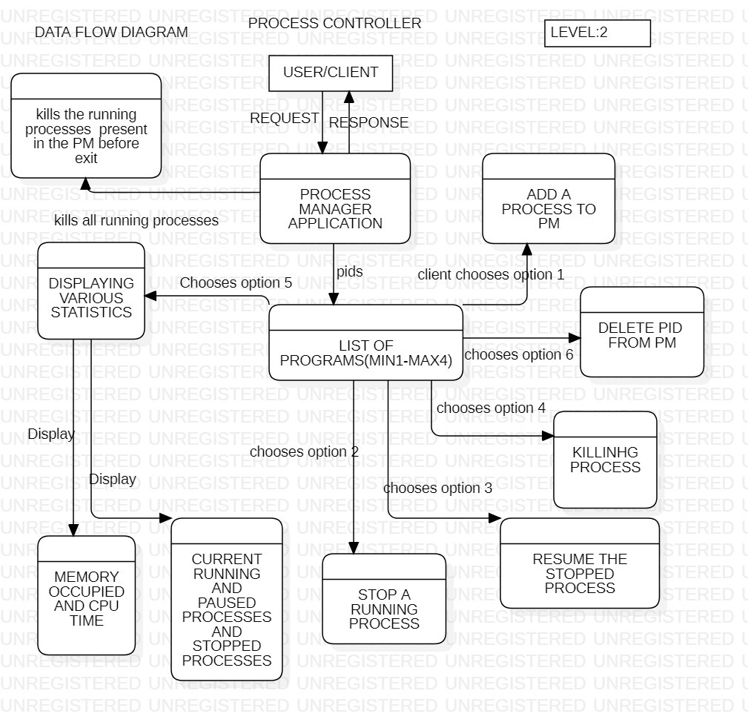
DFD diagram
Here the external entity was USER and user request PM for PIDs and set of operations of his choices

Slide 6
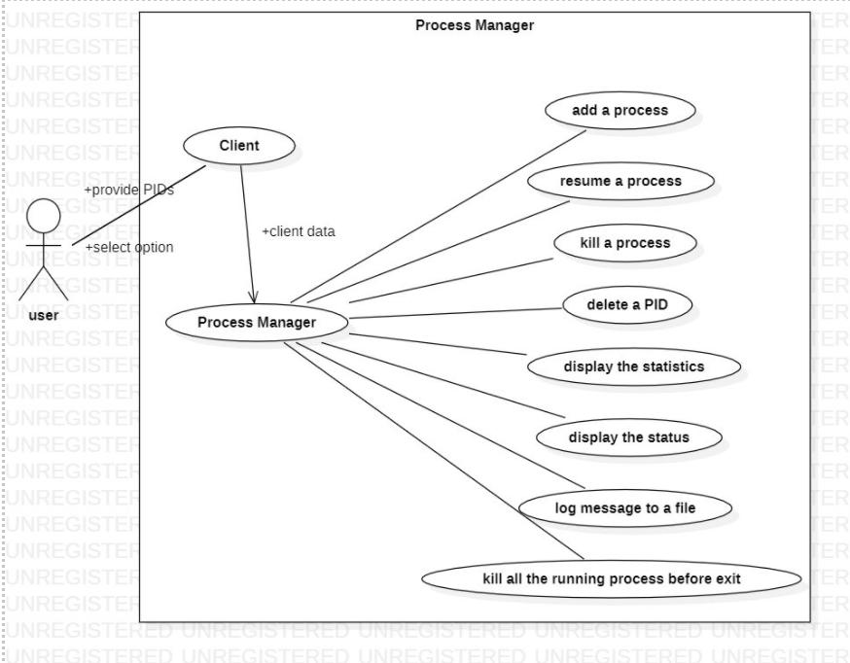
Usecase diagram

Slide 7
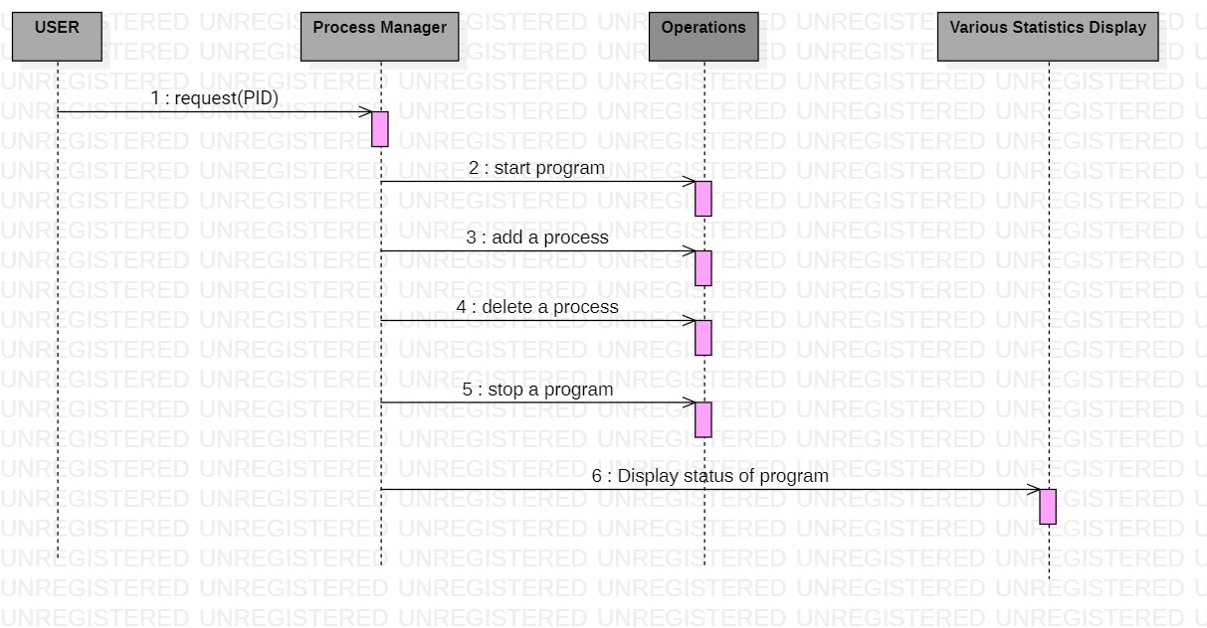
Sequence diagram

Slide 8
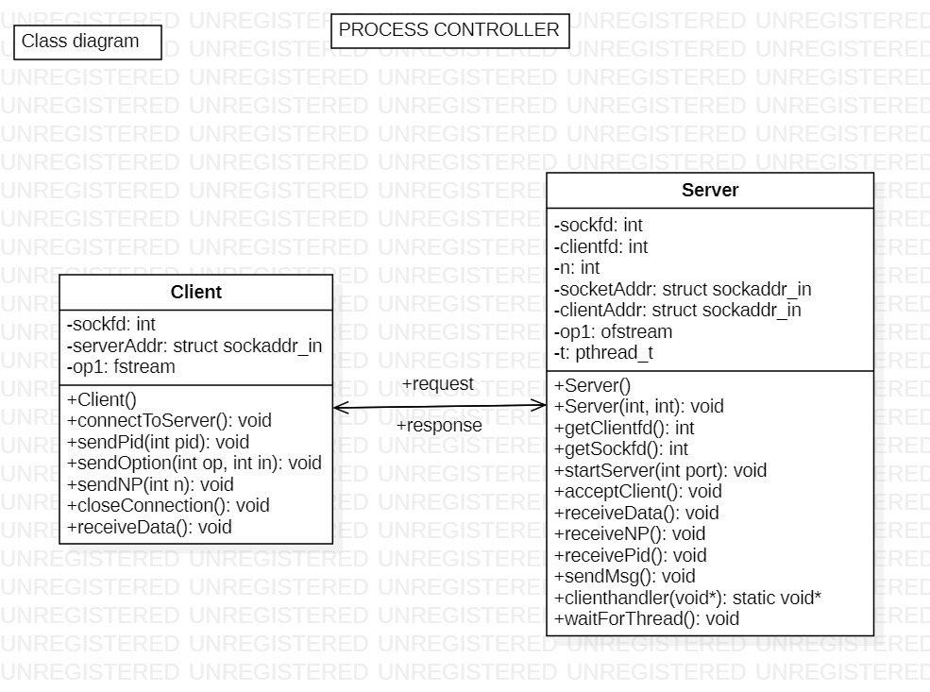
Class Diagram

Slide 9
Menu Interface
The PM application provides a menu interface for the user to select an option
The options provided in menu interface include the following:
1. Add a process to the list of process manager.
2. Stop the running process.
3.Resuming the suspended process.
4. kill the running process
5. Display the status of process.
6.Delete a process from process manager list.
7.Exit

Slide 10
Client-Server Communication
Client
Server
Socket creation
Sends info from the user as pids to the server.
Client sends the message to kill the process.
Client sends the message to pause the process.
Client sends the message to stop the process.
Socket creation.
Receives info from the client and performs the given task.
Server operates to kill the process.
Server operates to pause the process.
Server operates to terminates the process.

Slide 11
Firstly, count of PIDs is required and the user enters the count of his choice followed by the PIDs.
The PIDs are sent to the process manager and they are stored in the map with key as process number and value as PID.
User selects an option and process number of his choice to perform operations .
The option and process number are sent to the PM .
The PM checks whether the process number is present in the map, if present it performs operation
All the running process gets killed before PM exits.

Slide 12
Signals
Every signal has a unique signal number and an associated signal action.​
A process after receiving a signal will perform the default action associated with that signal number​.
If the user wants to stop a process PM send the SIGSTOP signal to the respective process
If the user wants to resume the suspended process PM send the SIGCONT signal to the respective process
If the user wants to kill a running process PM send the SIGKILL signal to the respective process

Slide 13
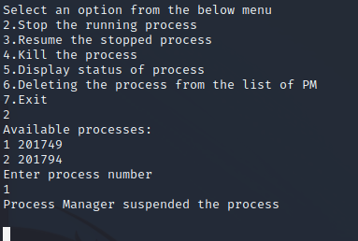
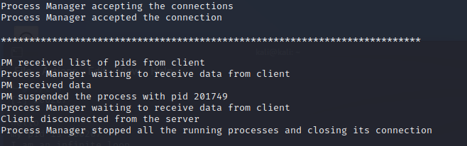
Client
Server

Slide 14
THANK YOU

