Slide 1



CIT COURSE
FINAL PROJECT
This Photo by Unknown Author is licensed under CC BY-SA-NC
This Photo by Unknown Author is licensed under CC BY-SA
BY
ANABIA KHALID
This Photo by Unknown Author is licensed under CC BY-NC-ND

Slide 2
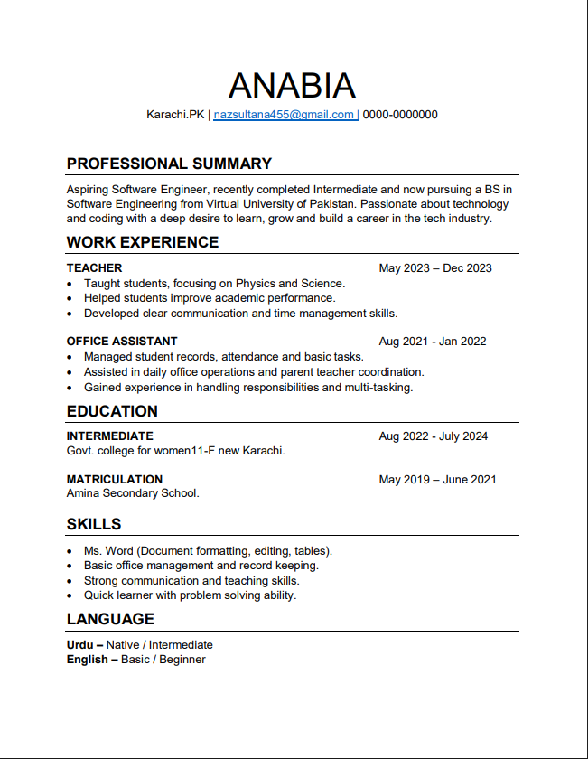





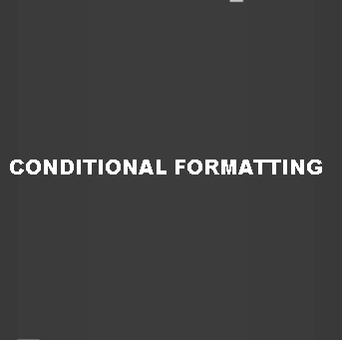
Resume (MS Word)
Created a professional resume using Microsoft Word.
Learned formatting tools like alignment, bullet points, borders, and table designs.

Slide 3
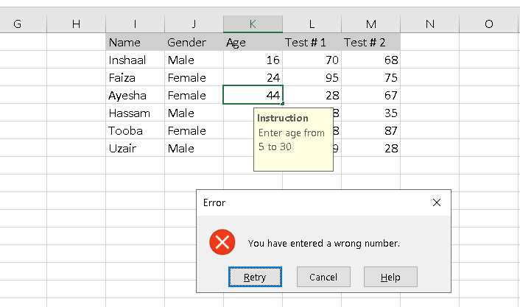
Data Validation (Excel)
Applied data validation rules to control the type of data entered in a cell.
Ensures accuracy and consistency in data entry.

Slide 4
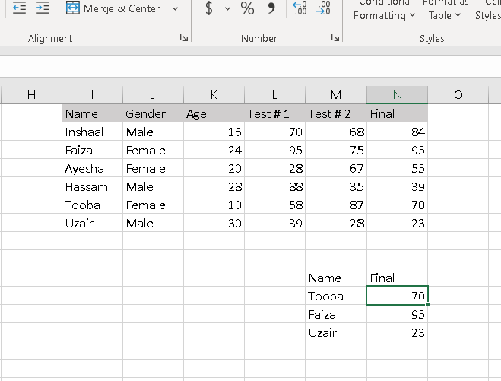
VLOOKUP (Excel)
Used VLOOKUP to search for specific data in a table.
Learned how to quickly match and retrieve information from large datasets.

Slide 5
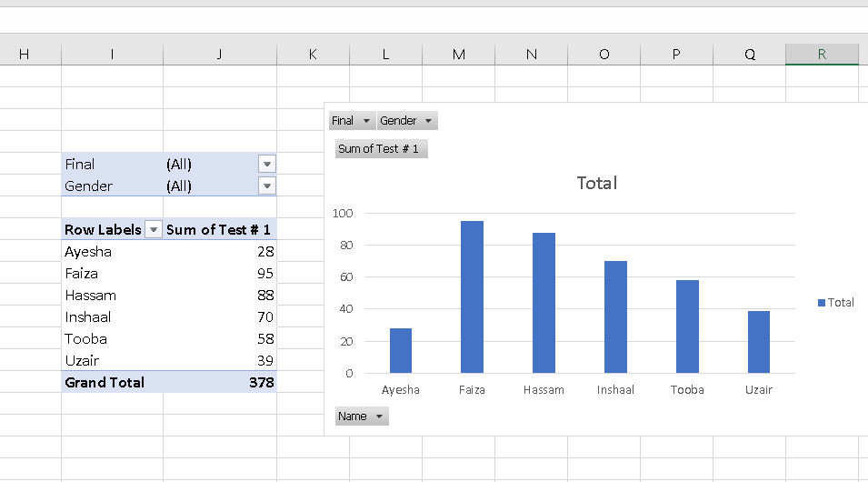
Pivot Table with Charts (Excel)
Created pivot tables charts to visually display the summarized data.
Used bar charts, pie charts, or line graphs to show patterns and comparisons.

Slide 6
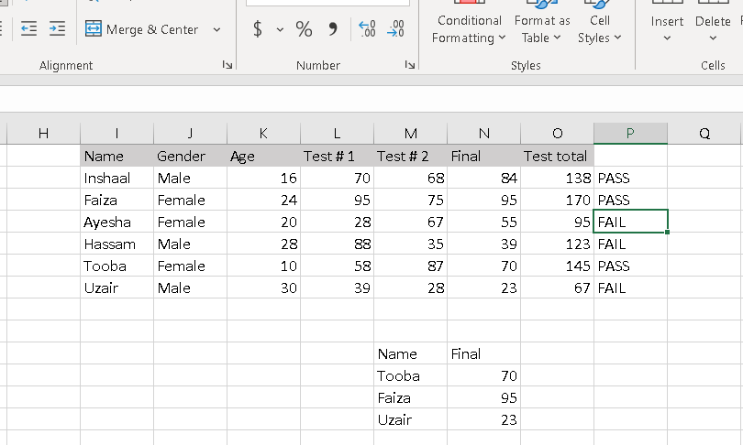
IF Statement (Excel)
Used the IF function to apply logic in Excel (e.g., “If marks >= 50 → Pass, else → Fail”).
Learned how we can automate decision-making based on conditions.

Slide 7
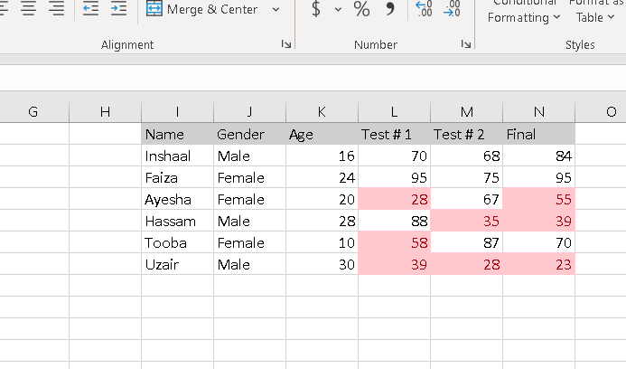
Conditional Formatting (Excel)
Applied conditional formatting to highlight important data (like highest/lowest values, duplicates).
Helped in quick decision-making by making data more readable.

Slide 8

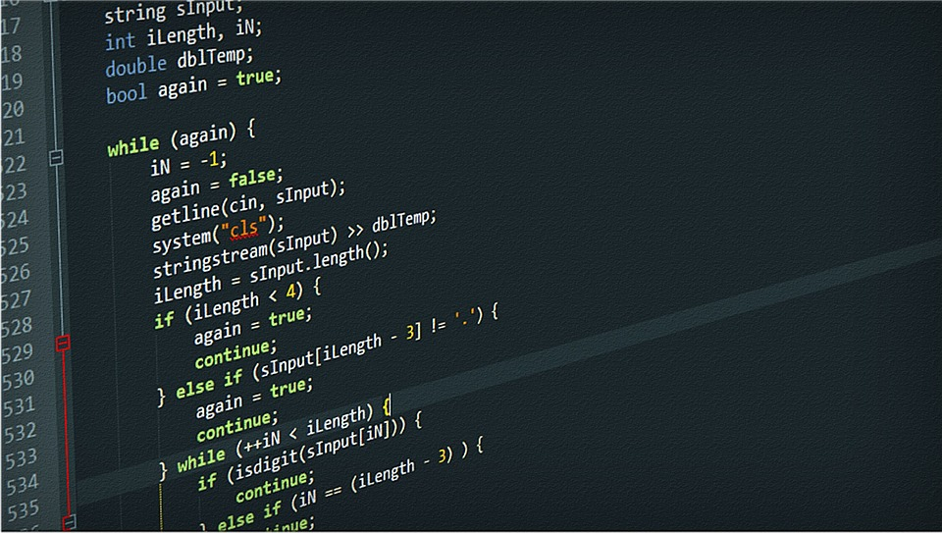
THE END
INSTRUCTOR :
SIR ABDUL MUNIM USMANI

