Slide 1

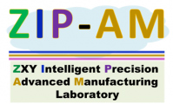

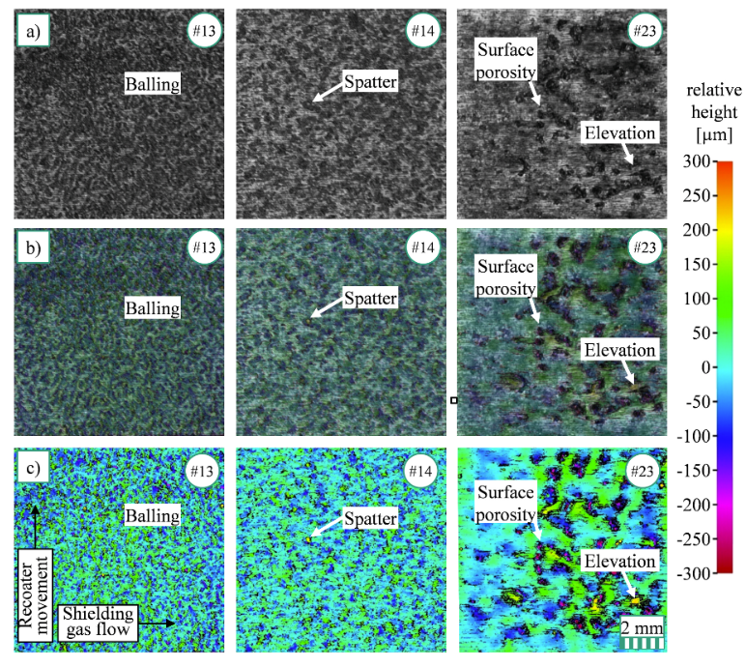
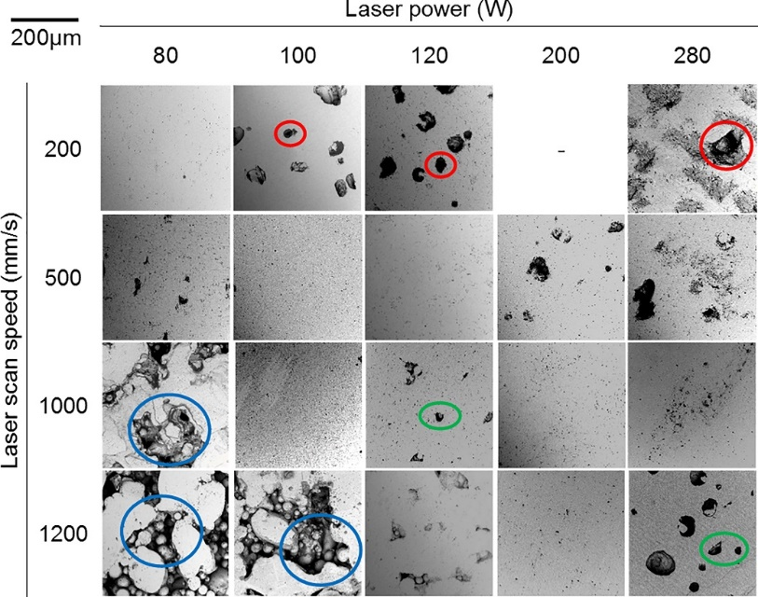
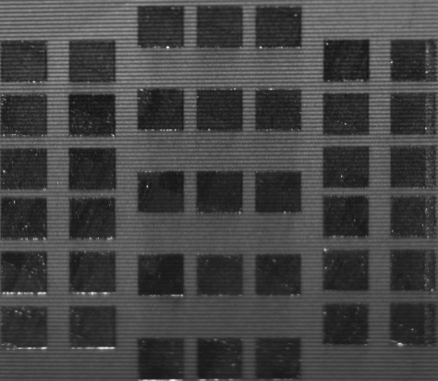
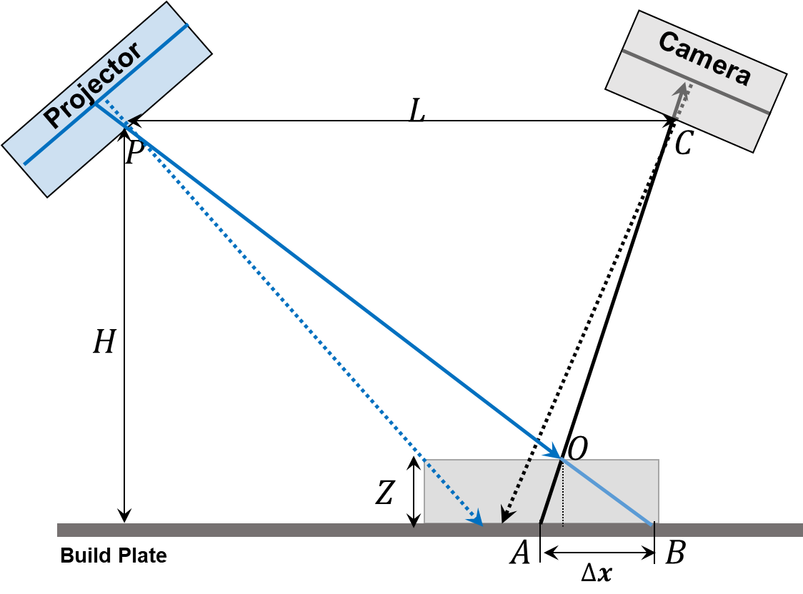
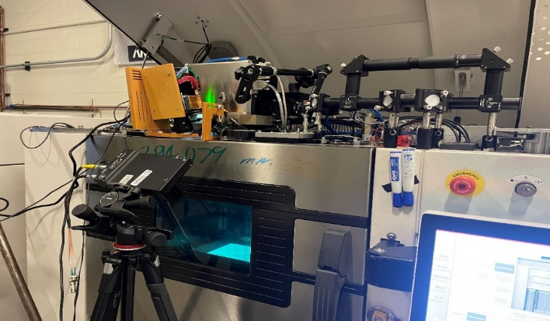
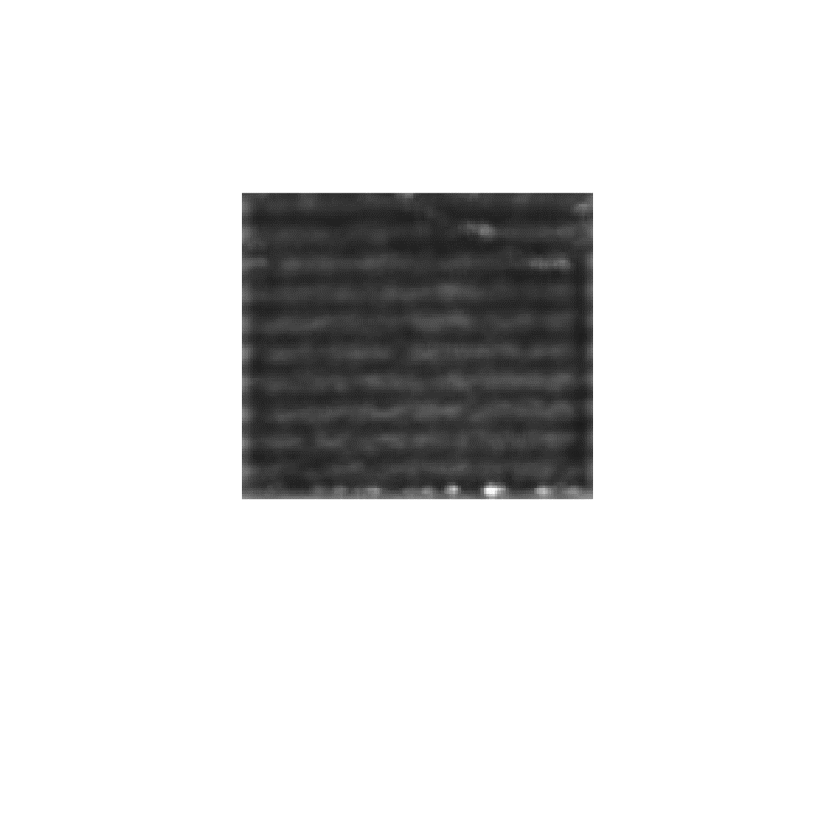
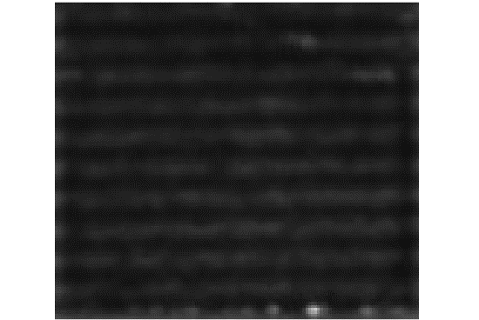
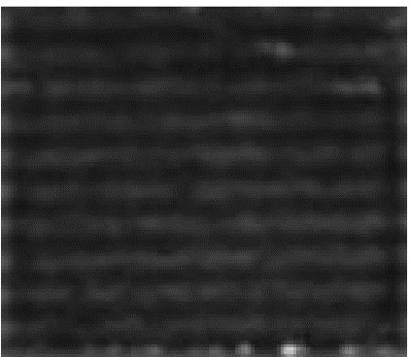
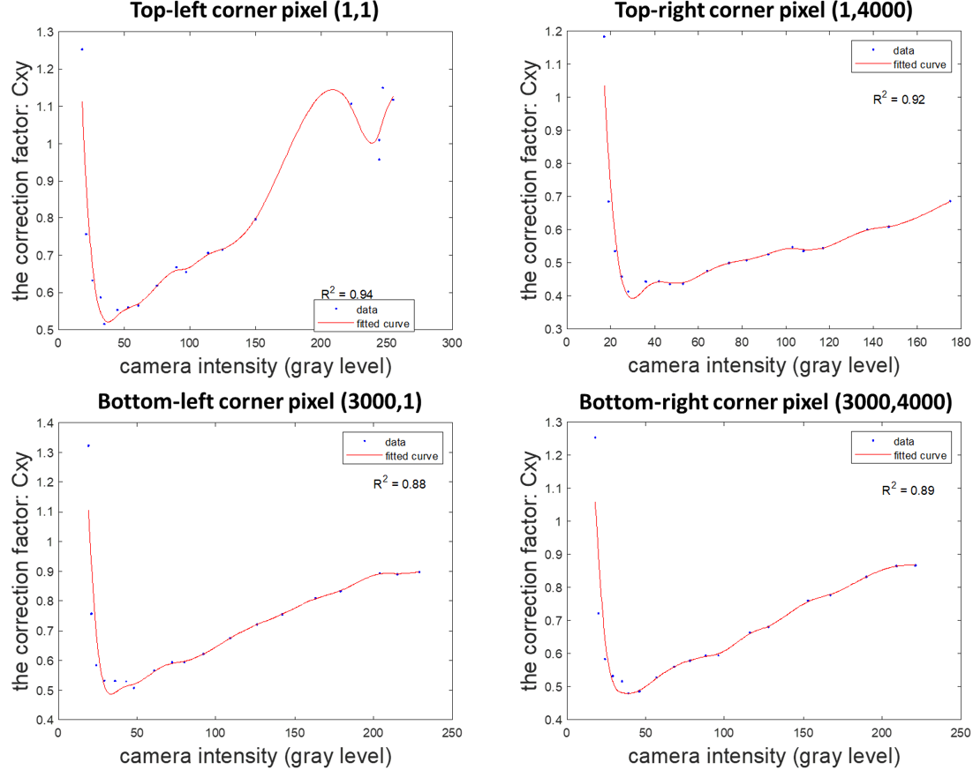
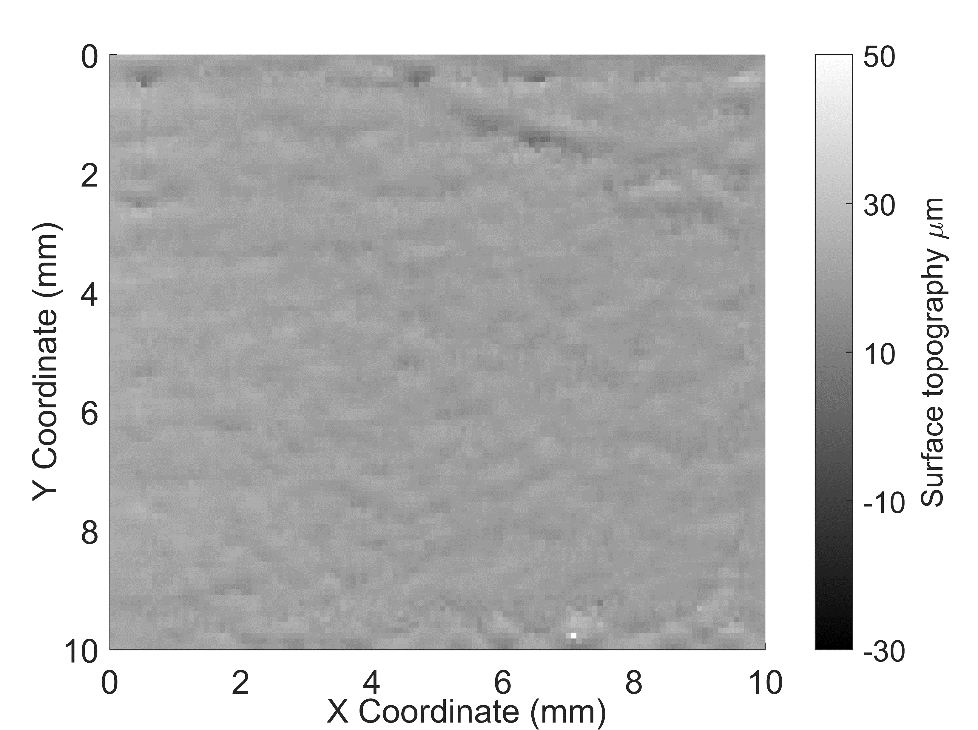
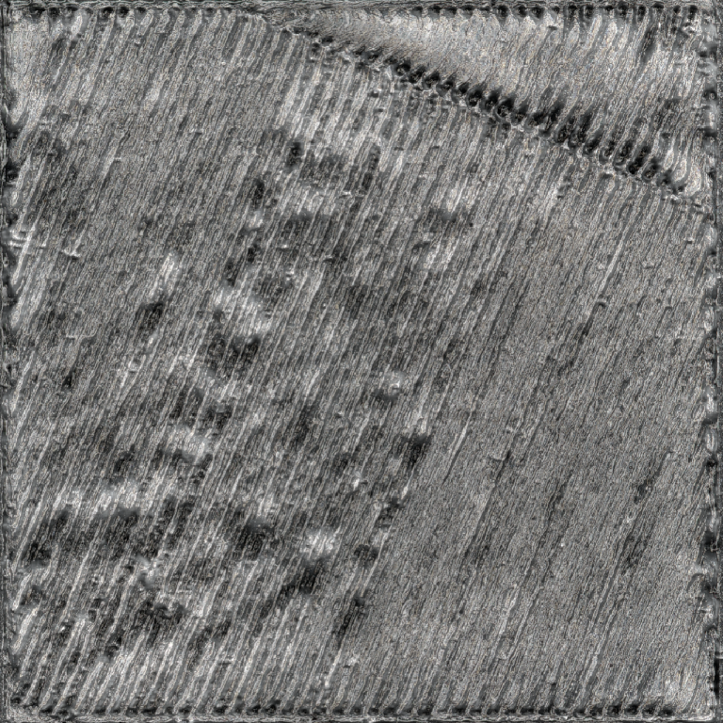
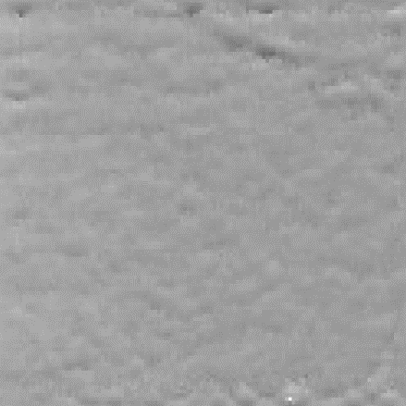
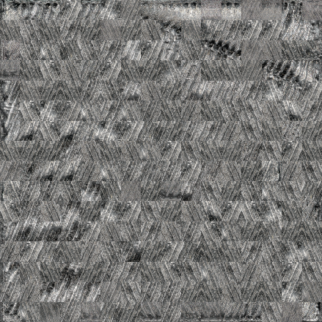
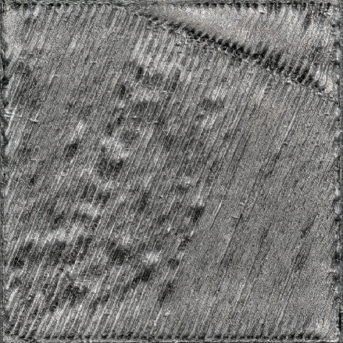
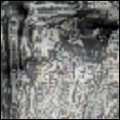
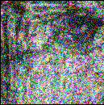
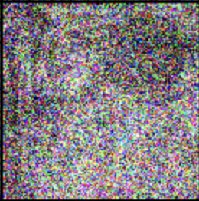


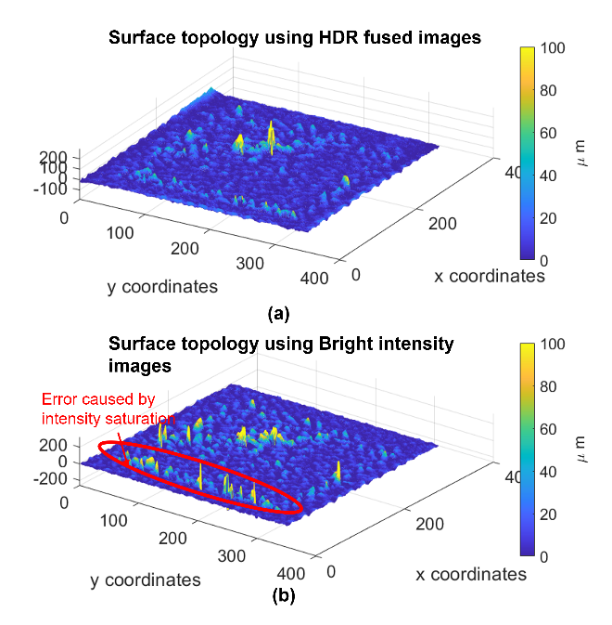
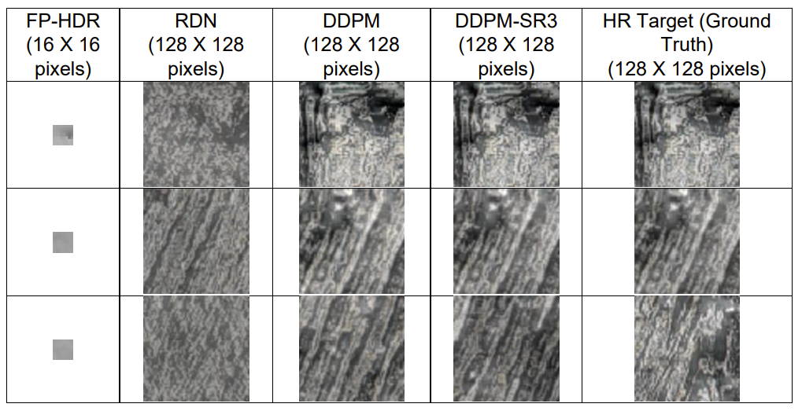
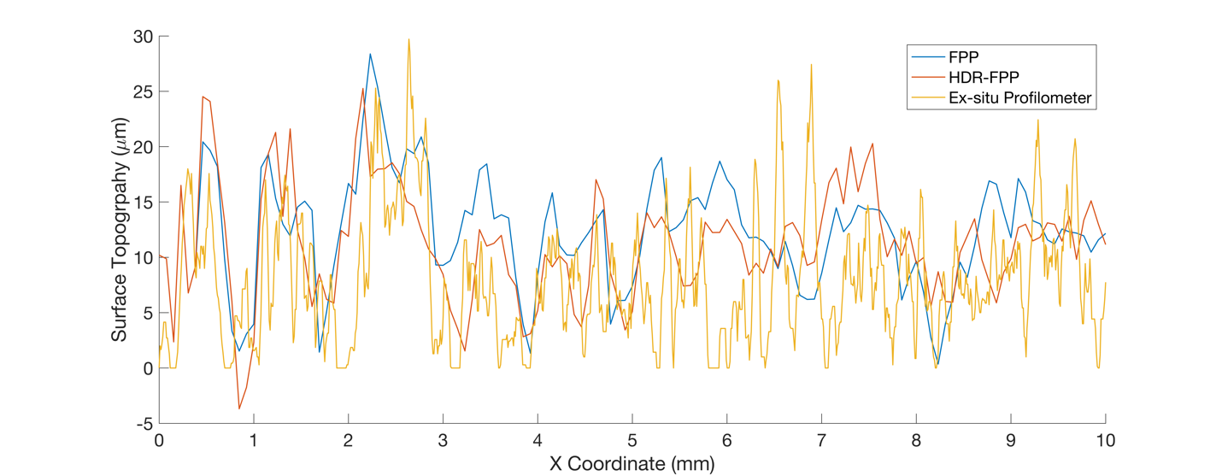
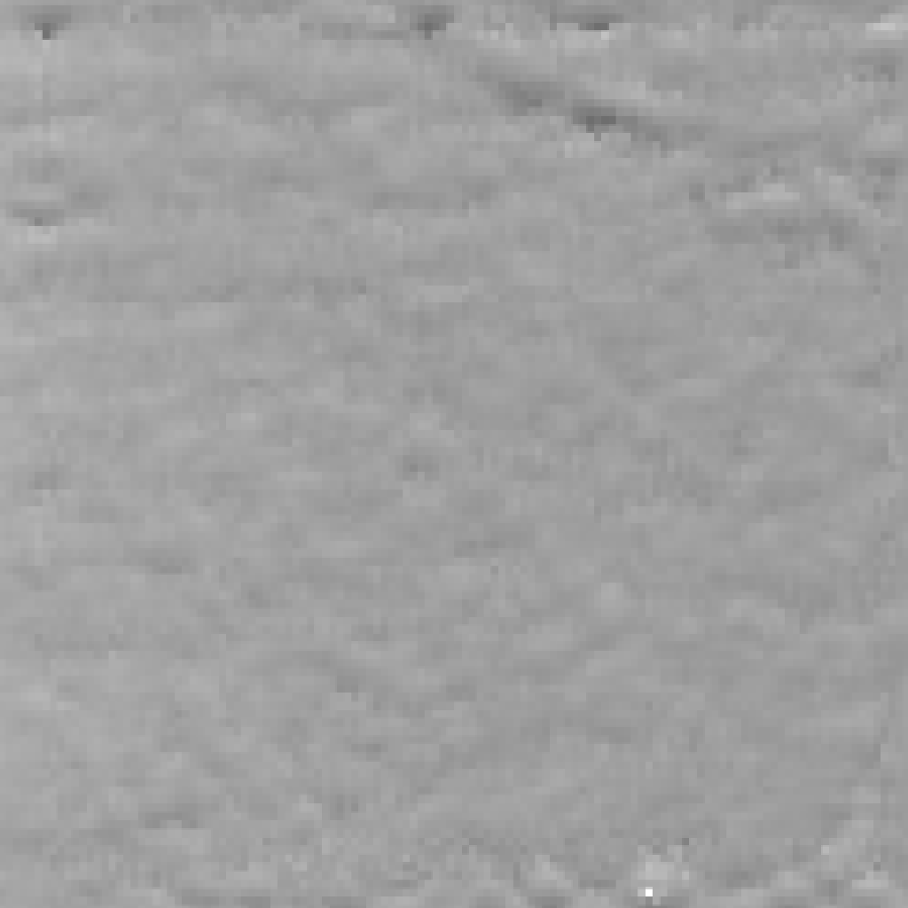
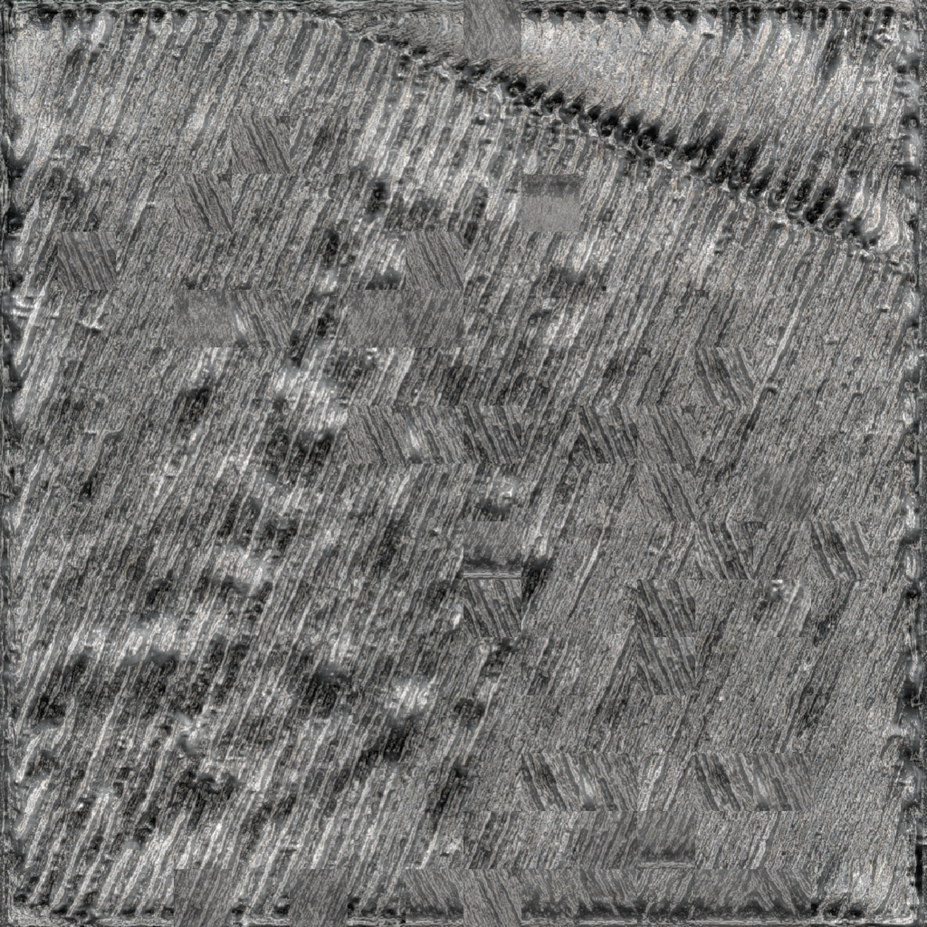






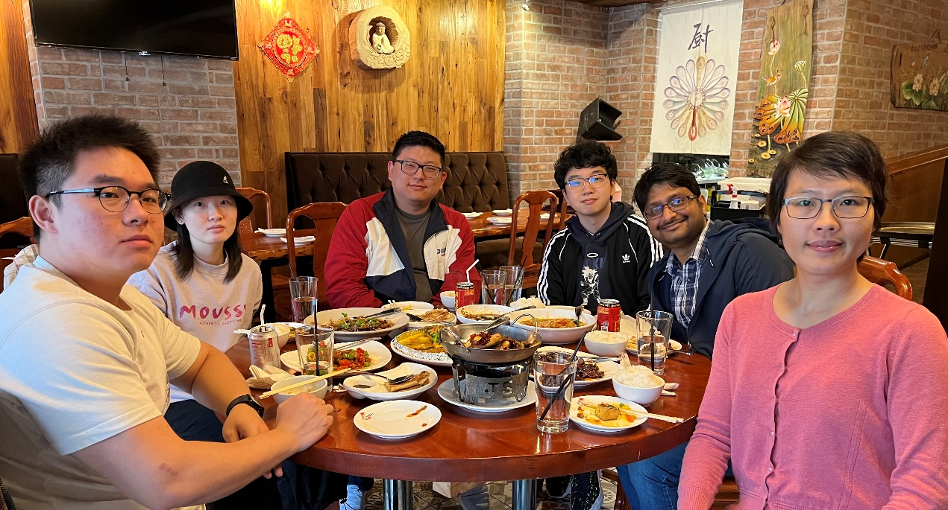





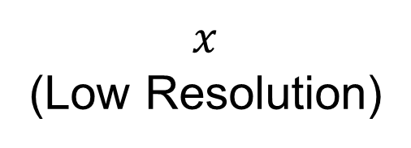


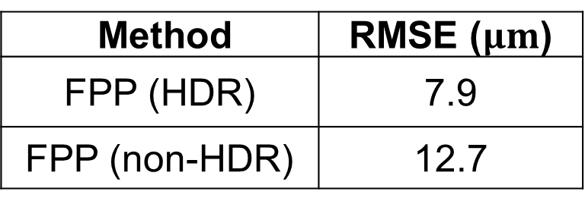

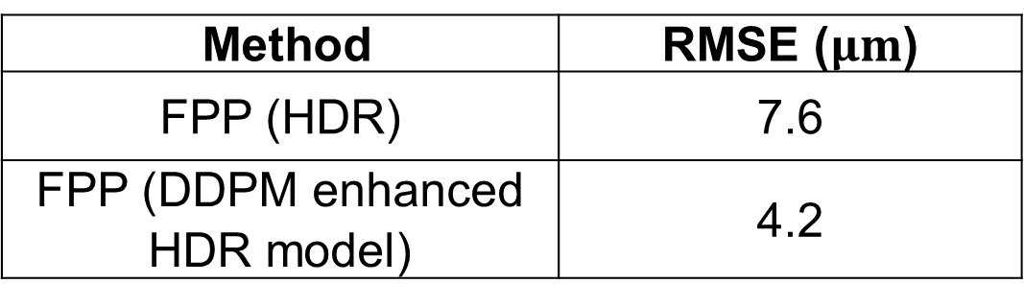

Enhancing Fringe Projection Profilometry for
in-situ Monitoring of LPBF Additive Manufacturing
Haolin Zhang, Chaitanya Krishna Vallabh, and Xiayun Zhao
Motivations
In-situ layer-wise surface topography is essential for part qualification, providing information related to defects such as recoater hopping & streaking, porosity, and spatter re-deposition.
Fringe Projection Profilometry (FPP) is one such method which can offer in-situ surface topography measurements in LPBF efficiently, in a non-destructive and cost-effective manner
However, the current state of art FPP for LPBF is susceptible to certain unique challenges such as low-resolution imaging, variable reflectance issues from powder and print part
Surface defects and corresponding topography measurements (Fischer, Birk, et al. (2021))
Process Parameters vs Porosity Defects (Majumdar, Trina, et al. (2019))
Representative FPP image for a LPBF print
Fringe Projection Profilometry (FPP)
Research Objectives
Projector
Improve FPP for LPBF process measurement with a modified sensor model using localized intensity correction and phase unwrapping with FFT filtering
Implement projector-based high dynamic range (HDR) methods to mitigate shadowing and intensity saturation issues due to the reflectance difference between powder and print part
Develop machine Learning (ML) based models to overcome the hardware and optics constraints for better accuracy and resolution
CMOS camera
Building Chamber
Schematics and actual setup of FPP on EOS M290
Our Developed Framework of LPBF-Specific FPP for Enhanced Measurement Capability
ML #1: Convolution-based Model
Image with Bright Intensity
Image with Dark Intensity
Fused Image
Input: FPP measured
surface topography
Resnet 101 Encoder
Extracted
Feature vector
Resnet 101 Decoder
Training: ex-situ Keyence Profilometry measured surface topography
Output:
high-resolution
surface topography
FPP images at different intensities projected
Image fusion for HDR
Wrapped Phase calculation with local intensity calibration C_{xy} & Phase Unwrapping with 2D FFT
FPP measured Layer-wise print part surface topography
(limited resolution)
Developed Machine Learning (ML) models
ML enhanced Layer-wise print part surface topography (higher resolution)
$${ y}_{0}\sim p(y|x)$$
$${ y}_{t−1}$$
$${ y}_{t}$$
$$q({ y}_{t}|{ y}_{t−1})$$
$${ y}_{T}\sim Ν(0, I)$$
(High Resolution)
$$p({ y}_{t−1}|{ y}_{t},x)$$
ML #2: Denoising Diffusion
Probabilistic Model (DDPM)
$x$
(Low Resolution)
Experimental case study and Results
Remarks and Ongoing Work
Sample results from different ML models enhanced HDR-FPP
Outcomes:
The developed ML enhanced HDR-FPP method successfully mitigates the intensity saturation and shadowing problems and improves the resolution that is typically limited by hardware.
Through developed ML models, the lateral resolution of HDR-FPP (38 µm) is improved to 5 µm, and the vertical resolution is improved from 10 µm to 1 µm.
The ML enhanced HDR-FPP method aids the detection of microscopic defects that are not discernable by conventional FPP methods.
Ongoing Work:
Improve the algorithm and code for computation time-efficiency and real-time implementation.
Develop more advanced phase unwrapping methods
Surface topography from FPP
Surface topography from HDR-FPP
RMSE for line profile comparison
HDR FPP vs. non-HDR FPP
Method | RMSE ($μm$)
FPP (HDR) | 7.9
FPP (non-HDR) | 12.7
RMSE for surface topography comparison HDR FPP vs.
ML (DDPM) enhanced HDR-FPP
Method | RMSE ($μm$)
FPP (HDR) | 7.6
FPP (DDPM enhanced HDR model) | 4.2
Surface topography from FPP
Surface topography from ML (DDPM) enhanced HDR-FPP
Surface topography from ex-situ profilometry measurement
Acknowledgements:
Department of Energy University Turbine Systems Research grant (DE-FOA-0001993 Award Number: FE0031774)
NSF IUCRC Center for Materials Data Science for Reliability and Degradation (MDS-Rely) (Award#: 2052662)
ANSYS Additive Manufacturing Research Laboratory (AMRL) at University of Pittsburgh
This work used the NSF’s Extreme Science and Engineering Discovery Environment (XSEDE) resource - Pittsburgh Supercomputing Center Bridges-2 GPU and Storage through allocation grants MCH200015 and MCH210015

