Slide 1
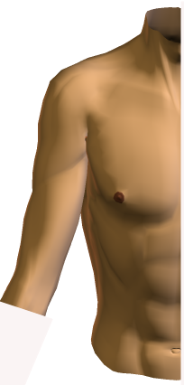
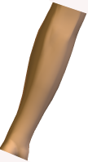
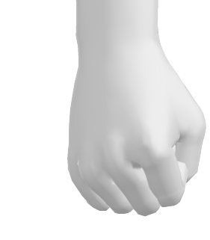
Upper Extremities Marker Model
EJC
T3
WJC
RTB
GHJC
u_{z}
MAN
RULN
u_{z}
RUSP
RRSP
T10
u_{y}
u_{x}
u_{y}
u_{z}
u_{x}
u_{y}
u_{x}
RUA
u_{z}
XIP
RM3
u_{y}
RRSP
RLM5(cal)
u_{x}
WJC
RUSP
RLEP
RDC(wheel marker)
EJC
RMEP(cal)
RHC(wheel)
RPC(wheel)
Subject Parameters:
Mass= 70kg
Height=1.6m
Hand seg. Length = 0.099m
Forearm seg. Length = 0.279m
Upper arm seg. Length =0.320m
Trunk seg. Length = 0.212m
Markers:
"10TH THORACIC VERT.", "T10"
"3RD THORACIC VERT.", "T3"
"MANUBRIUM", "MAN"
"XIPHOID", "XIP"
"RT. Wheel Marker1", "RDC"
"RT. Wheel Marker2", "RPC"
"RT. Wheel Marker3", "RHC"
"RT. LAT. 5TH METACARP.", "RLM5"
"RT. 3RD METACARPAL", "RM3"
"RT. RAD. STYLOID. PROC.", "RRSP"
"RT. ULN.", "RULN"
"RT. LAT. EPICONDYLE", "RLEP"
"RT. ULN. STYLOID. PROC.", "RUSP"
"RT. MED. EPICONDYLE", "RMEP"
"RT. UPPER ARM", "RUA"
"RT. TUBERCLE", "RTB"
Analog:
“Anterior Deltoid” , “A DELT”
“Infraspinatus”, “INFRASP”
“Medial Deltoid”,“M DELT”
“Rhomboid”, “RHOMB”
“Supraspinatus”, “SUPRASP”
“A/P force to hand”,”WHLCHR FX”
“M/L force to hand”,”WHLCHR FY”
“Vertical force to hand”,”WHLCHR FZ”
Reference article:
Rao, S. S., E. L. Bontrager, J. K. Gronley, C. J. Newsam and J. Perry (1996). Three-dimensional kinematics of wheelchair propulsion. IEEE Trans Rehabil Eng 4(3): 152-60.

Slide 2
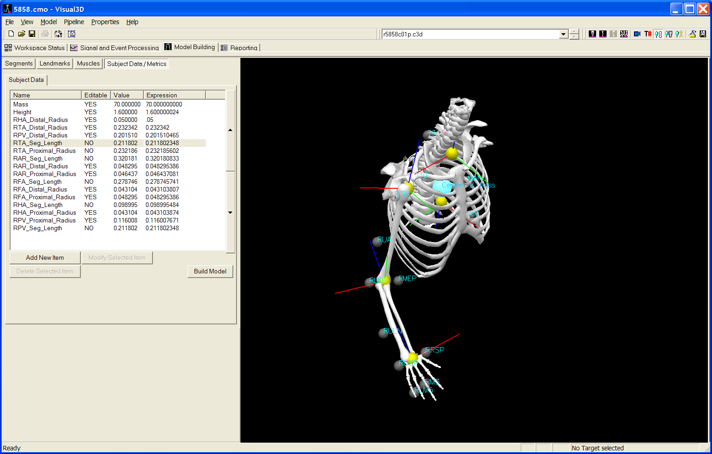

Slide 3
