Slide 1
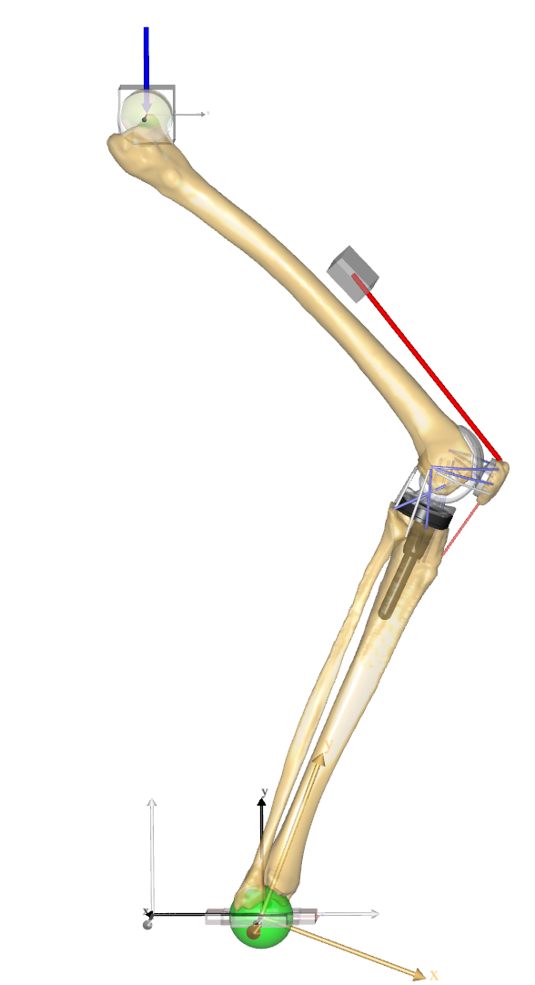
External Load
Hip slider segment
Quadriceps actuator
Femur segment
Patella segment
Tibia segment
Ankle slider segment

Slide 2
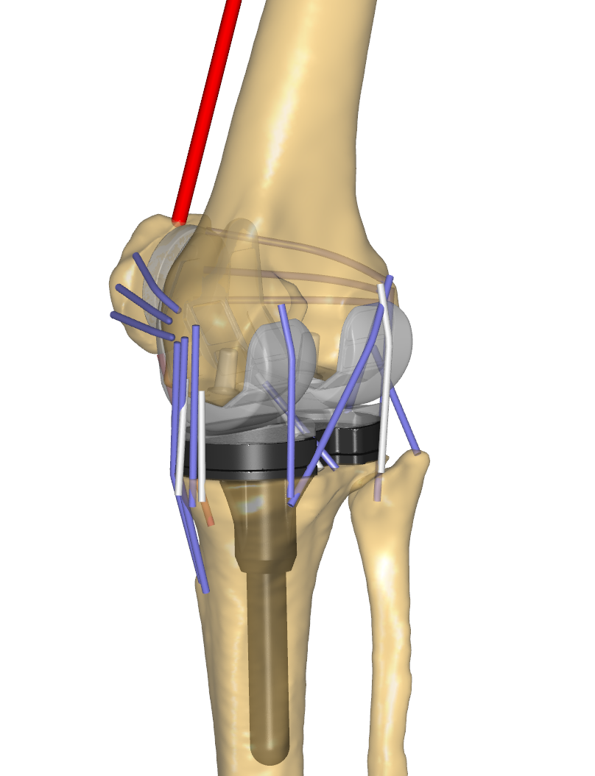
sLPFL
sMPFL
mLPFL
mMPFL
iLPFL
LCL
iMPFL
pMCL
Lcap
Mcap
OPL
PFL
aPCL
aCM
PPCL
pCM
aMCL
cMCL

Slide 3
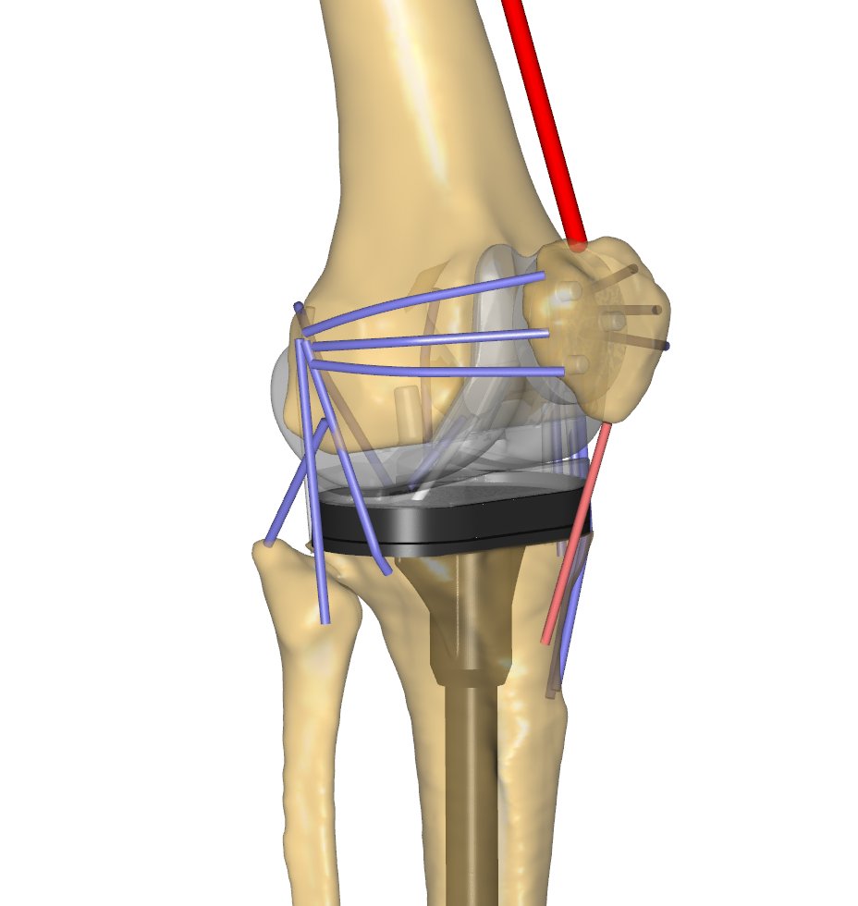
Patella femur contact
Femur-Tibia contact
Femur-Tibia Medial C Contact

