Slide 1
Recycling
In sweden, everything is recycled :
  There is no 1 green bins for recyclables products but:
    1 light green for paper,
    1 dark green for glass,
    1 blue pour newspapers,
    an other for plastics, …
    In some regions, their are more than 20 bins !
Garbage become energy !
  They’ve got a lot of recycling plants which convert organics garbage into electricity.
  These plants are so efficient that Sweden had to import waste to profitable for them
1

Slide 2
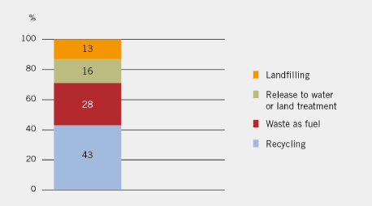
Recycling
In 2010, 71 % of all waste were recycled or re-used

Slide 3
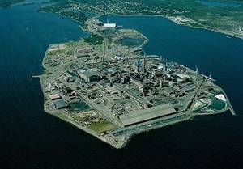
Electronic reclycling
Rönnskär is one of the world’s most efficient recycling plant.
It can recycle 120,000 tons of electronic products a year

