Slide 1
Recycling
In sweden, everything is recycled :
There is no 1 green bins for recyclables products but:
1 light green for paper,
1 dark green for glass,
1 blue pour newspapers,
an other for plastics, …
In some regions, their are more than 20 bins !
Garbage become energy !
They’ve got a lot of recycling plants which convert organics garbage into electricity.
These plants are so efficient that Sweden had to import waste to profitable for them
<numéro>

Slide 2
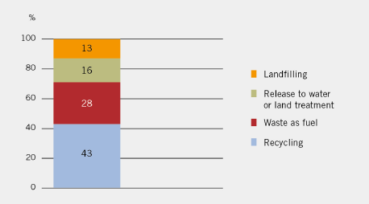
Recycling
In 2010, 71 % of all waste were recycled or re-used
<numéro>

Slide 3
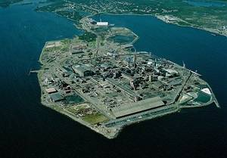
Electronic reclycling
Rönnskär is one of the world’s most efficient recycling plant.
It can recycle 120,000 tons of electronic products a year
<numéro>

