Slide 1
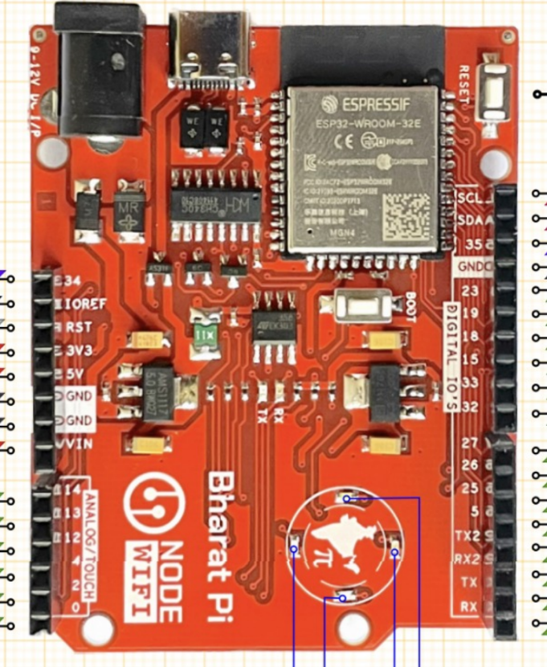
RESET
SCL (AMG8833)
SDA (AMG8833)
AMG8833 Sensor AD0 (Address Pin)
MOSI/SDA (TFT DISPLAY)
3V3
SCL/CLK(TFT DISPLAY)
5V(USB Power Output)
AMG8833 Sensor GND
ST7735 TFT Display GND
AMG8833 Sensor VIN
ST7735-TFT Display CS(CHIP SELECT)
ST7735 TFT Display DC/A0(Data/Command)
BOOT

Slide 2
RESET
SCL (AMG8833)
SDA (AMG8833)
AMG8833 Sensor AD0 (Address Pin)
MOSI (GPIO 23)
3V3
SCL/CLK (GPIO 18)
5V(USB Power Output)
AMG8833 Sensor GND
ST7735 TFT Display GND
AMG8833 Sensor VIN
ST7735-TFT Display CS(CHIP SELECT)
ST7735 TFT Display DC/A0(Data/Command)

Slide 3
RESET
SCL (GPIO 22)
SDA (GPIO 21)
MOSI (GPIO 23)
SCK (GPIO 18)
i
I
i
i
3V3
i
i
5V(USB Power Output)
i
AMG8833 Sensor GND
i
ST7735 TFT Display GND
i
AMG8833 Sensor VIN
i
i
i
i
ST7735-TFT Display CS(CHIP SELECT)
i
i
i
i
ST7735 TFT Display DC/A0(Data/Command)
i
i
i

