Slide 1


Analyzing User Engagement on Facebook Marketplace
Insight into listing patterns and reaction behavior
By: Anya Jain

Slide 2
Objectives
To explore patterns in user engagement (reactions, comments, shares) on Facebook Marketplace listings.
To analyze how time-based factors (hour and weekday of posting) influence engagement metrics.
To identify which post features or behaviors drive higher interaction.
To explore and understand how different features (like posting time, media type, product category) influence user engagement.

Slide 3
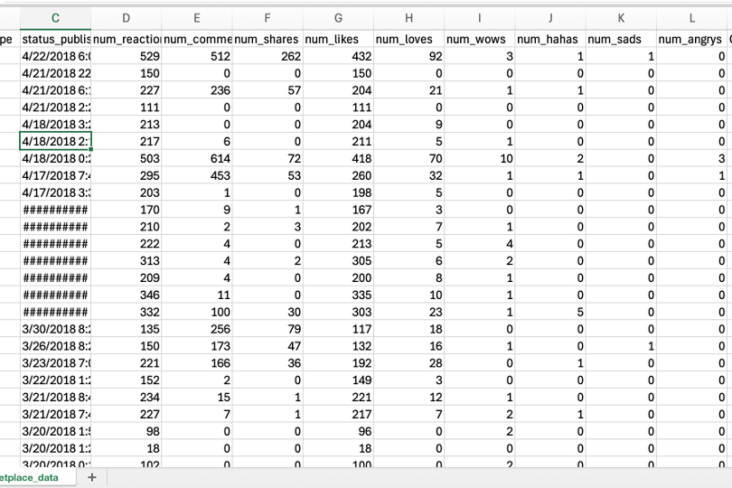
Dataset overview
The dataset used in this project contains information about the Facebook pages of 10 Thai fashion and cosmetics retail sellers. Each record corresponds to a unique post and includes various features such as:
Product ID : Unique identifier for each status post.
Status Published : Date and time when the status post was published.
Status Type : Nature of the status post (e.g., video, photo, status, link).
Num_Reactions : Number of reactions (likes, loves, wow, haha, sad, angry) received on the status post.
Num_Comments : Number of comments received on the status post.
Num_Shares : Number of shares received on the status post.
Thus, the dataset contains a mix of text, numerical, categorical, and timestamp data.

Slide 4
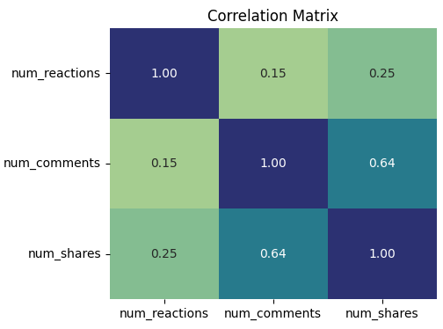
Correlation between different engagement metrics
The correlation matrix reveals that comments and shares are moderately correlated (0.64), suggesting that more interactive posts are more likely to be shared.
In contrast, reactions have a weak correlation with both comments (0.15) and shares (0.25), indicating that while reactions show engagement, they are less influential in driving further interaction or virality.

Slide 5
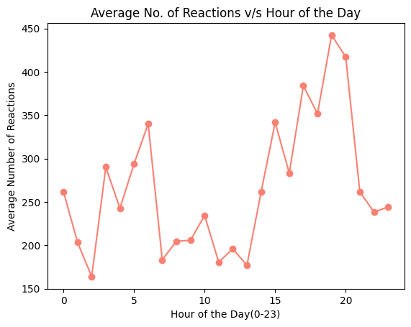
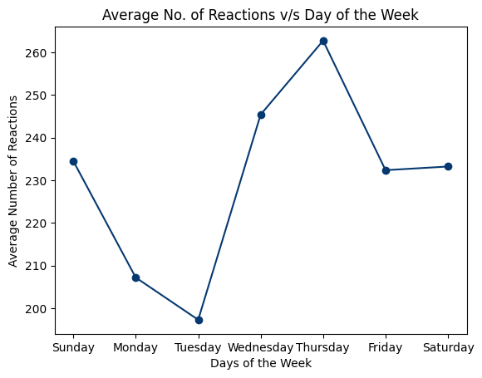
Time based trends in engagement

Slide 6
Time based trend analysis
Based on day of the week:
  Thursday has the highest average number of reactions, indicating peak engagement.
  Tuesday sees the lowest engagement, suggesting it's a less effective day to post.
  Midweek (Wednesday to Friday) generally shows higher interaction than the start of the week.
  Weekend (Saturday & Sunday) also maintains decent average reactions.
Based on time of the day:
  The highest engagement occurs around 7 PM (19:00 hours).
  Reactions begin increasing from 3 PM (15:00) and peak in the late evening.
  Lowest activity is observed in the early morning (2–6 AM).
  There is a noticeable dip in reactions between 9 AM to 2 PM, possibly due to users being busy with daytime routines.
Key Insights : To maximize engagement, aim to post on Thursdays or Wednesdays, and avoid Tuesdays if possible. Schedule posts between 6 PM to 9 PM for maximum reach and reactions.

Slide 7

Engagement analysis by post type
The number of different types of posts in the given dataset are:
→Photo : 2388 →Video : 2334
→Status : 365. →Link : 63
These metrics indicate that:
  Videos drive the most interaction, specially in comments and shares, indicating they are highly engaging content.
  Status posts generate the most reactions, suggesting personal or text-based updates spark interest.
  Links, while getting some reactions, are least interactive in terms of comments and shares.
The average engagement statistics are given by the following table:
 | Photo | Video | Status | Link
Reactions | 181 | 283 | 439 | 370
Comments | 16 | 642 | 36 | 6
Shares | 3 | 116 | 3 | 4

Slide 8
conclusion
Video posts generate exceptionally high engagement, especially in comments and shares, making them the most interactive content type.
Status updates receive the highest number of reactions, indicating strong viewer interest in text-based or personal posts.
Day of the week matters — Thursday sees the highest average reactions, while Tuesday has the lowest.
Evening hours are the most effective for engagement, with posts published around 7 PM receiving the highest average reactions.

