Slide 1




Approximation Algorithm on
Strip Packing Problem
——Group 4：陈科睿、裘海怡、董冬

Slide 2


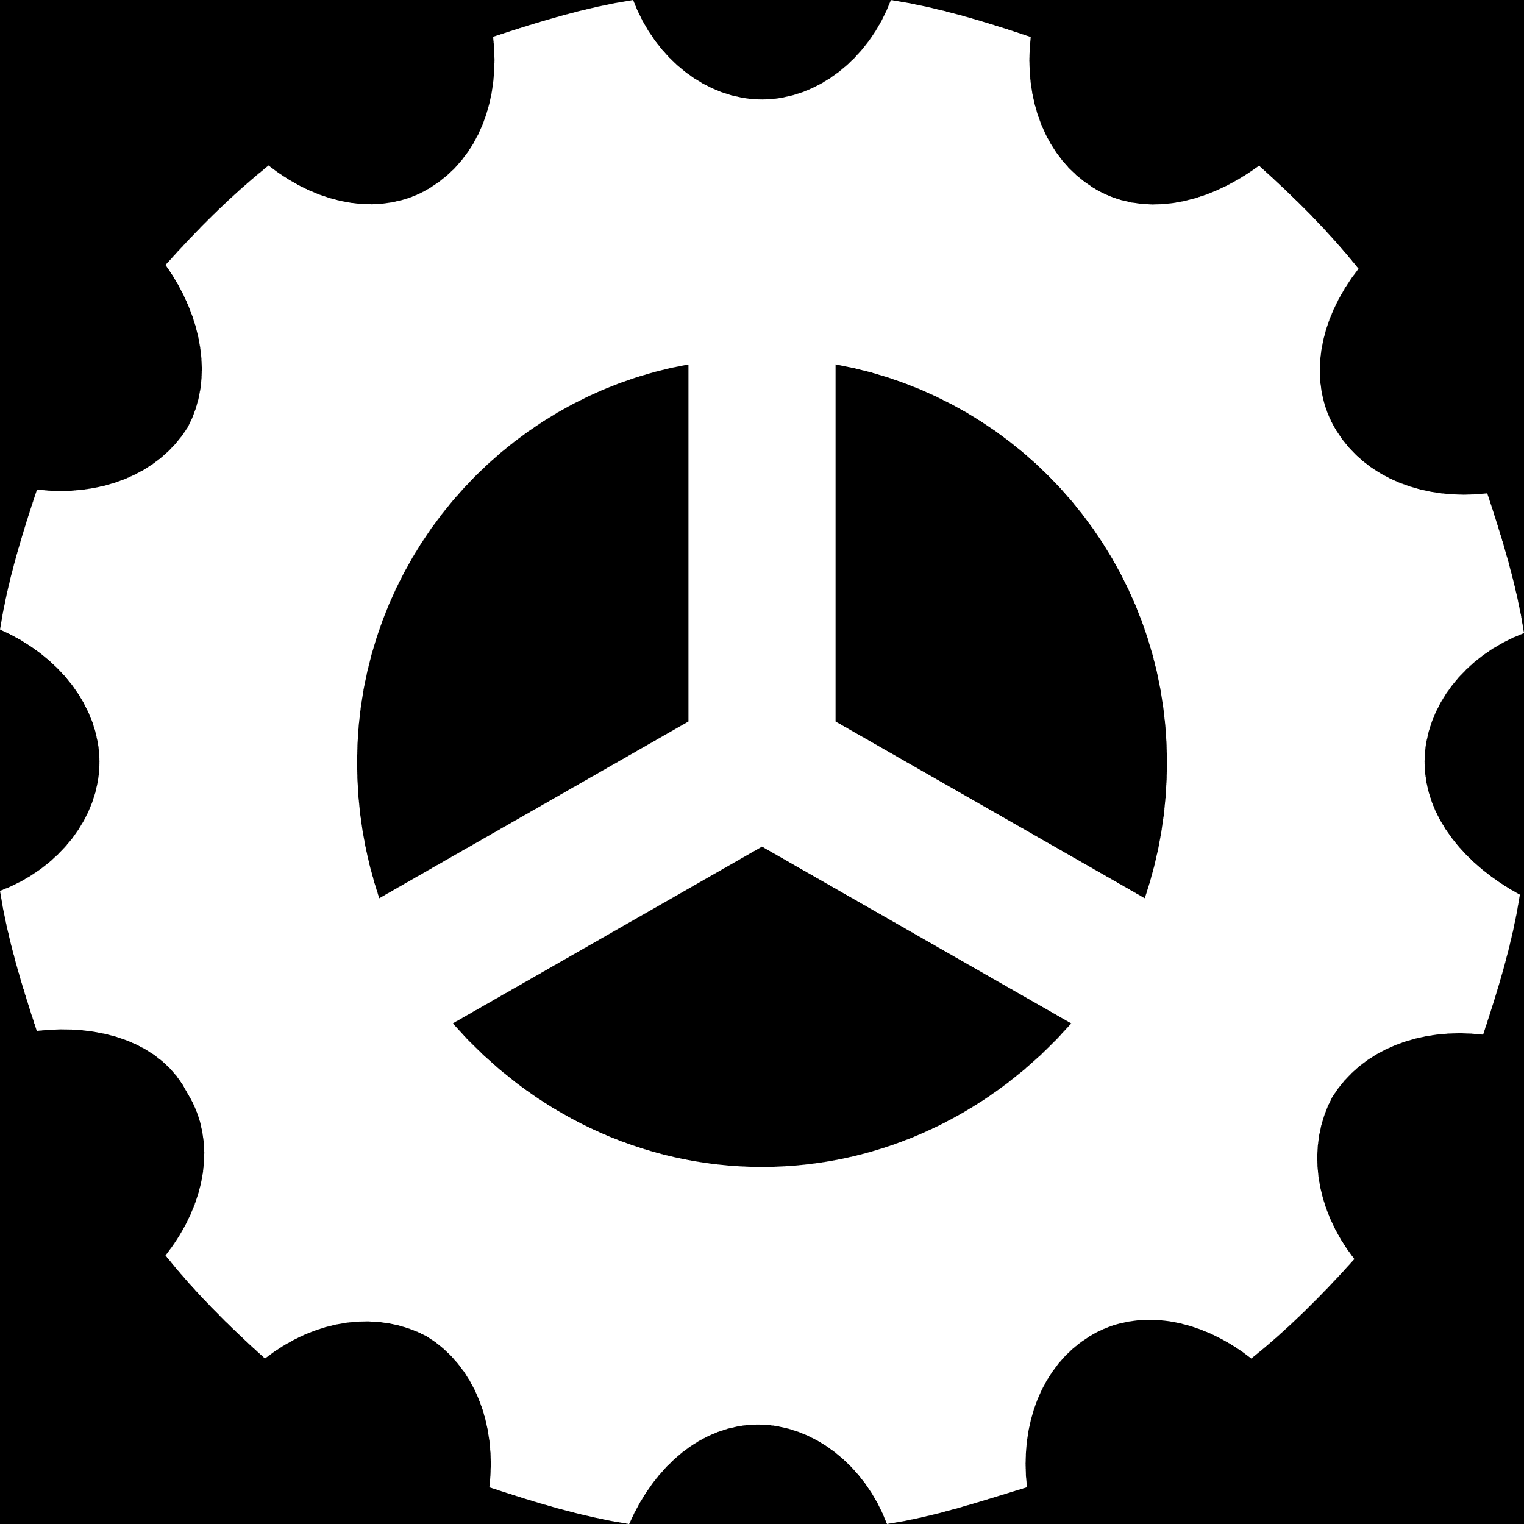
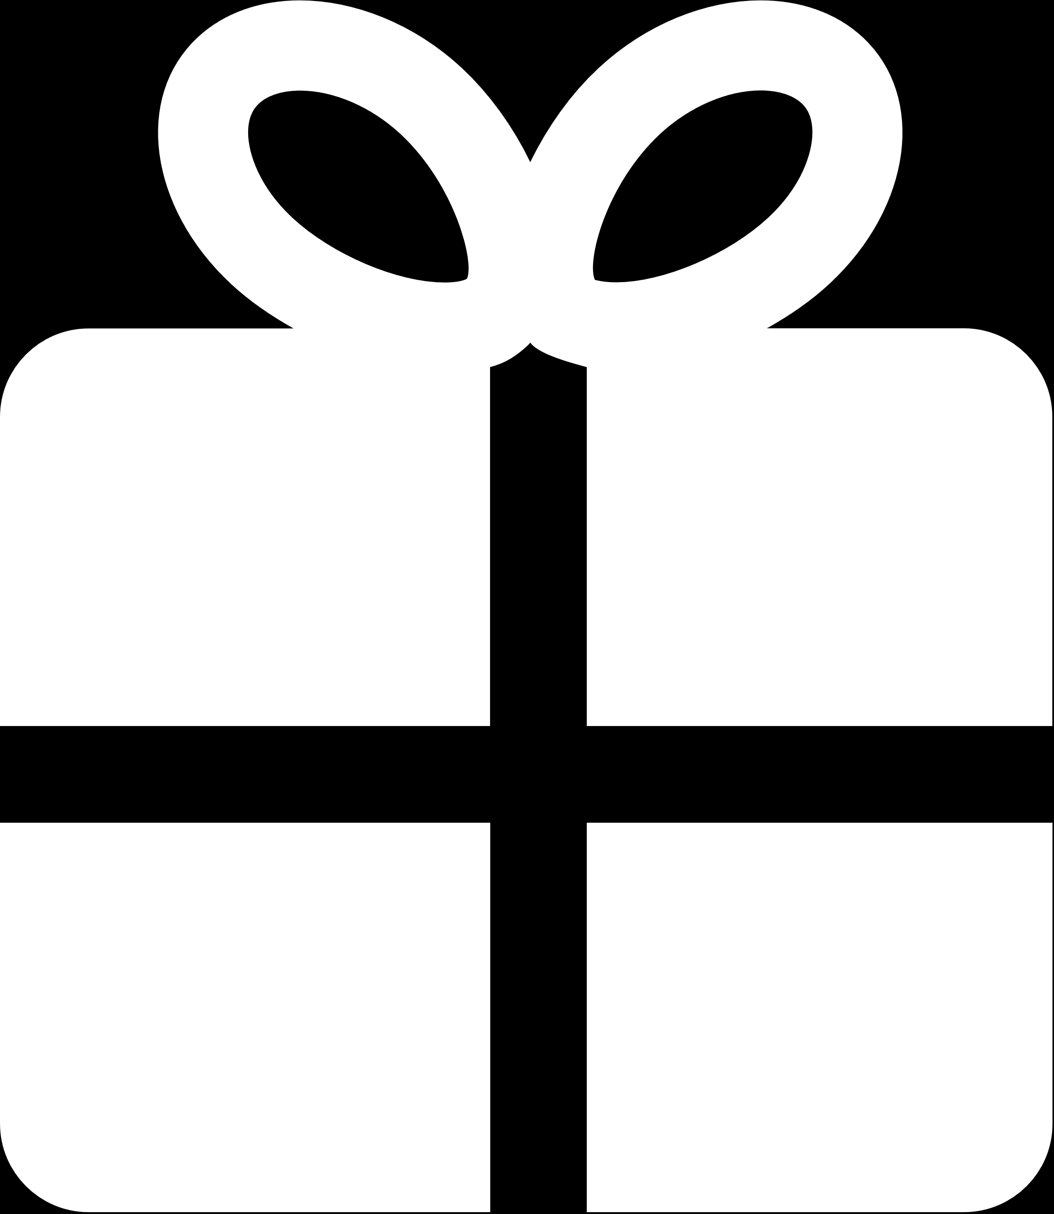
CONTENTS
Introduction
Algorithm
Test
Conclusion
- approximate radio
- time complexity
- random width and height
- Square sequence
- Literature-offered
- tetrominos

Slide 3

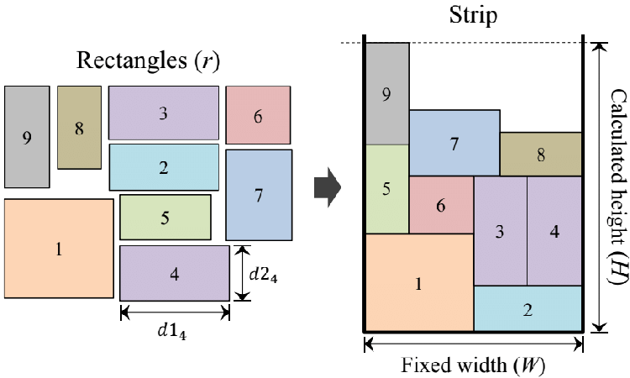
Introduction
Algorithm
Test
Conclusion
Strip Packing Problem
The strip packing problem is a 2-dimensional geometric minimization problem. Given a set of axis-aligned rectangles and a strip of bounded width and infinite height, determine an overlapping-free packing of the rectangles into the strip minimizing its height.
Relationship between bin-packing & strip-packing
It is well known that strip packing is a generalization of bin packing. Namely if we restrict all input rectangles to be of the same height, then strip packing is equivalent to bin packing.
Notes:
Strip packing problem 其实就是把给定的一组轴对齐的矩形放进一条宽度有限但高度无限的 Strip 里面，在确保矩形之间不重叠的情况下，需要使得Strp的高度尽量小。
实际上Strip packing problem 是上课时所讲的 bin packing的推广形式，如果我们将所有输入的矩形限制为相同的高度，那么Strip packing problem就等同于 bin packing problem。

Slide 4
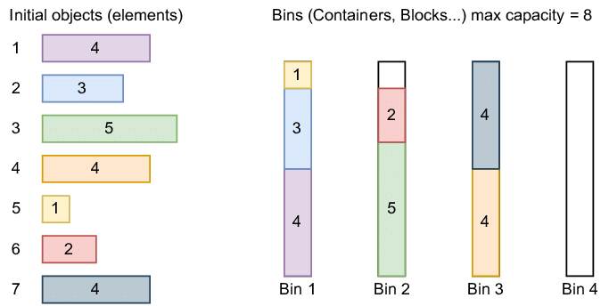
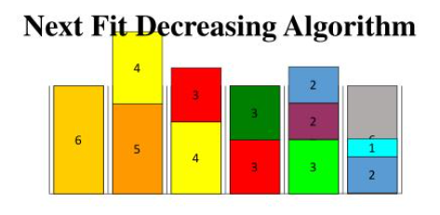
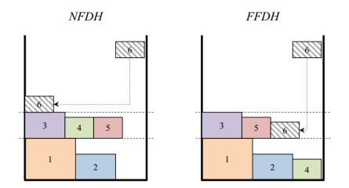
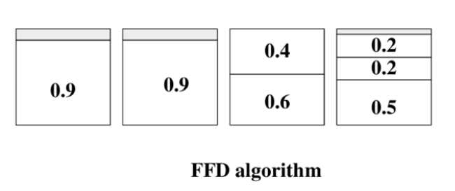
Introduction
Algorithm
Test
Conclusion
bin-packing strip-packing
the same height
NFD
NFDH
FFD
FFDH
Notes:
因此，类比bin packing的NFD和FFD算法，我们很自然地得到了strip packing的NFDH和FFDH算法

Slide 5
CONTENT
Introduction
Algorithm
Test
Conclusion
- approximate radio
- time complexity
- random width and height
- Square sequence
- Literature-offered
- tetrominos

Slide 6
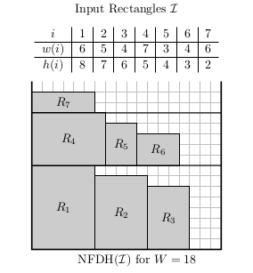
Introduction
Algorithm
Test
Conclusion
NFDH（Next-fit decreasing-height）
First, the algorithm sorts the items by order of nonincreasing height. Then rectangles are packed left-justified on a level until there is insuﬀicient space at the right to accommodate the next rectangle. At that point, the next level is defined, packing on the current level is discontinued, and packing proceeds on the new level.
Approximation ratio：
NFDH(I) ≤ 2 OPT(I) + h_{max} ≤ 3 OPT(I)
For every ε> 0, there exists a sample NFDH(I) > (2-ε)OPT(I)
Time Complexity：
sort：O(nlogn)
place：O(n)
Notes:
首先，我们按高度递减对矩形排序。然后，按照左对齐的方式在当前层级上进行装箱，直到右侧没有足够的空间容纳下一个矩形，我们就开启一个新的层级。对应到bin packing problem，其实就类似在当前的bin装不下了的时候，我们就装下一个bin。（这里的level可以类比bin）不考虑排序它的时间复杂度是O（n）

Slide 7
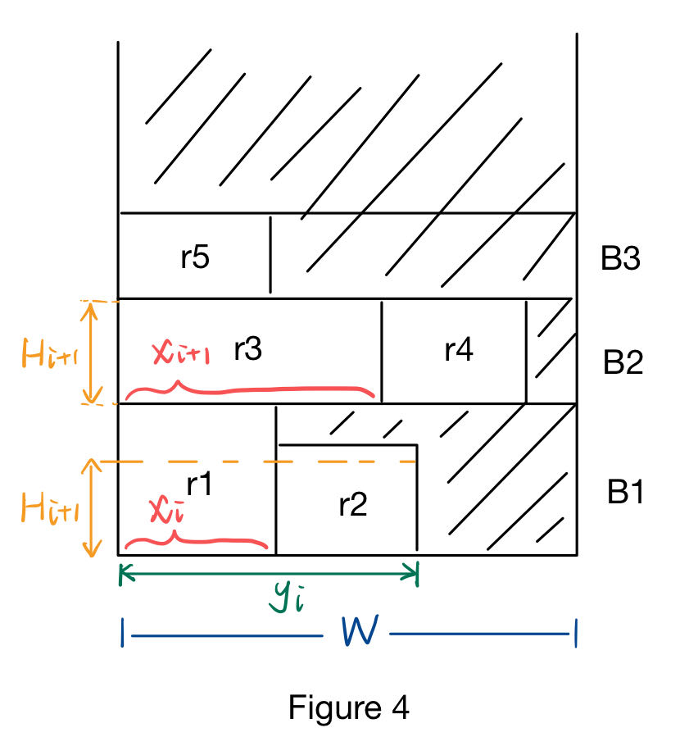
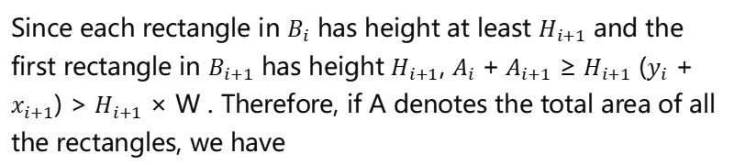

Introduction
Algorithm
Test
Conclusion
Prove the approximation ratio of NFDH
Consider the NFDH packing of such a list L, with blocks $B_{1}$, $B_{2}$, · · · , $B_{t}$. For each i, let $x_{i}$ be the width of the first rectangle in $B_{i}$, and $y_{i}$ be the total width of rectangles in $B_{i}$. For each i < t, the first rectangle in $B_{i+1}$ does not fit in $B_{i}$. Therefore $y_{i}$ + $x_{i+1}$ > W, 1 ≤ i < t, W is the width of strip.
Since each rectangle in $B_{i}$ has height at least $H_{i+1}$ and the first rectangle in $B_{i+1}$ has height $H_{i+1}$, $A_{i}$ +${ A}_{i+1}$ ≥ $H_{i+1}$ ($y_{i}$ + $x_{i+1}$) > $H_{i+1}$ × W . Therefore, if A denotes the total area of all the rectangles, we have
Notes:
然后和bin packing类似的，我们也可以证明他的近似率。我们设每一层是block i，每一层的第一个矩形的宽度是xi，每一层放置的矩形的总宽度是yi，那我们可以得到xi+1+yi是大于strip宽度W的。
设Ai表示第i层所放置的矩形的总面积，我们可以得到Ai+Ai+1>Hi+1（yi+xi+1)，最后计算将每层的高度相加，得到总高度，可以算出是小于等于H1+2*A/W，A是所有矩形的总面积。A/W是OPT的下限，所以最后我们得到NFDH小于等于hmax+2OPT，小于等于3OPT.

Slide 8
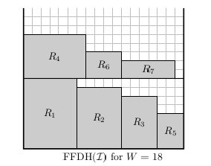
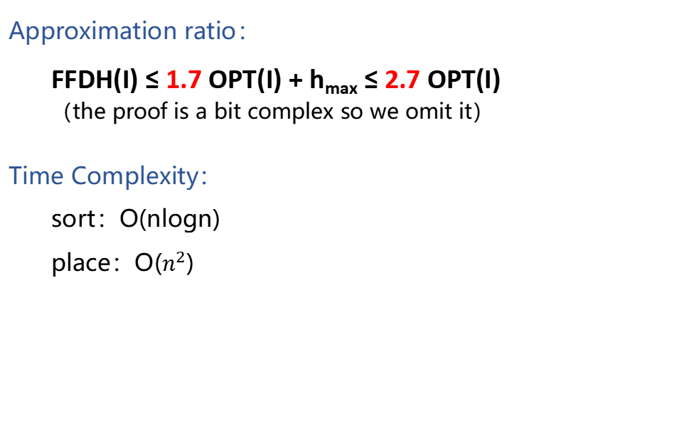
Introduction
Algorithm
Test
Conclusion
FFDH（First-fit decreasing-height）
It is similar to NFDH algorithm, but when placing the next item, this algorithm scans thelevels from bottom to top and places the item in the first level on which it will fit. A new level is only opened if the item does not fit in any previous
Approximation ratio：
FFDH(I) ≤ 1.7 OPT(I) + h_{max} ≤ 2.7 OPT(I)
（the proof is a bit complex so we omit it）
Time Complexity：
sort：O(nlogn)
place：O($n^{2}$)
Notes:
FFDH和NFDH类似，区别就是在放置下一个物品的时候它会先去看前面的几层中还有没有位置可以放，它是近似率是…… 证明比较复杂所以我们省略。不考虑排序它的时间复杂度是O（n^2）

Slide 9
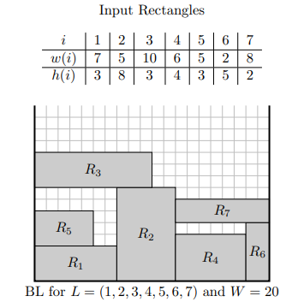
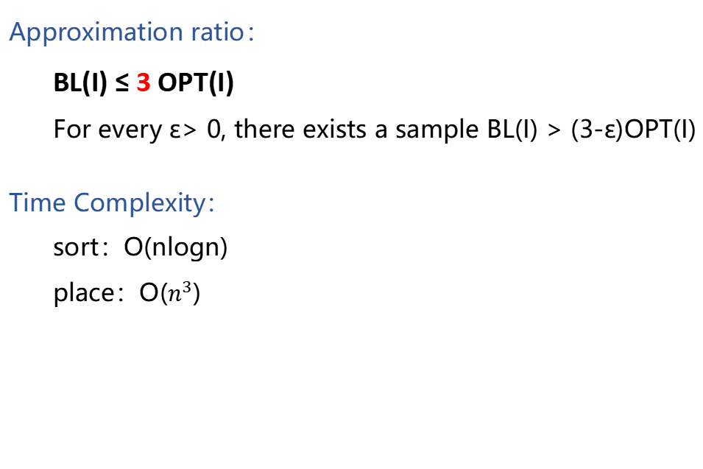
Introduction
Algorithm
Test
Conclusion
BL（Bottom-up left-justifie）
For a sequence of rectangular items, the algorithm searches for the bottom-most position to place each item and then shifts it as far to the left as possible. In the improved version, the items are ordered by decreasing widths.
Approximation ratio：
BL(I) ≤ 3 OPT(I)
For every ε> 0, there exists a sample BL(I) > (3-ε)OPT(I)
Time Complexity：
sort：O(nlogn)
place：O($n^{3}$)
Notes:
BL是一个新的算法，它的思想很简单，就是尽可能把物品放在最下面最左边的位置。对于一系列矩形物品，该算法会先寻找每个物品可以放置的最底部位置，然后尽可能将其向左移动。但在实现过程中，由于我们要逐一判断是否重叠，所以它的时间复杂度为O(n^3)

Slide 10
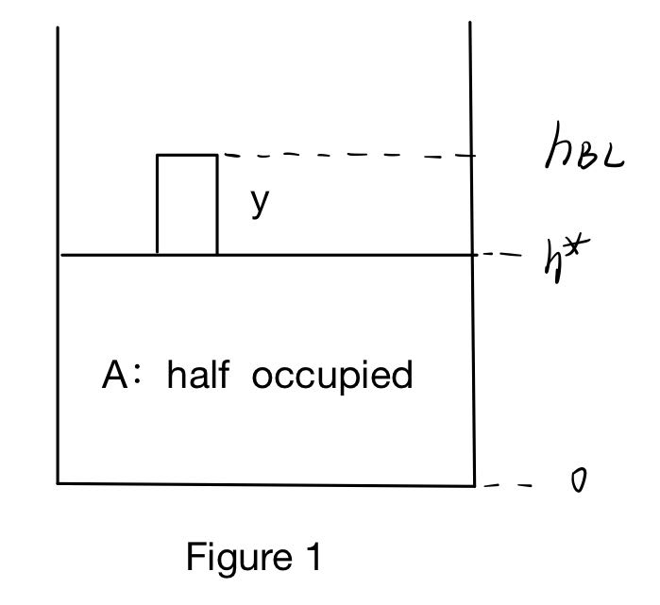
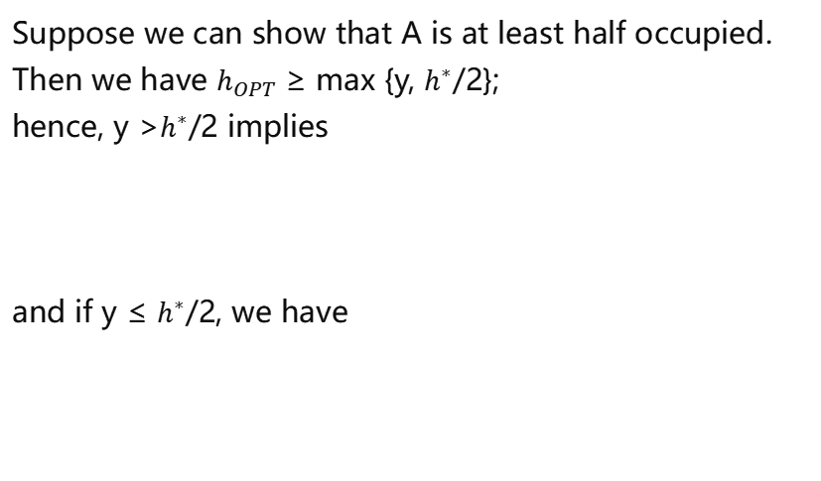
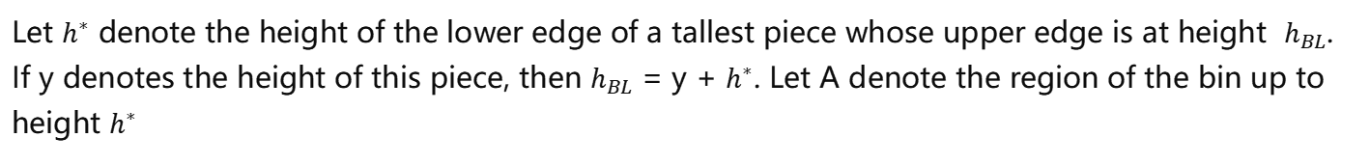
Introduction
Algorithm
Test
Conclusion
Prove the approximation ratio of BL (1)
Let $h^{∗}$ denote the height of the lower edge of a tallest piece whose upper edge is at height $h_{BL}$. If y denotes the height of this piece, then $h_{BL}$ = y + $h^{∗}$. Let A denote the region of the bin up to height $h^{∗}$
Suppose we can show that A is at least half occupied. Then we have $h_{OPT}$ ≥ max {y, $h^{∗}$/2};
hence, y >$h^{∗}$/2 implies
and if y ≤ $h^{∗}$/2, we have
Notes:
接下来我们来证明一下它的近似率，我们考虑放置结束后最高的那个矩形，它的上边就是hBL，假设高度为y，那么下边h*=hBL-y，A是h*以下的区域。我们先假设我们能证明A是半满的，也就是放置的矩形面积占总面积的一半，假设我们能证明这个，那么我们就有hOPT大于y和h*/2的最大值，不管y和h*/2的大小关系如何，我们都能得到3的近似率。

Slide 11
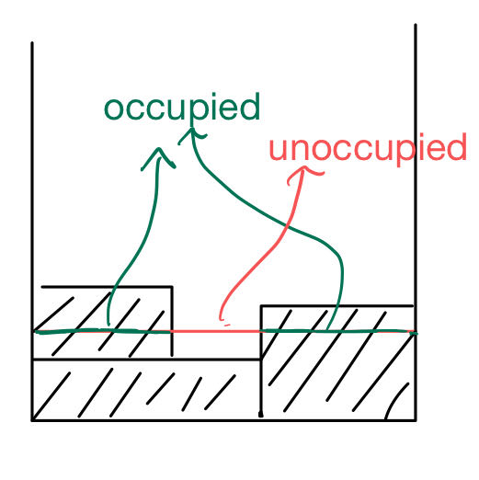
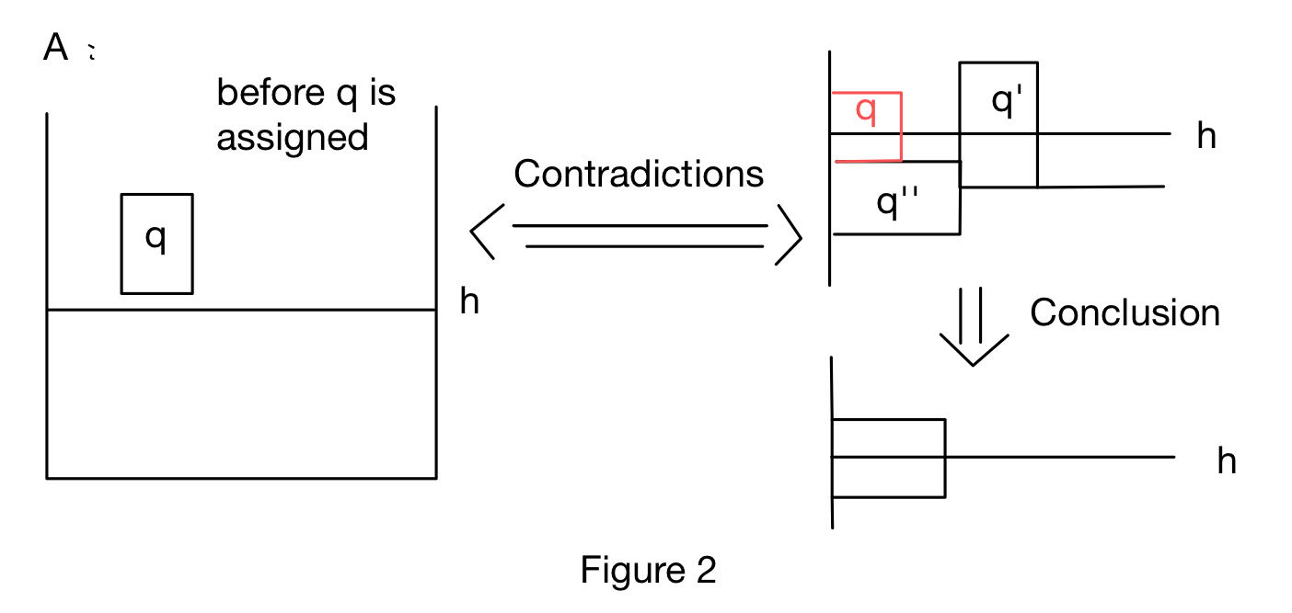
Introduction
Algorithm
Test
Conclusion
Prove the approximation ratio of BL(2)
Suppose there are many lines horizontal cut lines in A, which can be divided into alternating segments representing unoccupied and occupied areas of the BL packing. Now we’ll show the sum of occupied segments is always at least equal to the sum of unoccupied segments.
Consider the partition of a given line just prior to when the first rectangle, say q, is assigned with a lower edge at a height exceeding the height, h, of the line.
Proof：
1. all lines must cut through at least one piece.
2. all lines must cut through a piece abutting the left bin edge.
Notes:
接下去我们来证明A是半满的，假设在A中有许多水平切割线，可以将其分为交替的段，代表着BL装箱中的未占用和已占用区域（如右图）。如果我们能证明对于每一条水平切割线，已占用段的总和始终大于或等于未占用段的总和，那么对A的整个高度积分一下，我们就能证明A是半满的。
那现在我们考虑其中一条水平切割线，假设高度为h。我们考虑当第一个放置的下边超过h的矩形q被放置进strip前的这条line的状态。首先很显然，这条line一定切割了至少一个矩形，不然q肯定能放得更下面。同时，这条line一定切割了一个和strip的左边界相邻的矩形。我们采取反证法，如果它切割的矩形中最左边的那个和strip的左边界是不相邻的，那它肯定图中q’的这个状态，也就是说有一个左下方的q”阻挡了q’往左边移。但由于我们是按宽度递减的顺序放置的，所以后面放进的q的宽度一定比q”要小，那它肯定会放在q”的上面，和我们前面说它的下边比h高的假设矛盾了。所以我们也就证明了每一条切割线都会切割和strip左边界相邻的矩形。

Slide 12
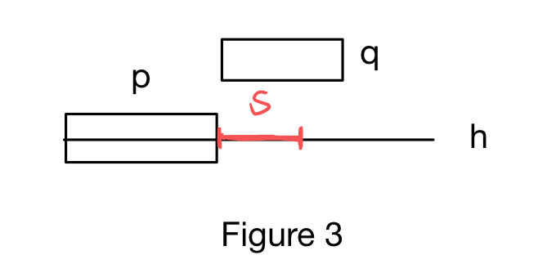
Introduction
Algorithm
Test
Conclusion
Prove the approximation ratio of BL(3)
Now consider any segment, S, of the line which cuts through an unoccupied space. Let p
be the piece bordering S on the left. Since when q is assigned, it is placed above the line, q
must be wider than the length of S. And for the nonincreasing order of assignmemt, q is packed
later than p so p is at least as wide as q.
Hence, for every unoccupied segment, there is a longer occupied segment immediately to its left. This pattern continues throughout the packing sequence, ensuring that the line remains at least half occupied. Integration over the height of A confirms that A is at least half full.
Notes:
得到了刚刚两个结论，我们就可以来看line中的任意一个片段S，如果是unoccupied，那它左边一定有一块occupied的区域，同时，p的宽度一定大于S，因为q无法放置在S的区域中，而q又小于p的宽度。
因此我们证明了对于每一条切割线，它的occupied的片段长度一定大于unoccupied的片段长度，从而证明了A是半满的。

Slide 13
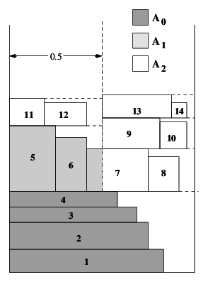
Introduction
Algorithm
Test
Conclusion
Sleator’s Algorithm
First, the algorithm find all the items with a width larger than W/2 and stack them one by one at the bottom of the strip whatever the order is. Then sort all the remaining items in nonincreasing order of height. The items will be placed in this order. Draw a vertical line at W/2 which cuts the strip into two equal halves. Let hl be the highest point covered by any item in the left half, and hr be the highest point covered by any item in the right half. Place the items one by on in sorted order. If hl <=hr, place the item on the left, otherwise on the right.
Approximation ratio：
Sleator(I) ≤ 1.5 OPT(I) + h_{max} ≤ 2.5 OPT(I)
（the proof is a bit complex so we omit it）
Time Complexity：
sort：O(nlogn)
place：O(n)
Notes:
除了前面三个算法之外，我们还尝试了Sleator算法和SP算法，他们都是有点类似分块的算法。对于Sleator算法，它先找到所有宽度大于W/2的矩形，并无论顺序如何，将它们逐个堆叠在条带的底部。然后在W/2处画一条垂直线，让hl表示左半部分中任何物品覆盖的最高点，hr表示右半部分中任何物品覆盖的最高点，将剩下的矩形以高度递减的顺序依次放置，如果hl <= hr，将物品放在左边，否则放在右边。Sleator的理论近似率是最低的，达到了2.5，并且除排序外的时间复杂度是O（n）。但是其实我们可以看到它在底层放置W/2的物品时浪费的空间还是挺多的，在测试中的表现也并没有理论上这么好。

Slide 14
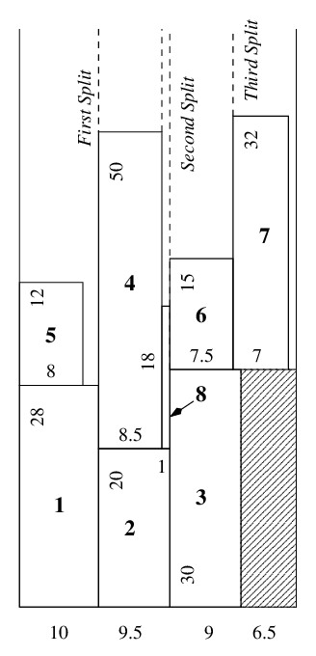

Introduction
Algorithm
Test
Conclusion
SP（The Split Algorithm）
This algorithm places the items in nonincreasing order of width. The intuitive idea is to split the strip into sub-strips while placing some items. Whenever possible, the algorithm places the current item i side-by-side of an already placed item j. In this case, it splits the corresponding sub-strip into two pieces: one containing the first item j and the other containing the current item i. If this is not possible, it places i on top of an already placed item and does not split the sub-strip.
Approximation ratio：
SP(I) ≤ 2 OPT(I) + h_{max} ≤ 3 OPT(I)
（the proof is a bit complex so we omit it）
Time Complexity：
sort：O(nlogn)
place：O($n^{2}$)
Notes:
SP的直观思想是在放置物品时将条带分割为子条带，尽可能将当前item i与已放置的item j并排放置，然后就有了下一个子条带的分隔。如果无法实现并排放置，它将item i 放在已放置物品的顶部，而不进行子条带的分割，可以看到它的近似率也是不超过3。时间复杂度为O（n^2）

Slide 15
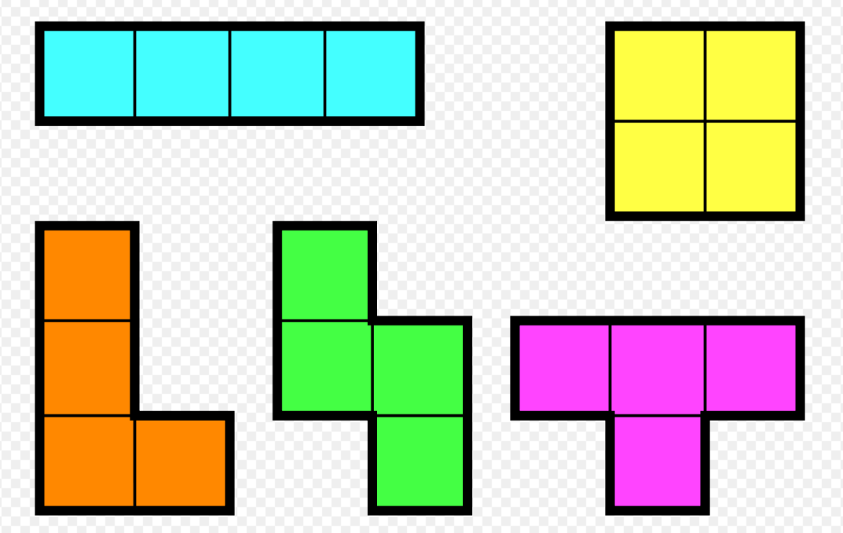

Introduction
Algorithm
Test
Conclusion
Bonus
This algorithm is online and similar to BL. In this algorithm, We use a two-dimensional 0/1 array to record whether each point has been filled in. For each tetraminos, we find the lowest possible position to fill it in. For this process, we only need to find the eligible union 0 and set them to 1. Obviously, it is necessary to pay attention to whether to fill from left to right or from right to left (It is depend on tetramino's shape)
Time Complexity：O($n^{2}W$)
Notes:
对于Bnous，是将原本的矩形变成了俄罗斯方块，我们使用了类似于BL的online的算法，我们把整个strip划分为一个个的小方格，对应着俄罗斯方块中的每个小方块。我们使用一个二维的0/1数组来记录每个小方块是否已经填充。而对于每个四格形状，我们找到最低的可填充位置，也就是BL中的最低高度。然后根据四边形的形状选择是从左到右填充还是从右到左填充。填充过程其实就是找到合适的0并将其设置为1。

Slide 16
CONTENT
Introduction
Algorithm
Test
Conclusion
- approximate radio
- time complexity
- random width and height
- Square sequence
- Literature-offered
- tetrominos

Slide 17
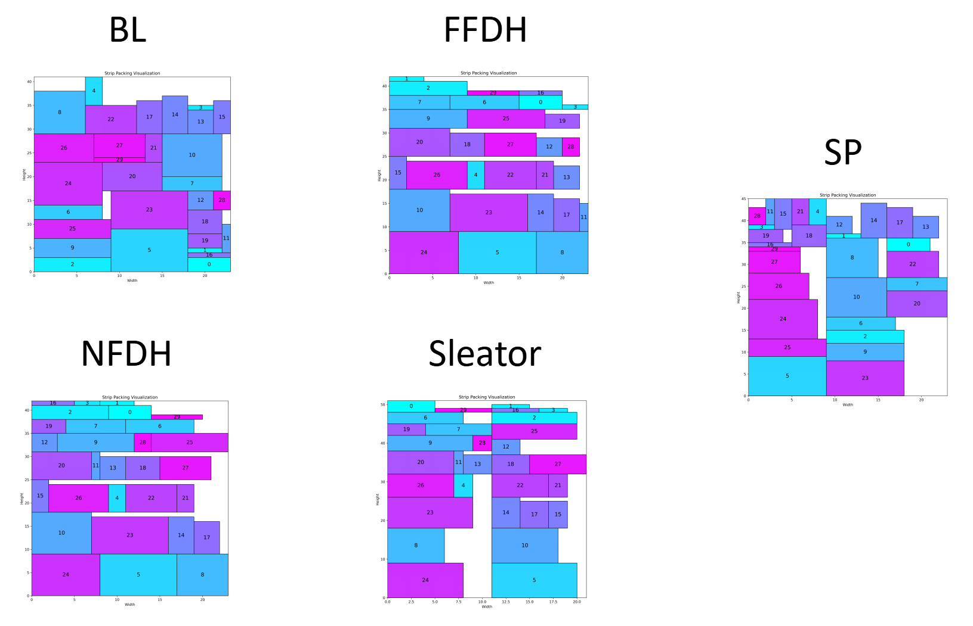
Introduction
Algorithm
Test
Conclusion
Visualization

Slide 18
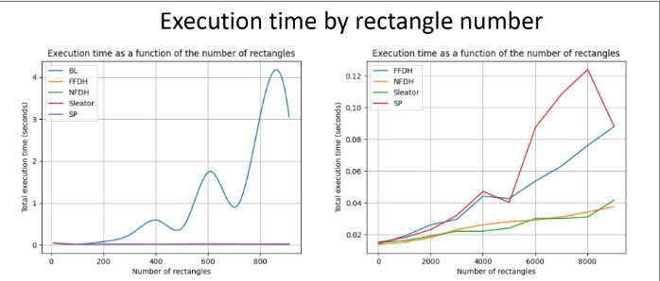
Introduction
Algorithm
Test
Conclusion
running time

Slide 19
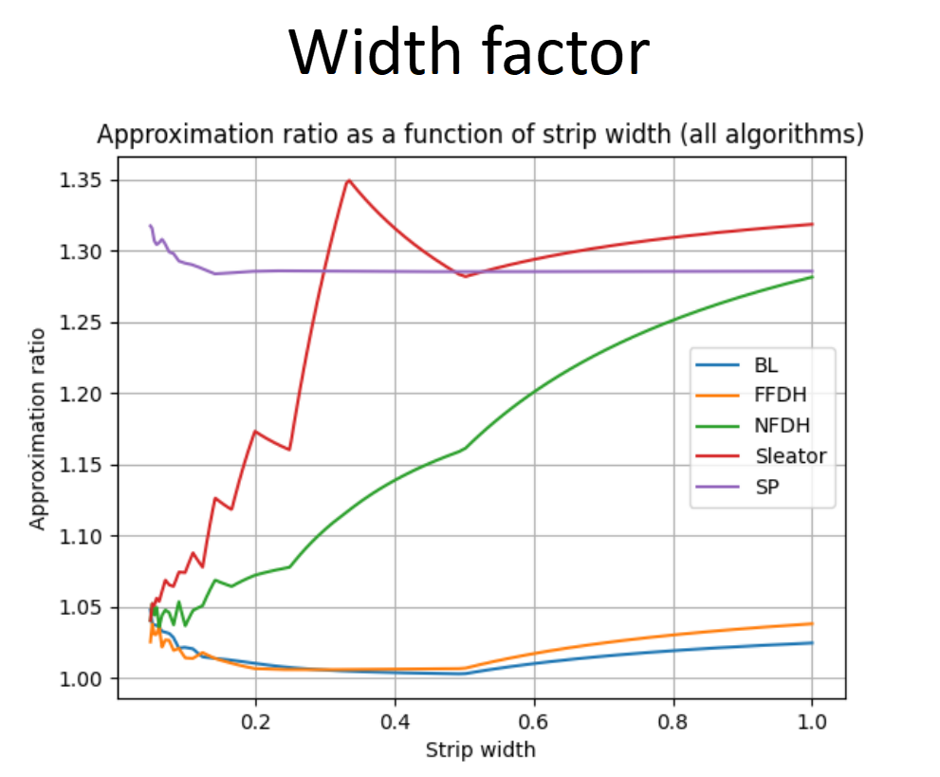
Introduction
Algorithm
Test
Conclusion
Width factors
(by max(widths)/strip_width)
The BL and FFDH algorithms perform the best, maintaining low and less fluctuating approximation ratios. The NFDH and Sleator algorithms perform poorly at higher width factors but improve as the width factor decreases. The SP algorithm shows consistent performance but with a declining performance as the width factor decreases.

Slide 20
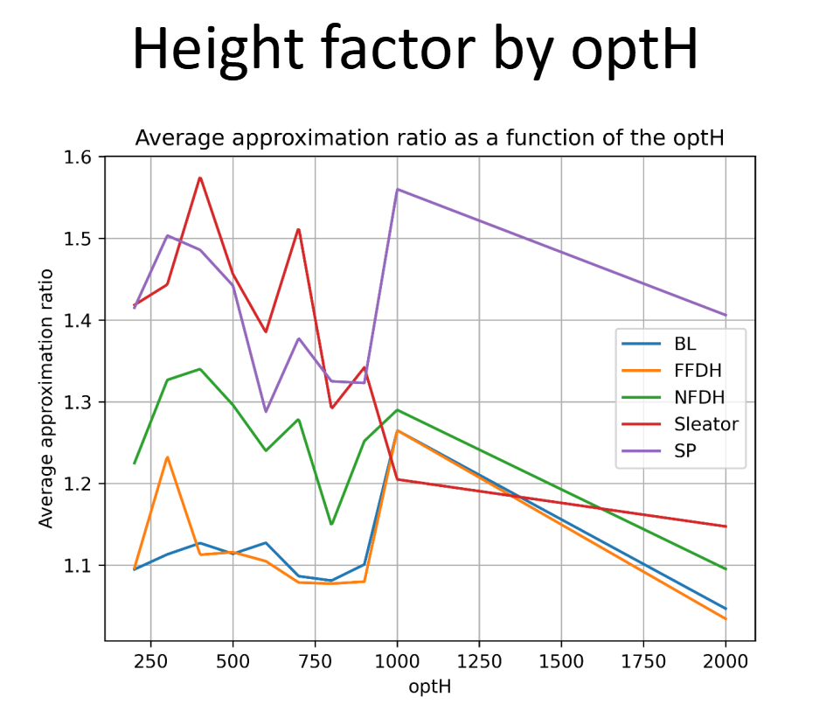
Introduction
Algorithm
Test
Conclusion
Height factors (optimal-cuts)
optimal-cuts：know the precise optH
With the increasing of optH(in other words, the numbers of rectangles), all algorithms’ approximation ratios has a declining trend
Approximation ratio: This indicates that all algorithms have similar accuracy levels, with Sleator and SP potentially offering slightly less precise results.
All algorithms offer comparable levels of accuracy as optH changes.

Slide 21
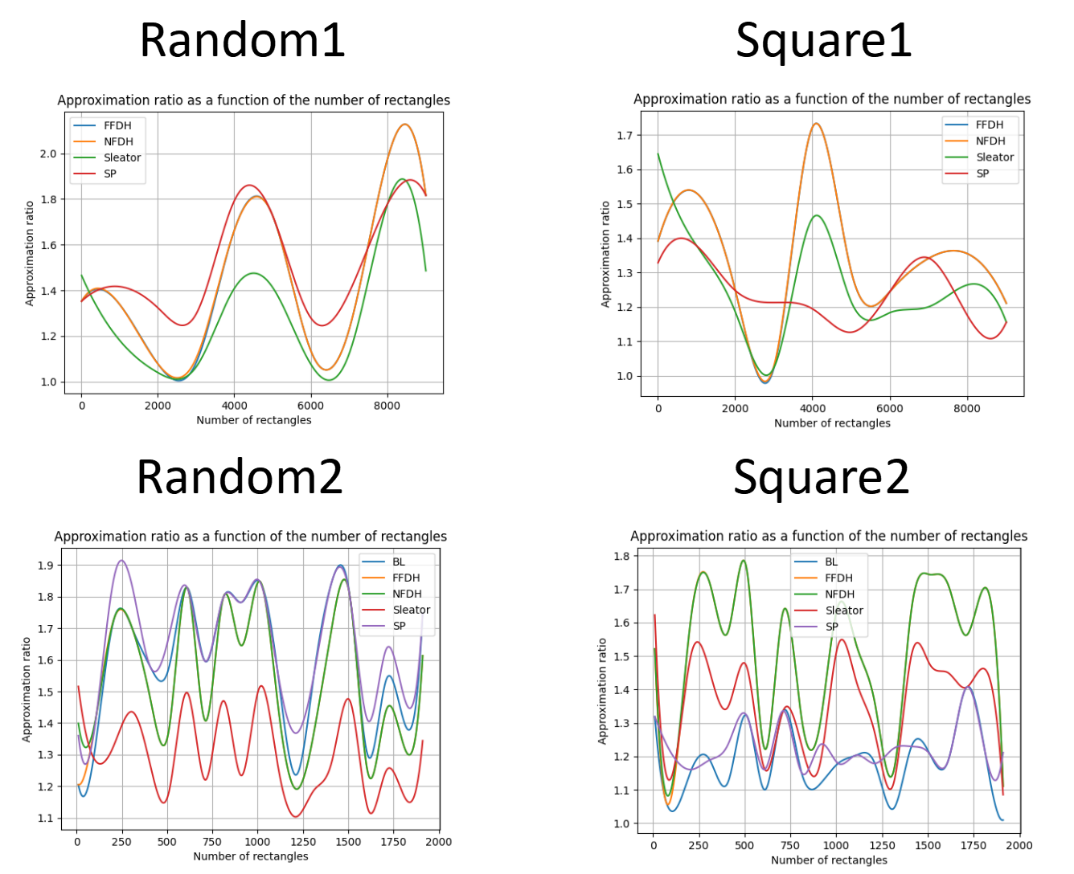
Introduction
Algorithm
Test
Conclusion
Random and square sequences
Random: It appears that the Sleator algorithm generally performs better in terms of packing efficiency.
Square: In this case, BL algorithm again performs best, as it did in other datasets.
What is worth mentioning, random tests dosen’t provide referable comparsions, just showing that every algorithm has its approximate ratio within a good range of 1~2.

Slide 22
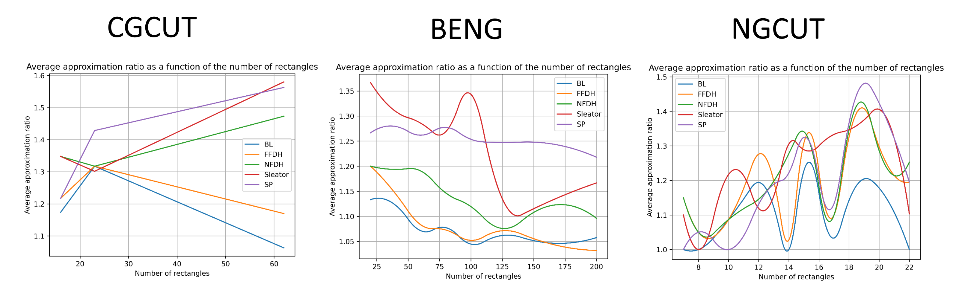
Introduction
Algorithm
Test
Conclusion
Literally offered
To better analyse their performances, we introduced some data-sets offered in previous papers, each of them provided with optimals.
The BL, FFDH, and NFDH algorithms show a decrease in approximation ratio as the dataset grows larger. Sleator's algorithm exhibits a relatively higher approximation ratio.
The SP algorithm exhibits a relatively stable approximation ratio as the dataset grows larger.
(CGCUT) Christofides and Whitlock (1977): Their approach begins with an initial rectangle
of area A0. Further rectangles are then created by generating areas Ai from a uniform distribution
in the range (0, A0/4). The height hi of each rectangle is an integer drawn from a uniform
distribution in the range (0, A0) and rounded upwards, while the width wi is calculated as the
ceiling of Ai/hi.
(BENG) Bengtsson (1982): In Bengtsson’s methodology, the lengths and widths of the rect_x0002_angles are calculated based on a random number r drawn from a uniform distribution in the range
(0,1). The lengths are equal to the nearest integer of the form 12r + 1 and the widths are equal
to the nearest integer of the form 8r + 1.
(NGCUT) Beasley (1985): Beasley’s second dataset follows the same constraints as Christofides
and Whitlock, but the height is an integer drawn from a uniform distribution in the range [1, h0].

Slide 23
CONTENT
Introduction
Algorithm
Test
Conclusion
- approximate radio
- time complexity
- random width and height
- Square sequence
- Literature-offered
- tetrominos

Slide 24

Introduction
Algorithm
Test
Conclusion
Width factor
Height factor
Algorithm choice
As the width factor increases, FFDH, BL, and SP performances are largely unaffected. Sleator and NFDH algorithms show a greater sensitivity to changes in width.
Height factor may not pose a significant challenge to the overall performance, regardless of the algorithm chosen.
BL and FFDH algorithm provide excellent approximate raito. Sleator algorithm provides reasonable compromise between efficiency and precision.

Slide 25
Reference
1.Baker, Brenda S.; Coffman Jr., Edward G.; Rivest, Ronald L. (1980). ”Orthogonal Packings
in Two Dimensions”. SIAM J. Comput. 9 (4): 846–855.
2. Coffman Jr., Edward G.; Garey, M. R.; Johnson, David S.; Tarjan, Robert Endre (1980).
”Performance Bounds for Level-Oriented Two-Dimensional Packing Algorithms”. SIAM J.
10 Comput. 9 (4): 808–826.
3. Sleator, Daniel Dominic (1980). ”A 2.5 Times Optimal Algorithm for Packing in Two
Dimensions”. Inf. Process. Lett. 10: 37–40.
4. Golan, Igal (August 1981). ”Performance Bounds for Orthogonal Oriented Two-Dimensional
Packing Algorithms”. SIAM Journal on Computing. 10 (3)

Slide 26
Approximation Algorithm on
Strip Packing Problem
陈科睿：Sleator/SP算法 报告+PPT
裘海怡：BL/NFDH/FFDH算法 报告+PPT
董冬：算法测试 报告+PPT

