Slide 1



Yelp Restaurant Photo Classification
Anna Rumyantseva & Alex Chao
Springboard Data Science Intensive Workshop
Spring 2016

Slide 2

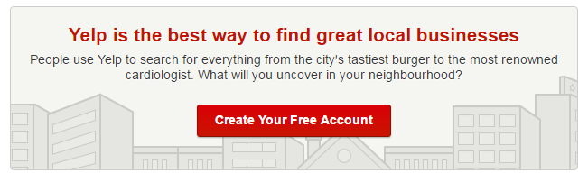
Client
Yelp is an American multinational corporation headquartered in San Francisco, California.
Yelp.com and the Yelp mobile app, which publish crowd-sourced reviews about local businesses

Slide 3
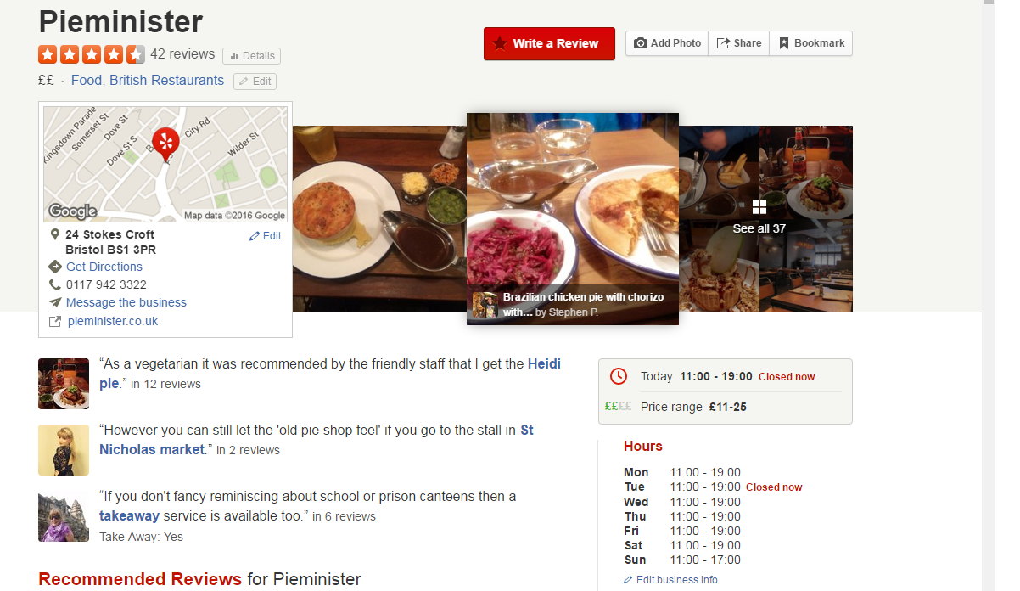
Review example

Slide 4
Task overview
Currently, restaurant labels are manually selected by Yelp users
But Yelp’s users upload an enormous amount of photos every day alongside their written reviews
Selecting the labels is optional, leaving some restaurants un- or only partially-categorized.
AIM: build a model that automatically tags restaurants with multiple labels using user-submitted photos

Slide 5
Data set
photos of the training set (235841 images; 6.64 GB)
photos of the test set (474304 images; 6.71 GB)
maps the photo id to business id
maps the photo id to business id
maps the business ids to their corresponding labels.

Slide 6
Restaurant labels
Label | Description
0 | good_for_lunch
1 | good_for_dinner
2 | takes_reservations
3 | outdoor_seating
4 | restaurant_is_expensive
5 | has_alcohol
6 | has_table_service
7 | ambience_is_classy
8 | good_for_kids

Slide 7
Approach

Slide 8
Convolutional Neural Networks

Slide 9
