Slide 1



Yelp Restaurant Photo Classification
Anna Rumyantseva
Springboard Data Science Intensive Workshop
Spring 2016
Mentor: Alex Chao

Slide 2

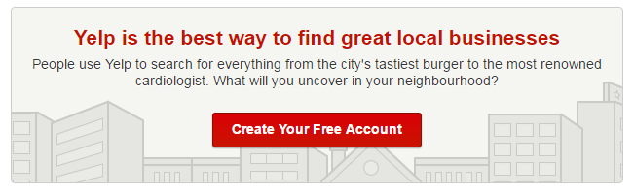
Client
Yelp is an American multinational corporation headquartered in San Francisco, California.
Yelp.com and the Yelp mobile app, which publish crowd-sourced reviews about local businesses

Slide 3
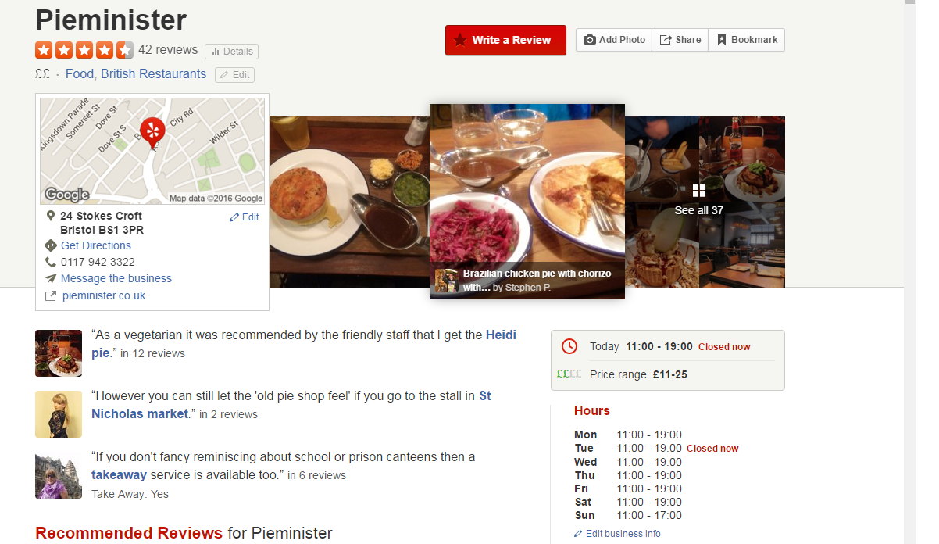
Review example

Slide 4
Task overview
Currently, restaurant labels are manually selected by Yelp users
But Yelp’s users upload an enormous amount of photos every day alongside their written reviews
Selecting the labels is optional, leaving some restaurants un- or only partially-categorized.
AIM: build a model that automatically tags restaurants with multiple labels using user-submitted photos

Slide 5
Data set
photos of the training set (235841 images; 6.64 GB)
photos of the test set (474304 images; 6.71 GB)
a file that maps the photo id to business id
a file that maps the business ids to their corresponding labels.

Slide 6
Restaurant labels
Label | Description
0 | good_for_lunch
1 | good_for_dinner
2 | takes_reservations
3 | outdoor_seating
4 | restaurant_is_expensive
5 | has_alcohol
6 | has_table_service
7 | ambience_is_classy
8 | good_for_kids

Slide 7
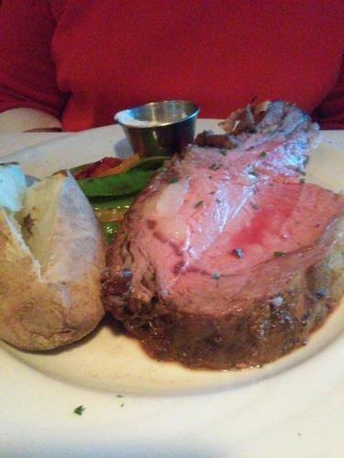
An example
good for dinner,
takes reservations,
has alcohol,
has table service,
ambience is classy

Slide 8









What kind of problem is it in Machine Learning?
Photos
Business ids
Labels
1
2
8
Business 1
0
2
4
8
Business 2
Business 3
2
3

Slide 9
What kind of problem is it in Machine Learning?
Photos
Business ids
Labels
1
2
8
Business 1
0
2
4
8
Business 2
Business 3
2
3
Multi-instance aspect
Multi-class aspect

Slide 10
Approach
Implement transfer learning approach on Convolutional Neural Networks for image feature extraction
Create mean feature vector for each business id (dealing with the multi-instance aspect of the problem)
Train One vs Rest classifier on top of several supervised learning models (dealing with the multi-class aspect of the problem)
Try ensemble models for improvement of prediction

Slide 11
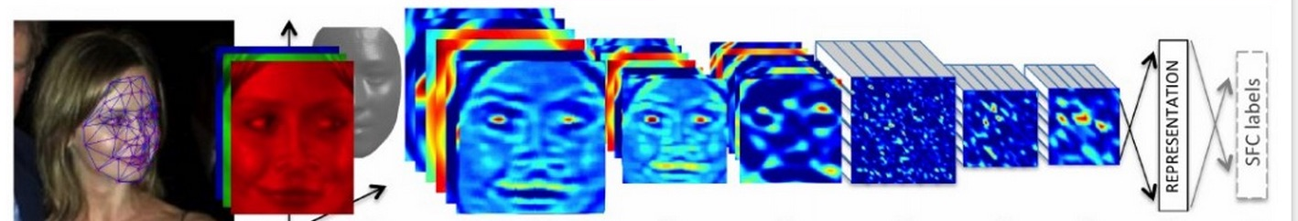
Convolutional Neural Networks (CNN)
A very powerful deep learning technique in computer vision (fast and works well)
CNN takes image as an input
“Neurons” are organized in three dimensions
Pre-trained CNNs can be used as an image feature extractor
An image going through a CNN…
From http://karpathy.github.io/2015/10/25/selfie/

Slide 12
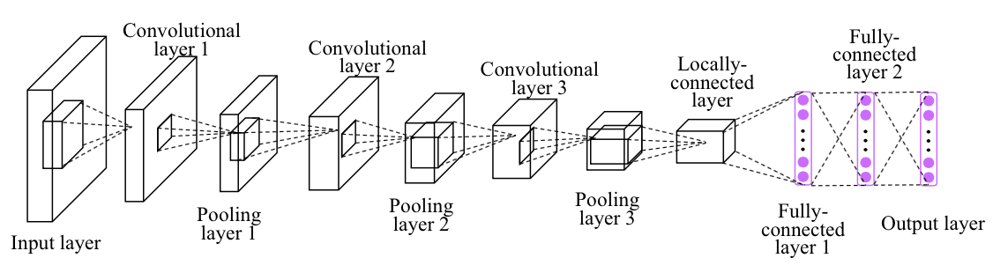
Convolutional Neural Networks (CNN)
CNN architecture example
from Deep Representation Learning with Target Coding
S. Yang, P. Luo, C. C. Loy, K. W. Shum, X. Tang
in Proceedings of AAAI Conference on Artificial Intelligence, 2015
Outcome from this layers can be used as an image feature vector (CNN code)!

Slide 13
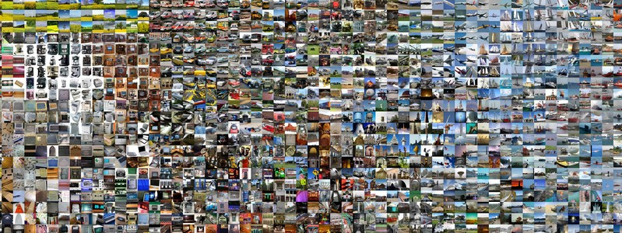
Pre-trained CNN used in the project
Visual Geometry Group (VGG) CNN model developed by Karen Simonyan and Andrew Zisserman (http://www.robots.ox.ac.uk/~vgg/research/very_deep/)
Trained on the ImageNet data set (1.2 million images with 1000 categories)
Runner-up for the Large Scale Visual Recognition Challenge 2014
VGG ConvNet features perform well in multiple transfer learning tasks

Slide 14
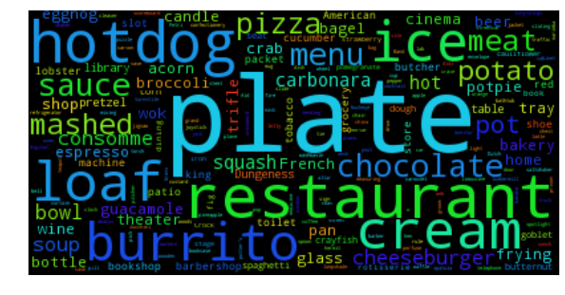
If you run Yelp images through VGG CNN model and get scores…
All of them are food related ☺

Slide 15
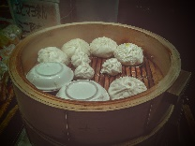
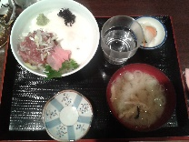
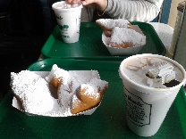
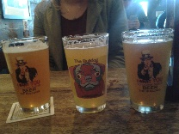
Extracting features from CNN
Photos corresponding to a business id
1
CNN code 1
VGG CNN
Mean CNN code for a business id
2
CNN code 2
3
CNN code 3
CNN code 4
4

Slide 16
Multi-class classification
Logistic Regression
Support Vector Classifier
Decision Tree
K Nearest Neighbour
Gaussian Naïve Bayes
One vs Rest Classifier
plus
PCA decomposition on 100 components was applied
(better performance and faster model training)

Slide 17
Multi-class classification: results on cross validation
Classifier | Mean f-score
Logistic Regression | 0.82818
Support Vector Classifier | 0.83254
Decision Tree | 0.77096
K Nearest Neighbour | 0.80608
Gaussian Naïve Bayes | 0.694705
K-fold cross validation using 5 folds

Slide 18
Ensemble learning: Approach 1
Logistic Regression
Support Vector Classifier
Decision tree
K Nearest
Neighbour
Gaussian
Naïve Bayes
Ensemble all predictions and do majority vote
Vote!

Slide 19
Ensemble learning: Approach 2
Logistic Regression
Support Vector Classifier
Decision tree
K Nearest
Neighbour
Gaussian
Naïve Bayes
3
3
2
2
1
Ensemble all predictions and do weighted vote
Vote!

Slide 20
Ensemble learning: Approach 3
Logistic Regression
Support Vector Classifier
Decision tree
K Nearest
Neighbour
Gaussian
Naïve Bayes
Ensemble all predictions and train a Logistic Regression on top of them
Train Logistic Regression

Slide 21
Results on the Kaggle leaderboard
Model | f-score | Place on the leaderboard
Logistic Regression Classifier | 0.80184 | 95
Support Vector Classifier (rbf kernel) | 0.80957 | 76
Ensemble Learning based on majority vote | 0.74898 | 146
Ensemble Learning based on weighted vote | 0.62099 | 280
Ensemble learning stacked with Logistic Regression | 0.80538 | 86
Support Vector Classifier performed better then the ensemble models

Slide 22

Trying the prediction model on my photos
Beers in a bar in New Orleans: good for lunch, has alcohol

Slide 23

Trying the prediction model on my photos
Having coffee in Cafe du Monde in New Orleans: good for lunch, good for kids

Slide 24
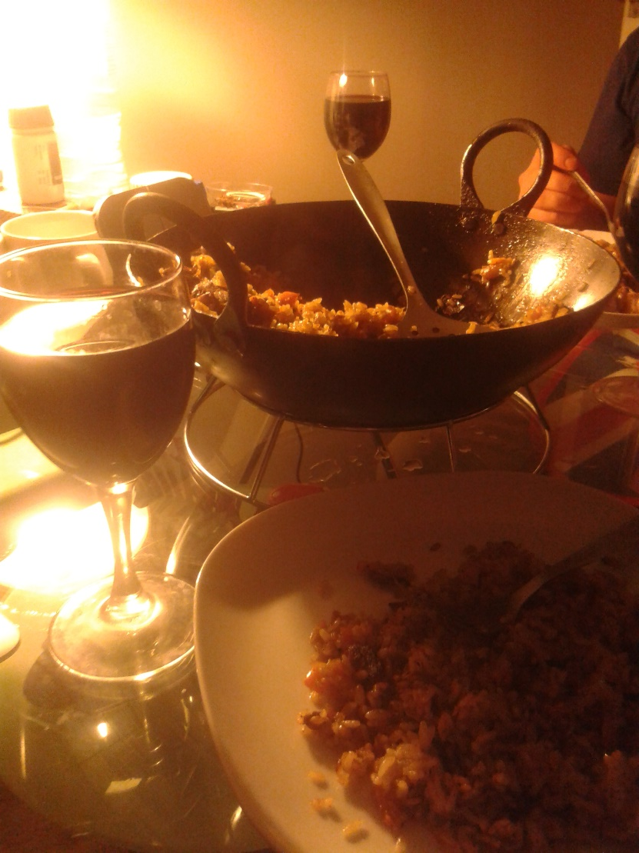
Trying the prediction model on my photos
Fancy dinner with a friend:
good for dinner,
takes reservations,
restaurant is expensive,
has alcohol,
has table service

Slide 25
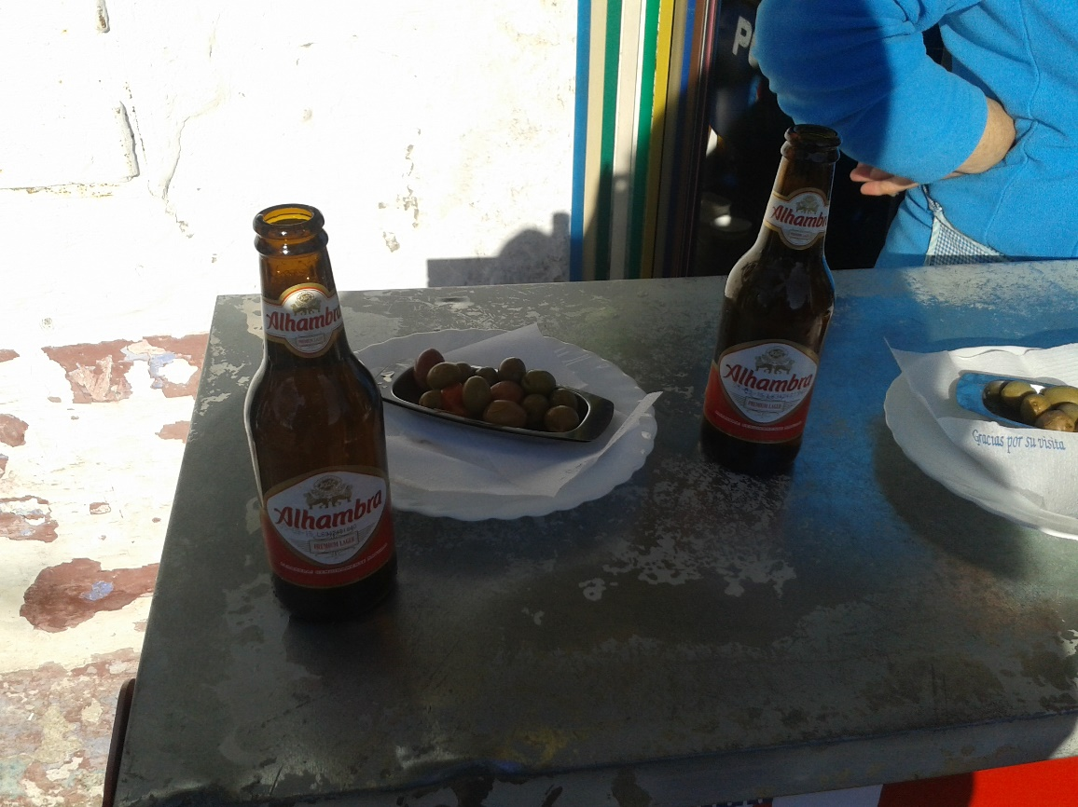
Trying the prediction model on my photos
Beer in a street café in Spain:
has alcohol, has table services

Slide 26
Final remarks
Classification of images using the outcome just from one CNN model results in relatively good f-score (~0.81)
Simple model (SVC classifier) outperformed the ensemble models.
76th place on the Kaggle leaderboard
Further improvements in the model performance can be achieved by advanced feature engineering
The model gives sensible labels for my photos

