Slide 1
AI + CYBERSECURITY | OCT 2026
AEGISNET
A self-explaining Edge-AI neural network that catches cyber-attacks, even ones it has never seen.
Built from scratch in NumPy | 34 KB | 12/12 tests passed | 100% free tools
Presented by: Rushi | Analyst
Notes:
Open with the one-line promise: a tiny neural network that detects attacks, explains why, and asks a human before risky actions. Mention it is built from scratch in NumPy, so it runs anywhere for free.

Slide 2
Oct 2026: models race, production lags
40%
11%
~9 in 10
3x
of enterprise apps will embed task-specific AI agents by end-2026 (Gartner)
of firms run AI agents in production, although 79% say they have adopted them
organisations now use AI regularly in at least one function (McKinsey 2026)
more usage of small task-specific models than giant LLMs by 2027 (Gartner)
THE MODEL RACE (early Oct 2026)
Claude Opus 5.5
GPT-6.1
Gemini 4
DeepSeek V4.1
Qwen3.8
Kimi K3
Violet = closed frontier Aqua = open-weight
Frontier models are converging. The winners are small, explainable, governed systems that actually ship, which is exactly what AegisNet is.
Notes:
Numbers come from Gartner (via industry trackers), McKinsey State of AI 2026 and model trackers, early Oct 2026. Verify the figures once more before presenting. Key message: the gap is production, not model size.

Slide 3



The gap: what IT teams really need
Small and private
Explainable
Governed
Runs on a laptop or Raspberry Pi. Telemetry never leaves your network.
On-call engineers need to know WHY they were paged, not just a score.
Risky actions need a human OK, and the model must warn when it goes stale.
Our answer: one 34 KB neural network that watches server metrics, explains every alert, and asks a human before anything risky.
Notes:
Three real-world requirements: small and private, explainable, governed. AegisNet is designed around exactly these.

Slide 4
Architecture: the Dual-Brain design
Explain
BRAIN 1: Autoencoder
26>18>6>18>26. Learns only NORMAL. Finds unknown threats.
Telemetry
Features
FUSION
Guardian agent
13 server metrics every minute
26 inputs: level + change
Risk 0-100 + signature check
BRAIN 2: Classifier
26>48>24>7. Names the known attack families.
Drift watchdog
Brain 1 never sees an attack, so it flags anything strange (zero-days). Brain 2 recognises known attacks by name. Fusion adds a check that turns never-seen patterns into 'unknown anomaly'.
Notes:
Walk left to right. Stress that Brain 1 is trained on normal data only, so it does not need examples of the attack. Brain 2 gives names. Fusion combines them into one 0-100 risk score.

Slide 5






Six ideas that make it different
Dual-Brain
Zero-day safety net
Explains itself
Unsupervised and supervised networks fused into one 0-100 risk score.
Never-seen patterns become 'unknown anomaly', never a wrong label.
Every alert names the metrics that caused it.
Guardian agent
Drift watchdog
Edge-ready
Safe actions auto-run. Risky ones wait for a human.
A PSI monitor says when the model needs retraining.
34 KB, 0.004 ms per window. Fits a Raspberry Pi.
Notes:
Each card is one talking point. If time is short, spend your time on Dual-Brain, Zero-day safety net and Guardian agent.

Slide 6
A realistic test bench
28,800
minutes of normal data to train Brain 1
Attack | Tell-tale metrics
Brute-force | failed logins, connections up
DDoS | inbound traffic, connections, HTTP 5xx up
Port scan | unique ports way up, tiny packets
Exfiltration | outbound traffic + DNS queries up
Cryptominer | CPU and process count up
Ransomware | file writes + disk I/O way up
28,800
minutes of labelled attacks for Brain 2
14,400
unseen test minutes, 37 attack episodes
Daily load cycle, correlated metrics
Benign flash-crowds as hard negatives
Attack strength 40-100%: weak ones hide
Notes:
The data is simulated so every result is reproducible and labelled. Flash crowds are legitimate traffic spikes that look like DDoS: they test for false alarms. Be upfront: real-data results will be lower.

Slide 7
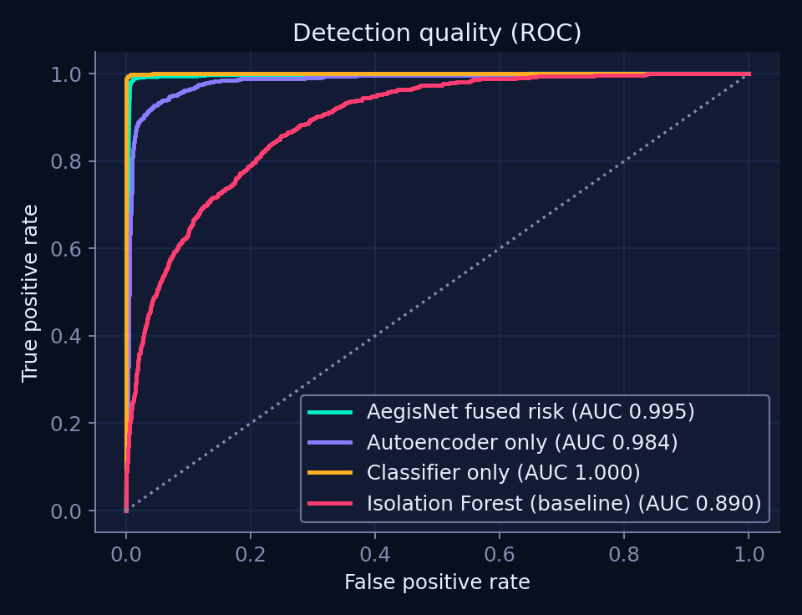
Results on 10 unseen days
98.5%
0.98%
attack-minute recall
false-alarm rate
37/37
0.2 min
attack episodes detected
mean time to detect
Fused AUC 0.995 vs Isolation-Forest baseline 0.890. Precision 83%: attacks are rare, so some alerts are false.
Notes:
Measured on 10 unseen days (685 attack minutes). Be honest: 3 of 40 incidents were false. The classifier alone scores the highest AUC on known attacks; the fused system exists for the zero-day case on the next slides.

Slide 8
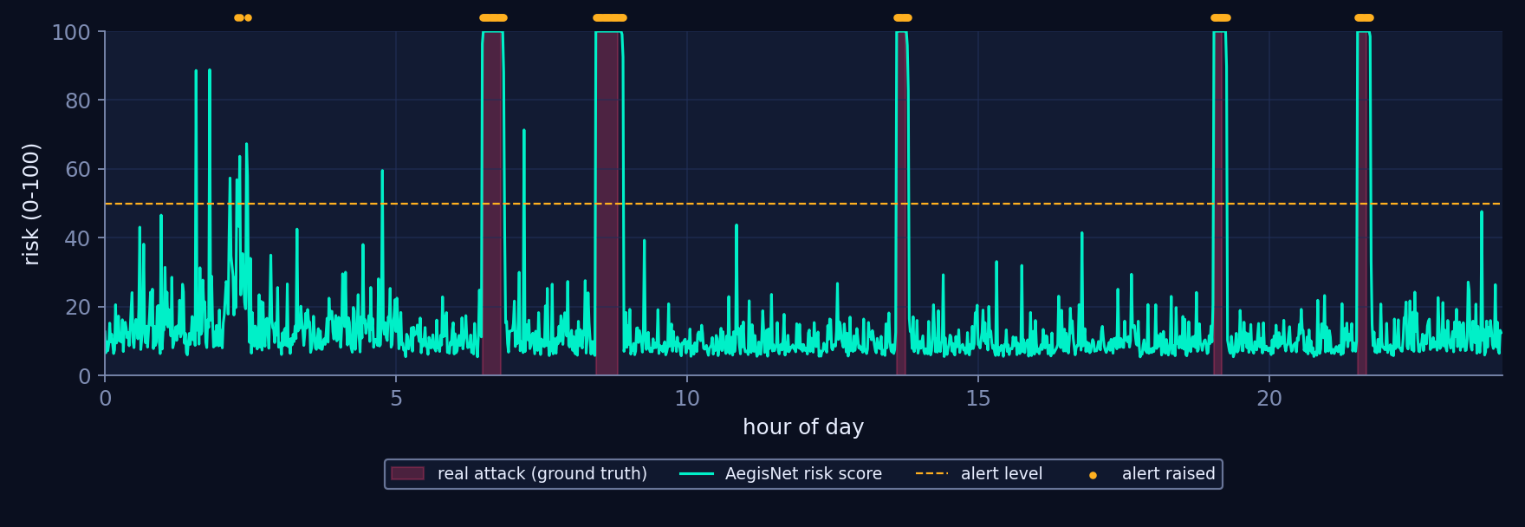
One day of live monitoring
Red = real attacks. Amber dots = AegisNet alerts. Over 10 days it raised 40 incidents; only 3 had no real attack behind them.
Notes:
Point at one red band and show the risk curve crossing the alert line almost immediately.

Slide 9
Zero-day test: the unseen ransomware
Setup
Ransomware was removed from the classifier's training data.
Result
The classifier alone was blind (0%). AegisNet caught every minute and tagged it a new pattern instead of guessing a wrong name.
Why
Brain 1 only knows what normal looks like.
Notes:
This is the headline experiment. A supervised classifier cannot recognise what it was never shown. The autoencoder does not need to: anything unlike normal is flagged. The signature check then refuses to give it a wrong name.

Slide 10
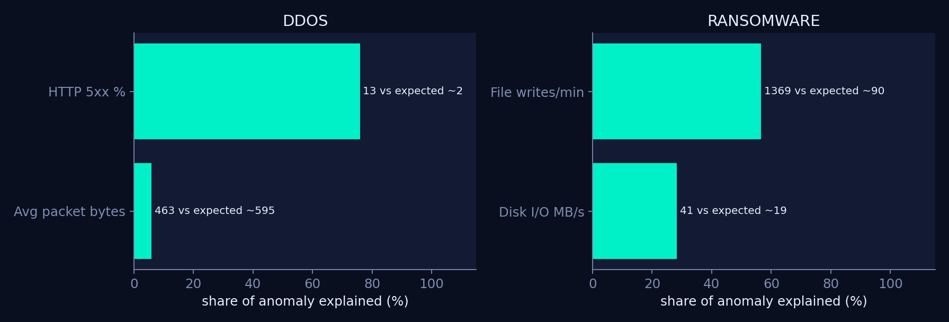
Every alert explains itself
Bars show how much of the anomaly each metric explains. The label compares the observed value with what the autoencoder expected, so an engineer sees the cause in seconds.
Notes:
Explainability comes from the autoencoder: the error per metric tells which metric broke the pattern. Note that the 'expected' value is the model's reconstruction, not a ground-truth baseline.

Slide 11

Guardian agent: bounded autonomy
1 Detect
[CRITICAL] Volumetric DDoS attack
minutes 92666-92694 (29 min) | peak risk 100/100
WHY HTTP 5xx % = 13 (model expected ~2)
Avg packet bytes = 463 (model expected ~595)
AUTO Enable CDN / WAF rate-limiting profile
AUTO Page the on-call network engineer
ASK Null-route top offending prefixes
ASK Scale out replicas behind the load balancer
AUDIT 4 actions logged, 2 wait for a human
Risk crosses the alert line.
2 Auto-run safe actions
Snapshots, tickets, paging.
3 Human OKs risky ones
Block, isolate, quarantine.
Every action is audit-logged. Actions are simulated; connect your firewall or ticket API to go live.
Notes:
This text is real output from the run, not a mock-up. This is the agentic-AI trend done safely: bounded autonomy with a human in the loop.

Slide 12
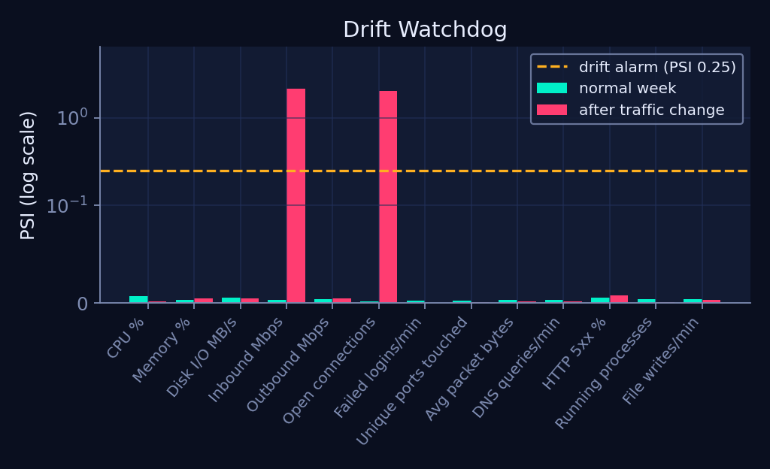
Built for production, not just demos
34 KB
whole model file
0.004 ms
per minute-window on 1 CPU
12 / 12
automated tests pass + REST API
Normal week: PSI 0.007 = STABLE. After a traffic change: PSI 2.15 on inbound traffic = retrain alarm.
Notes:
Only about a tenth of agents reach production, partly because nobody monitors them. The drift watchdog compares live data with training data and says when to retrain. Latency is tiny, so it fits edge devices.

Slide 13
100% free tools, run it in 3 commands
Python 3
NumPy
pandas
scikit-learn
Matplotlib
Flask
unittest
# 1. install
pip install -r requirements.txt
# 2. train + evaluate + report
python run_all.py
# 3. prove it works
python -m unittest discover -s tests -v
Tested, not claimed
Gradient check proves the backprop maths
Quality, zero-day, drift and API tests
Verified from a clean folder, plus a live API call
Notes:
Everything is free and open source. No GPU, no API keys, no internet after pip install. Mention the README and outputs/report.html.

Slide 14
What we proved, and what is next
Proved
98.5% attack recall at 1.0% false alarms
Catches an attack family it never saw
Explains and asks before acting
Fits in 34 KB, runs for free
Honest limits and next steps
Data is simulated: test on CICIDS2017 and real logs
Guardian actions are simulated: plug in a firewall API
Add a local LLM to write incident stories
Export to ONNX, train federated across servers
Thank you. Questions?
Rushi | Analyst
Notes:
Close with honesty: simulated data and simulated actions are limits, and the next steps address them. Then invite questions.

