Slide 1
RAG-POWERED CAREER & SKILL INTELLIGENCE AGENT
CareerSage AI
A working, tested and deployable product: real inputs, real outputs, every answer cited.
Live product demo | 22 Oct 2026

Slide 2
WHY CAREERSAGE
Problem > Solution
The Problem
The Approach
The Outcome
Career advice is generic and outdated.
Chat AI invents skills, courses and requirements.
No way to verify where an answer came from.
Retrieval-Augmented Generation: answer only from a curated knowledge base.
Out-of-scope questions are refused, never guessed.
Roadmaps, interview prep, skill-gap score and role matching, each with a [source-id] you can check.

Slide 3
ARCHITECTURE
How It Works
Normalize
Typo-fix
Scope guard
BM25 search
Intent boost
Cited answer
Aliases: ML > machine learning
"machin" > machine
No role or skill term? Refuse
27 docs, 9 roles x 3 types
Roadmap / interview / skills
LLM optional, extractive fallback
>
>
>
>
>
>
Python standard library only: zero dependencies, so it runs and deploys anywhere

Slide 4
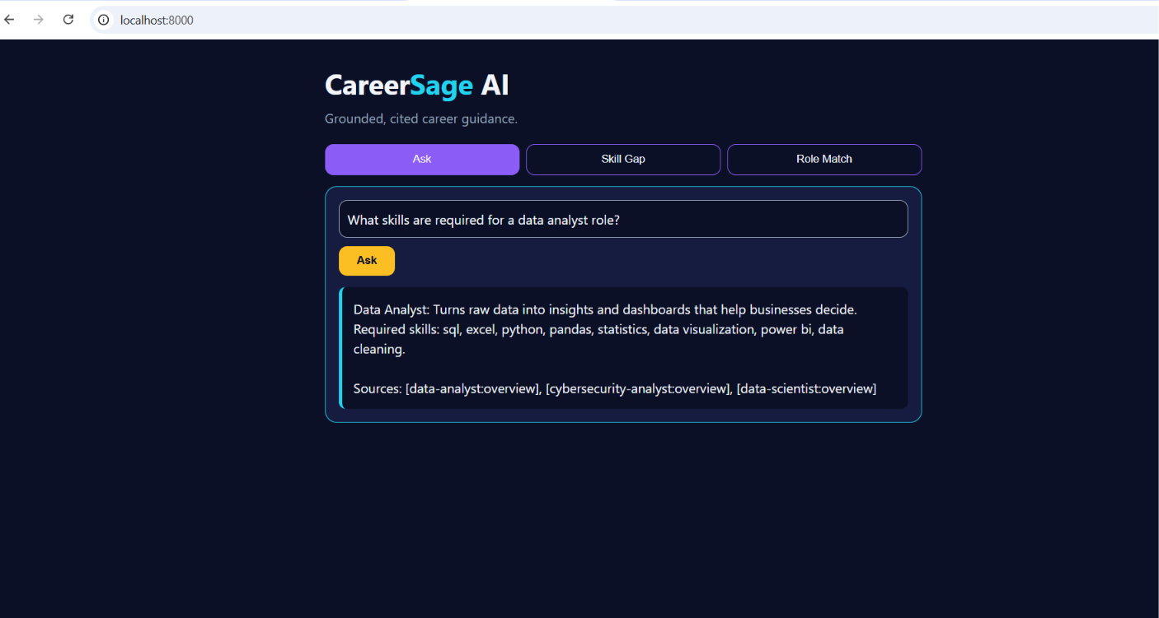
REAL OUTPUT
Live Demo 1: Ask a Career Question
1 Natural question
"What skills are required for a data analyst role?"
2 Grounded answer
Role summary and exact skill list from the knowledge base
3 Verifiable sources
Every answer ends with [doc-id] citations

Slide 5
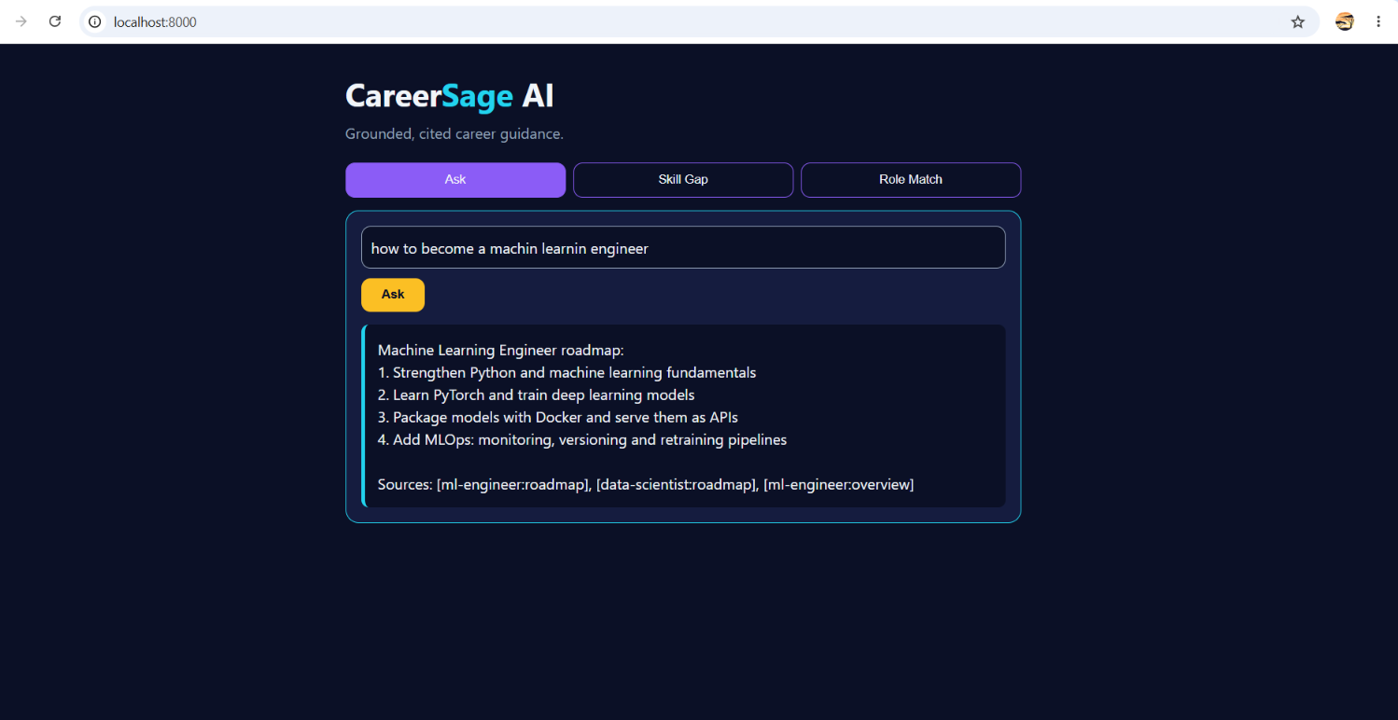
REAL OUTPUT
Live Demo 2: Typos and Intent
Typo-tolerant
"machin learnin" was understood as machine learning
Intent detected
"how to become" returns the roadmap, not a summary
Top source correct
[ml-engineer:roadmap] ranked first

Slide 6
PERSONALISED INTELLIGENCE
Skill-Gap Analyzer and Role Match
Skill Gap (Backend Developer)
Role Match
Resume: Python, SQL, Docker, Git, FastAPI, testing
Result: 75% match
Missing: rest apis, system design
+ 4-step roadmap and interview focus
Resume: html css javascript react typescript git
Result: #1 Frontend Developer
Ranked by % of required skills matched
Both examples are asserted in the automated test suite, so the numbers are reproducible.

Slide 7
QUALITY
Testing and Guardrails
23 / 23
100%
100%
0
Automated tests passing
hit@1 on 35-question golden set
Out-of-scope refusal
Third-party dependencies
Metrics are measured on our golden set and gated in CI. Also: input validation, 100 KB body cap, per-IP rate limit, non-root Docker.

Slide 8
DEPLOYMENT
From Laptop to Public URL
1 Run locally
2 Containerize
3 Ship
python -m app.server
Open localhost:8000
UI + API in one process
Docker image, non-root user, built-in health check at /health
GitHub Actions runs tests + eval, then Render deploys from render.yaml to a public link

Slide 9
WHAT NEXT
Roadmap
Retrieval upgrades
Product upgrades
Dense embeddings + Qdrant hybrid search
Cross-encoder reranker
Live job-posting ingestion
Marathi / Hindi queries
User accounts and memory
RAGAS faithfulness scoring in CI
Thank you - Questions?

