Slide 1
css
<!DOCTYPE html>
<html>
1
<script src="https://d3js.org/d3.v7.min.js"></script>
2
3
Javascript to build graph
4
Data
</html>
Index.html

Slide 2
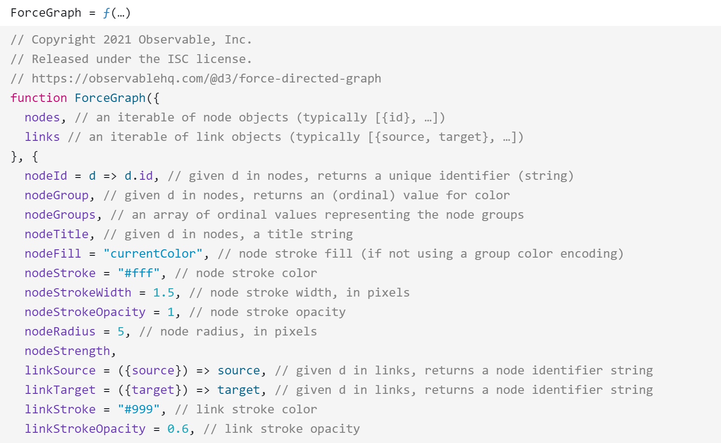
d3graphscript.js

