Slide 1

Movie Success Insights: Statistics, Popularity and Timing Considerations

Slide 2
Research Questions
How have movie ratings evolved over the years, and are there discernible trends within different genres?
Which movie genres reign supreme in popularity, and is there a correlation between a movie's genre and its commercial success?
Do certain actors or directors wield a significant influence on a movie's success or ratings?
How does the duration of a movie impact audience reception and ratings? Are longer or shorter movies more favorably received?
Is there a relationship between a movie's budget, box office performance, ratings, and how timing influences these dynamics?

Slide 3
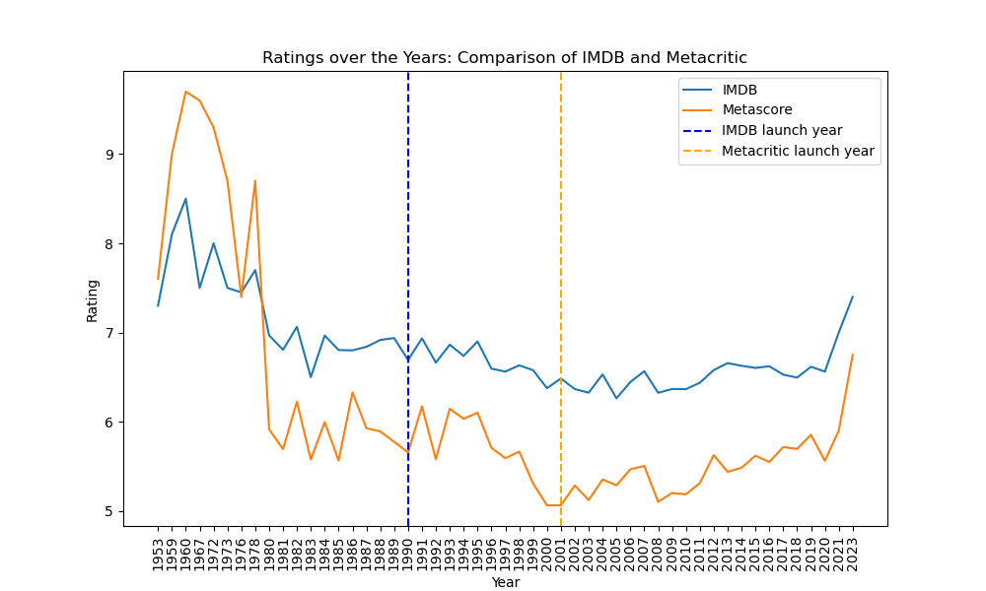
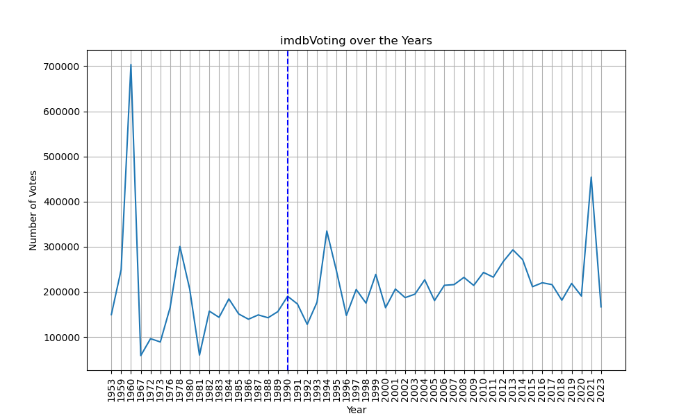
1. How have movie ratings evolved over the years, and are there discernible trends within different genres?

Slide 4
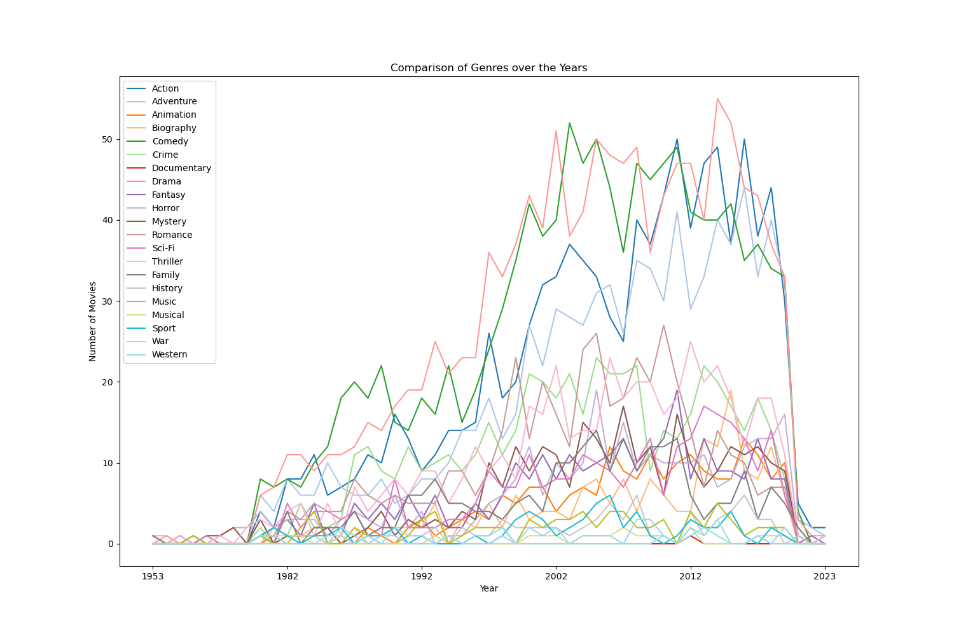

Slide 5
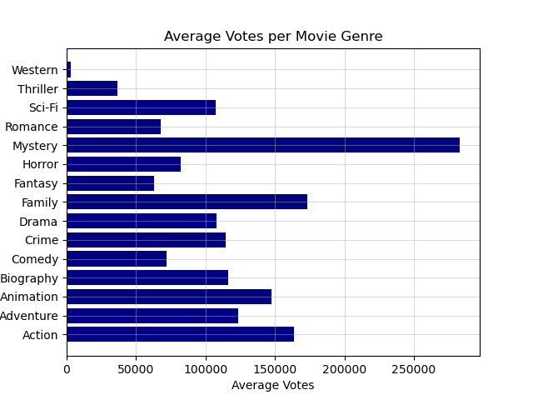
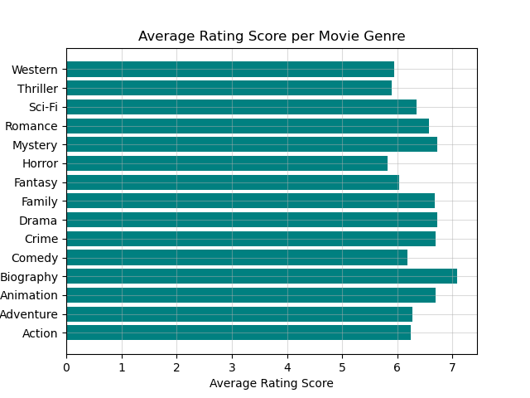
2. Which movie genres reign supreme in popularity, and is there a correlation between a movie's genre and its commercial success?

Slide 6
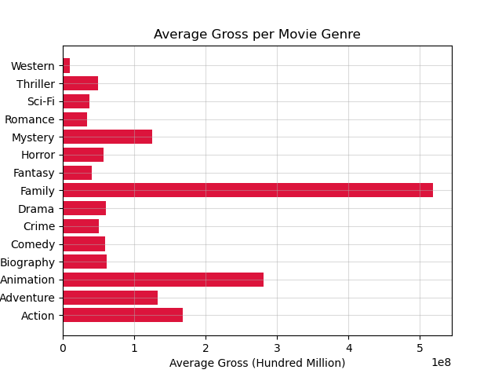

Slide 7



Slide 8
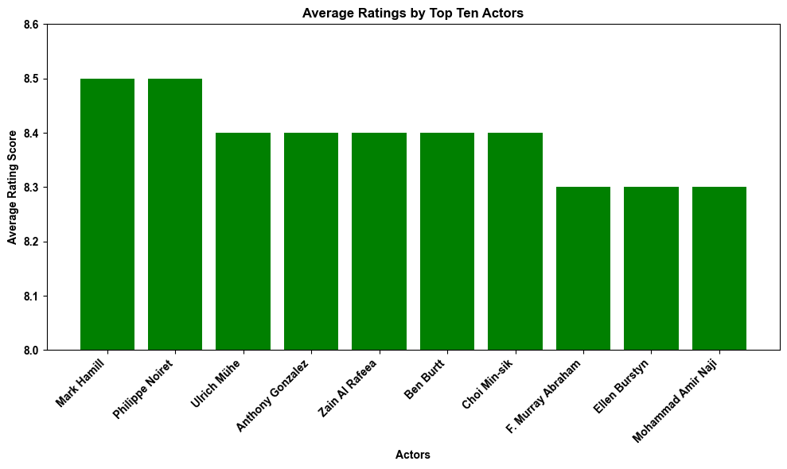
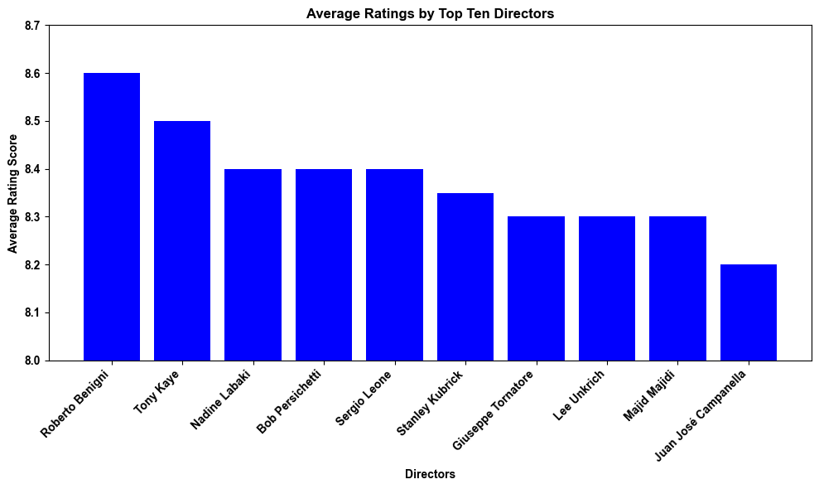
3. Do certain actors or directors wield a significant influence on a movie's success or ratings?

Slide 9
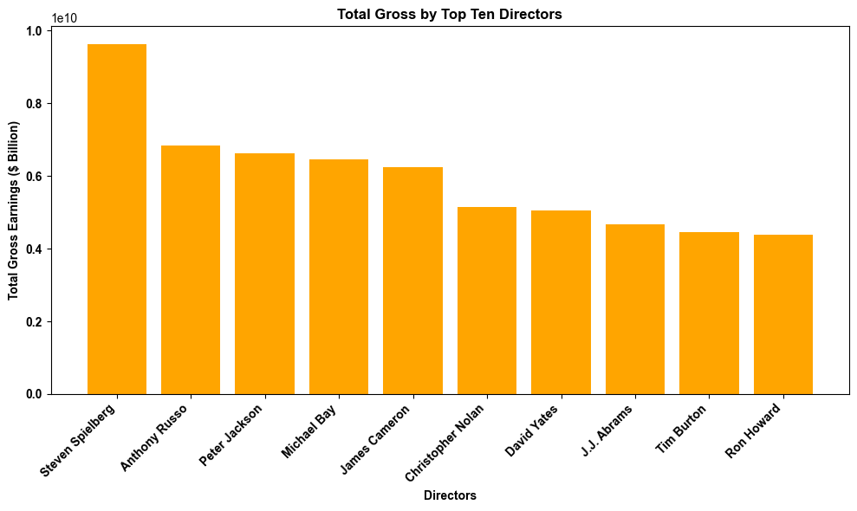


Slide 10

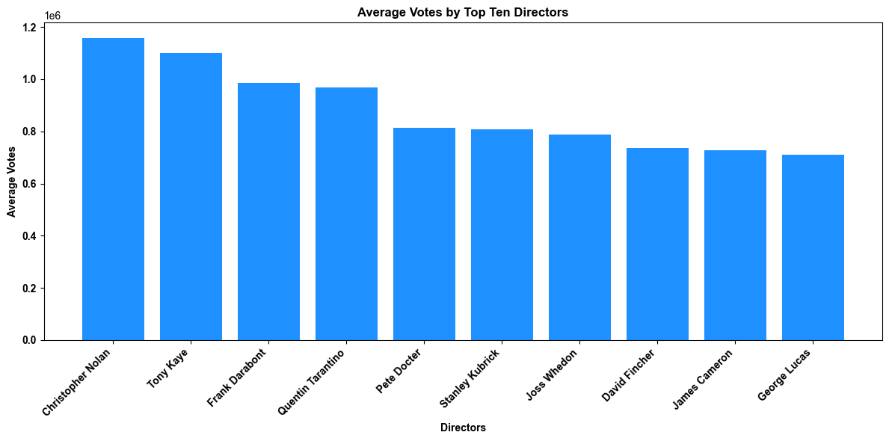

Slide 11
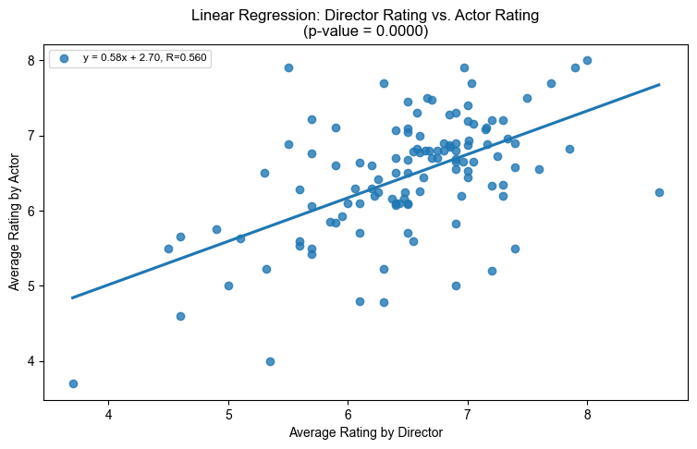
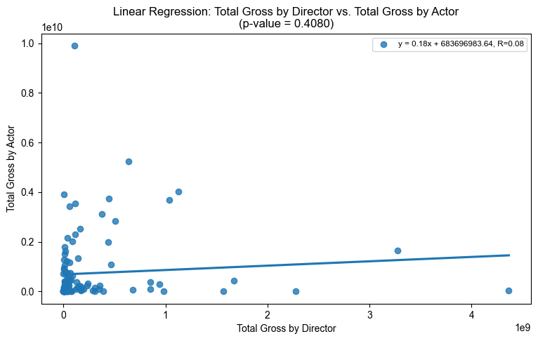


Slide 12


Slide 13
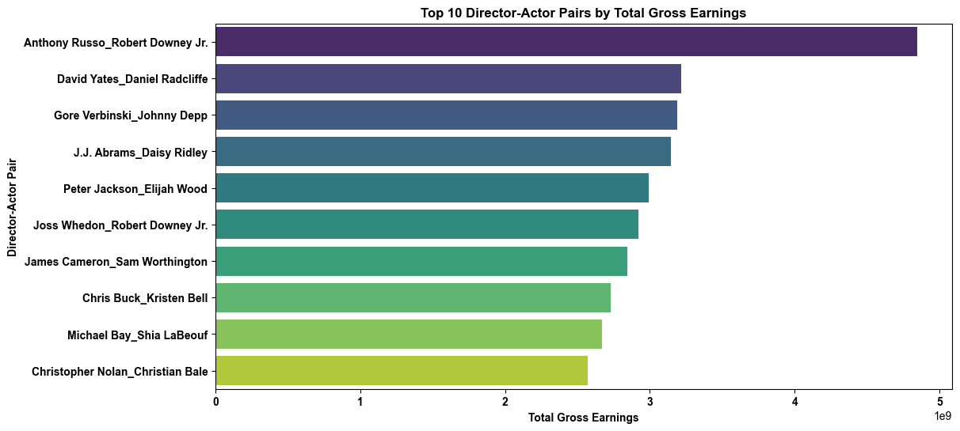

Slide 14
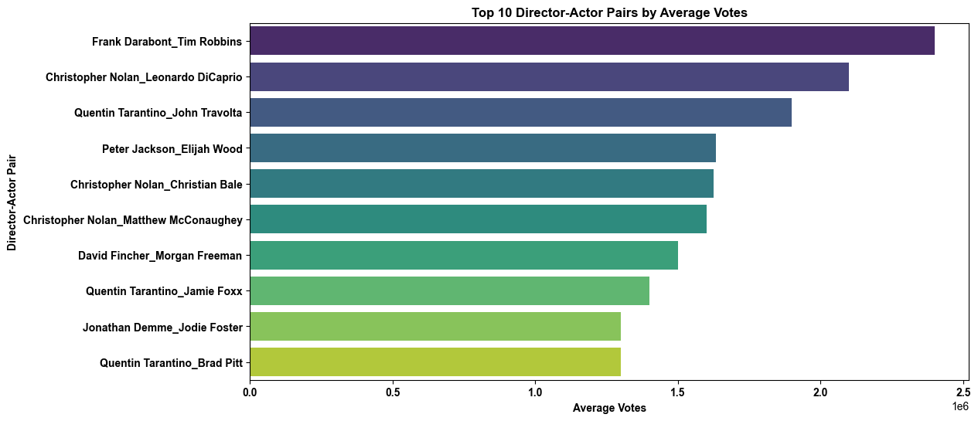

Slide 15
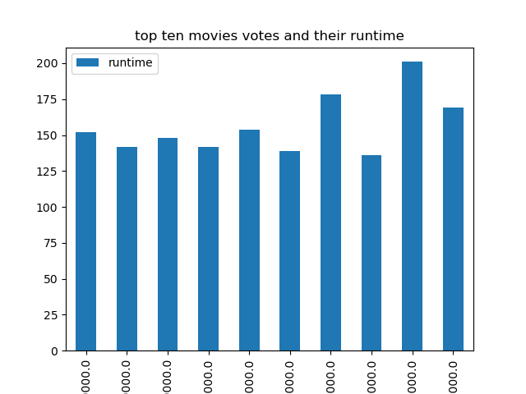
4. How does the duration of a movie impact audience reception and ratings? Are longer or shorter movies more favorably received?

Slide 16


Slide 17


Slide 18
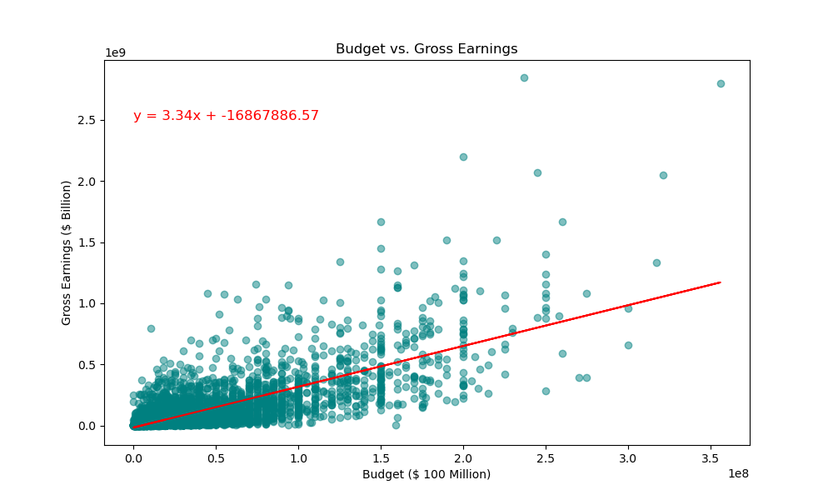
5. Is there a relationship between a movie's budget, box office performance, ratings, and how timing influences these dynamics?

Slide 19
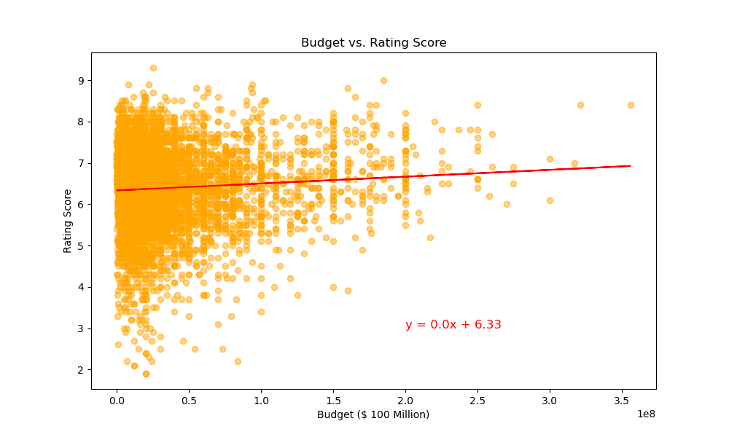

Slide 20
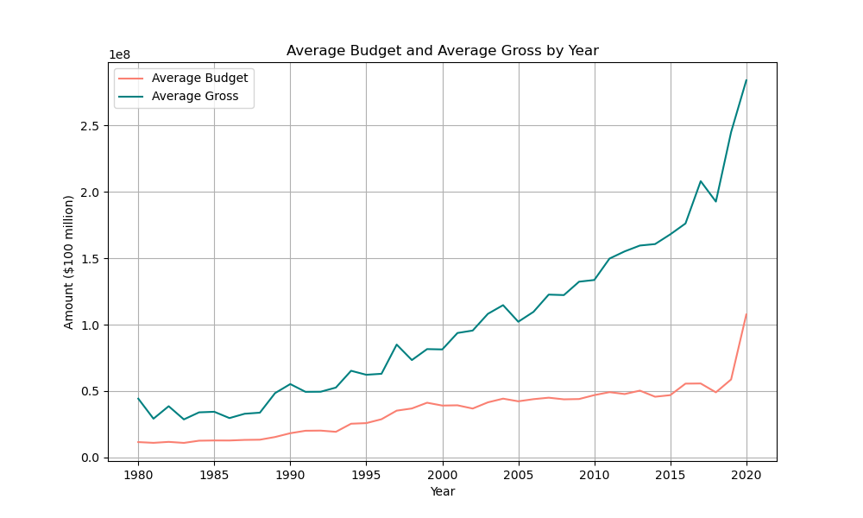

Slide 21
Summary
In summary, stakeholders in the film industry can benefit from these insights by adopting strategic approaches to release, marketing, talent investment, budgeting, and adaptation.
These measures aim to navigate the dynamic landscape, contribute to impactful cinematic experiences, and establish a lasting influence in the competitive film production environment.
While a moderate correlation exists with some of the variables, it’s essential to consider other factors when making decisions related to film production, investment, or marketing strategies.
It’s important to note that correlation doesn’t imply causation.
Other factors, such as marketing strategies, script quality, competition, etc., also play crucial roles in a movie’s success at the box office.

