Slide 1

Optimizing Digit Recognition with the MNIST Database
Ibrahim Balogun, Grace Ashley, Paul Steller, Prosper Anyidoho

Slide 2
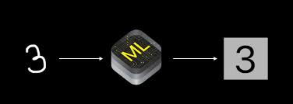
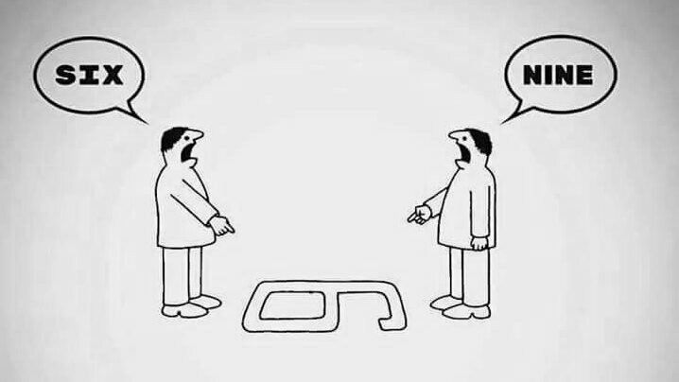
Introduction
Hand-written digit recognition has been in existence since the 1980s for various reasons:
Handwriting recognition on computer tablets
Zip codes for postal mail sorting
Processing bank check amounts
Challenges:
Size, thickness,
Orientation and position

Slide 3
Aim and Objectives
Implement pattern classification (CNN) method to recognize hand-written digits using MNIST dataset.
Implement other machine learning classifiers (SVM, KNN, Random Forest Classifier, etc.)
Improve predictive power of existing models
Implement final algorithm in an android environment

Slide 4
EXISTING MODELS
Model | Test error rate % | Reference
Linear Classifier | 7.6 | LeCun et al. 1998
K-Nearest Neighbors | 0.52 | Keysers et al. IEEE PAMI 2007
Non-Linear Classifiers | 3.3 | LeCun et al. 1998
SVM | 0.56 | DeCoste and Scholkopf, MLJ 2002
Neural Nets | 0.35 | Ciresan et al. Neural Computation 10, 2010
CNN | 0.23 | Ciresan et al. CVPR 2012

Slide 5
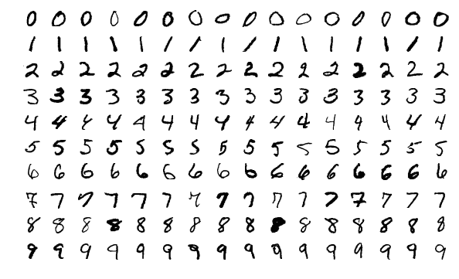
MNIST Database
Handwritten digits 0-9
28x28 pixels
60,000 training images, 10,000 testing images

Slide 6
Support Vector Machines

Slide 7
Support Vector Machines
Classes of SVM
Class | Error % | Total Time Taken
SVC | 2.08
NuSVC | 7.87
LinearSVC | 14.63
 |  | 115.74 minutes

Slide 8
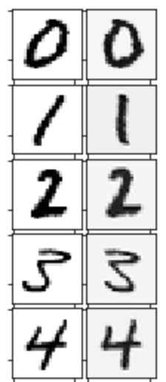
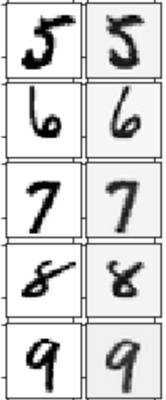
Deskewing the Data
Preprocess the data

Slide 9
Deskewing the Data
Results
Skewed vs. Deskewed
Preprocessing | Error % | Total Time Taken
Skewed | 2.08
Deskewed test and train data | 1.38
Deskewed only train data | 89.68
 |  | 14.4 minutes

Slide 10
Optimizing over Kernel
Optimizing over Kernel on Deskewed Data
Kernel | Error % | Total Time Taken
rbf | 2.08
Linear | 3.62
Poly | 1.35
Sigmoid | 30.44
 |  | 22.82 minutes

Slide 11
Optimizing over Polynomial Degree
Optimizing over Degree, Skewed vs. Deskewed
Degree | Skewed/Deskewed | Error %
1 | Skewed | 5.55
1 | Deskewed | 3.24
2 | Skewed | 2.26
2 | Deskewed | 1.56
3 | Skewed | 2.29
3 | Deskewed | 1.35
4 | Skewed | 3.02
4 | Deskewed | 1.38
5 | Skewed | 4.39
5 | Deskewed | 1.56
6 | Skewed | 6.26
6 | Deskewed | 1.83
Optimizing over Degree, Skewed vs. Deskewed
Degree | Skewed/Deskewed | Error %
7 | Skewed | 8.68
7 | Deskewed | 2.10
8 | Skewed | 11.35
8 | Deskewed | 2.54
9 | Skewed | 14.19
9 | Deskewed | 3.12
10 | Skewed | 17.27
10 | Deskewed | 3.83
11 | Skewed | 20.14
11 | Deskewed | 4.51
12 | Skewed | 22.89
12 | Deskewed | 5.20

Slide 12
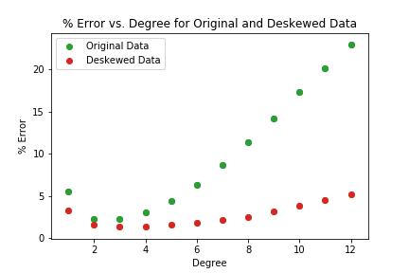
Optimizing over Polynomial Degree

Slide 13
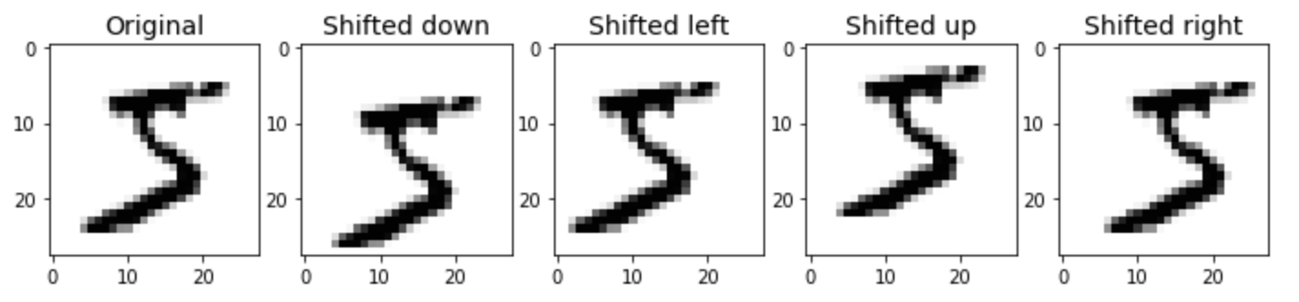
Pixel Jittering
Preprocessing
Size of training set goes from 60,000 to 300,000
2-pixel jittering on the first element of the dataset

Slide 14
Optimizing over Polynomial Degree
Optimizing over Degree, Deskewed with 1-Pixel Jitter, C = 2
Degree | Error %
1 | 3.22
2 | 0.90
3 | 0.84
4 | 0.97
5 | 1.06
6 | 1.19
7 | 1.41
8 | 1.66
9 | 1.93
10 | 2.26

Slide 15
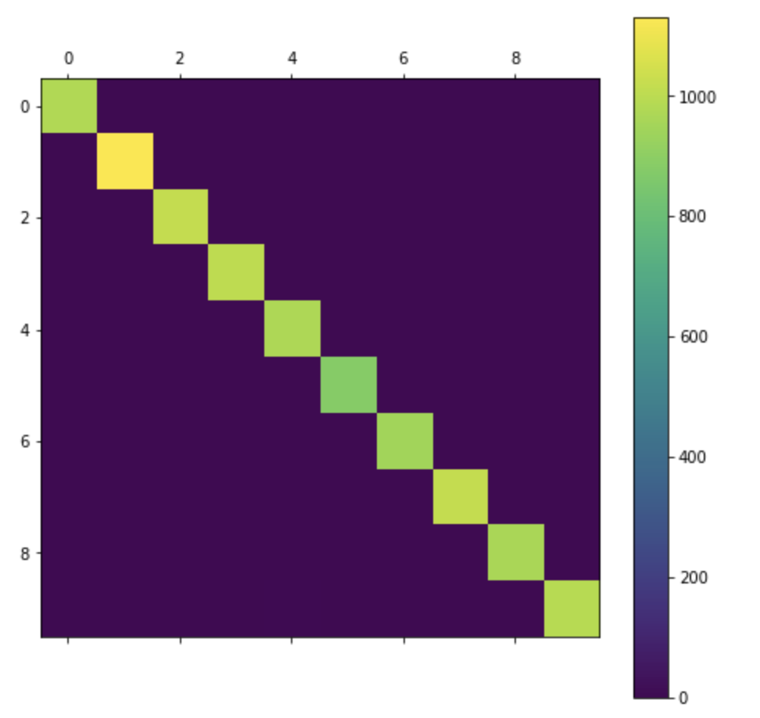
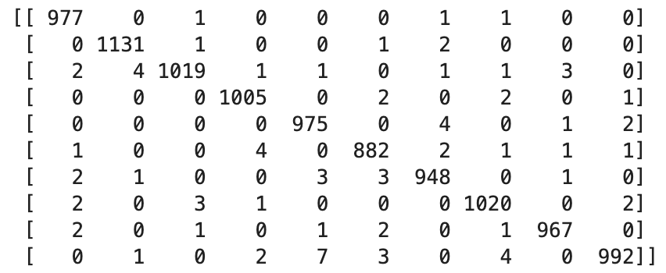
Optimal SVC Model
Kernel = Poly (degree 3)
C = 2
Preprocessing: deskewing and 1-pixel jitter
Error = 0.84%

Slide 16
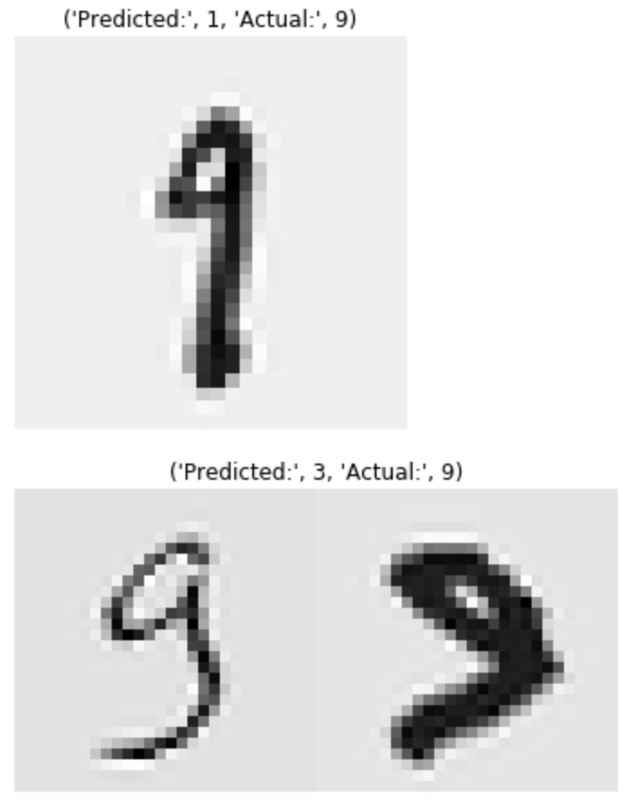
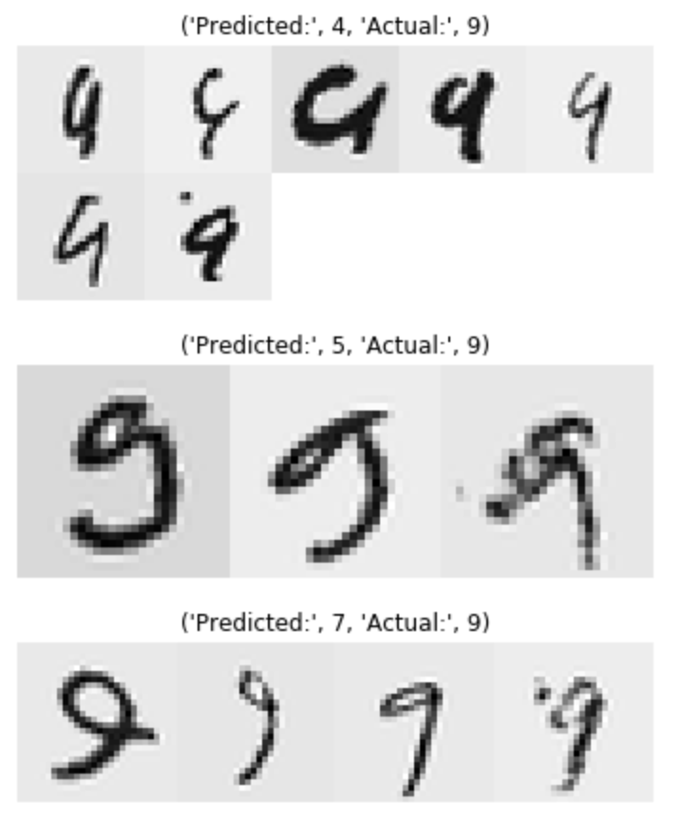
What did this model get wrong?

Slide 17
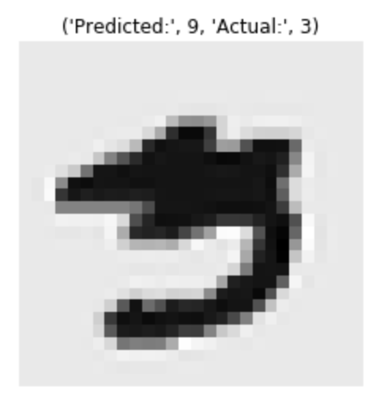
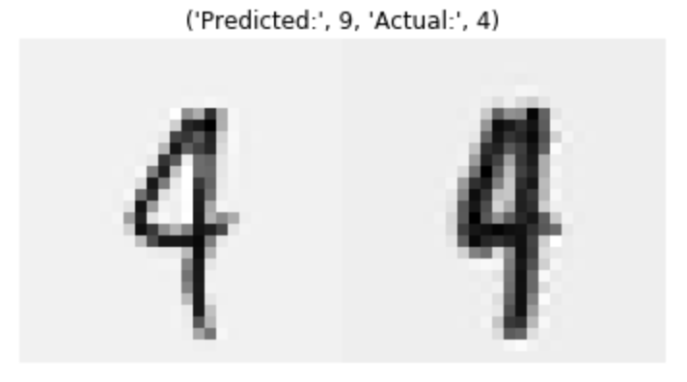
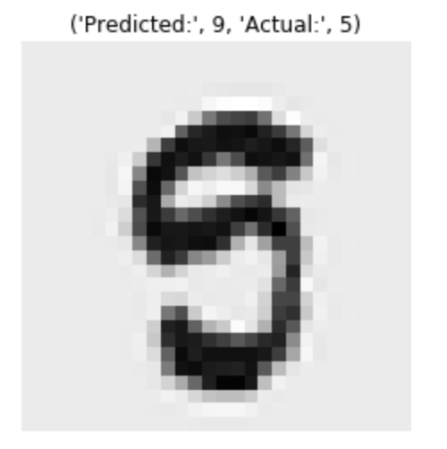
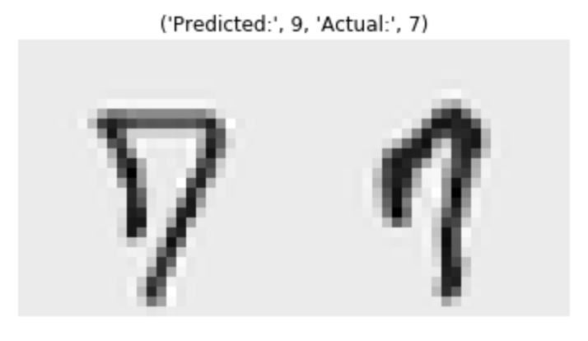
What did this model get wrong?

Slide 18
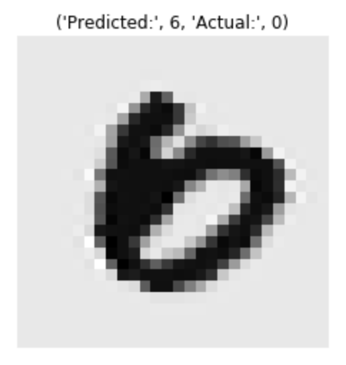
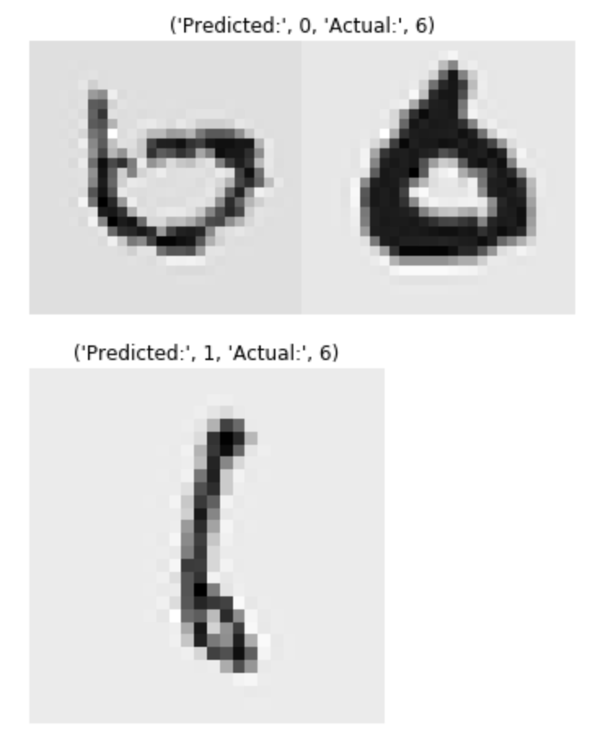
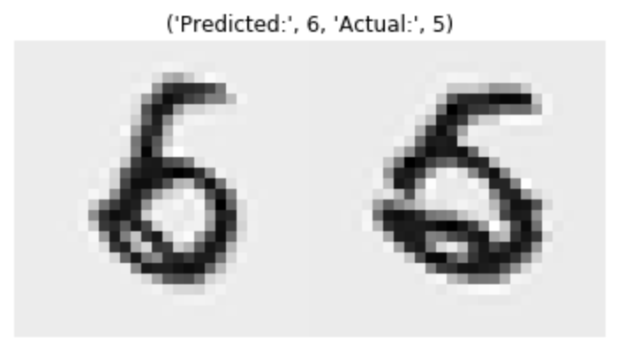
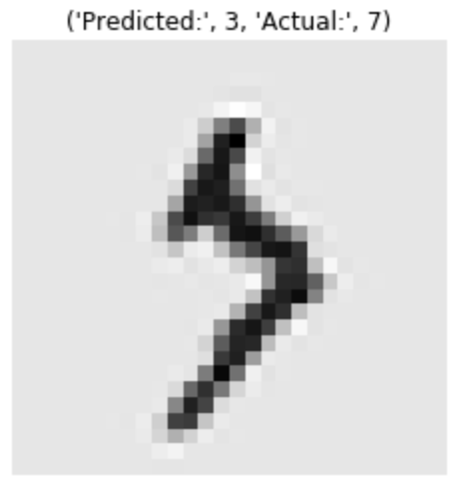
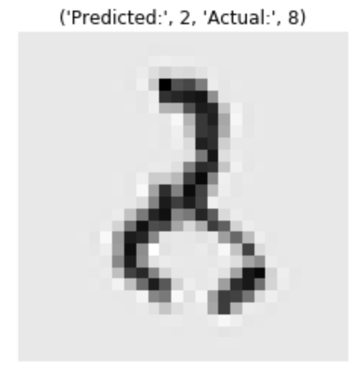
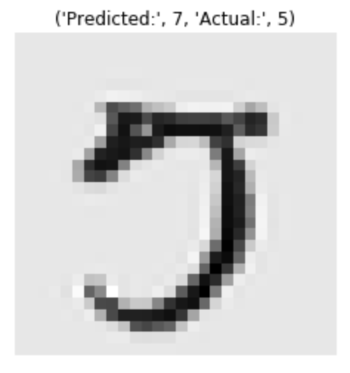
What did this model get wrong?

Slide 19
K-Nearest Neighbor

Slide 20
KNN on original data
KNN on Original Data
Nearest Neighbor | Error % | Model Ranking | Total Time Taken
2 | 3.73 | 3
5 | 3.12 | 1
10 | 3.35 | 2
 |  |  | 52 minutes
The model created with nearest neighbors=5 outperformed the other models
The model with nearest neighbors=2 produced the highest error rate
We believed that we could improve the results by applying a data augmentation method

Slide 21
KNN on skewed data
KNN on Deskewed Data
Nearest Neighbor | Error % | Model Ranking | Total Time Taken
2 | 1.93 | 3
5 | 1.69 | 1
10 | 1.87 | 2
 |  |  | 57 minutes
Data augmentation process we decided to apply was deskewing.
Results proved that deskewing the images in the dataset was a very effective way to improve model performance.
For nearest neighbor=2, the model improved my 1.8%.
An improvement of 1.43% was observed for nearest neighbor=5
Error for nearest neighbor=10 reduced by 1.48%.
Nearest neighbor=10 saw the best model improvement

Slide 22
Effect of changing distance metric
Effect of Changing Distance Metric on Model
Distance | Neighbors | Error % | Model Rank
Minkowski | 5 | 1.69 | 1
Manhattan | 5 | 2.51 | 2
Minkowski and Manhattan distances for nearest neighbor=5.
0.82% increase in the error rate when the distance metric was changed.
If this model was going to be used, we would have to maintain the Minkowski distance metric.

Slide 23
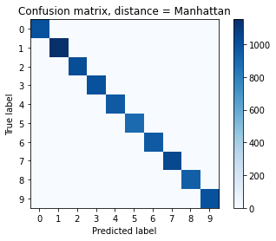

Confusion Matrices cont’d
We took a closer look at each label prediction by creating confusion matrices for both models.
Both models did well with the predictions
Model with the Minkowski distance metric performed slightly better.

Slide 24
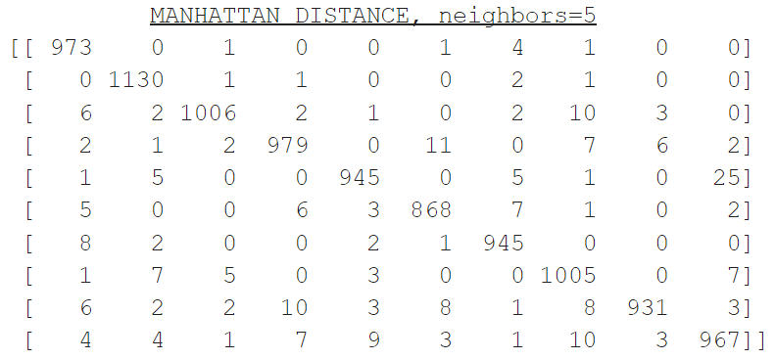
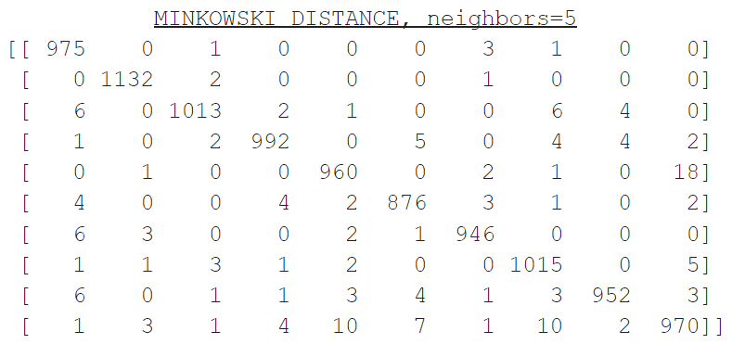
Confusion Matrices
The images labelled as “1” were predicted most accurately by both models.
The least accurately predicted label was “9” by both models.
Most of the misclassified “9” labels were predicted to be “4” and “7”.
Many “2” labels were predicted to be “7” by the model with the Manhattan metric.

Slide 25
Classification Report
 | Precision |  | Recall |  | F1-score |  | Support
Label | Manhattan | Minkowski | Manhattan | Minkowski | Manhattan | Minkowski | Manhattan | Minkowski
0 | 0.97 | 0.97 | 0.99 | 0.99 | 0.98 | 0.98 | 980 | 980
1 | 0.98 | 0.99 | 1.00 | 1.00 | 0.99 | 1.00 | 1135 | 1135
2 | 0.99 | 0.99 | 0.97 | 0.98 | 0.98 | 0.99 | 1032 | 1032
3 | 0.97 | 0.99 | 0.97 | 0.98 | 0.97 | 0.99 | 1010 | 1010
4 | 0.98 | 0.98 | 0.96 | 0.98 | 0.97 | 0.98 | 982 | 982
5 | 0.97 | 0.98 | 0.97 | 0.98 | 0.97 | 0.98 | 892 | 892
6 | 0.98 | 0.99 | 0.99 | 0.99 | 0.98 | 0.99 | 958 | 958
7 | 0.96 | 0.98 | 0.98 | 0.99 | 0.97 | 0.98 | 1028 | 1028
8 | 0.99 | 0.99 | 0.96 | 0.98 | 0.97 | 0.98 | 974 | 974
9 | 0.96 | 0.97 | 0.96 | 0.96 | 0.96 | 0.97 | 1009 | 1009

Slide 26
Random Forest

Slide 27
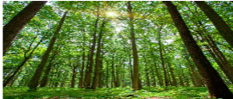
Introduction
Random Forest is a supervised learning algorithm which is used for both classification as well as regression.[1]
Literatures have shown that the accuracy of any given classifier is dependent on how well the algorithm treats the Biasness and the Variance of the dataset.
One of the advantages of the Random Forest is the ability to keep the variance and the bias low. This allows the model to predict accurately to the correct values.
Fig.1 Random Forest [3]

Slide 28
Introduction Cont’d
The handwritten analysis using RandomForest Classifier was done in the following order
Load Dataset
Divide Data into Training and Test set
Exploratory data analysis (EDA)
Create Model
Prediction

Slide 29
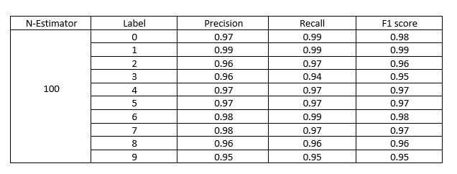
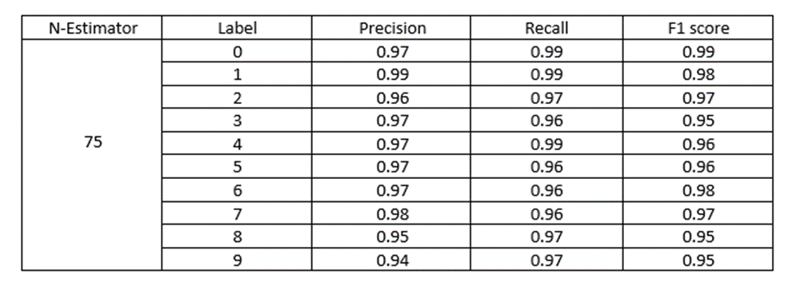
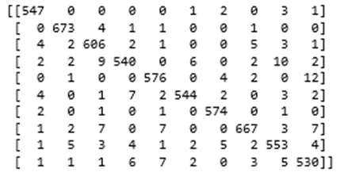
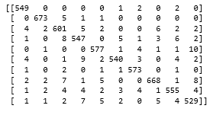
RandomForest Analysis
The most important parameters of the Random Forest Classifier is the number of estimator. We try to vary the estimator in order 20, 50, 75 and 100 to see how our algorithm performs.

Slide 30
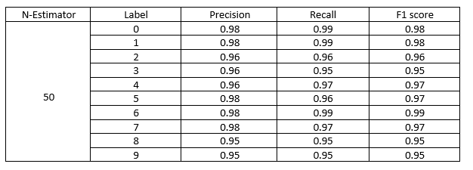
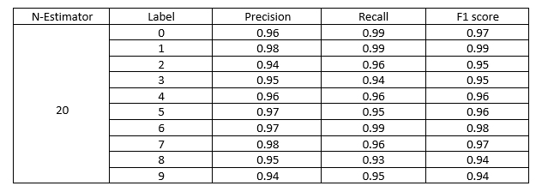
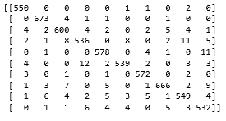
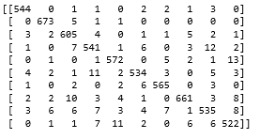
OPTIMIZING DIGIT RECOGNISTION WITH MNIST DATASET CONT’D

Slide 31
CONCLUSION
The following points were deduced from the analysis:
The accuracy obtained by varying the number of estimator does not have much effects on bigger trees e.g 50,75 and 100. However, the least estimator gave the accuracy of 96% and as such ranked 4th.
In general, the digits are well classified using the RandomForest except for the digit “9” which was weakly classify across the estimators.
The digits 1,2,3 4, and 5 were predicted correctly. This tells how efficient the classifier could be.
It was observed that the accuracy of the RFC is dependent on how well the parameters are carefully examined e.g the “n-estimator” and the “criterion”.
Although, the larger n-estimator tends to have similar accuracy but with the confusion matrix and the RMSE, we can justify the ranking.
S/N | N- Estimator | Accuracy | Ranking
1 | 20 | 96 | 4
2 | 50 | 97 | 3
3 | 75 | 97 | 2
4 | 100 | 97 | 1

Slide 32
Convolutional Neural Network

Slide 33
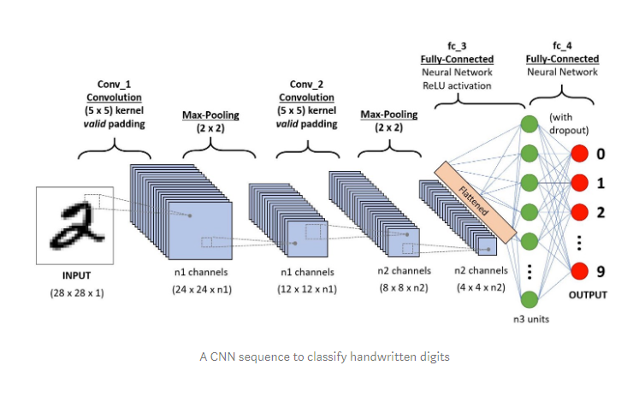
CONVOLUTIONAL NEURAL NETS
Deep Learning algorithm
Receives images and assigns parameters (weights and biases)
Differentiates images

Slide 34
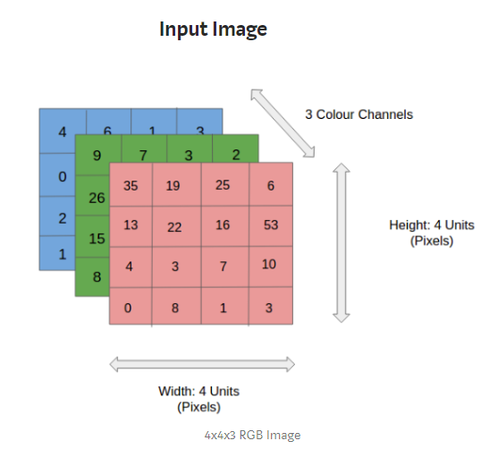
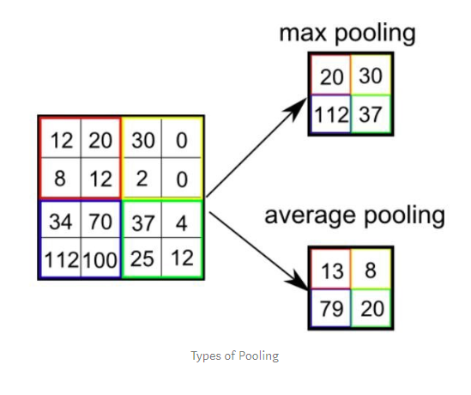
Components of CCN’s

Slide 35
Model
Architecture: Con2D->Conv2D->MaxPooling->S_E>B_N>Dropout->Con2D-MaxPool->Dropout->Flatten->Dense>Dropout->Dense->prediction
Activation: ReLu, Softmax
Regularization: Dropout (threshold=0.5,0.25)
Optimizer: Adam
Learning rate: 0.001
Data Augmentation to prevent overfitting
Epochs, Batch size: 20, 64

Slide 36
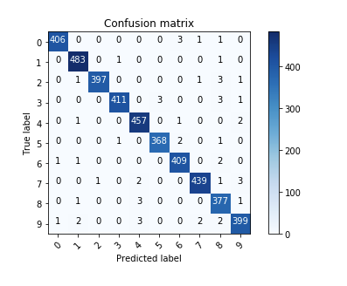
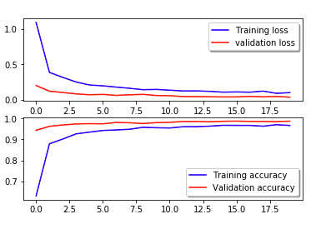
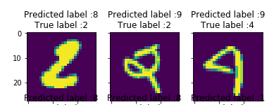
MODEL EVALUATION

Slide 37
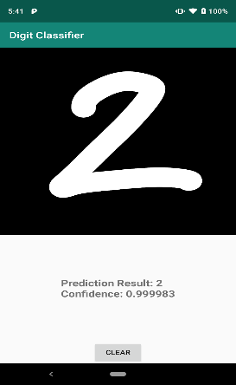
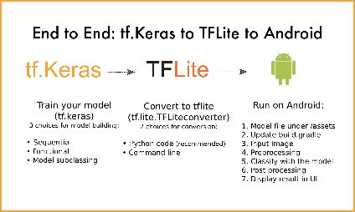
TensorFlow Lite to Android
Quantization of Tf model
Reduce precision with decrease in accuracy.

Slide 38
Conclusion and Future works
CNN had the best predictive power among the 4 models.
We could improve performance on the CNN again by using transfer learning (AlexNet, VGG16..etc)
Modify app for real time usage (integrate a camera component)

Slide 39


