Slide 1

Energy Production Exploration
CRUDE OIL PRODUCTION ANALYSIS TOOL

Slide 2

Oil Introduction
The U. S
How is produced?
Major Companies
It is produced by extraction of the Fossil fuels formed millions of years ago
Is the world’s largest producer of oil and gas.
Chevron, Exxon, ConocoPhillips, Devon Energy and Marathon Petroleum.

Slide 3

United States Production
The U.S. produces 90 percent of the gas that is used in the U.S. and 75 present of the crude oil that is used in the U.S.
By 2021 it was producing 11M barrels per year with Texas taking the lead of the states.

Slide 4
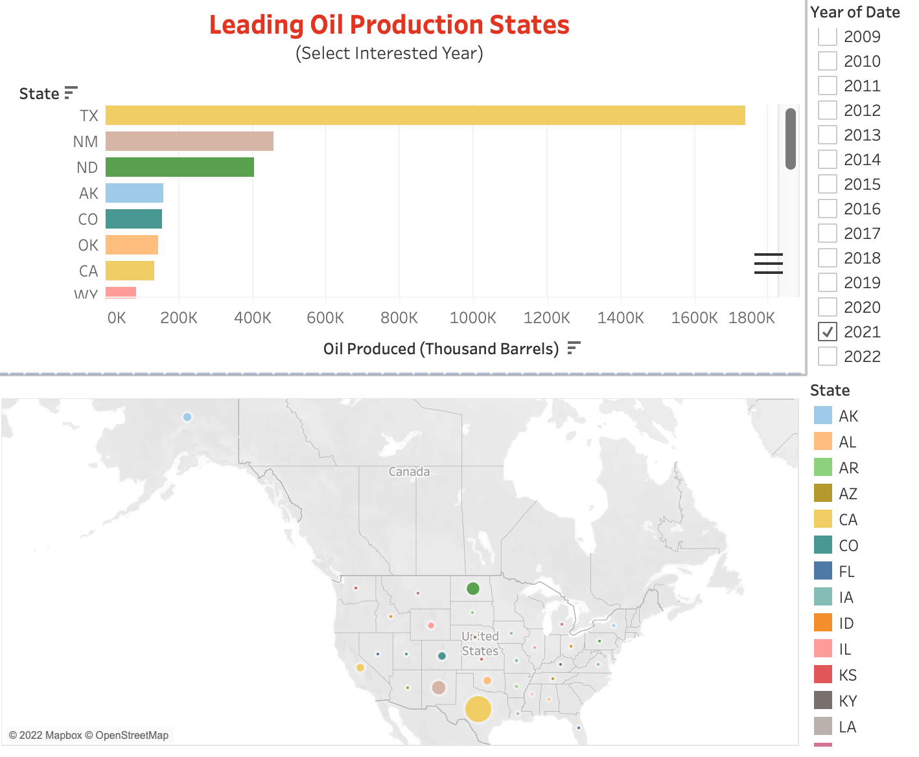
1985
2000
2022
1
2
3
Mercury is the smallest planet of them all

Slide 5
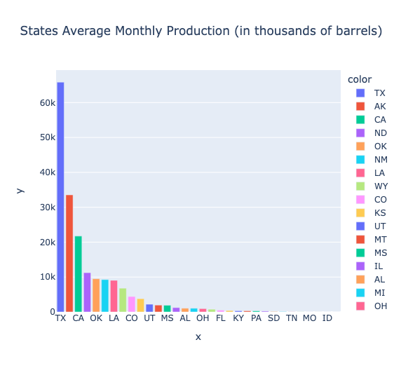
QUANTATIVE DATA ANALYSIS METHODS

Slide 6
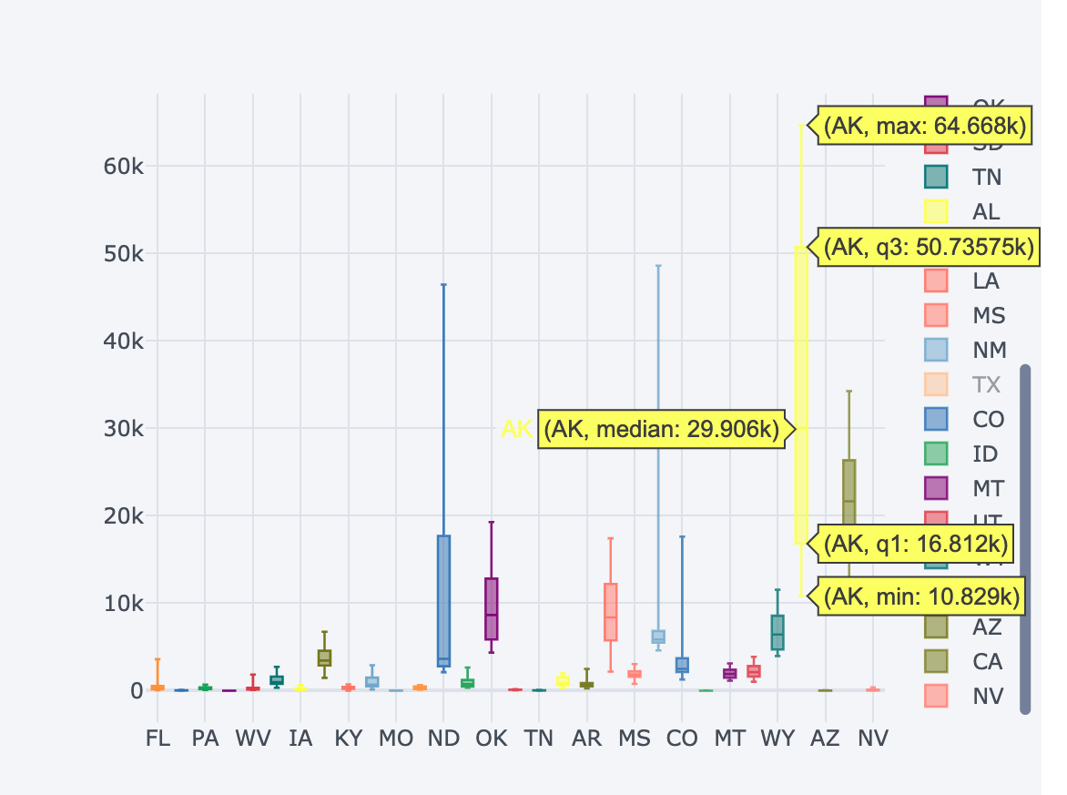
QUANTATIVE DATA ANALYSIS METHODS
Box Plot For Statistical Data By State

Slide 7
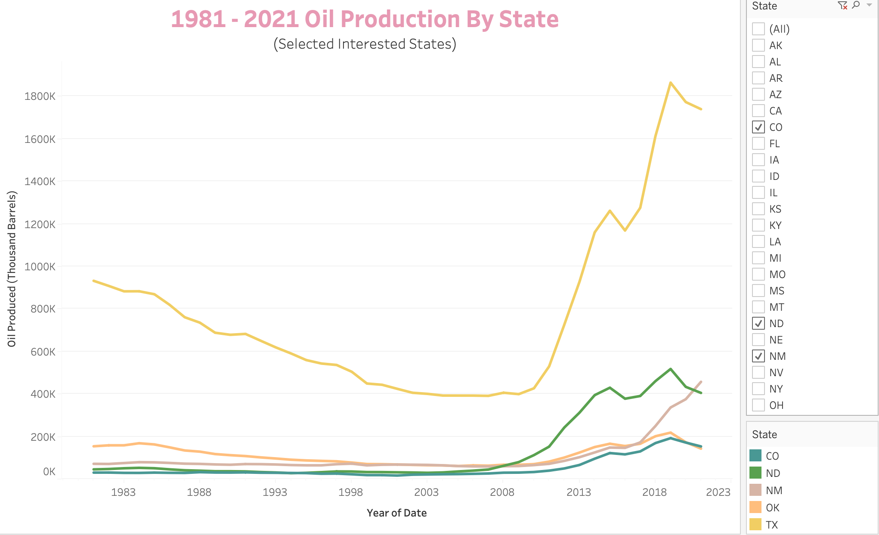
Market prices

Slide 8
Analysis of the recent years
The production of oil has decreased in the past couple of years due to several reason, such as climate change awareness, electric car production increase and the effects of the pandemic COVID-19

Slide 9
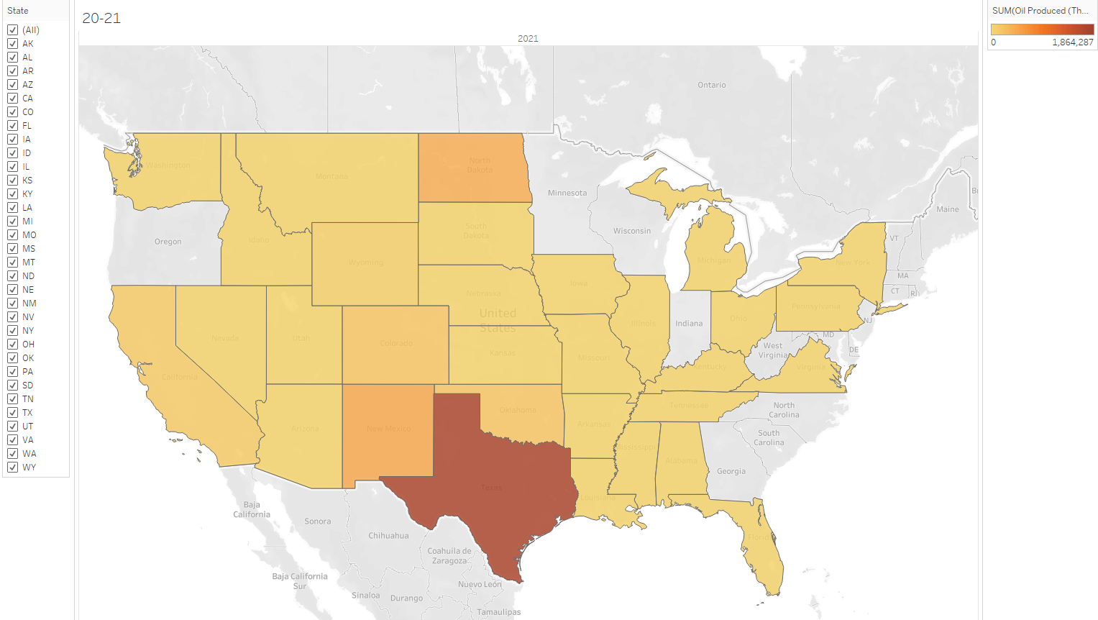
Comparing State Production
NORTH
EAST
WEST
Jupiter is a gas giant
Saturn has rings
Mars is a red planet

Slide 10





Let’s talk
Ana Paola
Lohany Smith
Davin Dillon
Bachelor in Computer Science
Sophomore
Masters in Data Analytics
Senior
Bachelor in Data Science
Senior

Slide 11
Resources
WEBSITES
https://www.eia.gov/tools/faqs/faq.php?id=32&t=6
https://www.cfr.org/backgrounder/how-us-oil-and-gas-industry-works

