Slide 1


Overtake and Undertake Quantities Billing for German Energy Utilities (MeMi)
Internal
Support Package 02
Shelwin Wei Aug. 2016

Slide 2
Agenda
MeMi Overview
MeMi CI Integration
MeMi Reversal Solution
MGV Billing Process
MeMi Simulation
Subscription of Allocation List

Slide 3

MeMi is a solution for DSOs for electricity and gas
Electricity and Gas
Per point of delivery:
DSO
MSCONS with settlement quantity or reversal data
INVOIC with MeMi data or reversal data
EDM:
Settlement
settlement period
Supplier
REMADV payment advices with approved MeMi invoices and grid usage invoices
settlement quantity
ISU:
Grid Usage Billing
ISU:
MeMi Billing
(incl. CI)
ISU:
IDEX DE / GC
REMADV non-payment advices with complaint MeMi invoices and grid usage invoices
Aggregated:
SSQNOT with MeMi quantity
MeMi quantity
MeMi period
MeMi amount
MGV
grid usage period
grid usage quantity
Gas only
Paper Invoice (-> INVOIC) with MeMi amount

Slide 4
Overview of MeMi
Definition of overtake and undertake
Feed-Out PoD (Energy Consuming)
Result = Settled quantity – Feed Out quantity (Grid usage quantity)
Feed-In PoD (Energy Feeding)
Result = Feed In quantity – Settled quantity
If Result > 0, It’s overtake quantity, means DSO should pay money to Supplier (DSO payable)
If Result ≤ 0, It’s undertake quantity, means Supplier should pay money to DSO (DSO receivable)

Slide 5
Overview of MeMi - 2
MeMi Other Key Features
MeMi Category -> Combination of grid usage and settlement (View: /IDXMM/V_DOC_CAT)
MeMi Quantity Type -> Overtake or undertake (View: /IDXMM/V_QUANTYP)
MeMi Period -> Longer period between start to end of grid usage period or settlement period
MeMi Price -> used for amount calculation and can be configured (View: /IDXMM/V_PRICE)
Reverse Charge Type
Grid Account Number -> only valid for division gas and will be used for MGV processing

Slide 6


Definition: settlement period & settlement amount
settlement period
settlement amount
“ | The settlement period that belongs to billing period of grid usage together with asynchronous periods is relevant for computing the settlement amount.”
“ | settlement amount : After the clearing phases the amount that is assigned to the settlement area.”
begin grid usage period <= begin settlement period
End grid usage period <= End settlement period

Slide 7

Definition: MeMi period & MeMi amount
MeMi period
MeMi amount
“ | The MeMi period includes grid usage period and settlement period.”
 | MeMi amount: Consumption: settlement amount - consumed amount Energy Feeding: supplied amount - settlement amount
begin MeMi period = begin grid usage period
if no GU: begin settlement
end MeMi period = end settlement period
if no settlement: end GU

Slide 8
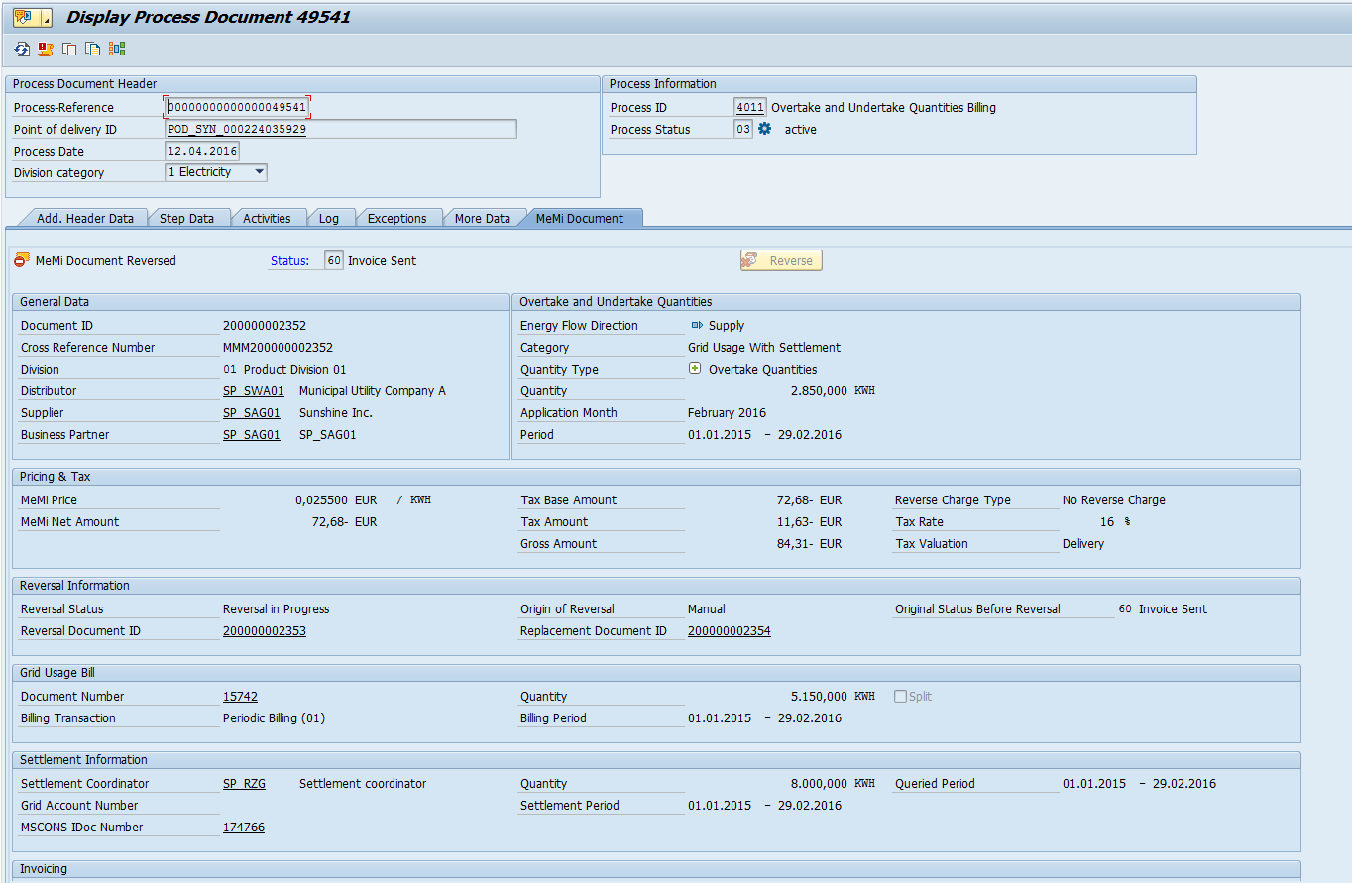
Overview of MeMi - 2
MeMi UI integrated in Process Document UI

Slide 9
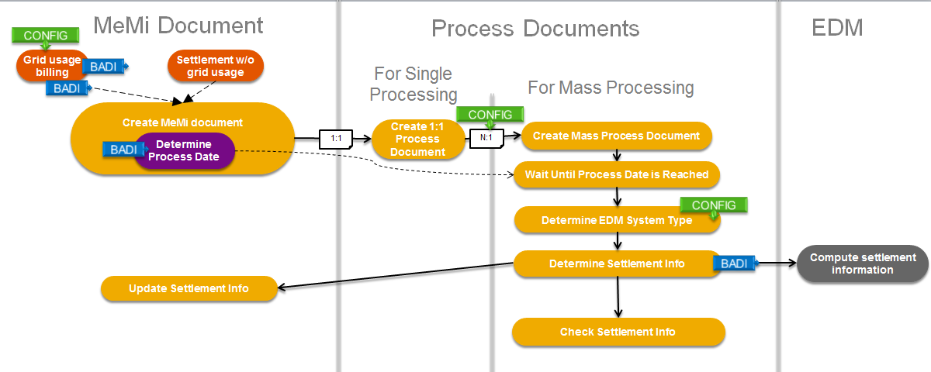
Core Billing Process Detailed View - Internal EDM
Notes:
Grid Usage Billing Triggering:
Config: IMG…->Overtake and Undertake Quantities Billing for German Energy Utilities ->Define Creation Process
BAdI ISU_BI_FUNCNAME_VARIANT, implementation /IDXMM/BADI_IM_ISU_BI_FUNCNAME
BAdI ISU_BI_UPDATE, implementation /IDXMM/BADI_IM_ISU_BI_UPDATE
Variant program MEMIDOC1 is available, which creates customer specific line items in the billing document. Within this variant program, grid usage billing period and grid usage billing quantity will be taken for the MEMI document.
Create MeMi document
Enhancement Sport /IDXMM/ES_BO, BAdI /IDXMM/BADI_MEMI_DOCUMENT, Default fallback class /IDXMM/CL_DEF_BADI_MEMI_DOC.
Single Processing: Mass Process N:1 General Configuration – Package Size
Determine EDM System Type: General Configuration – EDM type
Determine Settlement Info
Enhancement Spot /IDXMM/ES_EDM_SERVICE, BAdI /IDXMM/BADI_EDM_SERVICE, no implementation delivered.

Slide 10
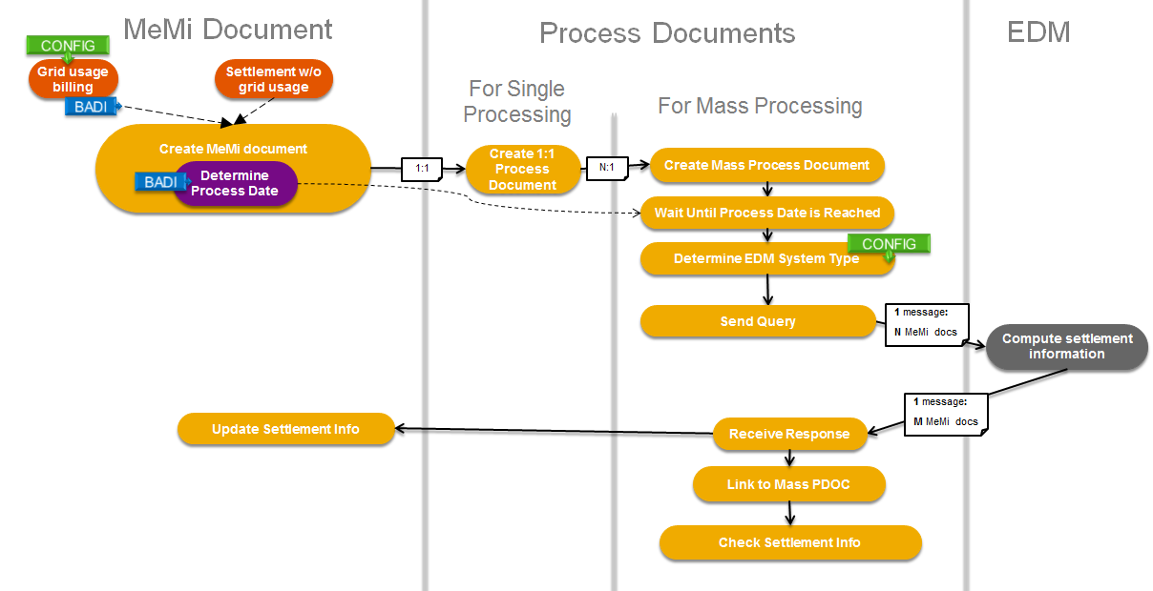
Core Billing Process Detailed View - External EDM

Slide 11
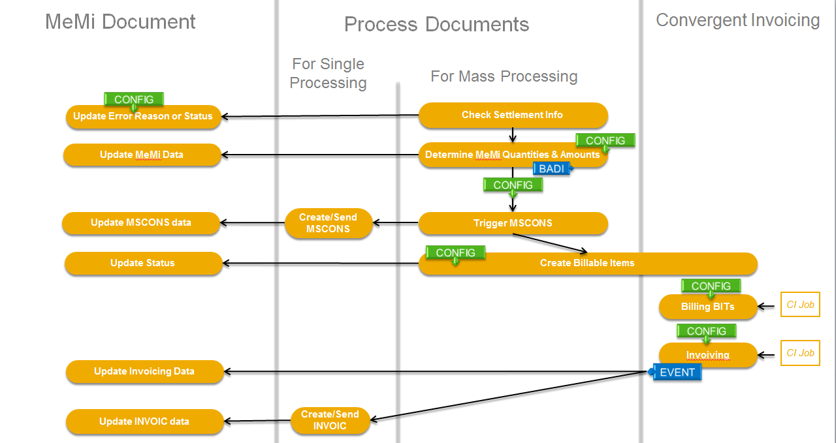
Core Billing Process Detailed View – Continued for both internal and external EDM type
Notes:
Update Error Reason or Status
Overtake and Undertake Quantities Billing for German Energy Utilities -> Define Error Reason Codes
Overtake and Undertake Quantities Billing for German Energy Utilities -> Define Mapping Between Error Reason Code and Check Result
Determine MeMi Quantities & Amounts
IDXGC configuration (check framework). Check ID methods call BAdI /IDXMM/BADI_MEMI_DOCUMENT->DETERMINE_PRICE, /IDXMM/BADI_MEMI_DOCUMENT->DETERMINE_APPL_YEAR_MONTH
Trigger MSCONS: IDXGC configuration(process framework)
Create Billable Items
BAdI /IDXMM/BADI_MEMI_DOCUMENT->DETERMINE_PARAMETERS_FOR_BIT, default implementation reads IMG customizing
IMG… -> Overtake and Undertake Quantities Billing for German Energy Utilities -> Determine Parameters for Creating Billable Items
Billing BITs CI customizing, in sample BC-Set for CI, /MEMI/CI_00
Invoicing CI customizing, , in sample BC-Set for CI

Slide 12
Practice
Automation Tool: 1) Scenario Test Report (T-code: /IDXMM/TEST)
Manual Creation: [Normal billing] 1) Create master data (Report: /IDXMM/RP_MEMI_MD_CREATE) 2) Individual bill (T-code: EASIBI) [Outsorted billing] 1) Create master data (Report: /IDXMM/RP_MEMI_MD_CREATE) 2) Display Installation (Get contract number) (T-code: ES32) -> Change Contract (Add outsorting check group for billing) (T-code: ES21) 3) Individual bill (T-code: EASIBI) 4) List outsorted billing documents and release (T-code: EA05)

Slide 13
Agenda
MeMi Overview
MeMi CI Integration
MeMi Reversal Solution
MGV Billing Process
MeMi Simulation
Subscription of Allocation List

Slide 14
Convergent Invoicing used in MeMi
MeMi Doc 1
Billable Items 1
Billing Doc 1
Invoicing Doc
MeMi Doc 2
Billing Doc 2
Billable Items 2
FI-CA Posting Doc
Billing Doc 3
MeMi Doc N
Billable Items N
Billing Doc N

Slide 15
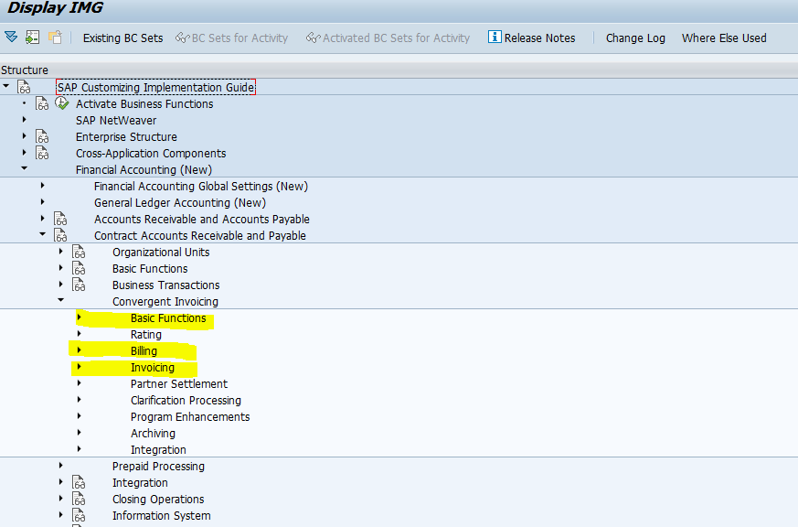
Convergent Invoicing Integrated in MeMi
Related Customizing:

Slide 16
Agenda
MeMi Overview
MeMi CI Integration
MeMi Reversal Solution
MGV Billing Process
MeMi Simulation
Subscription of Allocation List

Slide 17
Reversal
General Ideas
Reversal document rolls back all actions executed by the original MeMi document
Stops all market communications once executed
Posting of an inverse BIT in Convergent Invoicing
Reversal posting and original posting document are counterbalancing
Automatic clearing of reversal and original posting document is done
Once the reversal is executed without sending out an INVOIC message to the market partner
Once a complaint notification PAN is received and the original document is reversed
Reversal of a MeMi document without a grid usage reversal leads always to a new and empty MeMi document
The replacement document is processed like usual and reflects the corrections
Reversal triggers
MeMi UI reversal button
Mass reversal transaction
Reversal of grid usage bill

Slide 18
Overview Reversal Process
Reversal MeMi document
Mass Reversal Process document
MeMi document
Inform External EDM System about Reversal
Send Reversal MSCON Message
Trigger Reversal MSCONS Outbound Message
Send Reversal INVOIC Message
Create Billable Items for Reversal Documents
Replacement document is created automatically if the grid usage bill is not yet reversed
Deadlines of Mass reversal document can be set individually according to reversal origin (MeMi reversal, Grid Usage reversal)
Replacement MeMi document

Slide 19
Reversal No EDM request sent
MeMi Document
Application Month: ?
Quantity type: ?
Quantity: ?
Gross amount: ?
EDM
MeMi Reversal Document
Application Month: ?
Quantity type: ?
Quantity: ?
Gross amount: ?
Supplier
BIT
Account Balance

Slide 20
Reversal BIT not yet created
MeMi Document
Application Month: 10/2015
Quantity type: Overtake
Quantity: 3035 kWh
Gross amount: -122,87 €
EDM
MeMi Reversal Document
Application Month: 10/2015
Quantity type: Reversal Overtake
Quantity: 3035 kWh
Gross amount: +122,87 €
MSCONS
INVOIC
Supplier
Reversal
MSCONS
Reversal
INVOIC
BIT
Account Balance

Slide 21
Reversal Invoice not yet sent
MeMi Document
Application Month: 10/2015
Quantity type: Overtake
Quantity: 3035 kWh
Gross amount: -122,87 €
EDM
MeMi Reversal Document
Application Month: 10/2015
Quantity type: Reversal Overtake
Quantity: 3035 kWh
Gross amount: +122,87 €
MSCONS
INVOIC
Supplier
Reversal
MSCONS
Reversal
INVOIC
BIT
Account Balance
-122,87 €
+122,87 €
Automatically cleared

Slide 22
Reversal Full Reversal
MeMi Document
Application Month: 10/2015
Quantity type: Overtake
Quantity: 3035 kWh
Gross amount: -122,87 €
EDM
MeMi Reversal Document
Application Month: 10/2015
Quantity type: Reversal Overtake
Quantity: 3035 kWh
Gross amount: +122,87 €
MSCONS
INVOIC
Supplier
Reversal
MSCONS
Reversal
INVOIC
BIT
Account Balance
-122,87 €
+122,87 €
Automatically cleared once initiated by a complaint notification

Slide 23
Status & Action
Original MeMi Document
10 New
Reverse
15 Obsolete
20 Settlement Info Queried
25 Settlement Info Received
30 Settlement Data Validated
35 Ready for Billing
Automatic Account Maintenance by CI when posting reversal
65 Cleared with Original / Reversal Document
40 Billable Item Created
50 Invoice Posted
60 Invoice Sent

Slide 24
Status & Action
Reversal MeMi Document
10 New
Complete Reversal
15 Obsolete
22 Settlement Reversal Information Sent
32 Reversal MSCONS Sent
Automatic Account Maintenance by CI when posting reversal
42 Reversal Billable Item Created
50 Invoice Posted
65 Cleared with Original / Reversal Document
60 Invoice Sent

Slide 25
Continued…MeMi Document (Original & Reversal)
60 Invoice Sent
70 Waiting for Incoming Payment
Post Payment Lot
85 Incoming Payment Received
Process Payment Advice
75 Waiting for Outgoing Payment
Payment Run
86 Outgoing Payment Paid
71 Zero-Balance Advice Received
Process Zero-Balance Advice
80 Cleared as Zero-Balance
77 Waiting for Confirmation after Complaint
Wait for Confirmation
Process Complaint Notification
76 Complaint Notification Received
Automatic Account Maintenance by CI when posting reversal
81 Cleared as Complaint Notification

Slide 26
10 New
Zero-amount MeMi document is reversed after receiving complaint notification
40 Billable Item Created
66 Cleared as Zero Amount
Complaint Received
76 Complaint Notification Received
Reversed
10 New
42 Reversal Billable Item Created
Update original document
66 Cleared as Zero Amount
66 Cleared as Zero Amount

Slide 27
10 New
Zero-amount MeMi document is reversed before receiving complaint notification
40 Billable Item Created
Reversed
10 New
66 Cleared as Zero Amount
42 Reversal Billable Item Created
Complaint Received after reversal doc reaches 66
66 Cleared as Zero Amount
76 Complaint Notification Received
Since both original INVOIC and reversal INVOIC have been sent out, DSO should communicate with SUP to let them send back a normal REMADV and then continue process designed previously (e.g. if zero balance is received, after processing zero-balance PAN both original and reversal MeMi documents will be updated with 66)

Slide 28
Reversal MeMi Process Overview
Reversal MeMi process documents have also 2 kinds:
Single reversal process document (Process ID 4012):
Determine the process handling of reversal
Market communication (Send Reversal MSCONS, Send Reversal INVOIC)
Mass reversal process document (Process ID 4022):
Mass reversal process documents collect documents with the same EDM processing date, same supplier service provider, same reversal origin, same division and company code.
Mass reversal processing for all reversal MeMi documents

Slide 29
Reversal MeMi Process Overview - 2
Automatic clearing after reversal process
Integrated FI-CA event frameworks
Event 2630 – Mark all the open items as selected
Event 2631 – Create proposal for MeMi related open items and then deselect the rest open items
No manual account maintenance allowed for MeMi related open items. Automatic clearing shall be completely covered by MeMi process for MeMi related items.

Slide 30
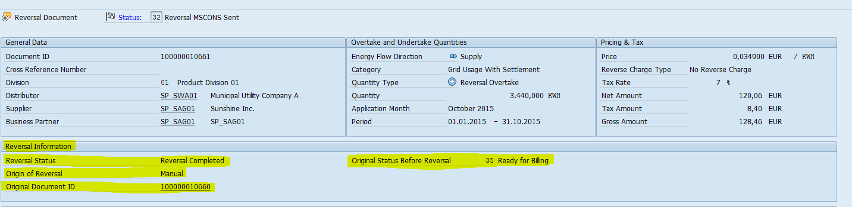
Reversal MeMi Process Overview - 3
MeMi reversal key features:
Reversal Origin -> how this reversal is triggered
Reversal status -> indicates the status of reversal processing
Status before reversal
Reversal document
Original document
Replacement document

Slide 31
Agenda
MeMi Overview
MeMi CI Integration
MeMi Reversal Solution
MGV Billing Process
MeMi Simulation
Subscription of Allocation List

Slide 32
Introduction to MGV Billing Process
Concept
MGV (German: Marktgebietsverantwortlicher)
Gas Settlement Coordinator
Business Scenario
Supplier -> Distributor -> Settlement Coordinator
Database tables
/IDXMM/MGV_DETIF: Detail Information for MGV Billing Process
/IDXMM/MGV_GAMA: Grid Account Master Data
/IDXMM/V_MGVGAMA: Maintain Grid Accounts

Slide 33
Lifecycle of MGV Billing Process
Mass Processing (4021)
...
Create MGV detail information entry (Populate Grid Account Number and Settlement Data)
Class: /IDXMM/CL_MEMI_DOCUMENT
Method: /IDXMM/IF_MEMI_DOCUMENT~PROCESS_SETTLEMENT_RESULT
Split item
Determine EDM System Type
External EDM
Internal EDM
Send Query
Determine Settlement Info
Update MGV detail information entry (Populate MeMi quantity, Application Year and Month)
Receive Response
Class: /IDXMM/CL_CHECK_MEMI_DATA_DET
Method: DETERMINE_MGV_DETAIL_INFO
Update Settlement Info
Check Settlement Info
Update MGV detail information entry (Populate Consumption Item ID and CI Invoicing Doc Number)
Class: /IDXMM/CL_MGV_BILLING
Method: CREATE_AGGREGATED_CIT
Determine MeMi Quantities & Amounts
CI Invoicing
...
Notes:
Report /IDXMM/RP_MGV_DETIF_CONVERSION is designed for customers that would upgrade from MeMi SP01 to SP02, and it is used to collect information of MeMi documents for which MGV detail information entry should be created, and then create these entries in database. It should only be executed once after upgrading to SP02.
Report /IDXMM/RP_MGV_DETIF_UPDT_CORR is used to update MGV detail information entry if MeMi quantity, application year and application month are failed to be populated.

Slide 34
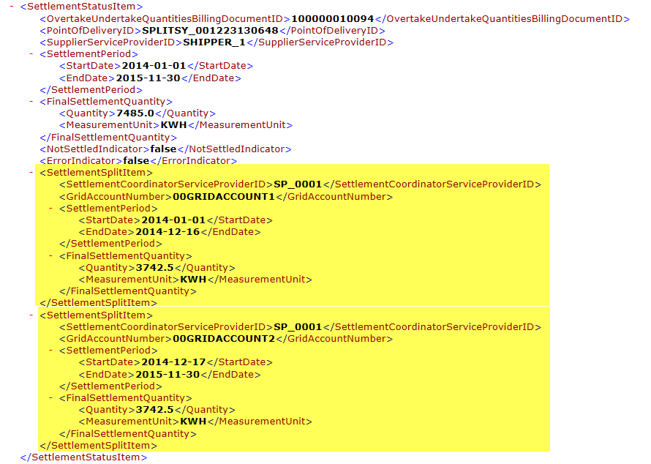
EDM Response: Split Settlement Items by Grid Account Number
Aggregation of all Split Items
First Split Item
SecondSplit Item

Slide 35
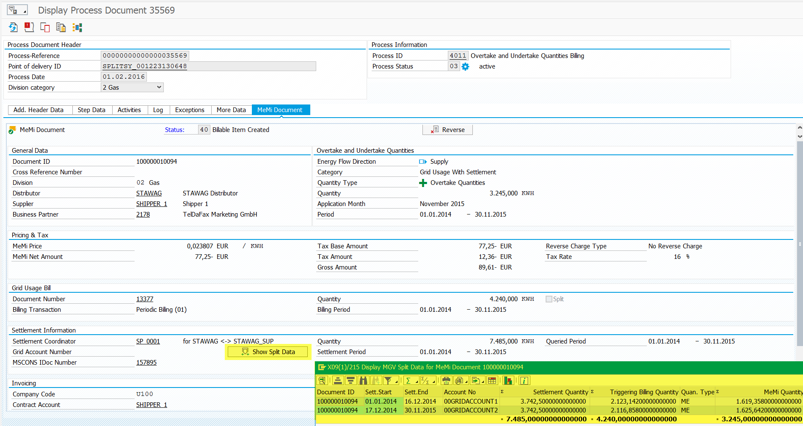
MeMi Quantity is computed per Split Item

Slide 36
Convergent Invoicing: MGV Billing
CI Job
Invoicing
EVENT
Create INVOIC
Supplier
By Grid Account Number
By Application Month Baseline Date
Aggregate
Create Consumption Items
Determine MeMi Price
Reverse Charge?
or
CI Job
Rating
EVENT
Energy Tax?
Determine Energy Tax Price
or
CI Job
Billing
EVENT
Create SSQNOT
or
CI Job
Invoicing
MGV
Printing
Send Paper Invoice
Notes:
Function modules for Rating: /IDXMM/FM_RATING_EVENT_10, /IDXMM/FM_RATING_EVENT_30
Event for Billing: [T-code FQEVENTS] 8135 (Create reference in billing document) / 8137 (Send SSQNOT IDoc)

Slide 37
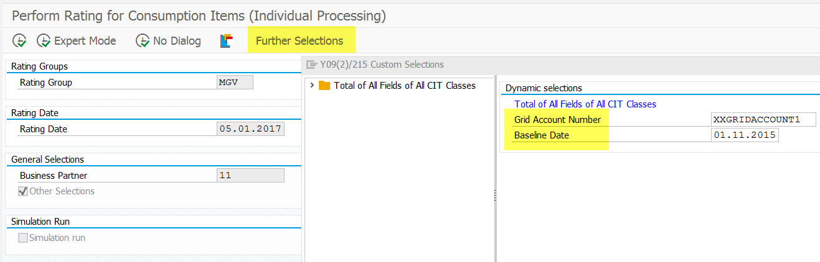
Convergent Invoicing:
Use “Further Selections” to restrict by
grid account number
baseline date (= first of application month)

Slide 38
Integration with MeMi reversal process
Update original MGV entry with field OBSOLETE = ‘X’
No
MeMi document reversed
Billable item is created?
Class: /IDXMM/CL_MEMI_DOCUMENT
Method: CREATE_REVERSAL_MGV_DETIF
Reverse GU
Reverse MeMi Doc
Yes
Copy from original MGV entry and create reversal MGV entry
Initialize Consumption Item ID and Invoicing Doc Number
Update quantity type (ME -> RO; MI -> RU)
Notes:
If billable item is not created when MeMi document is reversed, which means that MeMi document will not be invoiced anymore, we should set obsolete flag of MGV detail information to 'X'.
This is the case if we have already created an MGV entry after receiving external EDM response or determining settlement info from internal EDM, but have not created any BIT and the MeMi document is reversed.

Slide 39
Agenda
MeMi Overview
MeMi CI Integration
MeMi Reversal Solution
MGV Billing Process
MeMi Simulation
Subscription of Allocation List

Slide 40
Simulation MeMi process
MeMi simulation key features:
No market message will be sent out (MSCONS & INVOIC)
Simulation Billable Items are created
No FI-CA posting document will be posted
No MGV CIT will be created

Slide 41
Simulation MeMi Document
Simulation Process Documents
Grid Usage Billing Simulation
Settlement w/o grid usage Simulation Indicator Set
For Single Processing
For Mass Processing
Customizing
Create MeMi document
Create 1:1 Process Document
N:1
Create Mass Process Document
1:1
Simulation MeMi Doc
Simulation PDOC
Simulation Mass PDOC
S
S
S
S
Message:
Simulation
N MeMi docs
Send Query
Compute settlement information
S
Message:
Simulation
M MeMi docs
EDM
Receive Response
SAP CI
Create Billable Items
Simulation BITs
S
Billing BITs
Billing Document
S
S
= Simulation Entity or Indicator
Invoiving
Invoicing Document
S
Notes:
T-code of Simulation Billing: EASISI

Slide 42
Agenda
MeMi Overview
MeMi CI Integration
MeMi Reversal Solution
MGV Billing Process
MeMi Simulation
Subscription of Allocation List

Slide 43
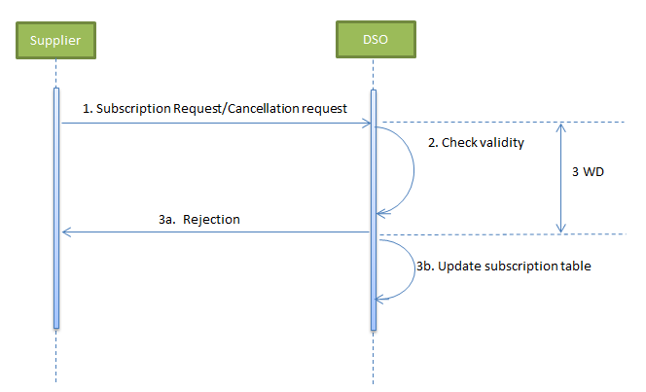
Send and Receive Subscription of Allocation List
Supplier:
Report /IDXMM/RP_SUBSCRIBE_ALOCAT
-> Trigger process 4031 (Send ORDERS to DSO)
DSO:
Receive ORDERS ->
Trigger process 4032 (Insert or Update subscription to table /IDEXGE/SUBSCRIF)
Notes:
T-code: /IDXMM/SUBSCR_ALOCAT
Market Document: \\Sapcd\projects\03_L-R\RCS_MeMi_R-ESB\05_Specification\Market_Documents\EN\2014-10-14_Mehr-Mindermengenabrechnung_Energieinfo_final_EN.docx

Slide 44
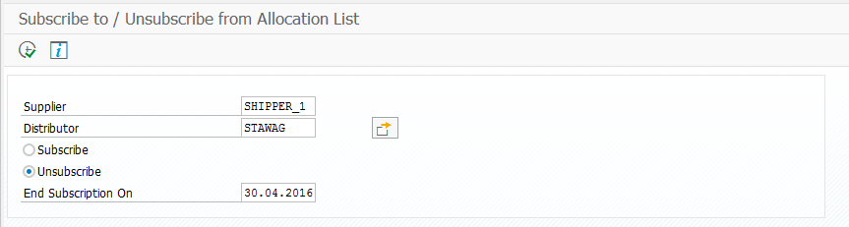
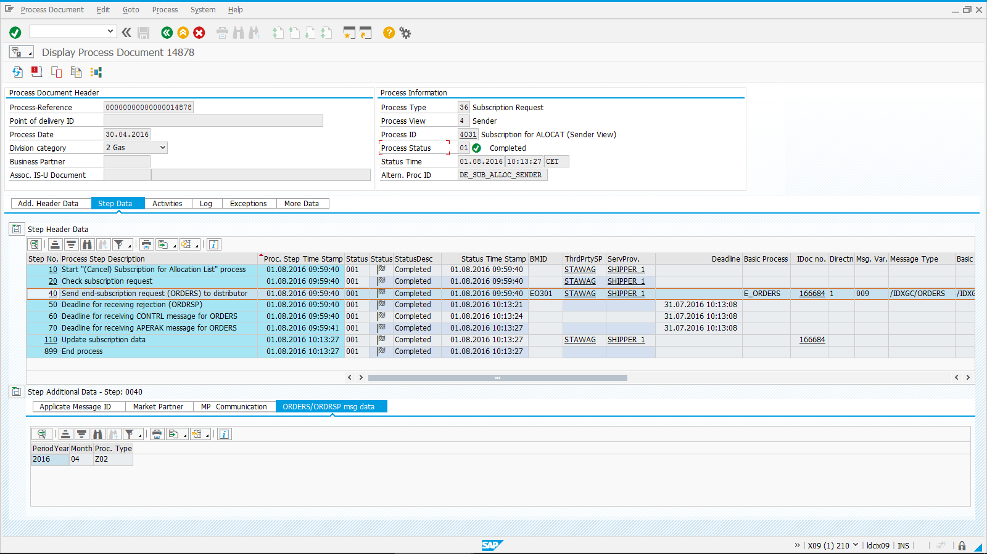
Send and Receive Subscription of Allocation List
Supplier sends request of ending subscription to distributor:
Notes:
Process Type Z02: End Subscription

Slide 45
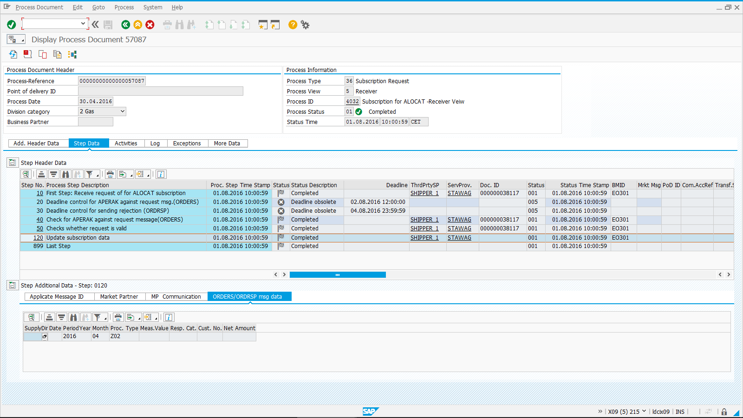
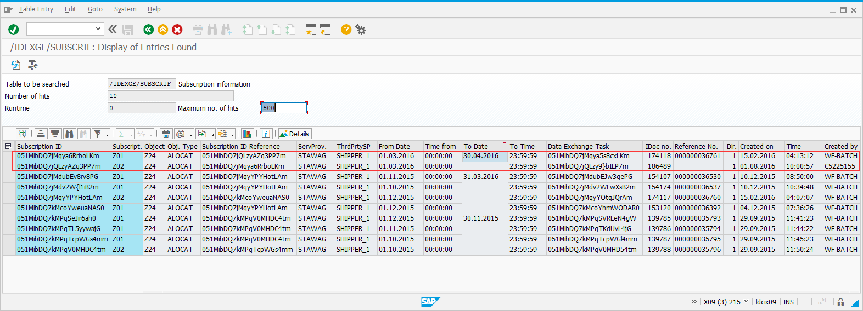
Send and Receive Subscription of Allocation List
Distributor receives request of ending subscription from supplier:
Notes:
Process Type Z02: End Subscription

Slide 46
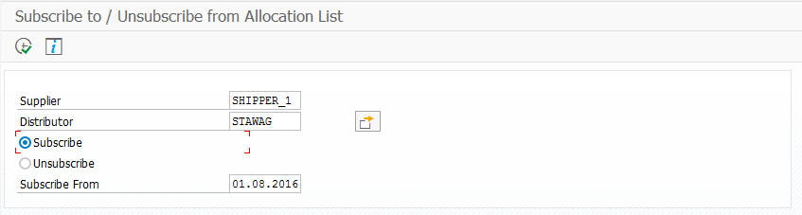
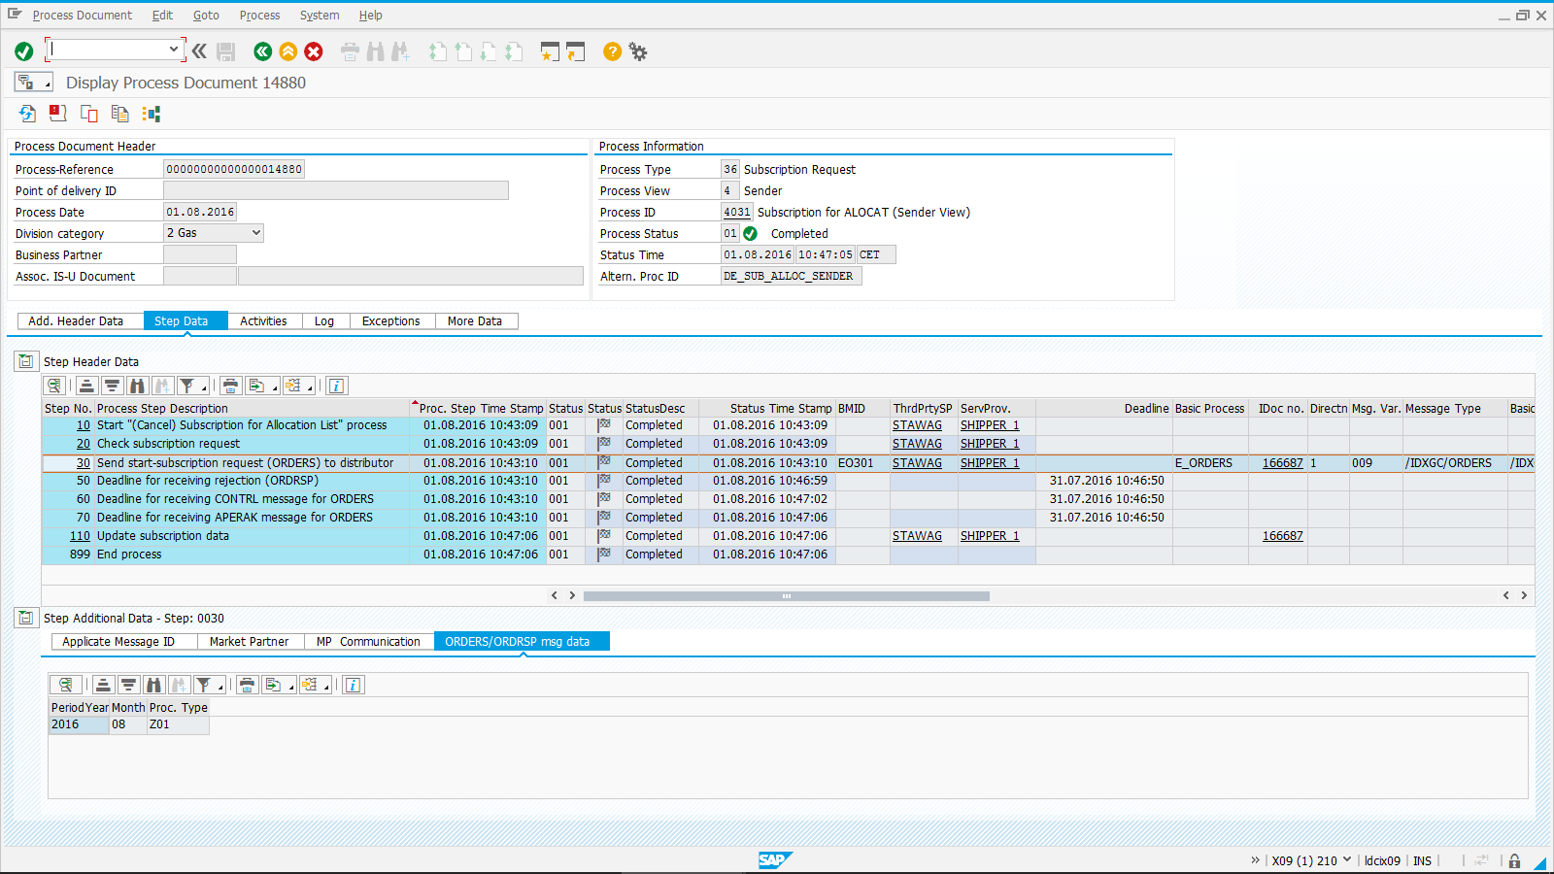
Send and Receive Subscription of Allocation List
Supplier sends request of starting subscription to distributor:
Notes:
Process Type Z01: Start Subscription

Slide 47

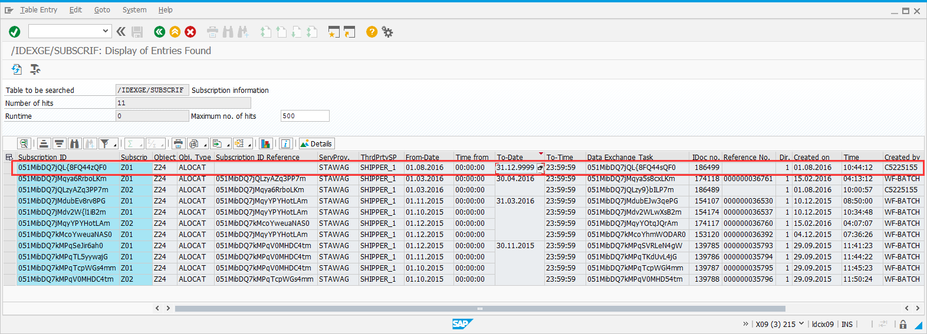
Send and Receive Subscription of Allocation List
Distributor receives request of starting subscription from supplier:
Notes:
Process Type Z01: Start Subscription

Slide 48
Send Allocation List (DSO)
Execute report /IDXMM/RP_ALLOCAT_LIST_CREATE
Subscription Info: /IDEXGE/SUBSCRIF
Get valid receiver(s)
Get all PODs under every receiver
Inventory List: /IDEXGE/T_CORR_L
Get daily allocation value of every POD
Send MSCONS IDoc
View: /IDEXGE/V_ALC_NO
Configuration
Define numbers of PODs in one IDoc

Slide 49
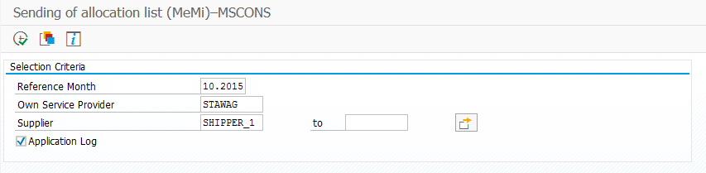
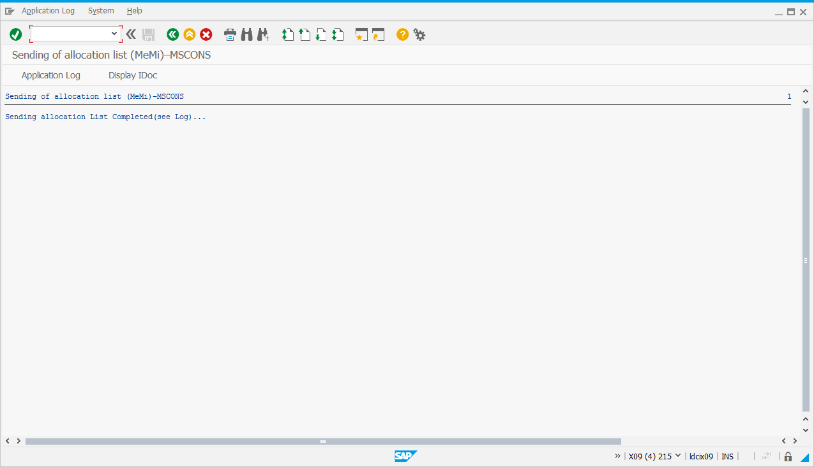
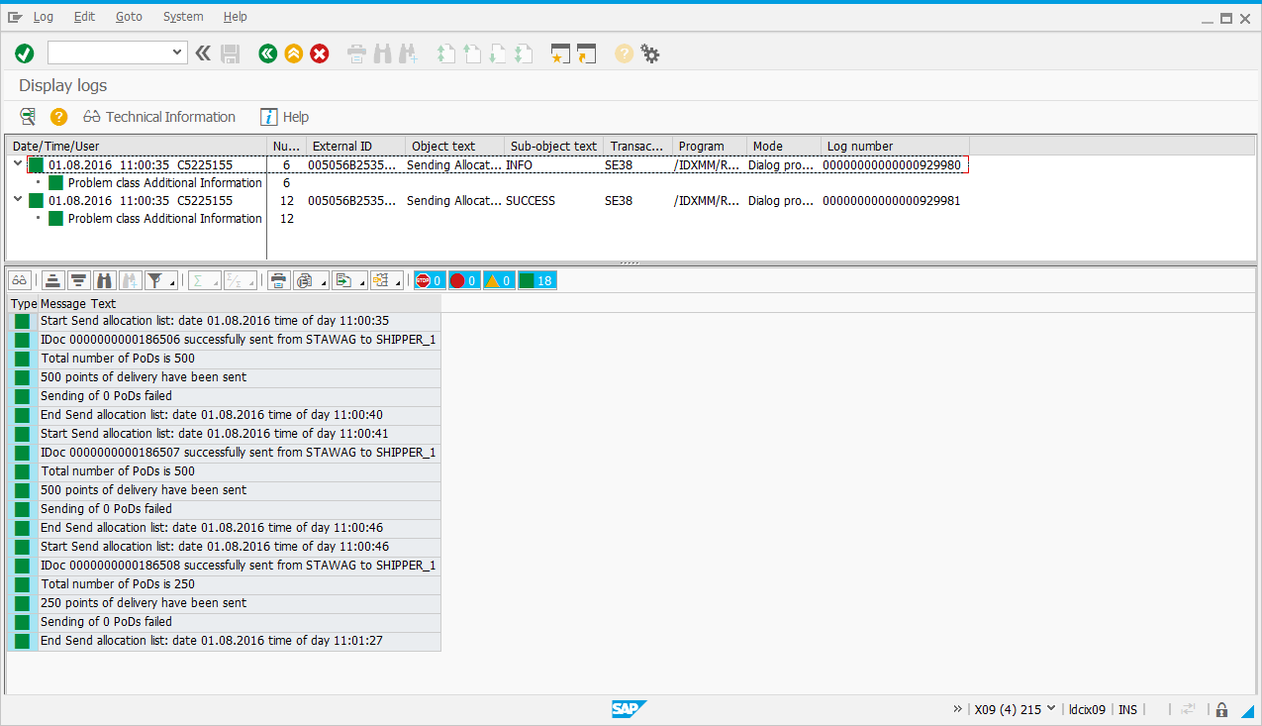
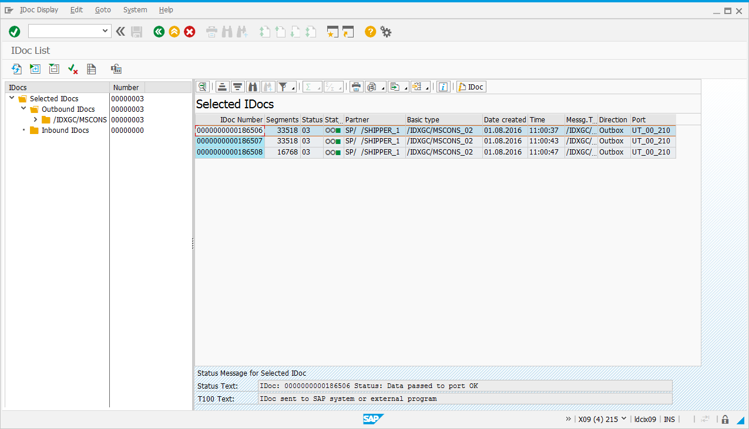
Send Allocation List (DSO)

Slide 50
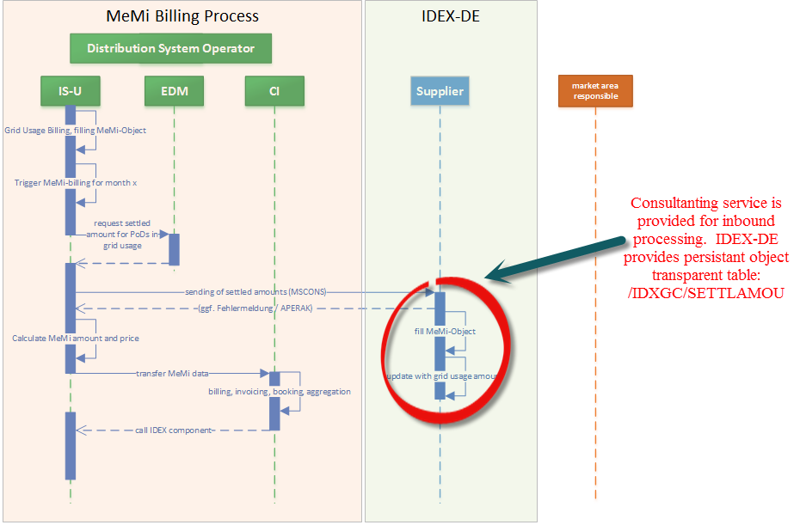
Relationship with IDEX-DE – Business View

Slide 51
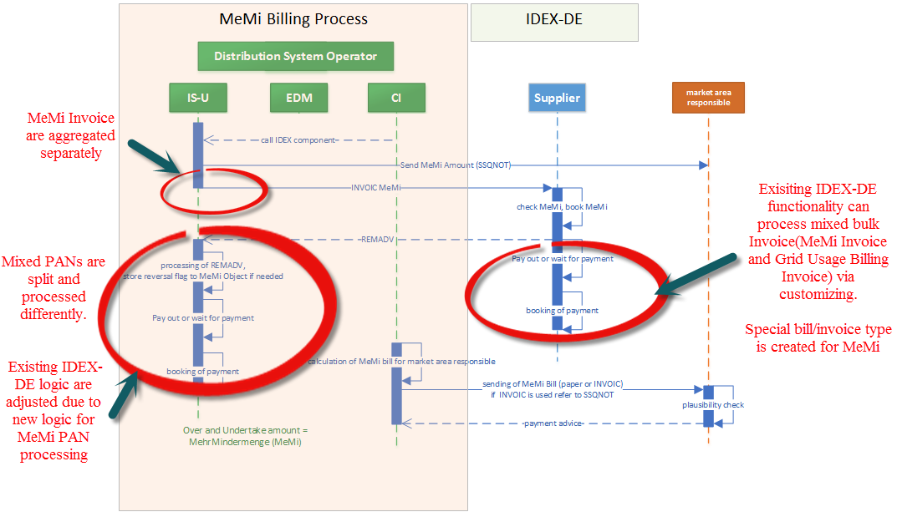
Relationship with IDEX-DE – Business View - II

Slide 52
Thank you
This document will be put in folder:
\\Sapcd\projects\03_L-R\RCS_MeMi_R-ESB\11_Documentation\Knowledge_Transfer

