Slide 1
Data Security of IoT-based smart health care
Presented By:
Divyansh Nigam
Md Rashedur Rahman
Graduate student, GMU

Slide 2
Outline
Introduction
Proposed Architecture
Future Work
Conclusion and Demo

Slide 3
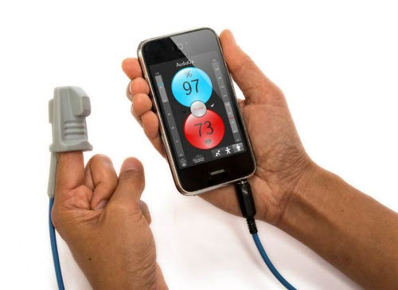
Introduction-Background
Patient Care Application
  Monitoring the patient status
  Required for critical patients
    Alzheimer, Cancer, Chronic diseases like diabetes etc.
Cloud Based Architecture
  Real Time monitoring
  Emergency Response System

Slide 4
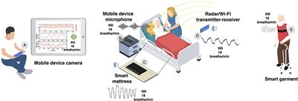
Introduction-Motivation
Why Healthcare?
  Remote Patient Monitoring
  Real time data analysis
  Disease Management
Application Requirements
  Functional
    Remote monitoring, data collection and analytics, alert and notification etc.
  Technical
    Scalability, Data security and Privacy, Battery Efficiency and Reliability and so on.
  Regulatory
    Compliance, Fail-safe, audit and reporting etc.

Slide 5
Introduction-Contribution
Secured Patient Monitoring System
  Ensuring security and privacy in data acquisition
Data Generation Simulation
  Simulation tool in python to generate real life data
Cloud based Architecture
  Leveraging Cloud server to share data between patient and doctor.

Slide 6
Introduction-Project Plan
Design an IoT based Health Care Application
  Sensor Networks collecting patient data
  Data Types
    Blood pressure, heart rate and so on.
Cloud-based Architecture
  Data would be synced to cloud server
  Introducing alert system
Introducing Security and Privacy
  Encrypted communication
  Secured Access Control

Slide 7





Architecture-Components
Components
  IoT device
    Collects the patient health data
  Smartphone
    Gets data from the IoT device
    Stores data in the cloud
    Can be used to access data for the patient
  Cloud Server
    Stores the patients data
    Doctors can view their individual patient data

Slide 8
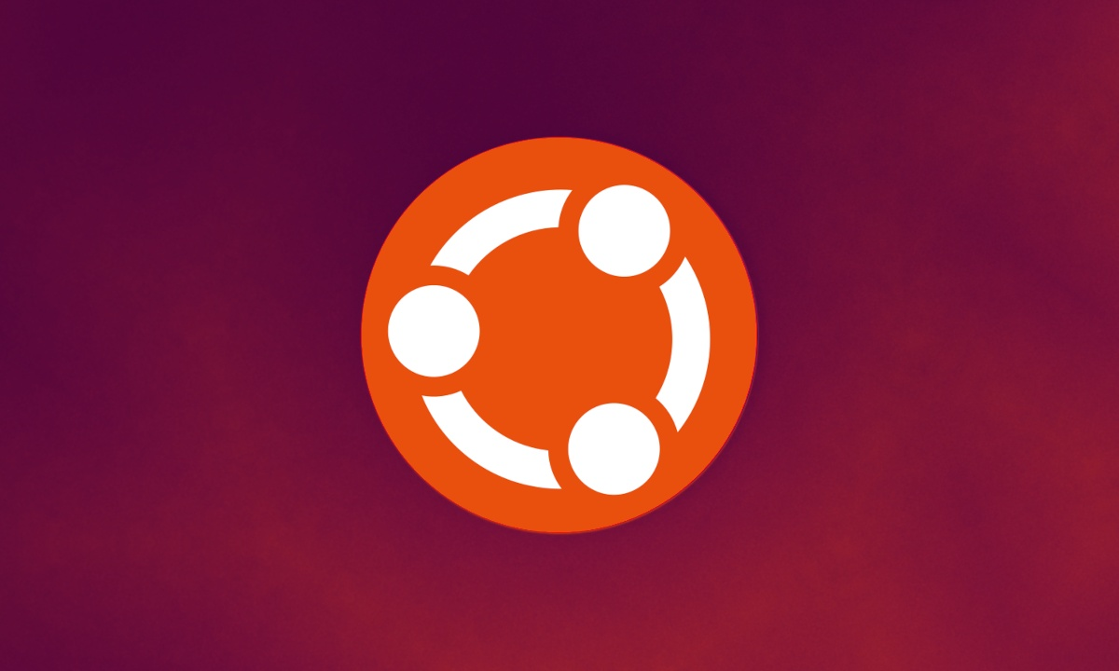
Implementation-VM Setup
VM Environment:
  Operating System: Ubuntu
    For reliability and robust security features.
  Purpose:
    Hosts the simulation code for generating healthcare data
    Acts as an MQTT client to communicate with HiveMQ Cloud.
  Configuration
    Optimized for lightweight performance and real-time data processing.
VM Responsibilities:
  Generate simulated health data.
  Securely transmit data to HiveMQ Cloud.
  Ensure consistent connectivity for real-time monitoring.

Slide 9
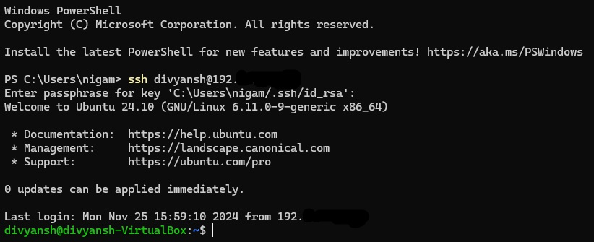
Implementation- Securing the VM
Key Security Measures Implemented:
  SSH Access:
    Remote access secured with Secure Shell (SSH) protocol.
    Port 22 exclusively opened for SSH.
  RSA Key-Based Authentication:
    RSA key pairs ensure only authorized systems can access the VM
    Public key stored securely on the VM
    Private key remains confidential with the user.
  Firewall Configuration
    Limits inbound connections to essential ports (22 for SSH, 8883 for MQTT).

Slide 10
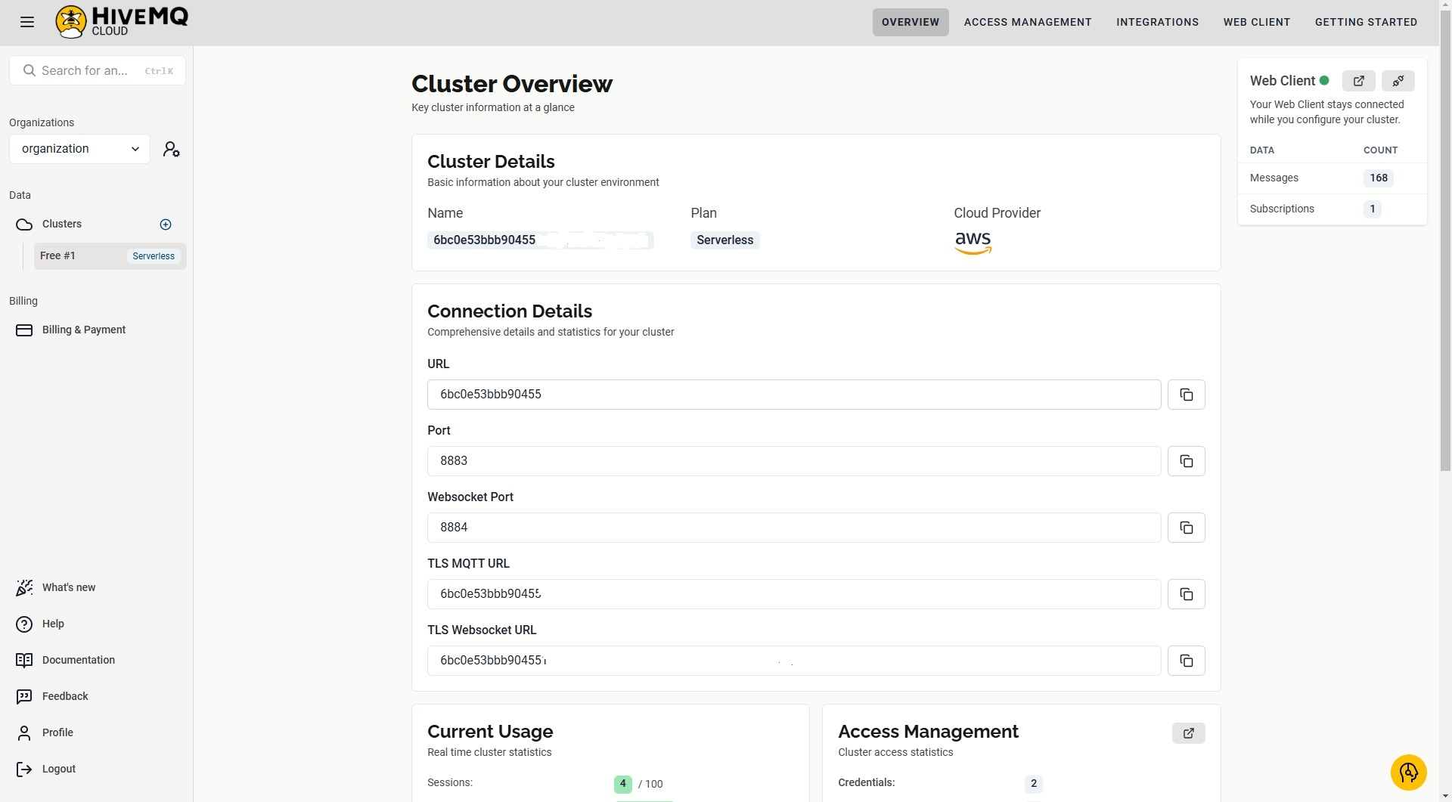
Implementation- HiveMQ Cloud
What is HiveMQ Cloud?
  Managed MQTT broker
    Designed for real-time data transmission.
  Key role:
    Acts as a secure intermediary between the VM and applications
    Consuming the healthcare data, exclusively opened for SSH.
Features for VM Integration:
  Secure Communication:
    Supports TLS encryption on port 8883.
  Topic-Based Messaging:
    Enables organized communication
  Scalability:
    Handles multiple concurrent MQTT clients.
  Global Availability:
    Low latency for seamless real-time data flow.

Slide 11
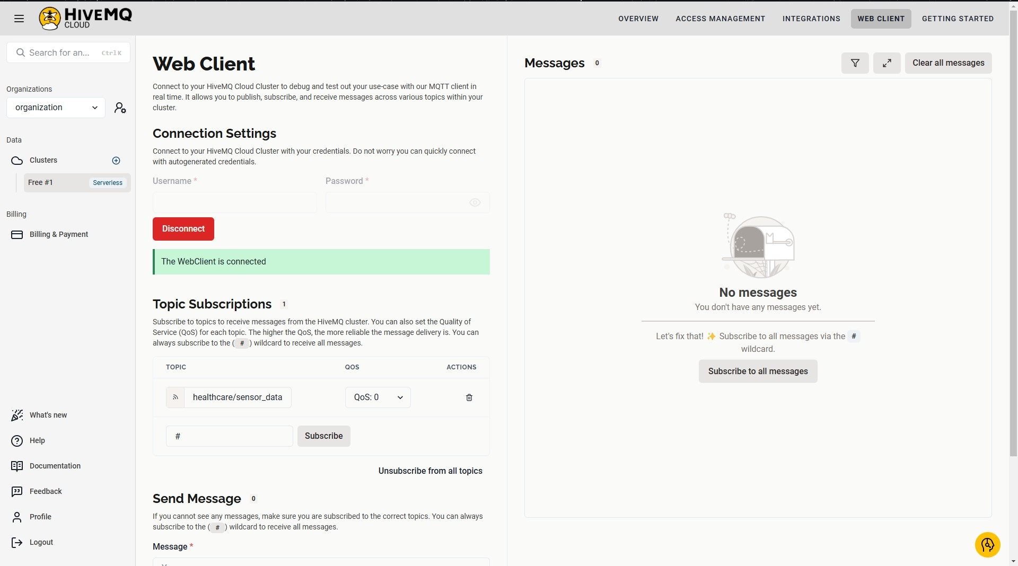
Implementation- HiveMQ Cloud
Security Integration:
  Credentials-based authentication
    username/password
  End-to-end encryption
    Ensures data integrity and confidentiality

Slide 12
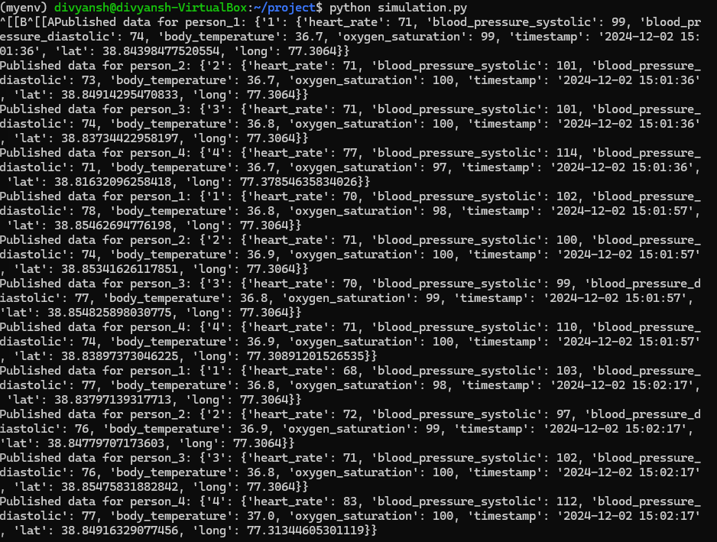
Implementation- Data Generation
Parameters Generated:
  Heart Rate (bpm)
    Indicates cardiac activity and detects irregularities.
  Blood Pressure (mmHg)
    Tracks systolic and diastolic health.
  Body Temperature (°C)
    Monitors thermal regulation.
  Oxygen Saturation (%)
    Measures blood oxygenation levels.
  Latitude and Longitude
    Track the location of the patient.

Slide 13
Implementation- Data Generation
Code Highlights:
  Simulation Logic:
    Class HealthyPerson, PersonWithHearthIssue and Alzheimer’s_patient
    Simulate normal and abnormal health conditions
    Data generated every 20 seconds for multiple individuals
  JSON Formatting:
    Structured for compatibility and parsing in healthcare applications.
Code Security:
  Credentials Storage
    Sensitive details centralized in mqtt_config.py.
  TLS Integration
    Secures MQTT connections during data publishing.

Slide 14
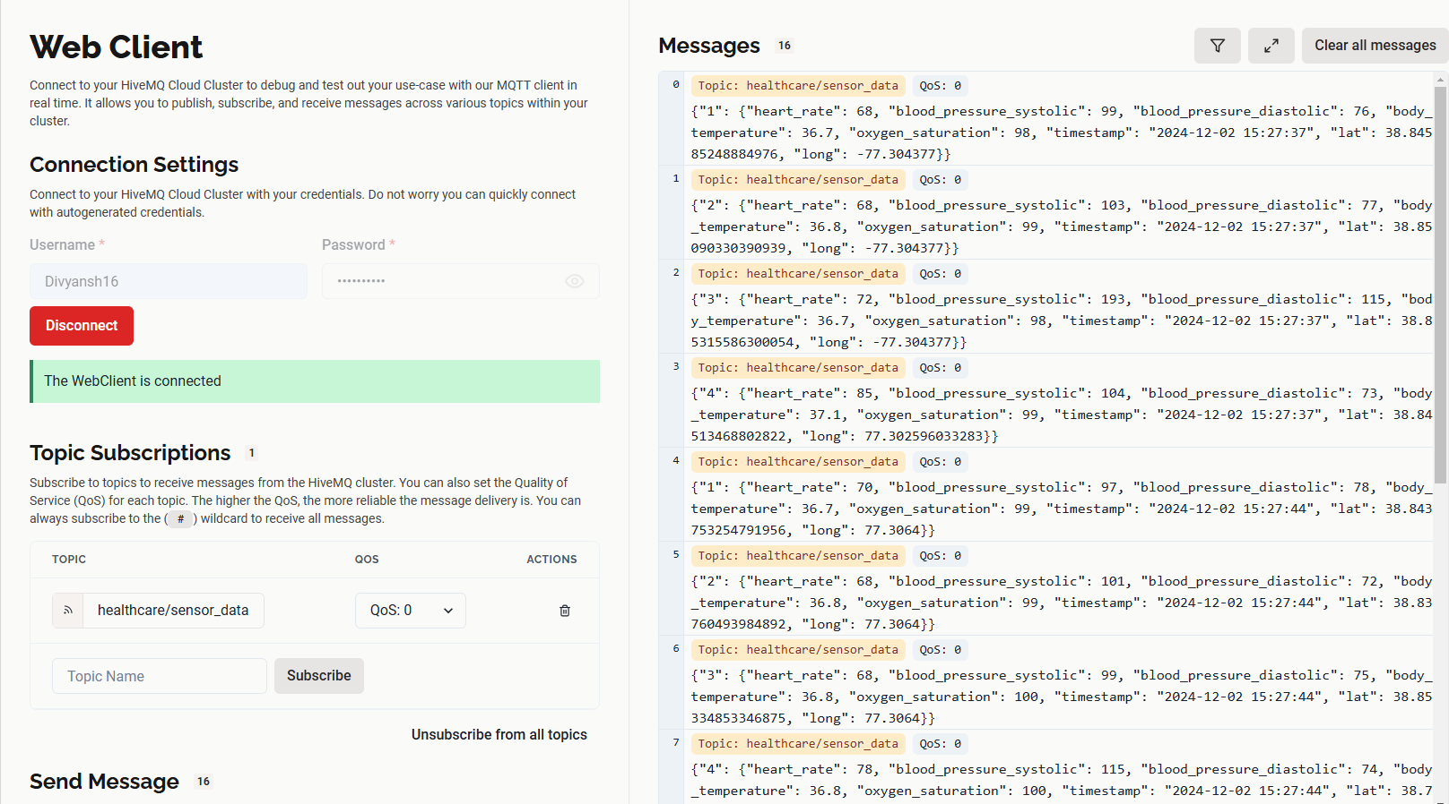
Implementation-Network Security
Transmission Workflow:
  VM acts a MQTT Client
  Data is published on specific topic
  Cloud as intermediary
    Data available for real-time analysis or visualization
Security Measures in Transmission:
  TLS Encryption
    Ensures data confidentiality during transmission and Uses HiveMQ Cloud's secure port (8883).​
  Authentication
    Username/password verified before the client connects.​
  Persistent Connection
    MQTT client maintains a live session for uninterrupted data flow.​
  Topic Access Control
    Messages are published to pre-defined, secure topics for better data management.​

Slide 15
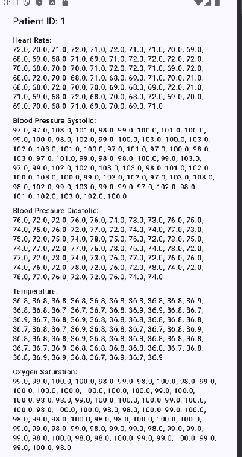
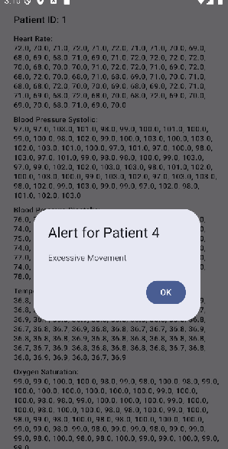
Implementation-Mobile Application
Doctor App
  Monitor each assigned patients
    Generate alerts if some abnormal condition occurs
  Access Control
    Only assigned patient’s data would be viewed

Slide 16
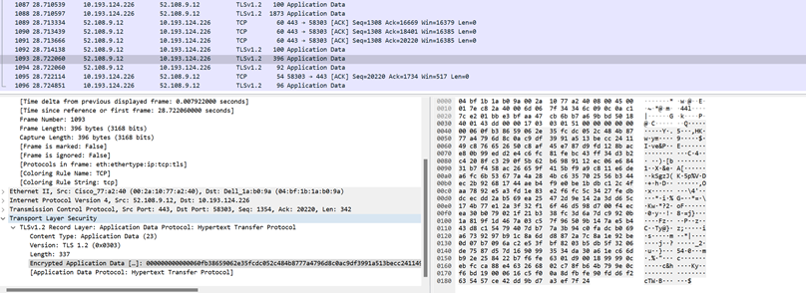
Implementation-TLS
Eavesdropping Security
  TLS
    Transport Layer security
  Wireshark demo
    Data is encrypted in both transmission and receiption.

Slide 17
Conclusion-Summary
Key Benefits
  Security
    Robust data protection measure
  Scalability
    Cloud integration supports scalability and seamless access
  Efficiency
    Automated alerts, data synchronization
Future Works
  Introduction of physical devices
    Using physical IoT devices to capture data
  Experimentation in real environment
    In real hospital settings or home environment
    Data collected using smartwatch, sensor nodes and so on.

