Slide 1





PCA definition
PCA: the principal components, e.g. PC1, refer to the data in the transformed space
The coordinates in the original space are called weights, loadings, or rotations
row i of data X
weights for PC k (each w = a unit vector)

Slide 2


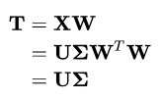
PCA equivalences
PCA: the principal components, e.g. PC1, refer to the data in the transformed space
Eigenvector of the sample covariance X^{T}X
Rearranged SVD (singular value decomposition
PC1 goes through the mean and minimizes the sum of squared distances from data to the line
row i of data X
weights for PC k (each w = a unit vector)

Slide 3
PCA in a few lines of R
library(MASS)
x <- mvrnorm(n=1000, mu=c(0,0),
Sigma=matrix(c(4,1,1,1),ncol=2))
plot(x, asp=1)
pc <- prcomp(x)
plot(pc$x, asp=1)
arrows(0,0,pc$sdev[1],0,col="red",lwd=3,length=.15)
arrows(0,0,0,pc$sdev[2],col="blue",lwd=3,length=.15)
plot(x, asp=1, col="grey")
arrows(0,0,
pc$sdev[1]*pc$rotation[1,"PC1"],
pc$sdev[1]*pc$rotation[2,"PC1"],
col="red",lwd=3,length=.15)
arrows(0,0,
pc$sdev[2]*pc$rotation[1,"PC2"],
pc$sdev[2]*pc$rotation[2,"PC2"],
col="blue",lwd=3,length=.15)

Slide 4
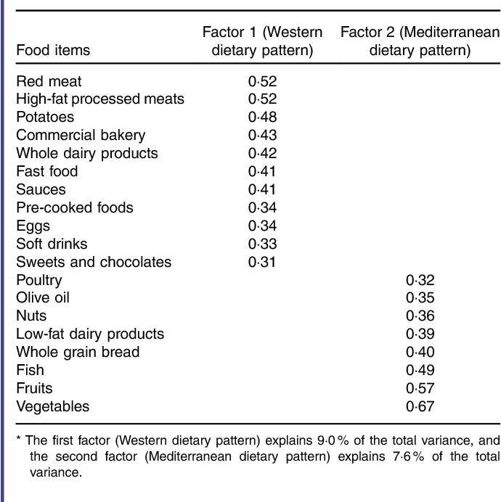
PCA on dietary patterns, loadings:

Slide 5
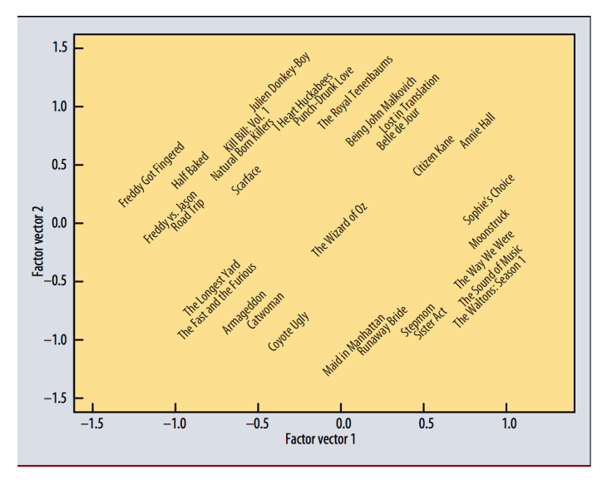
Netflix loadings

