Slide 1
Smart City Analysis: Traffic, Air Quality & Road Safety Insights
Anziya A S
anziya472@gmail.com
Data Analyst
June 2025

Slide 2
Introduction
This project explores urban conditions using real-world datasets on traffic, road accidents, and air pollution.
The aim is to support smart city development through visual insights for better policy-making.
A fully interactive Power BI dashboard was built to connect multiple urban indicators.

Slide 3
Project Objectives
Analyze accident trends to identify high-risk zones.
Study traffic congestion, speed zones, and vehicle movement.
Evaluate air pollution levels and their relationship with city zones.
Correlate datasets to extract deeper urban insights.
Build a unified and interactive dashboard using Power BI.

Slide 4
Dataset Description
Source: Urban monitoring datasets from Kaggle
Total Records: 12,405 aligned entries across all datasets
1.Road Accident Dataset – Includes accident severity, time, location, weather, police force
2.Traffic Condition Dataset –Includes traffic volume, congestion level, average speed, parking usage.
3.Air Pollution Dataset – Includes AQI values, pollutant types (PM2.5, CO2, NO2), weather

Slide 5
Tools and Technologies Used
Power BI: For dashboard development and visual storytelling.
Power Query: For data cleaning and transformation.
DAX: To create KPIs like average pollution, total accidents, congestion index.
Custom Visuals: Map, Heatmap, Donut chart, Stacked columns, and KPI cards.

Slide 6
Methodology
Imported and cleaned datasets using Power Query.
Performed data transformation: calculated Pollution Index, categorized accident severity, extracted hour from time.
Created one-to-one relationships using 'City' as a primary key to join all three datasets
Built DAX measures for averages, counts, and categories.
Developed 2 structured Power BI pages based on traffic, pollution, and accident insights.

Slide 7
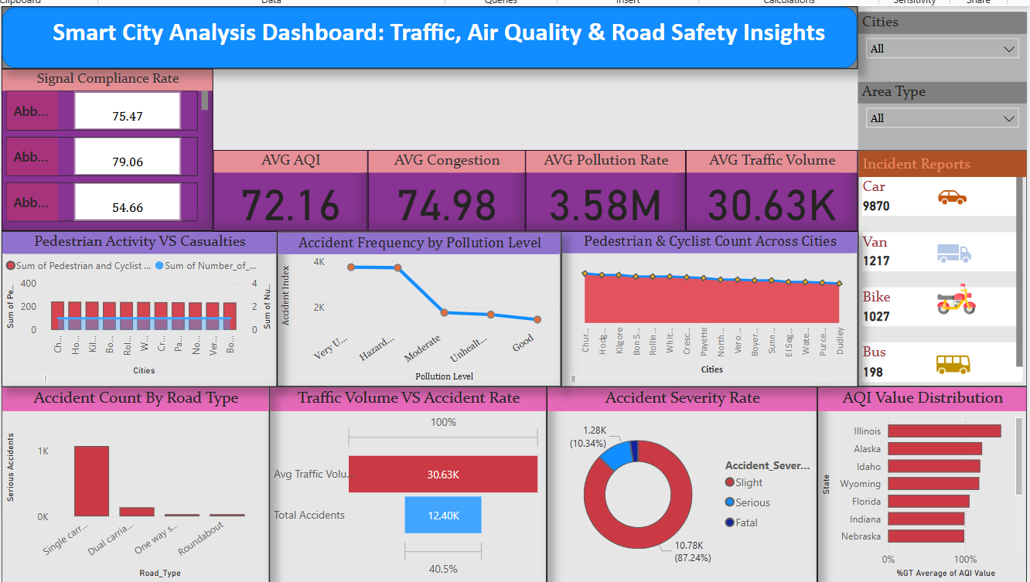

Slide 8
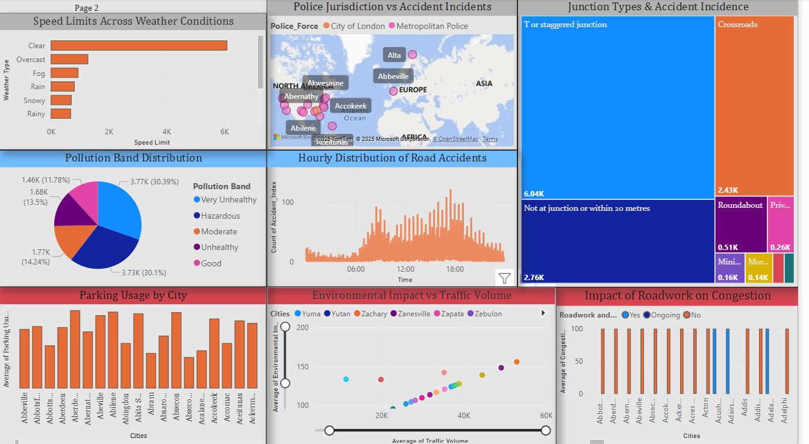

Slide 9
Dashboard Overview
Page 1: Traffic and Accident Analysis
Page 2: Environmental and Risk Overview
Each page includes KPIs, slicers, and interactive visuals with cross-filters.

Slide 10
Dashboard – Page 1 (Traffic & Accident)
KPIs: Average Speed, Congestion Level, Incident Reports
Bar Charts: Traffic Volume by City, Parking Usage
Scatter: Environmental Impact vs Traffic Volume
Stacked Chart: Speed Limit vs Accident Severity
Area Chart: Pedestrian and Cyclist Counts

Slide 11
Visual Insights Include:
Pedestrian Activity vs Casualties:
Compares the number of pedestrians and cyclists to the number of reported accident casualties across cities.
Accident Frequency by Pollution Level
Accidents are most frequent in cities with very unhealthy and hazardous pollution levels.
Cities with good AQI show significantly fewer incidents.
Pedestrian & Cyclist Count Across Cities
Cities like Churchill and Rollins have the highest non-motorized traffic movement.
These areas require better pedestrian infrastructure.
Accident Count by Road Type
Single carriageways report the most serious accidents and Roundabouts and dual roads show significantly fewer accidents.

Slide 12
Traffic Volume vs Accident Rate
Even cities with moderate traffic volumes report high accident rates.
Suggests that congestion isn’t the only factor — road design or enforcement may contribute.
Accident Severity Rate
Majority of incidents are slight (87.24%), while 10.34% are serious, and 2.42% fatal.
Indicates the need for better prevention in specific areas.
AQI Value Distribution
States like Illinois and Alaska have the highest percentage of values exceeding the AQI average.
Highlights regions for environmental intervention.

Slide 13
Dashboard – Page 2 (Pollution & Risk)
Pollution Band vs Accident Count
Police Jurisdiction vs Accident Count (Bar)
Weather vs Accident Rate
Top 10 Most Polluted Cities (Ranking Table)
Time of Day vs Accident Trend (Line Chart)

Slide 14
Accidents by Junction Type:
T or staggered junctions had the highest number of incidents (6.04K), indicating a need for better traffic control at these points.
Environmental Impact vs Traffic Volume:
Cities with higher traffic volume (e.g., Zachary, Zanesville) demonstrated increased environmental degradation.
Impact of Roadwork on Congestion:
Cities with ongoing roadwork reported 100+ average congestion index, calling for optimized scheduling.
Pollution Band Distribution:
Nearly 60% of data points fell under ‘Very Unhealthy’ and ‘Moderate’ pollution bands, suggesting urgent environmental action.

Slide 15
KPIs and DAX Measures
Average Pollution Index = AVERAGE('Air Pollution'[Pollution Index])
Total Accidents = COUNT('Road Accident'[Accident _ Index])
Pollution Banding: Calculated using SWITCH(TRUE()) to group AQI
Congestion Score = SUM(Congestion Level) / COUNT(City)

Slide 16
Interactivity Features
Dynamic slicers for City, Pollution Category, Time, Weather
Tooltips show Severity, Speed, and Pollutant Type on hover
Drill-through from City to deeper time-based trend views
Buttons for navigating between dashboard pages

Slide 17
Key Insights
Peak accident times: 6–9 PM and early mornings.
Cities with high pollution also show higher accident frequency.
Speed limit violations are more common in congested areas.
Rainy or foggy weather significantly increases accident severity.
Some police jurisdictions report more incidents – indicating pressure zones.

Slide 18
Conclusion
The dashboard provides real-time actionable intelligence for smart city stakeholders.
Combining multiple datasets offers better prioritization and area-specific planning.
Helps cities monitor performance over time, supporting strategic improvements in infrastructure and policy.
Helps make informed decisions about road safety, traffic planning, and environmental control.
Supports smart governance by integrating safety, sustainability, and mobility into a unified view.

Slide 19
Future Scope
Add real-time integration with IoT devices and live AQI feeds.
Deploy machine learning to predict accident hotspots.
Automate reporting for city departments.
Include public transport and emergency services data for deeper correlation.

Slide 20
Thank You

