Slide 1
Customer Behavior Analysis & Simulation with Markov Models
C-14
Abhishek Pandey
Aadith Krishna
Aditya Santosh
Surya Narayan S

Slide 2
Introduction
The retail environment is a complex system driven by the aggregate of individual customer decisions.
While individual paths may appear random, we hypothesize their collective behavior can be described by a stochastic process.
Markov Models provide a robust mathematical framework to model sequential customer actions, capturing the probabilistic transitions between different behavioral states.
These models reveal not only the frequency of customer actions but also the likelihood of moving from one action to another, delivering actionable insights into user engagement patterns and conversion pathways.

Slide 3
Problem Statement
The movement of customers in a supermarket, while seemingly random, can be modeled as a probabilistic process. This project analyzes raw, timestamped customer location data to construct a first-order Markov chain that quantifies the probabilities of transitions between different store sections.
Based on this model, a simulation is developed to reproduce and visualize aggregate customer flow, enabling the analysis of patterns and behaviors across store sections.

Slide 4
Literature
Title | Authors | Observations
Modeling Customer Behavior with Markov Chains (2023) | Gudimella | Introduces discrete-time Markov chains to model customer actions like browsing, adding to cart, purchasing, and churn. Focuses on segmentation, churn prediction, and personalized marketing using transition and steady-state analysis.
Customer Behavior Hidden Markov Model (2022) | Jandera & Skovranek | Proposes a Hidden Markov Model tailored for e-commerce to predict customer behavior and forecast purchases by modeling dynamic state transitions, improving prediction accuracy.

Slide 5
Title | Authors | Observations
A Markov network approach for reproducing purchase behaviors observed in convenience stores. | Dan Johansson, Hideki Takayasu & Misako Takayasu | This paper uses a Markov network to model how buying one product category influences buying another in Japanese convenience stores. Using 54 million receipts, the simulation reproduced real customer basket sizes and revealed “attractor” categories that drive other purchases.

Slide 6
Application
The application demonstrates the power of agent-based modeling and data-driven decision-making in retail.
It can help supermarkets analyze customer flow, optimize store layout, predict sales patterns, and improve operational efficiency.
By integrating real-time visualization with analytics, it provides actionable insights for enhancing customer experience and maximizing revenue.
Customer Behavior Analysis:
Data Input: Transition matrix drives probabilistic movement (e.g., 37.73% from entry to fruit).
Simulation Output: Tracks visit counts and revenue per section.
Insights: High visits to drinks ($5/visit) suggest popularity; low spices visits ($2/visit) indicate low demand.
Optimization: Move high-revenue sections (e.g., Drinks) near entry; place low-revenue ones (e.g., Spices) farther to encourage exploration.

Slide 7
Dataset Info
The dataset contains the location of customer in each section of the Grocery store with different time measured over 5 days from Monday to Friday (in csv form) and a JSON file.
Purpose: Track customer movement across different supermarket sections.
CSV File Columns
timestamp → Date & time of event (e.g., 2019-09-02 07:03:00).
customer no → Unique customer identifier (e.g., 1, 2, 3).
location → Store section visited (dairy, spices, fruit, drinks, checkout, entry.).

Slide 8
Flow Chart
Data Loading (all csv files )
Preprocessing (merge days, assign UIDs, extract time)
Data Analysis (section visits, hourly counts & plots)
Path Encoding (Converting visits into sequences with time spent)
Enhancing customer experience and maximizing revenue
Analyzing the customer flow, optimize store layout, predict sales patterns
Markov Chain Modeling(Next state prediction & simulation in python)
Transition Matrix (count state -- state moves)

Slide 9
Mathematical Formulation
Our model is predicated on the theory of discrete-time stochastic processes. We hypothesize that the sequence of locations visited by a customer, c0, c1, c2, etc., constitutes a Markov chain.
The Markov Property:
The fundamental assumption is that the future state is conditionally independent of the past, given the present state. Formally, for any time step t and sequence of states:
P(X_{t+1}=s_{j} ∣X_{t} =s_{i} ,X_{t-1}=s_{i-1} ,…,X₀ =s₀ )=P(X_{t+1} =s_{j} ∣X_{t} =s_{i} )
State Space (S):
The set of discrete, mutually exclusive locations within the supermarket defines our state space:
S = {entry, dairy, spices, drinks, fruit, checkout}

Slide 10
Transition Matrix:
The system's dynamics are governed by the transition matrix P, a n x n matrix where each element P_{ij} represents the stationary probability of transitioning from state s_{i} to state s_{j}:
P_{ij} =P(X_{t+1} =s_{j} ∣ X_{t} =s_{i} )
The matrix P is a stochastic matrix, meaning every element P_{ij} in [0,1] and each row sums to 1:
∑^{j=1}_{n} P_{ij} =1 ∀ i ∈ {1,…,n}

Slide 11
Methodology
Data Collection & Preprocessing
Collected customer movement data (Monday.csv – Friday.csv)
Assigned unique customer IDs across days
Converted timestamps → entry times
Data Cleaning & Preparation
Merged daily files into a single dataset
Identified and fixed missing checkout records
Extracted hourly and section-wise customer statistics
Path Construction
Encoded customer movement into section letters (e.g., Dairy → d)
Added entry (e) and absorbing checkout (cc) states
Generated customer path sequences (path_data.csv)

Slide 12

Probability Distribution of Arrivals
Calculated entry frequencies across all days
Created probability distribution of customer arrivals
Stored as customer_number_prob.json for simulations
Markov Chain Modeling
Built transition matrix from customer paths
Normalized to obtain state transition probabilities
Computed matrix powers (T^k) for long-term behavior
Using the transition matrix and probability distribution making a Simulation Model where we see the live movements of customer in different section.
Agent-based modeling and data-driven decision-making
Analyze customer flow, optimize store layout, predict sales patterns, and improve operational efficiency.
Integrating real-time visualization with analytics and maximizing revenue.

Slide 13
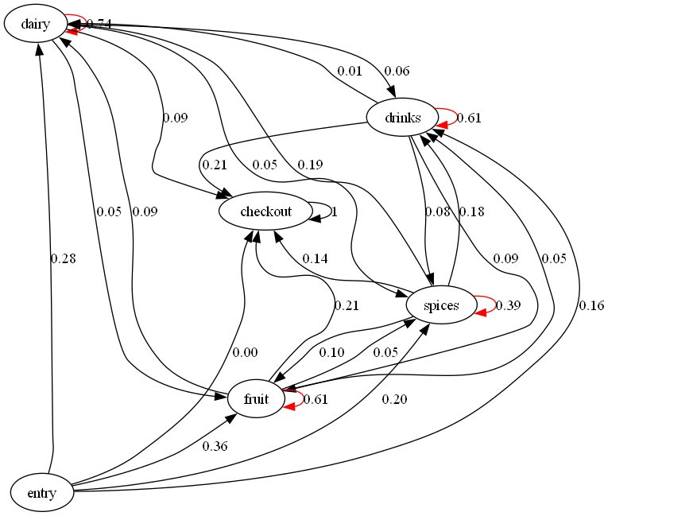
Results & Visualization
The image is a diagram of a Markov chain generated from a transition matrix in the file transition.csv, which shows probabilities of moving between states, such as sections in a supermarket.

Slide 14
Transition Matrix
 | Entry | Dairy | Spices | Drinks | Fruit | Checkout
Entry | 0 | 0.287441236 | 0.181329752 | 0.153391538 | 0.377300201 | 0.000537273
Dairy | 0 | 0.737022665 | 0.051346943 | 0.058545639 | 0.049772229 | 0.103312525
Spices | 0 | 0.193214399 | 0.402198152 | 0.16310927 | 0.090952533 | 0.150525645
Drinks | 0 | 0.010899743 | 0.086992288 | 0.598560411 | 0.087917738 | 0.21562982
Fruit | 0 | 0.095743844 | 0.050664779 | 0.054834395 | 0.597199276 | 0.201557706
Checkout | 0 | 0 | 0 | 0 | 0 | 1
The Markov transition matrix provided in a table format, representing the probabilities of moving between states (entry, dairy, spices, drinks, fruit, checkout)

Slide 15
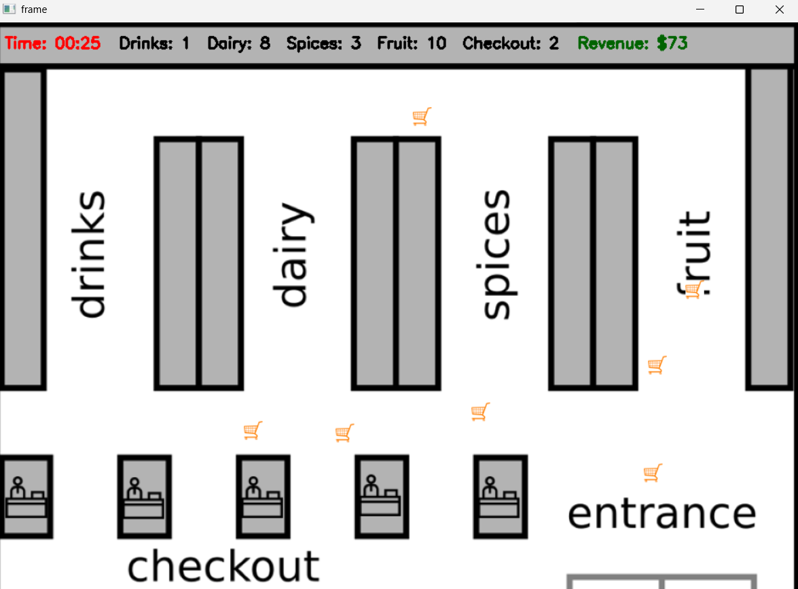
Simulation Frame Image
Purpose: Simulates customer movement in a supermarket using a Markov transition matrix, visualized on a floor plan. Supermarket Class: Initializes with floor plan image and customers.Tracks section visits (drinks, dairy, spices, fruit, checkout) and revenue ($5, $4, $2, $3, $0 per visit).Displays time, visit counts, and revenue using OpenCV. Loads counter image for checkout visualization.

Slide 16
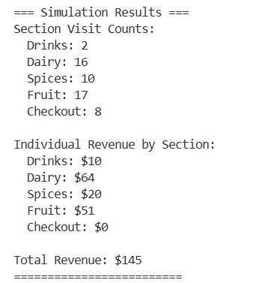
The supermarket simulation code effectively manages customer queues handles them without congestion by using Round Robin Method.
Round-Robin is a method for distributing tasks, resources, or assignments in a fair and cyclic manner across a fixed set of options. In the context of the supermarket simulation, it refers to assigning customers to the four checkout counters (x=100, 250, 400, 535) sequentially to ensure an even distribution.

Slide 17
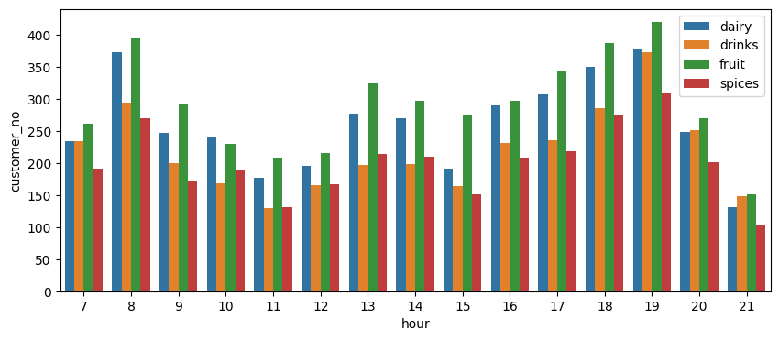
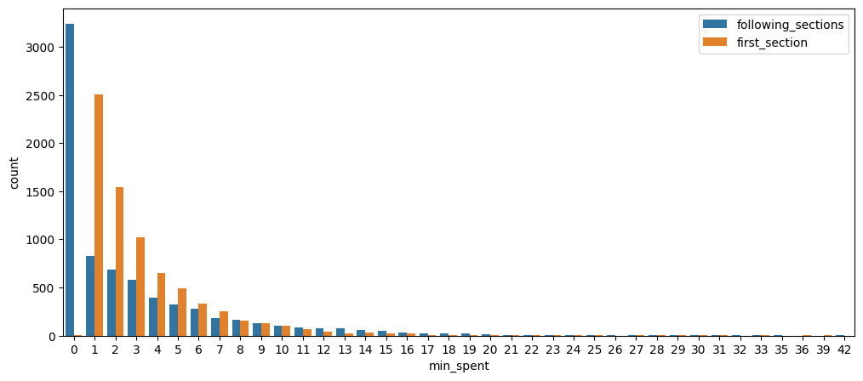
This Histogram tells the average number of people on each section on a weekly data
This plot tells number of customer visiting the first section compared with following sections so that we can set first section efficiently.

Slide 18
Conclusion
A structured pipeline was developed to transform raw, timestamped customer location logs across multiple days into unified shopping journeys. From this data, a first-order Markov model was constructed, which empirically quantifies the probabilistic flow of customers between store sections. The resulting model effectively captures customer movement patterns, common routes, time spent in sections, and progression to checkout, providing actionable insights into shopping behavior within the store.

Slide 19
References
[1] M. Gudimella, “Modeling customer behavior with Markov chains,” Data Science at Microsoft, Medium, Oct. 5, 2023. [Online]
[2] A. Jandera and T. Skovranek, “Customer behaviour Hidden Markov Model,” Mathematics, vol. 10, no. 8, art. 1230, 2022, doi: 10.3390/math10081230.
[3] Johansson, D., Takayasu, H. & Takayasu, M. A Markov network approach for reproducing purchase behaviours observed in convenience stores. Sci Rep 14, 10487 (2024).

