Slide 1
MOSAIC
Catalog Gap Analysis — MFL Living Landscapes
State of the dataset registry and gaps against the Minimum Spatial Package
AoW2 — Landscape Optimization & Inclusive Planning
Internal coordination briefing · Geospatial CoP | Prepared by Lizeth Llanos · 21 July 2026
Source: MFL_Dataset_Registry 21jul.xlsx · 68 datasets · 11 Living Landscapes

Slide 2
KEY FIGURES
Snapshot of the registry
68
datasets registered
11
Living Landscapes
4
landscapes with ZERO data
1
landscape complete on all 5 core themes
2.6
core themes covered on avg (of 5)
11/11
boundaries delineated
MOSAIC · MFL Science Programme (AoW2) — Catalog Gap Analysis · July 2026
4

Slide 3
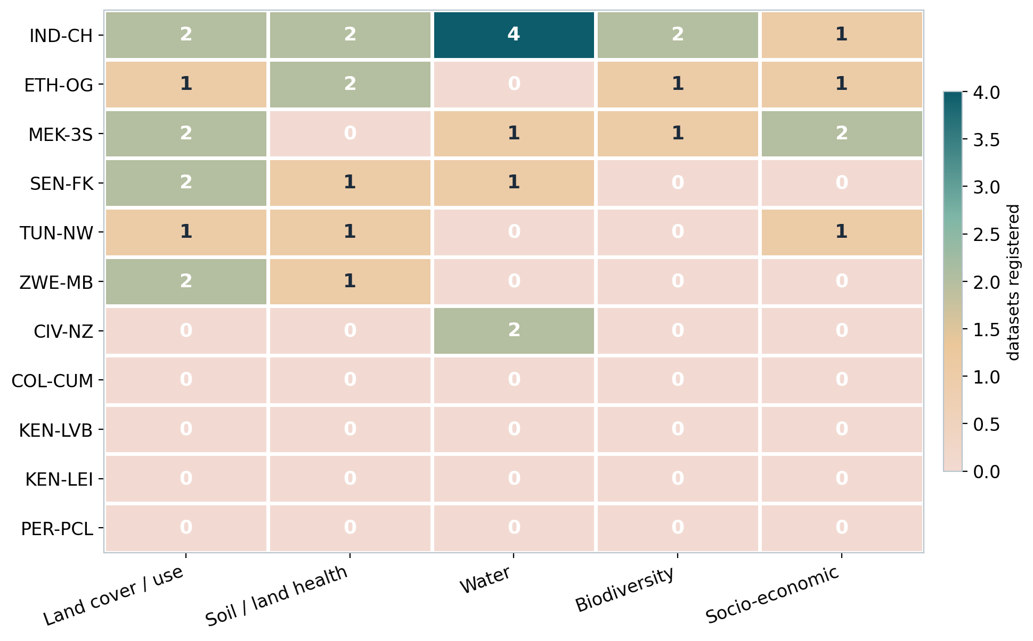
THE CENTRAL FINDING
Core coverage matrix
Reading the matrix
▪ IND-CH is the sole landscape complete on all 5 core themes (18 datasets).
▪ COL-CUM, KEN-LVB, KEN-LEI, PER-PCL — four landscapes are entirely empty (dark cells on 0).
▪ Mid-tier: ETH-OG and MEK-3S reach 4/5; SEN-FK and TUN-NW 3/5.
▪ Biodiversity is the single weakest column across the programme.
MOSAIC · MFL Science Programme (AoW2) — Catalog Gap Analysis · July 2026
5

Slide 4
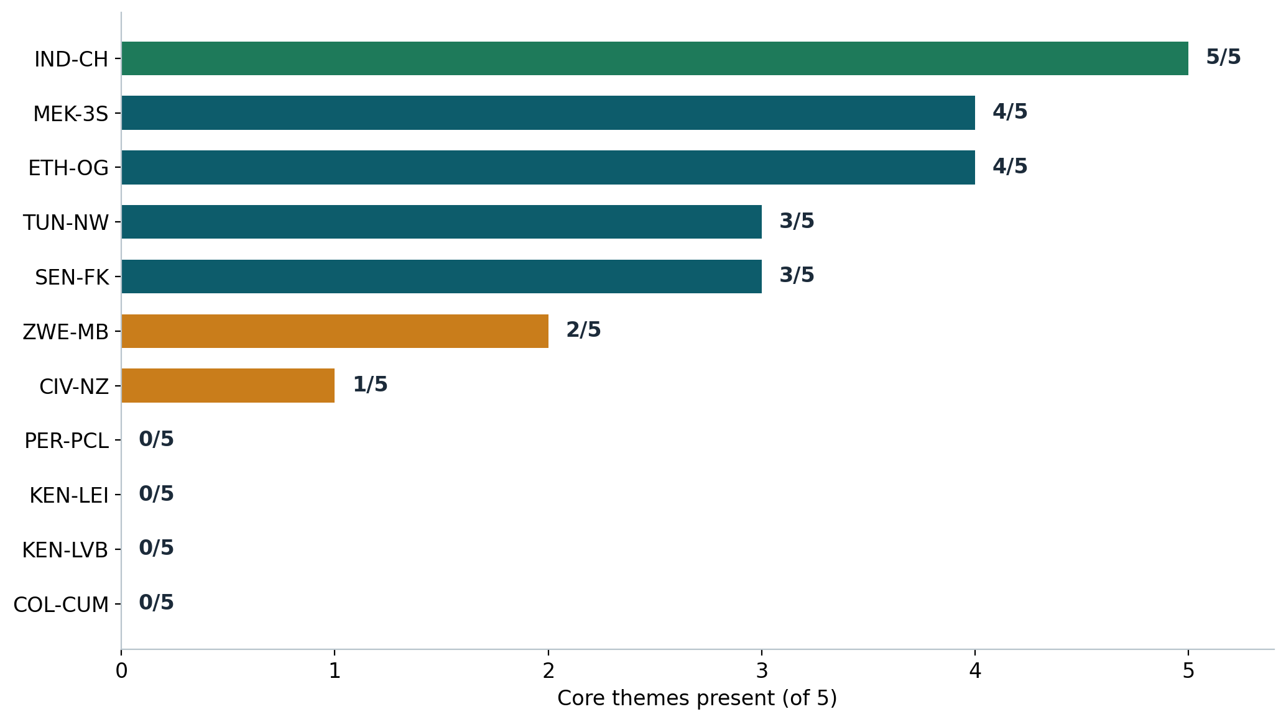
CORE THEMES PRESENT, OF 5
Landscape readiness
Three tiers
Ready (3–5/5)
IND-CH, ETH-OG, MEK-3S, SEN-FK, TUN-NW — deepen quality & metadata.
Partial / high priority (1–2/5)
ZWE-MB, CIV-NZ — targeted theme filling.
Critical (0/5)
COL-CUM, KEN-LVB, KEN-LEI, PER-PCL — no data despite delineated boundaries.
MOSAIC · MFL Science Programme (AoW2) — Catalog Gap Analysis · July 2026
6

Slide 5
ZERO DATASETS REGISTERED
Critical gaps: the four empty landscapes
COL-CUM
Cumbal (Nariño), Colombia
0 / 5 core themes
KEN-LVB
Lake Victoria Basin, Kenya
0 / 5 core themes
KEN-LEI
LEILA – S. Kenya Rangelands
0 / 5 core themes
PER-PCL
Pucallpa – Ucayali, Peru
0 / 5 core themes
▪ Boundary ready — delineation boundaries exist for all four (boundaries/<CODE>.geojson) — the frame is ready, the content is missing.
▪ Peru caveat — PER-PCL is still pending confirmation with the Peru team (Apurímac vs Pucallpa/Ucayali) — resolve before requesting data.
▪ Action — these four should anchor the 2026 contribution requests to the relevant centre focal points (CIP, Alliance, ILRI).
MOSAIC · MFL Science Programme (AoW2) — Catalog Gap Analysis · July 2026
7

Slide 6
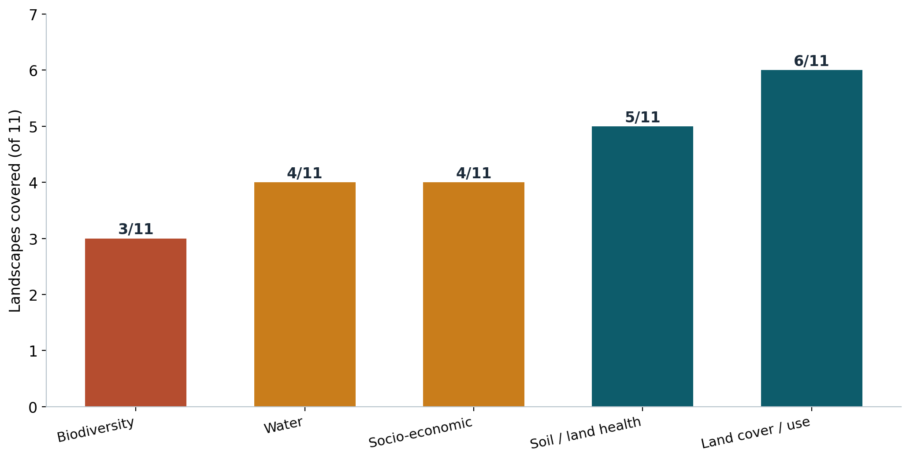
WHICH LAYERS ARE THIN PROGRAMME-WIDE
Coverage by theme
Weakest core layers
▪ Biodiversity — present in only 3 of 11 landscapes.
▪ Water & Socio-economic — each present in 4 of 11.
▪ Land cover / use — the best-covered core layer, still only 6 of 11.
Biodiversity, water and socio-economic layers are the programme-wide priority for 2026 sourcing.
MOSAIC · MFL Science Programme (AoW2) — Catalog Gap Analysis · July 2026
8

Slide 7
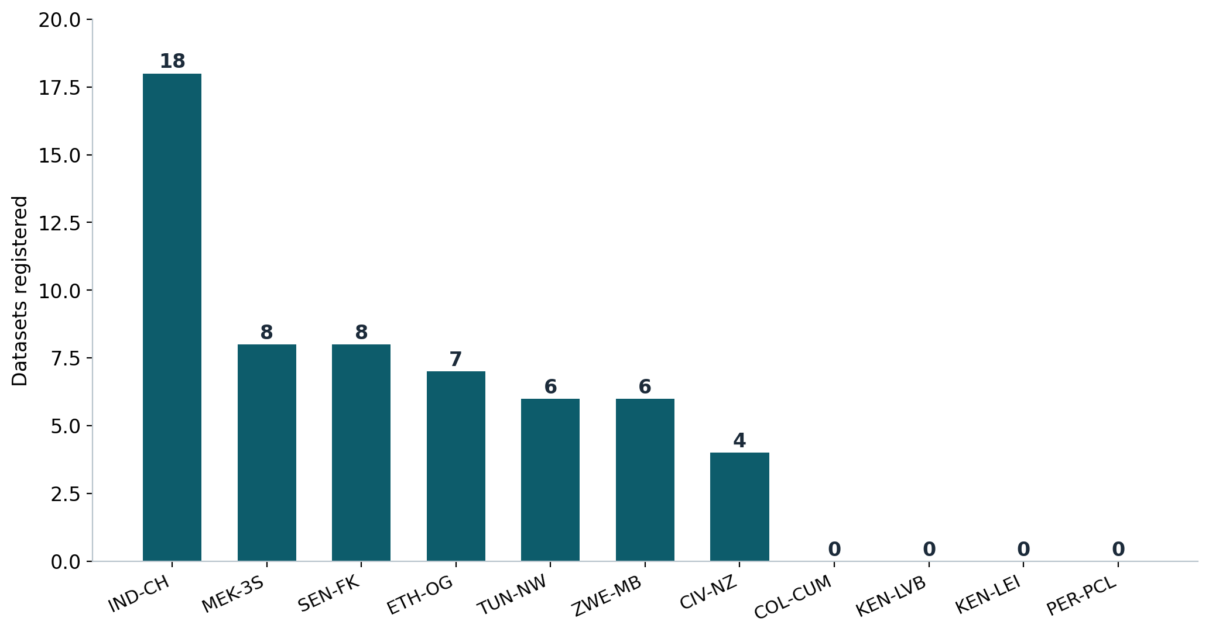
DATASETS PER LANDSCAPE
Where the data concentrates
Uneven contribution
▪ IND-CH alone (18) — over a quarter of the whole registry.
▪ SEN-FK and MEK-3S hold 8 each; the tail drops off sharply.
▪ Most datasets come from external / national-government sources (15 of 68); IWMI and ISRA-BAME are the top CGIAR/partner contributors.
Coverage reflects who has contributed, not landscape importance — a coordination gap, not only a data gap.
MOSAIC · MFL Science Programme (AoW2) — Catalog Gap Analysis · July 2026
9

Slide 8
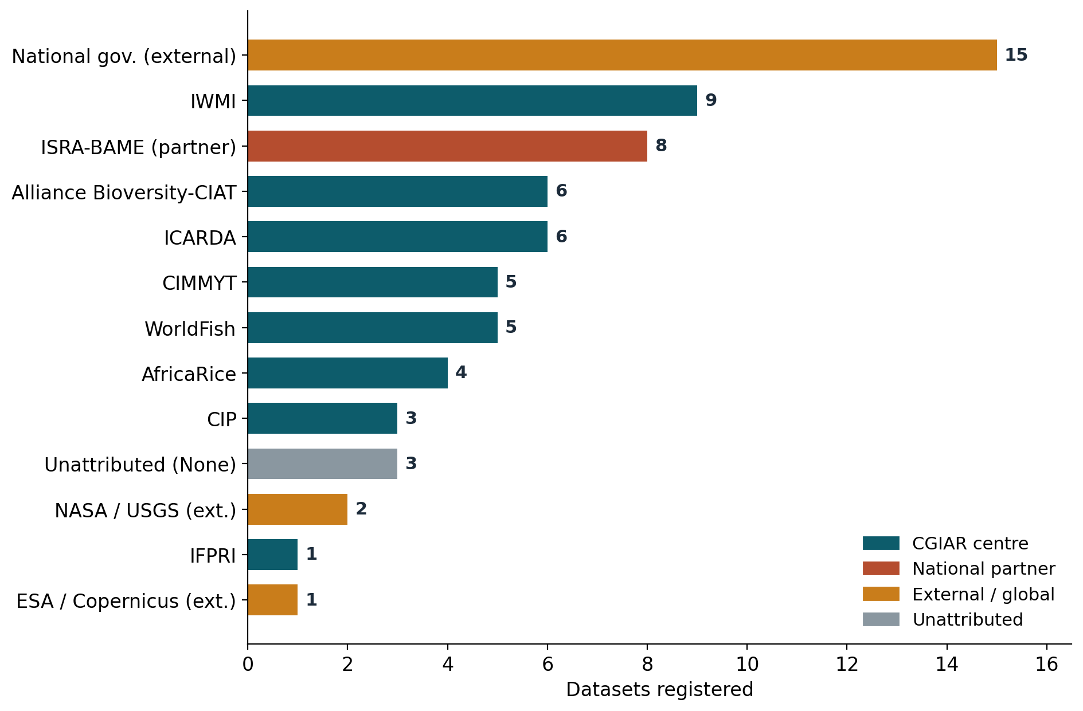
DATASETS BY CENTRE / SOURCE
Who is contributing
57%
from CGIAR centres (39 of 68)
8 / 11
CoP centres have contributed data
What it shows
▪ 3 CoP centres (ICRISAT, IITA, ILRI) have registered nothing yet.
▪ Siloed — most centres feed a single landscape (ICARDA→TUN-NW, CIMMYT→ZWE-MB, WorldFish→MEK-3S); IWMI is the only broad contributor (4).
▪ External-heavy — external / national-government and unattributed sources make up 31% (21 of 68).
MOSAIC · MFL Science Programme (AoW2) — Catalog Gap Analysis · July 2026
10

Slide 9
WHAT TO DO NEXT
Prioritized actions for 2026
1
Fill the four empty landscapes
Request the minimum package for COL-CUM, KEN-LVB, KEN-LEI, PER-PCL from CIP, Alliance and ILRI focal points. Confirm PER-PCL scope with the Peru team first.
2
Target the thin core themes
Prioritize Biodiversity, Water and Socio-economic layers across all landscapes — the weakest columns programme-wide.
3
Start the migration workflow
Populate file name, migration status and server path; adopt the naming convention. These fields are 100% empty today.
4
Clean the 8 suspect records
Fix the "Soil dataset" rows, missing themes/landscape and None access levels so the crosswalk and STAC build resolve cleanly.
5
Balance contribution across centres
Coverage tracks who contributed, not landscape need. Use the CoP focal points to close the coordination gap.
MOSAIC · MFL Science Programme (AoW2) — Catalog Gap Analysis · July 2026
13

Slide 10
From inventory to action
The registry gives MOSAIC its first coverage baseline: 11 landscapes framed, 1 complete, 4 empty, and a clear set of thin themes to fill in 2026.
Next: circulate contribution requests to CoP focal points and start the migration workflow.
Lizeth Llanos · l.llanos@cgiar.org | CGIAR MFL Science Programme — AoW2 · MOSAIC

