Slide 1
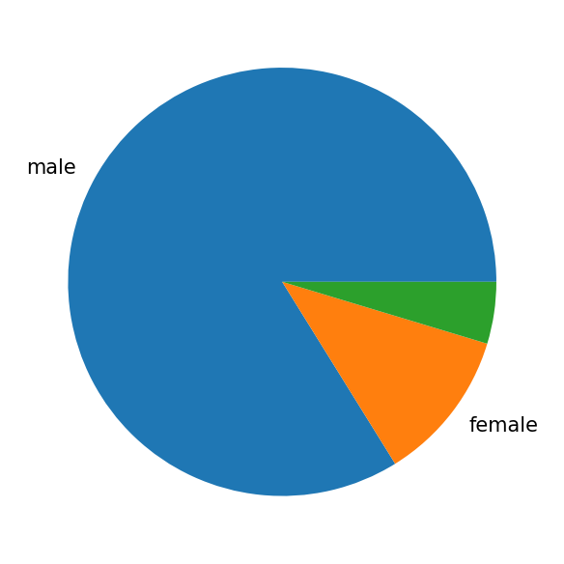
User Profiles & Demographics

