Slide 1
GamesOnTrack SDK
Presentation & Overview

Slide 2
The purpose of the SDK
Allow other developers to create applications using the GOT position system
Flexible component-based system
The SDK is just a .NET class library. Build whatever you want on top of it.
Used in our own product GTCommand / Faller Digital Car System

Slide 3
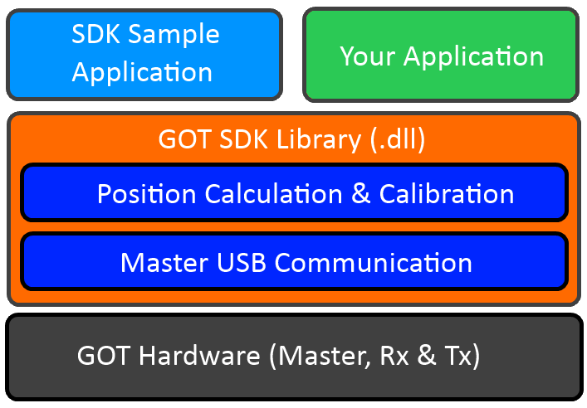
Architecture

Slide 4
SDK Requirements
.NET 4.0 Framework (Full, not Client Profile)
Third Party USB Driver (Silabs)
Sample Application: Visual Studio 2010 or later (Express is okay)
Mono currently unsupported (due to the use of System.Management and System.Windows.Media). Linux/Mac Silabs USB driver does exist.

Slide 5
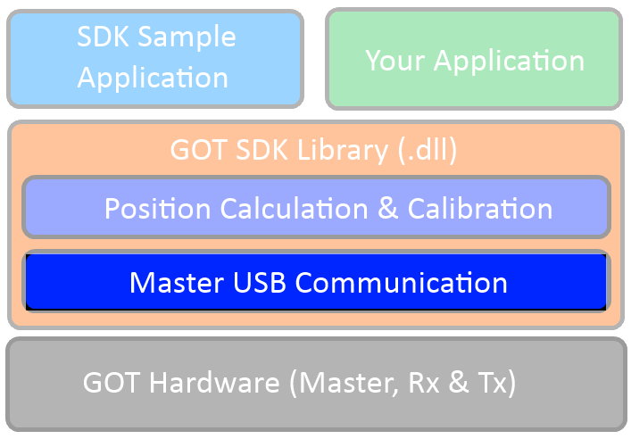
SDK Master USB Communication

Slide 6
Responsibilities
Detect USB-port, open connection, etc.
Low-level communication
Receive data (new connected units, measurement data)
Send data (setup configuration, temperature)

Slide 7
Basic Concepts
Transmitter, Receiver, Measurement
Unique id on everything (”GOT Address”)
Event-based API
  OnMasterStatusChanged(Status s)
  OnTransmittedConnected(Transmitter t)
  OnReceiverConnected(Receiver r)
  OnMeasurementReceived(Measurement m)

Slide 8
Measurement Data
// Slightly simplified version of the class (e.g. Battery info removed)
class Measurement
{
public GOTAddress TxAddress { get; set; }
public byte RSSI { get; set; }
public byte RadioQuality { get; set; } // [0..100%]
// Data for the individual measurements to each receiver.
public ReadOnlyCollection<Rx> RxMeasurements { get; set; }
struct Rx
{
public GOTAddress RxAddress;
public int RSSI;
public int Level; // 0..255
public int DistanceMM;
}
}

Slide 9
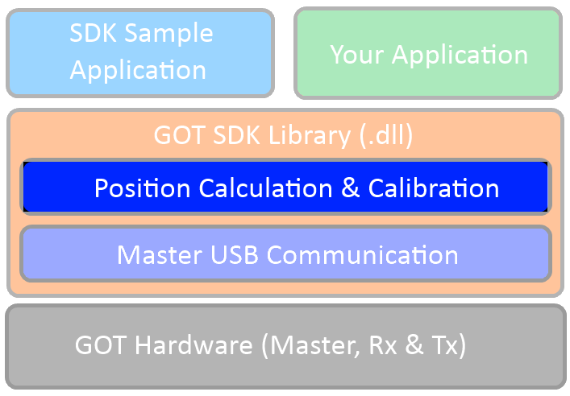
SDK Position Calculation

Slide 10
Responsibilities
This part of the SDK is optional
Converting the measured distances into (X, Y, Z) coordinates
The concept of ”Trilateration”
Two phases
  Calibration: Create the coordinate system. Only needs to be done once.
  Calculation: Use the calibration in conjuction with a measurement to find (X, Y, Z)

Slide 11
The ”Scenario” Concept
Represents a (calibrated) coordinate system
The SDK uses the ”auto calibrator”, but it can be done manually as well
3 transmitter positions + 3 receivers => 9 distances in total
See illustration on next slide

Slide 12
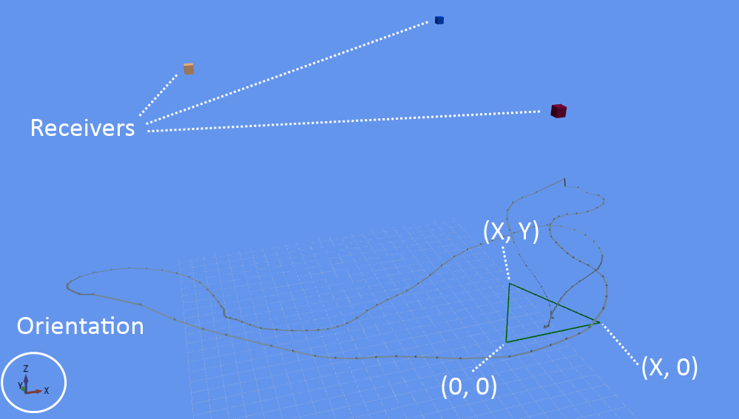
Calibration Overview

Slide 13
Detecting the Auto Calibrator
private CalibratorTriangle calibrator = null;
private List<Transmitter> connectedTransmitters = new List<Transmitter>();
// Called when a new transmitter has been detected
private void master_OnNewTransmitterConnected(Transmitter newTransmitter)
{
this.connectedTransmitters.Add(newTransmitter);
// Search for auto calibrator (uses a hardcoded range of ids)
bool found = CalibratorTriangle.TryFindCalibratorTriangle(this.connectedTransmitters, out this.calibrator);
if (found)
{
// Ready to start calibration
}
}

Slide 14
Calibration
// Called when a new measurement is received (usually every 100 ms)
private void master_OnMeasurementReceived(Measurement measurement)
{
this.calibrator.AddMeasurement(measurement);
double progress; // Status progress [0...1]
if (this.calibrator.IsCalibrationFinished(out progress))
{
// TODO: Save the calibrated scenario somewhere
Scenario3D calibratedScenario = calibrator.CreateScenario();
}
else
{
// TODO: Display progress somewhere in UI
}
}

Slide 15
Using a Scenario
// Called when a new measurement is received (usually every 100 ms)
private void master_OnMeasurementReceived(Measurement measurement)
{
Scenario3D myCalibratedScenario = GetScenarioSomehow(...);
CalculatedPosition cp;
if (PositionCalculator.TryCalculatePosition(measurement, myCalibratedScenario, out cp))
{
// TODO: Do something with pos
Point3D pos = cp.Position;
}
}

Slide 16
Extending a Scenario
Adding additional receiver
  Measure distance to a transmitter in multiple locations. Find position of a new receiver.
Merging multiple scenarios
  Promote one to ”main” scenario
  Find transform matrix from other scenarios to main and offset into a global coordinate system.

Slide 17
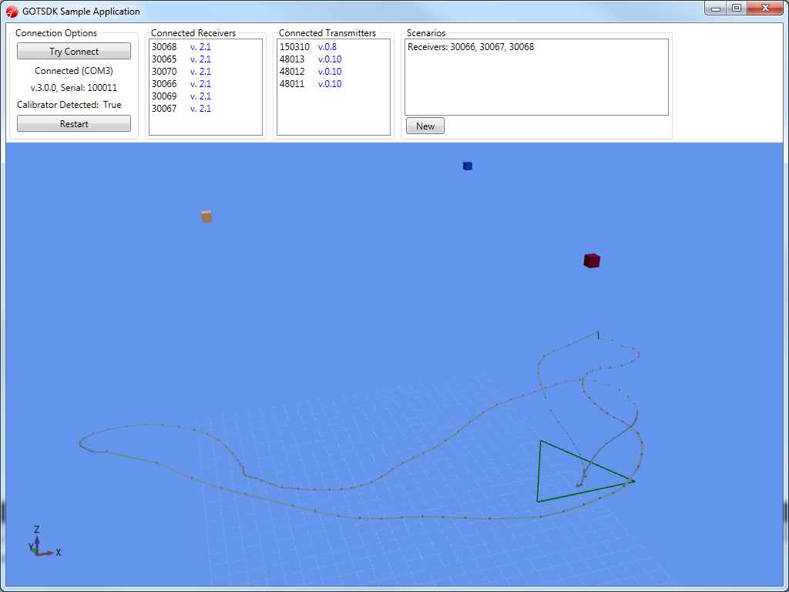
SDK Sample Application

