Slide 1
MEDICAL MLLMs / EVIDENCE & SUPERVISION
Which claims can the supplied evidence justify?
A tractable research question
Does aligning each training claim with the evidence actually supplied reduce unsupported assertions without losing useful diagnostic performance?
Central idea: supported. Dominant root cause: unproven.
Candidate contribution: source provenance + matched supervision intervention.
Advisor discussion · October 19, 2026
1
Notes:
Assessment of med_mllm_gap_notes.pdf. The framework is reasonable; causal dominance, population prevalence, and the pre/post boundary are hypotheses. New work: read-only data audit, lookup baselines and source-figure inspection. Existing GPU runs are inspected, not rerun.
Sources: Advisor discussion · October 19, 2026

Slide 2
MEDICAL MLLMs / EVIDENCE & SUPERVISION
Separate four problems before choosing a method
Missing evidence
Missed perception
A biopsy result or prior study is absent.
The relevant finding is present but missed.
Ambiguous evidence
Unused evidence
The supplied image cannot resolve the diagnosis.
A retained finding loses to a text shortcut.
Discussion notes, pp. 2–5
2
Notes:
Medical knowledge remains useful. Missing evidence, missed perception, ambiguity and unused evidence are not interchangeable. A confirmed diagnosis may be a valid probabilistic target while a fabricated visual premise remains defective.
Sources: Discussion notes, pp. 2–5

Slide 3
MEDICAL MLLMs / EVIDENCE & SUPERVISION
Teacher knowledge can exceed student evidence
Article / teacher
Training record
Possible mismatch
Images + captions
History, pathology,
other panels / dates
Selected image(s)
+ generated question
+ generated answer
Answer contains a fact
whose evidence never
reaches the student
This is a risk to measure, not proof that all synthetic supervision is defective.
P01 LLaVA-Med · P02 HuatuoGPT-Vision · P03 Lingshu
3
Notes:
LLaVA-Med uses caption and inline article mentions with a text teacher. Huatuo uses an image-aware GPT-4V reformatter, so it must not be called caption-only. Lingshu uses image, RoI, metadata and knowledge; reasoning distillation supplies the known answer. Privileged supervision is useful when targets remain answerable or probabilistic; per-claim auditing is needed.
Sources: P01 LLaVA-Med · P02 HuatuoGPT-Vision · P03 Lingshu

Slide 4
MEDICAL MLLMs / EVIDENCE & SUPERVISION
Accuracy can rise without stronger visual dependence
MedVLM-R1: 55.11% → 78.22% in its evaluation, using 600 training QA.
MedVLThinker: curated text-only RL can outperform its tested multimodal training recipe.
Beyond Accuracy: accuracy 56.5% → 58.8%, while image sensitivity falls 48.2% → 39.8%.
Test answer correctness and evidence dependence separately. Neither alone certifies a visual premise.
P08 MedVLM-R1 · P11 MedVLThinker · P12 Beyond Accuracy
4
Notes:
Scores are protocol-specific and not cross-paper rankings. MedVLM-R1 reports substantial RL gains. MedVLThinker shows stronger gains from curated text-only training in its comparisons; data quality is a confound. Beyond Accuracy is a small preprint using 100 items per benchmark. Its image-invariance heuristic is not an expert hallucination label; a shuffled image can preserve the correct answer.
Sources: P08 MedVLM-R1 · P11 MedVLThinker · P12 Beyond Accuracy

Slide 5
MEDICAL MLLMs / EVIDENCE & SUPERVISION
The latest work narrows the novelty claim
MCR and Med-OPD: image-conditioned rewards and token weighting already exist.
MedTRACE: evidence sufficiency, tools, verification and confidence already exist.
CARE-MVLM: lesion removal + matched random removal + abstention already exist.
Candidate extension: teacher-only patient facts and missing panels, tested through a controlled target-alignment intervention.
P15 MCR · P19 Med-OPD · P20 MedTRACE · P21 spatial/factual RL · P22 CARE-MVLM
5
Notes:
MCR already rewards perceptual and reasoning consistency. Med-OPD weights tokens using teacher image-degradation dependence. MedTRACE models sufficiency and acquisition. CARE-MVLM uses lesion and random-region removals with an answerability selector. New research must add evidence beyond these, not relabel them.
Sources: P15 MCR · P19 Med-OPD · P20 MedTRACE · P21 spatial/factual RL · P22 CARE-MVLM

Slide 6
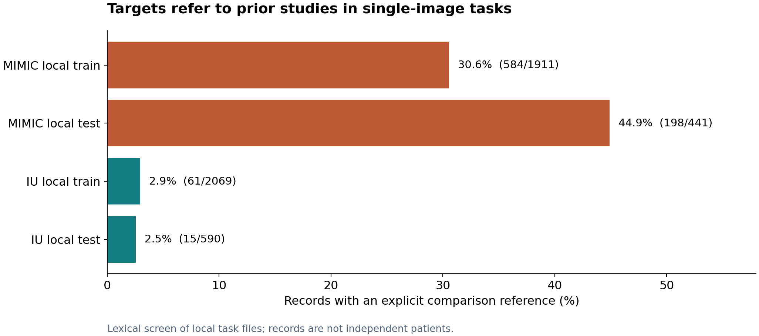
MEDICAL MLLMs / EVIDENCE & SUPERVISION
Single-image report targets refer to unavailable priors
New local-file audit · audit_data.py
6
Notes:
An explicit-comparison lexical screen, not a clinical hallucination rate. All audited report records contain one image and a generic report prompt, with no supplied prior. Local record counts are not full dataset or patient counts. Broader stable/unchanged flags are reported separately in the brief.
Sources: New local-file audit · audit_data.py

Slide 7
MEDICAL MLLMs / EVIDENCE & SUPERVISION
A traceable report example
Input: one current image + “generate a concise medical report.”
Target: “As compared to the previous radiograph, no relevant change has occurred.”
Current findings can remain valid.
The comparison needs another study. Supply it or revise the target.
C10–C11 · MIMIC_CXR/data_report/training.json · rows 0–1
7
Notes:
Row 0 supplies one image and asks for a concise report. The target compares to a previous radiograph and claims a right-hilar atelectasis is less severe. We do not adjudicate the current radiograph or assert that its present findings are wrong. This case concerns missing comparison evidence in the task wrapper. Missing-prior rewriting and DPO suppression have direct precedents P06–P07.
Sources: C10–C11 · MIMIC_CXR/data_report/training.json · rows 0–1

Slide 8
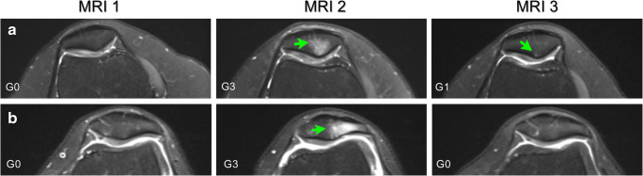
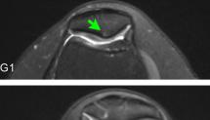
MEDICAL MLLMs / EVIDENCE & SUPERVISION
A stronger case: earlier timepoints were cropped away
Actual input
Published figure
Target describes recovery across time. Input contains only the final timepoint.
C05 · PubMedVision Instruction-Tuning_394494 · Original: PMC7300102, Figure 3
8
Notes:
The local 215×123 image was visually compared to the published figure and matches its rightmost MRI 3 column. The generated answer discusses improvement versus earlier scans and exact ages. Structural availability is verified; lesion grades are not independently clinically adjudicated. Restore source panels/dates separately from age metadata. Original figure attribution: Horga et al., Skeletal Radiology, 2020; https://pmc.ncbi.nlm.nih.gov/articles/PMC7300102/.
Sources: C05 · PubMedVision Instruction-Tuning_394494 · Original: PMC7300102, Figure 3

Slide 9
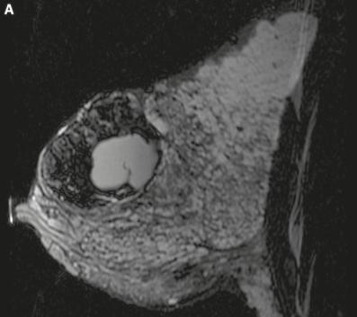
MEDICAL MLLMs / EVIDENCE & SUPERVISION
A true diagnosis can have unsupported provenance
Original target includes:
“Our biopsy results confirm this diagnosis.”
MRI features ≠ evidence that a biopsy happened.
Keep the differential; add the pathology record before asserting confirmation.
C01 · PubMedVision Instruction-Tuning_422538 · Original: PMC7720671, Figure 5
9
Notes:
The supplied file is an MR image; question asks about a large mass. The source caption reports a biopsy confirming fibroadenoma with lactational changes, but no biopsy report is supplied to the student. The claim that biopsy confirmation occurred is off-input even if the final diagnosis is true. We do not independently adjudicate diagnostic certainty from this image. Article attribution: Pregnancy-lactation cycle: how to use imaging methods for breast evaluation, Radiologia Brasileira 2020.
Sources: C01 · PubMedVision Instruction-Tuning_422538 · Original: PMC7720671, Figure 5

Slide 10
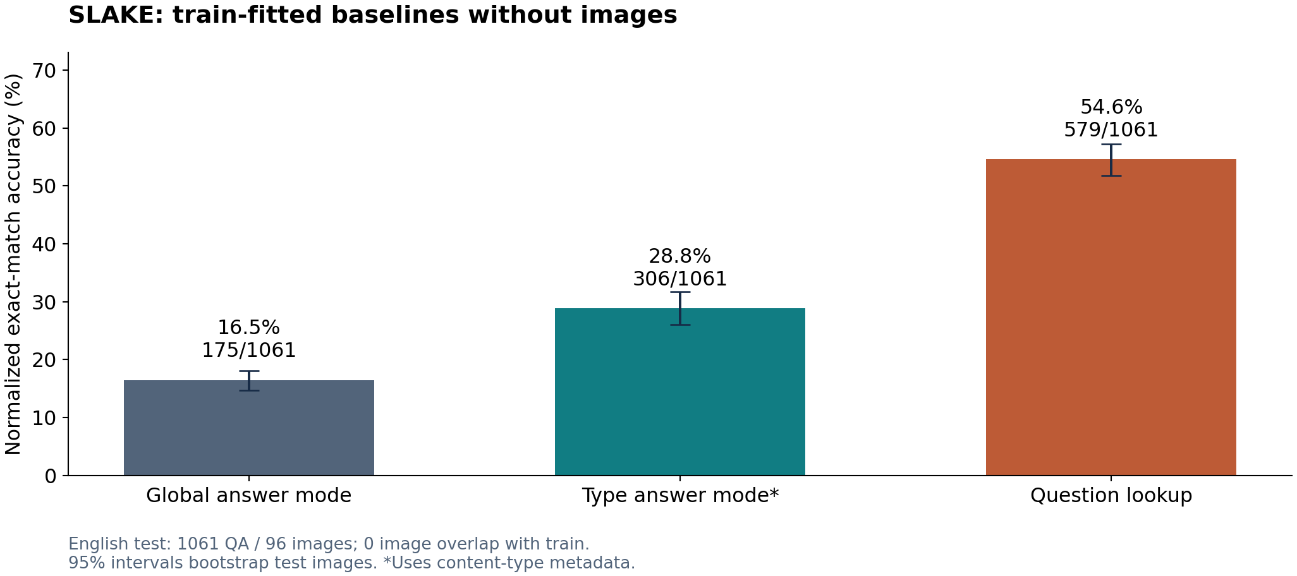
MEDICAL MLLMs / EVIDENCE & SUPERVISION
Local benchmark scores have strong text baselines
New SLAKE English train/test lookup · benchmark_text_baseline.py
10
Notes:
Exact normalized train-question lookup with global train-answer fallback; no images, metadata or pretrained language model. Correct: 579/1061 = 54.57%; 95% image-cluster bootstrap interval 51.74–57.21%. There are 4919 training QA over 450 images and 1061 test QA over 96 images. Image overlap is zero; 999 test questions occur in train. Type mode is a separate metadata-aware baseline. This does not claim the same performance protocol as published MLLM evaluations.
Sources: New SLAKE English train/test lookup · benchmark_text_baseline.py

Slide 11
MEDICAL MLLMs / EVIDENCE & SUPERVISION
Controls prevent an overbroad “language prior” story
Some knowledge is intended: asking the function of an organ legitimately needs medical knowledge.
A biopsy/IHC keyword may accompany an actual histology image. A keyword hit is not a missing-evidence label.
PMC-VQA: predicting the train-mode option B gives 31.708% on test. Check answer-position balance.
Visible dimensions can be answerable while longitudinal percentage change is not. Score atomic claims.
C06–C09 · dataset_audit.json · text_baseline.json
11
Notes:
Exact age, biopsy, and temporal regex hits need human review. PMC-VQA test row 9 actually supplies an IHC-containing image, though the exact marker identity can still require context. SLAKE includes legitimate knowledge QA. The 31.708% PMC-VQA answer-letter baseline includes 10 malformed test labels in its denominator. Broad anatomy is demonstrably retained and used in the archived pilot; small-lesion coverage remains open.
Sources: C06–C09 · dataset_audit.json · text_baseline.json

Slide 12
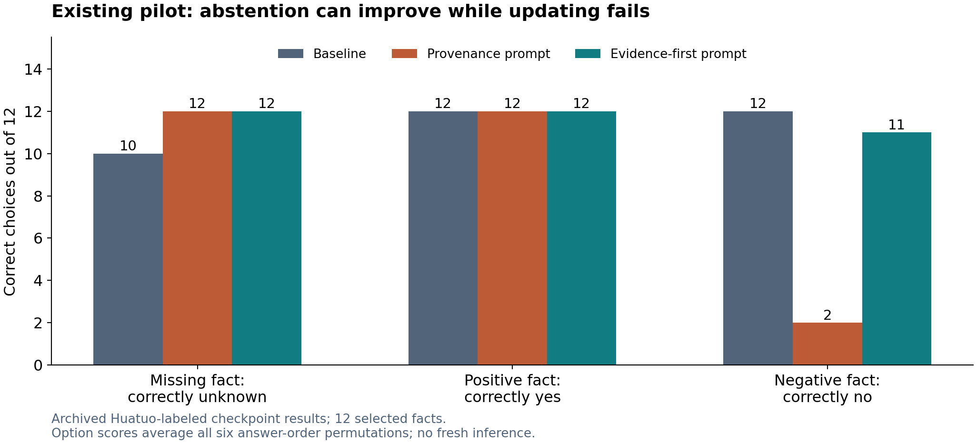
MEDICAL MLLMs / EVIDENCE & SUPERVISION
Existing pilot: abstention can conceal evidence suppression
Archived information_gap pilot · 12 selected facts · no new GPU inference
12
Notes:
The local Huatuo-labeled checkpoint uses a LLaVA-Qwen2 architecture, not necessarily the original 2024 Huatuo paper checkpoint. Choices are scored across all six answer permutations. The provenance prompt improves abstention when facts are missing but suppresses negative-context updating. The MedSIGHT counterpart also suppresses visual anatomy under conflicting notes. These are exploratory constrained-choice findings, not a clinical model ranking.
Sources: Archived information_gap pilot · 12 selected facts · no new GPU inference

Slide 13
MEDICAL MLLMs / EVIDENCE & SUPERVISION
Keep the decomposition; narrow what it proves
Prediction loss = intrinsic + missing context
+ lost encoding + predictor mismatch
Population identity under explicit assumptions; not a per-case uncertainty label.
Frozen-Z Fano bounds do not establish a universal pretraining/post-training boundary.
Ablation likelihood gain is model dependence, not Shannon MI or expert evidence sufficiency.
Discussion notes §4 · T01 usable information / PVI
13
Notes:
For deterministic Z=g(I), fixed question and finite Y under a specified distribution, the four-term identity is valid. Cross entropy equals H(Y|Z)+KL, then chain rules provide the decomposition. The last term includes approximation, fitting and calibration. A fixed-model ablation does not estimate these terms. A failed probe can reflect finite data, pooling or limited capacity; a successful probe can exploit correlations.
Sources: Discussion notes §4 · T01 usable information / PVI

Slide 14
MEDICAL MLLMs / EVIDENCE & SUPERVISION
A scoped experiment can establish the causal claim
Annotate claims and required evidence on independent, patient/article-separated cases.
Manipulate evidence availability: prior study, pathology report, missing panel. Keep questions fixed.
Cross supervision alignment with a strong grounding objective at matched data and compute.
Measure answerable-case accuracy, unsupported claims, correct updating and irrelevant-change stability together.
Proposed study · not an experiment already run
14
Notes:
Start in a single modality and use source-grounded claims. Prior studies and biopsy reports can be withheld or supplied without editing anatomy. Expert annotation should be blinded and include unavailable, visible, contextual, derived and ambiguous labels. For image changes, use matched cases or validated edits plus irrelevant-region controls. Do not automatically interpret lesion removal as proof of a unique negative diagnosis.
Sources: Proposed study · not an experiment already run

Slide 15
MEDICAL MLLMs / EVIDENCE & SUPERVISION
The primary outcome must require useful answers
Sufficient evidence
Irrelevant change
Answer adequately
Preserve supported claims
Required evidence absent
Valid evidence arrives
Qualify / request evidence
Update appropriately
Proposed joint evidential success
15
Notes:
A correct final answer can still contain false premises; evaluate that explicitly. Distinguish withholding evidence from a negative study. If the diagnosis is ambiguous, use acceptable sets or probability labels. Report the four components separately as well as their intersection, clustered by independent patient/article. Pre-register prompts, primary loss, sample-size justification and exclusions before inspecting new model outputs.
Sources: Proposed joint evidential success

Slide 16
MEDICAL MLLMs / EVIDENCE & SUPERVISION
What would weaken the hypothesis?
Independent experts find little unavailable-evidence supervision in uniform samples.
Aligned supervision fails to beat equal-size random cleaning or existing grounding objectives.
Unsupported claims fall only because correct answerable cases are refused.
A stronger frozen readout or better crop resolves the issue: investigate access/use before blaming irreversible encoding loss.
Pre-specified falsification and go/no-go criteria
16
Notes:
A method should not pass by refusing everything. Compare aligned cleaning with equal-size random cleaning, standard SFT/DPO and relevant MCR or counterfactual controls. Include patient/article clustering and an external-site evaluation. Representation tests become meaningful on independently annotated lesions rather than only broad head/chest anatomy. Conformal calibration comes after score and loss design, with separate calibration patients.
Sources: Pre-specified falsification and go/no-go criteria

Slide 17
MEDICAL MLLMs / EVIDENCE & SUPERVISION
Advisor discussion: approve the testable core
Proceed with an evidence-aligned supervision study.
Choose one modality and two evidence requirements.
Secure independent clinical annotation and provenance checks.
Agree on a matched causal ablation and a joint utility/grounding outcome.
The broad framework is reasonable. The decisive contribution still needs an experiment.
Full evidence and reproducible audit: advisor_evidence_brief.html
17
Notes:
Suggested discussion: choose one modality and clinical annotation partner; define source/evidence labels; agree on a budget-matched 2×2 supervision/objective study and joint outcome. Keep causal dominance, coverage deficits and deployment guarantees open. The project is ready to discuss as a hypothesis supported by traceable examples, not as an already established root-cause finding.
Sources: Full evidence and reproducible audit: advisor_evidence_brief.html

Slide 18
MEDICAL MLLMs / EVIDENCE & SUPERVISION
Sources: backbones and direct supervision precedents
P01 LLaVA-Med
https://arxiv.org/abs/2306.00890
P02 HuatuoGPT-Vision / PubMedVision
https://aclanthology.org/2024.emnlp-main.418/
P03 Lingshu / Lingshu-Med
https://arxiv.org/html/2506.07044v5
P04 MedGemma 1.5 Technical Report
https://arxiv.org/html/2604.05081v1
P05 Comparative evaluation of generative AI models for CXR report generation in the ED
https://pmc.ncbi.nlm.nih.gov/articles/PMC13574732/
P06 Removing hallucinated references to non-existent priors
https://proceedings.mlr.press/v193/ramesh22a.html
P07 DPO for suppressing hallucinated prior exams
https://arxiv.org/html/2406.06496v1
Primary-source links; full locators and limitations in paper_evidence.csv
18
Notes:
These links identify the primary sources used in the evidence brief. P24 MedBench and P25 the wound study are discussed in the brief with limitations. No cross-paper score ranking is intended.
Sources: Primary-source links; full locators and limitations in paper_evidence.csv

Slide 19
MEDICAL MLLMs / EVIDENCE & SUPERVISION
Sources: reasoning and benchmark evidence
P08 MedVLM-R1
https://papers.miccai.org/miccai-2025/0553-Paper3267.html
P09 Med-R1
https://arxiv.org/html/2503.13939v1
P10 GMAI-VL-R1
https://arxiv.org/html/2504.01886v1
P11 MedVLThinker
https://arxiv.org/html/2508.02669v1
P12 Beyond Accuracy: Evaluating Visual Grounding in Multimodal Medical Reasoning
https://arxiv.org/html/2603.03437v1
P13 MIRAGE: The Illusion of Visual Understanding
https://arxiv.org/html/2603.21687v2
P14 RadImageNet-VQA
https://arxiv.org/html/2512.17396v2
Primary-source links; full locators and limitations in paper_evidence.csv
19
Notes:
These links identify the primary sources used in the evidence brief. P24 MedBench and P25 the wound study are discussed in the brief with limitations. No cross-paper score ranking is intended.
Sources: Primary-source links; full locators and limitations in paper_evidence.csv

Slide 20
MEDICAL MLLMs / EVIDENCE & SUPERVISION
Sources: close methods
P15 Act as You Think / Multi-Consistency Reward
https://aclanthology.org/2026.acl-long.81/
P16 RadVLM with RL for reporting and grounding
https://arxiv.org/html/2512.10691v1
P17 ChestX-Reasoner: step-by-step verification from daily reports
https://www.nature.com/articles/s43856-026-01654-y
P18 MedReasoner
https://arxiv.org/html/2508.08177v1
P19 Med-OPD
https://arxiv.org/html/2607.16303v1
P20 MedTRACE
https://arxiv.org/html/2609.14823v1
Primary-source links; full locators and limitations in paper_evidence.csv
20
Notes:
These links identify the primary sources used in the evidence brief. P24 MedBench and P25 the wound study are discussed in the brief with limitations. No cross-paper score ranking is intended.
Sources: Primary-source links; full locators and limitations in paper_evidence.csv

Slide 21
MEDICAL MLLMs / EVIDENCE & SUPERVISION
Sources: attribution, abstention and calibration
P21 Spatial and factual RL for CXR reporting
https://arxiv.org/html/2609.31911v1
P22 CARE-MVLM
https://www.medrxiv.org/content/10.64898/2026.09.23.26363835v1.full
P23 RULE
https://aclanthology.org/2024.emnlp-main.62/
T01 V-usable information and pointwise V-information
https://proceedings.mlr.press/v162/ethayarajh22a.html
T02 Conformal Risk Control
https://arxiv.org/abs/2208.02814
T03 Language Models with Conformal Factuality Guarantees
https://proceedings.mlr.press/v235/mohri24a.html
Primary-source links; full locators and limitations in paper_evidence.csv
21
Notes:
These links identify the primary sources used in the evidence brief. P24 MedBench and P25 the wound study are discussed in the brief with limitations. No cross-paper score ranking is intended.
Sources: Primary-source links; full locators and limitations in paper_evidence.csv

