Slide 1




Calcium-influx-dependent plasticity model-STDP
AIBC2021
Aohua Cheng
Tsinghua University

Slide 2
Calcium-influx-dependent plasticity model-STDP
Aohua Cheng
Tsinghua University

Slide 3

Self-Introduction
Aohua Cheng
Lab1 : Medicine & Medical Robot Research Center, Tsinghua
Lab2 : Sunpei/Tyanyang Lab, Tsinghua
Lab3 : Robert Lab, MIT
Research background :
Medical Robot, Computational neuromorphology,
Memory recall
Interest:
Consciousness, Biophysics, ANN
Swimming, Tennis

Slide 4
Project background and the scientific question
• Hebbian plasticity means that if the firing of two neurons is correlated, then their connection is strengthened. Conversely, uncorrelated firing causes a decrease in synaptic strength.
• Spike-timing-dependent plasticity (STDP) represents one instantiation of Hebbian plasticity. Under STDP, synaptic changes depend on the relative timing of the pre- and post- synaptic firing.
• Strengthing(LTP) or weakening (LTD) of glutamatergic synapses depends on the post-synaptic influx of Ca2+: weak influx leads to LTD, while strong, transient influx causes LTP. The voltage-dependent NMDA receptors are the main source of Ca2+ influx, but only open if a post- synaptic depolarisation coincides with pre-synaptic neurotransmitter release
A calcium-influx-dependent plasticity model exhibiting multiple STDP curves Akke Mats Houben Matthias S. Keil 2020

Slide 5
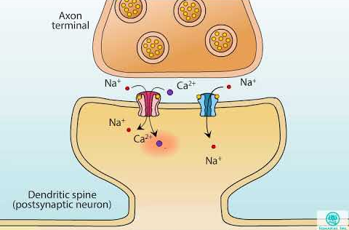









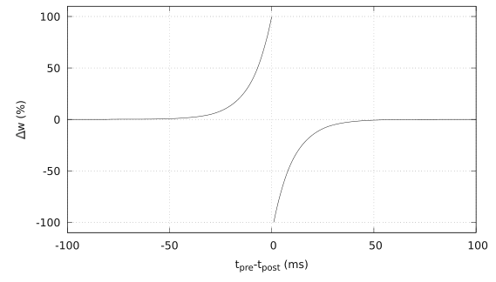



Method
Neuron : LIF model
STDP(small time scale)
Synapse: NMDA AMPA

Slide 6
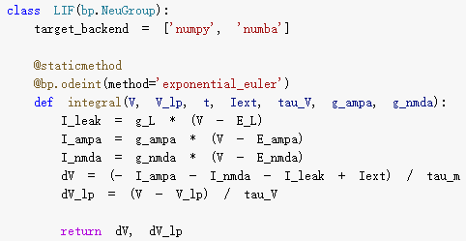
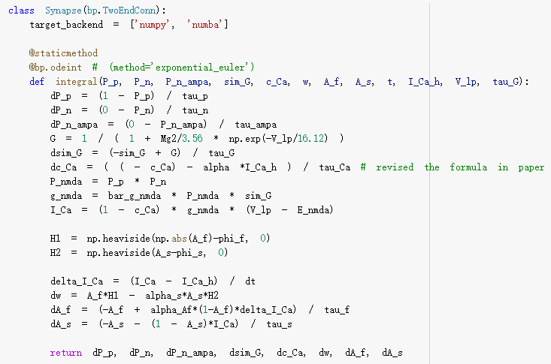
Method
LIF class
Synapse class
Coding link: https://cloud.tsinghua.edu.cn/f/483f62bf23f84226a573/
Brainpy: https://brainpy.readthedocs.io/en/latest/

Slide 7
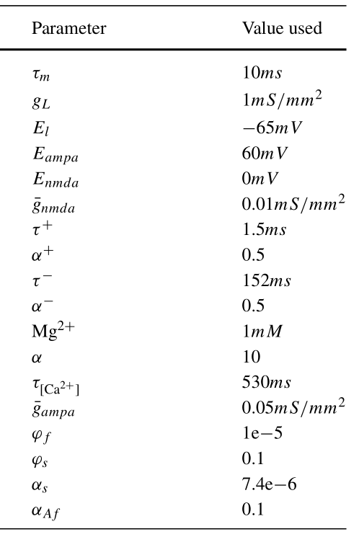
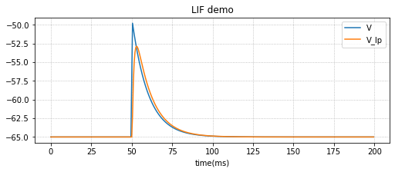
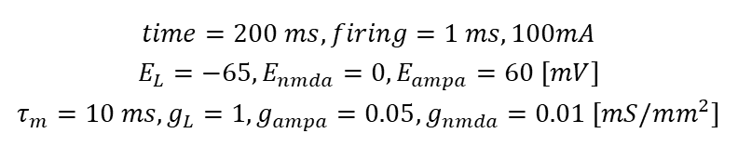
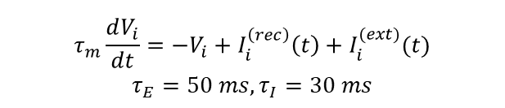
Results
$$τ_{m}\frac{dV_{i}}{dt}=−V_{i}+I_{i}^{\left(rec\right)}\left(t\right)+I_{i}^{(ext)}(t)$$
$$τ_{E}=50 ms, τ_{I}=30 ms$$
Parameters setting
Single neuron1-stimulus
$$time=200 ms, firing=1 ms, 100mA$$
$$E_{L}=−65, E_{nmda}=0, E_{ampa}=60 [mV]$$
$$τ_{m}=10 ms, g_{L}=1, g_{ampa}=0.05, g_{nmda}=0.01 [mS/mm^{2}]$$

Slide 8
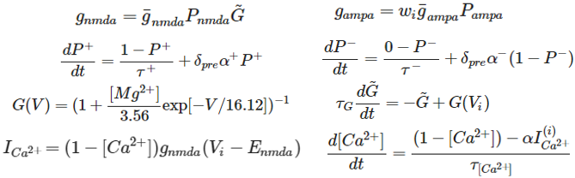
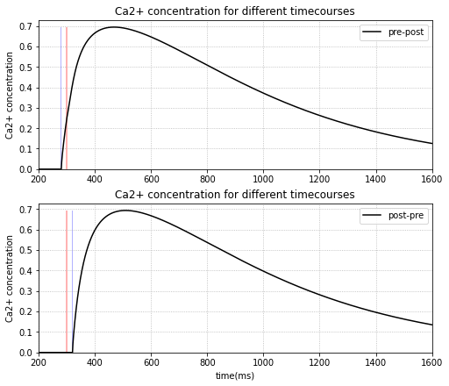
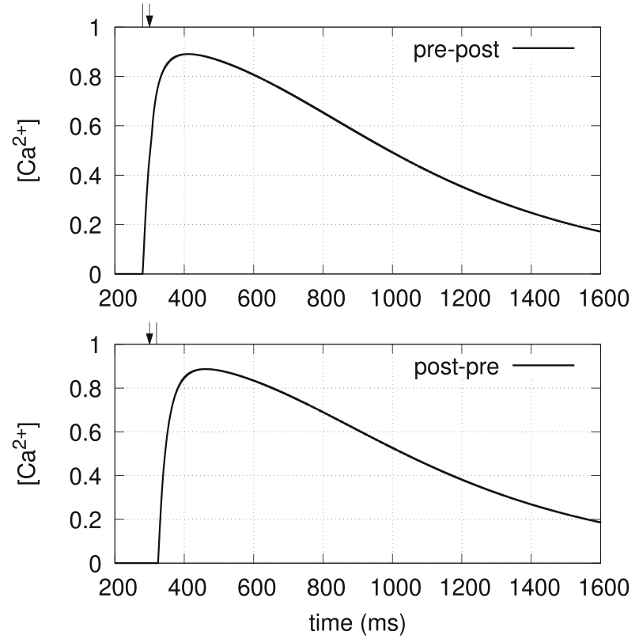
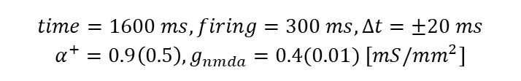
Results
$$time=1600 ms, firing=300 ms,Δt=±20 ms$$
$${α^{+}=0.9\left(0.5\right), g}_{nmda}=0.4(0.01) [mS/mm^{2}]$$
Ca2+ concentration for different timecourses

Slide 9
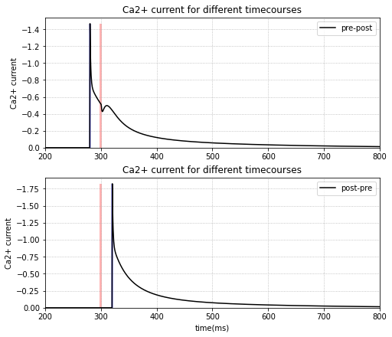
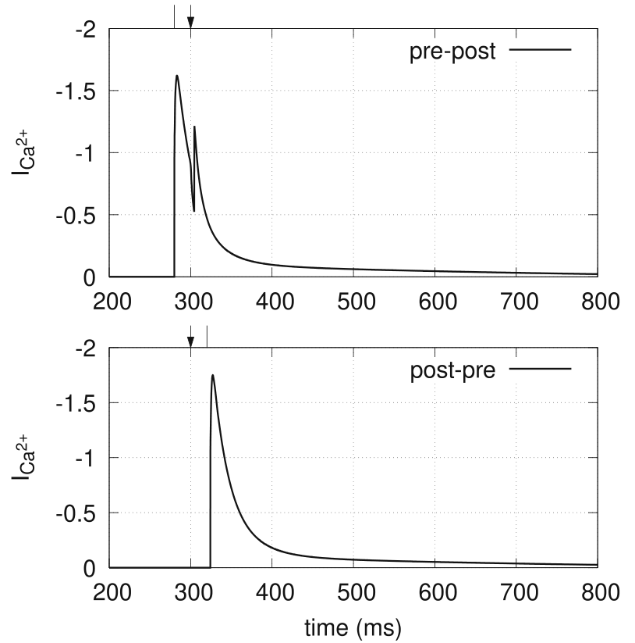
Results
$$time=1600 ms, firing=300 ms,Δt=±20 ms$$
$${α^{+}=0.9\left(0.5\right), g}_{nmda}=0.4(0.01) [mS/mm^{2}]$$
Ca2+ current for different timecourses

Slide 10
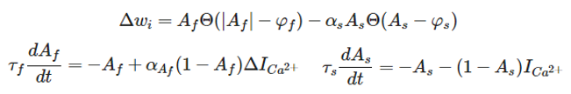
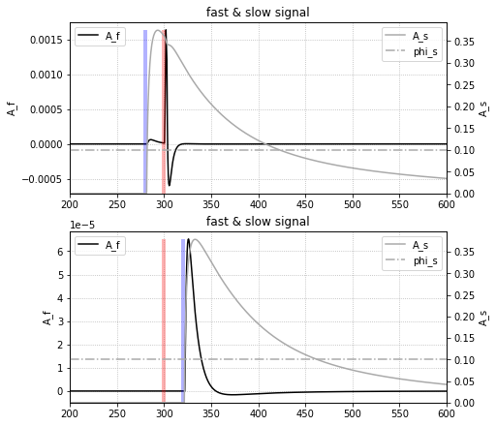
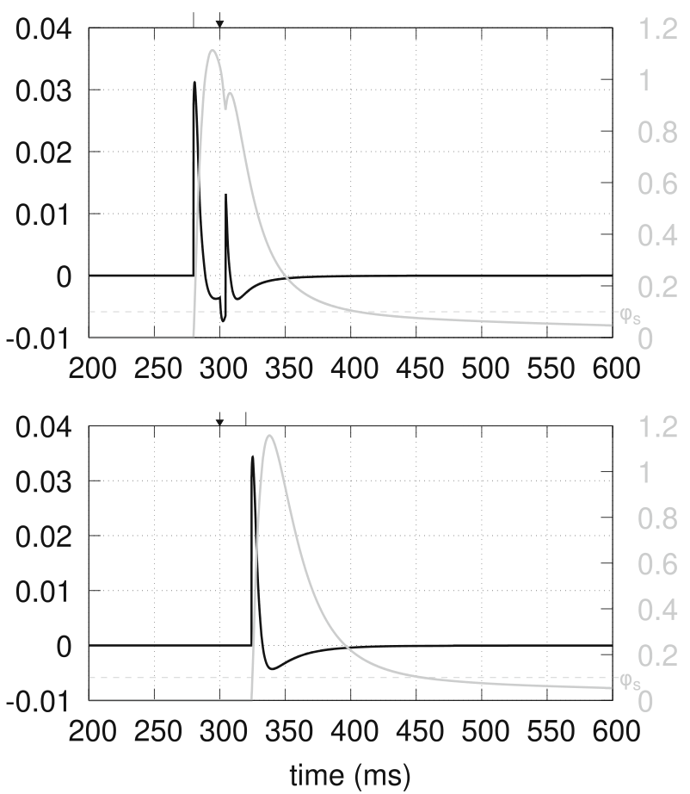
Results
$$time=1600 ms, firing=300 ms,Δt=±20 ms$$
$${α^{+}=0.9\left(0.5\right), g}_{nmda}=0.4(0.01) [mS/mm^{2}]$$
Fast (black lines) and slow (grey lines) plasticity signals
# 幅度数量级暂时不对
# post-pre整体趋势相同
# pre-post中post刺激强于pre刺激，趋势不同，可能与修改g_nmda有关

Slide 11
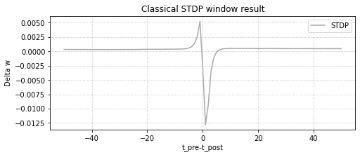
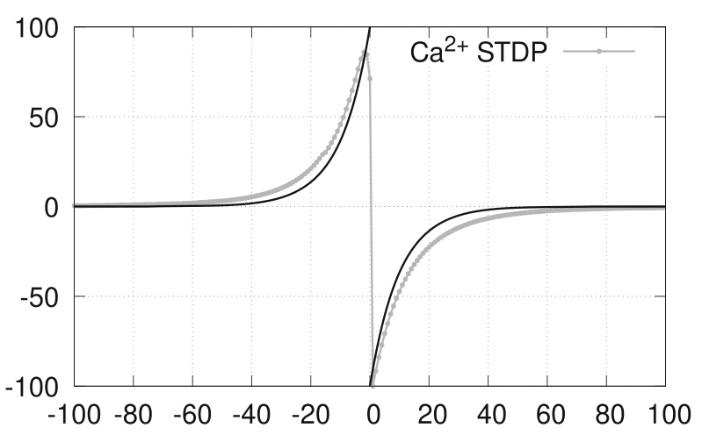
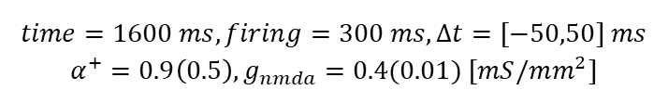
Results
$$time=1600 ms, firing=300 ms,Δt=[−50,50] ms$$
$${α^{+}=0.9\left(0.5\right), g}_{nmda}=0.4(0.01) [mS/mm^{2}]$$
Classical STDP window
# 没有太理解原文中纵坐标的含义，这里直接取某次实验中，权重w的改变值积累量为纵坐标
# 两侧不太对称，可能与纵坐标含义和参数设置有关

Slide 12
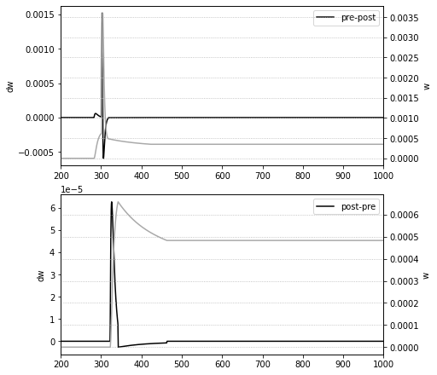
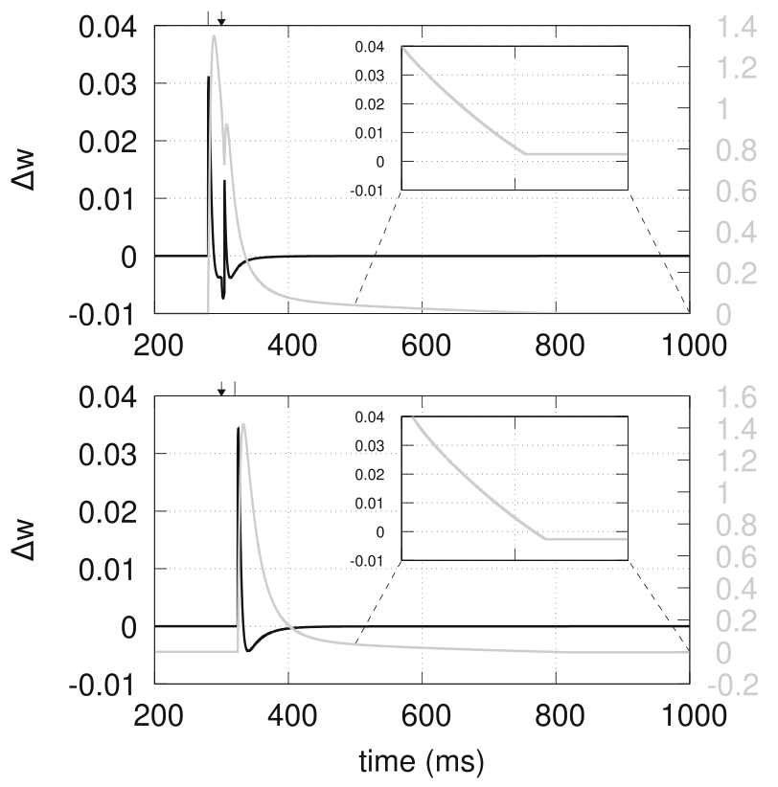
Results
$$time=1600 ms, firing=300 ms,Δt=±20 ms$$
$${α^{+}=0.9\left(0.5\right), g}_{nmda}=0.4(0.01) [mS/mm^{2}]$$
Synaptic change versus time
# 量级暂时不对
# w的最终值偏差较大

Slide 13
Discussion
• 这篇论文可能有用的地方：对synapse的建模，但是是small-time-scale(ms), 我们需要large-time-scale(hour)的神经元协同关系建模
• 接下来的工作：读一些review，注意STP, LTP, Misha

Slide 14
Acknowledgment
Thank Tian yang, Wang Chaoming’s help for the project.

Slide 15
Q & A ～5 mins

