Slide 1
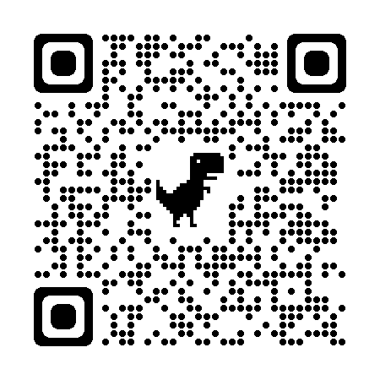
Technical Challenge Algorithm Development, ResMed Sensor Technologies
Aoibhe Turner-Heaney
GitHub repository: https://github.com/AoibheT-H/Algorithm_Challenge

Slide 2
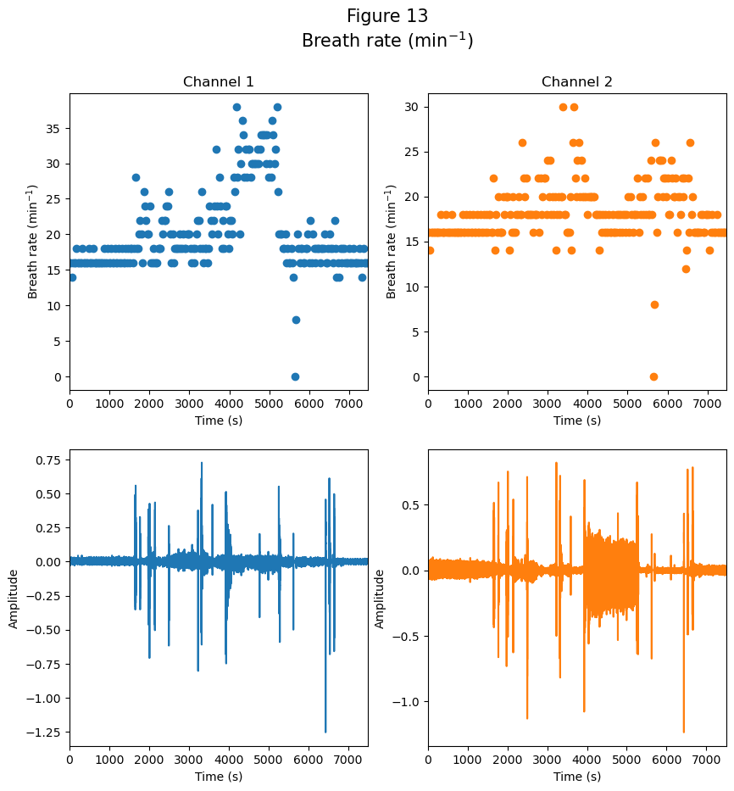
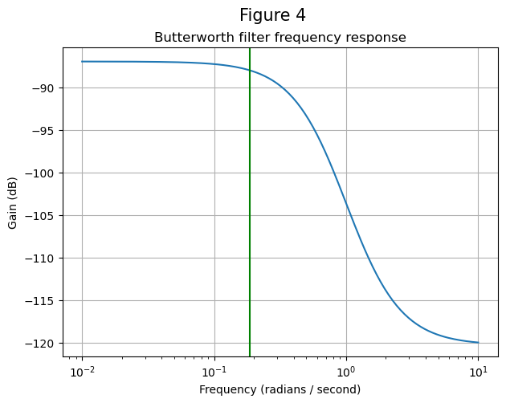
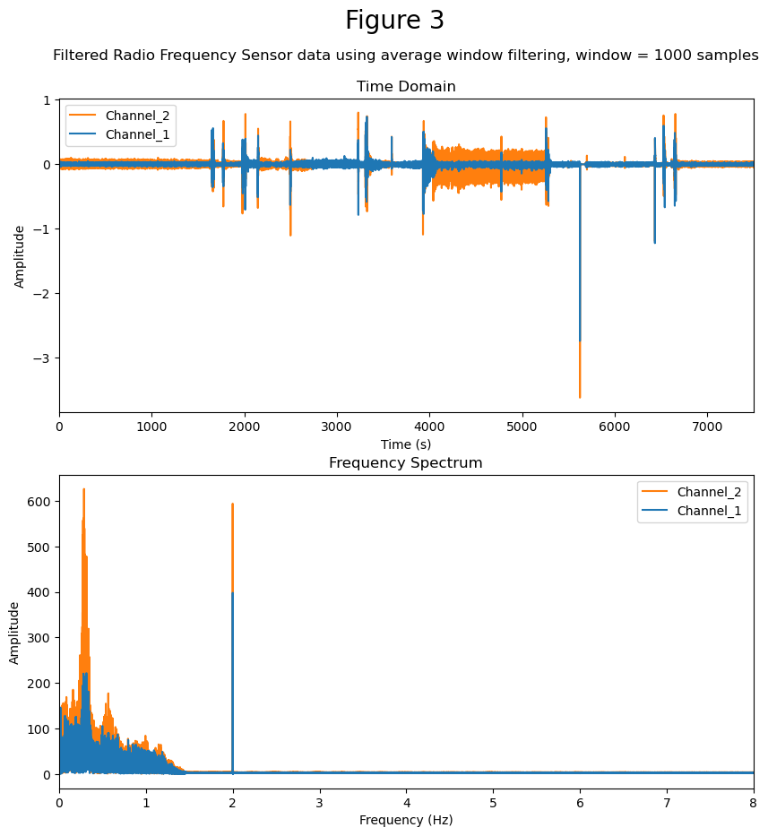
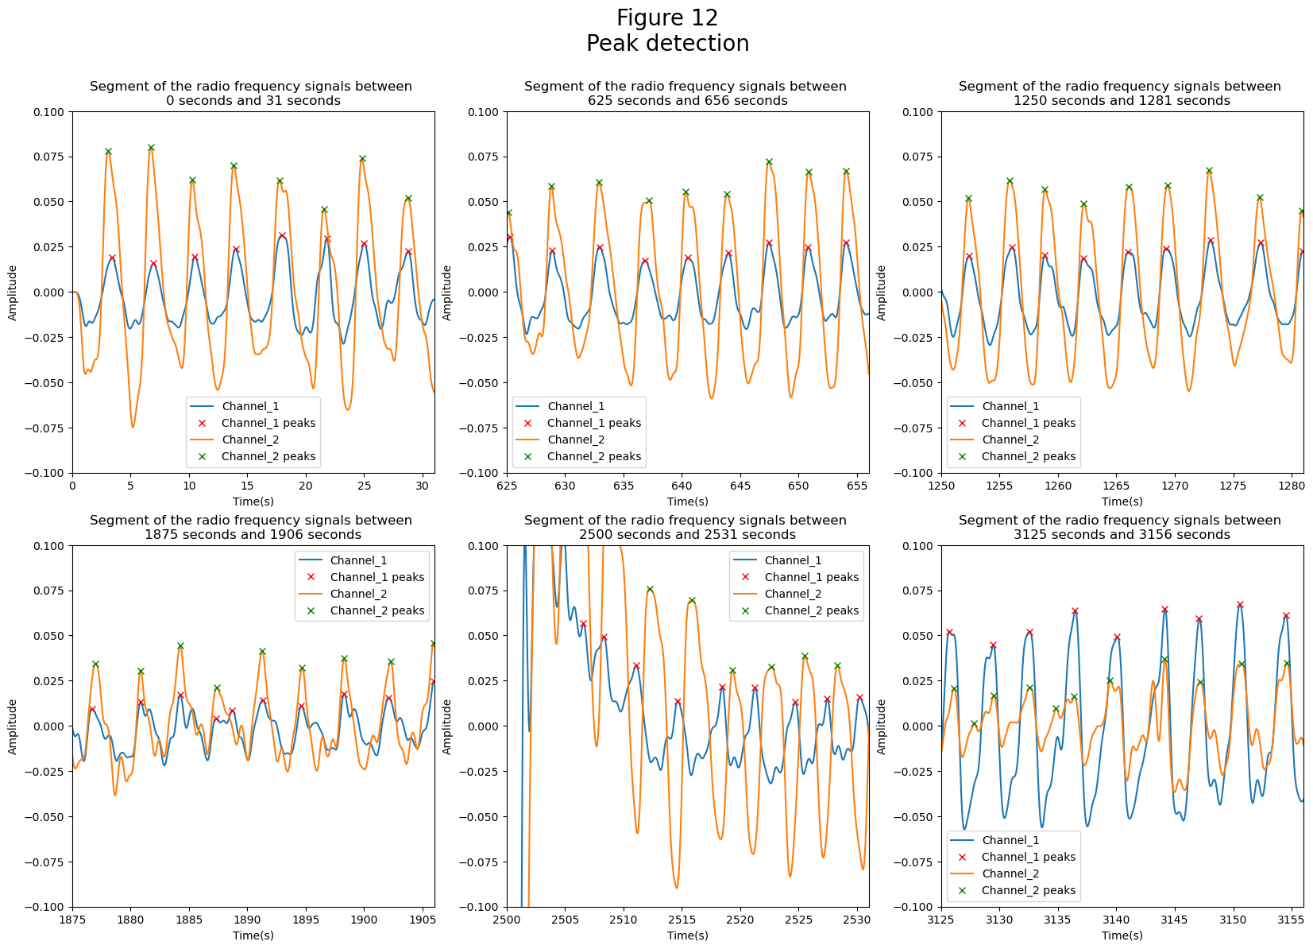
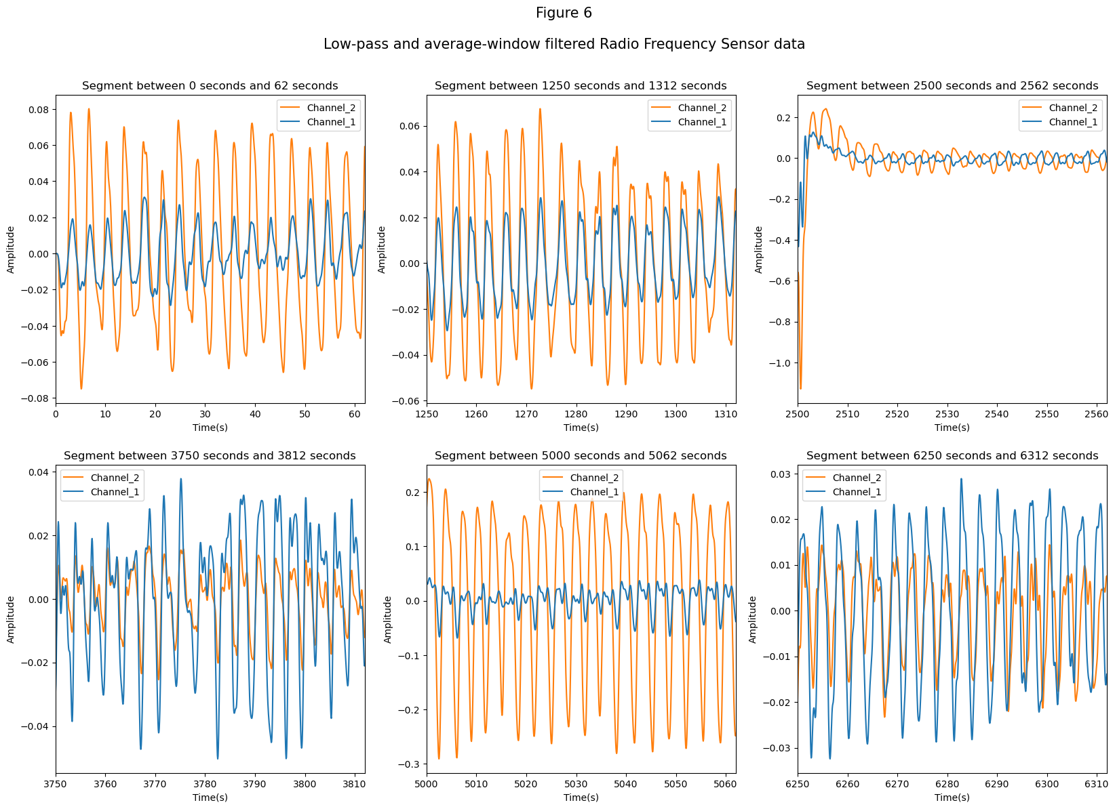
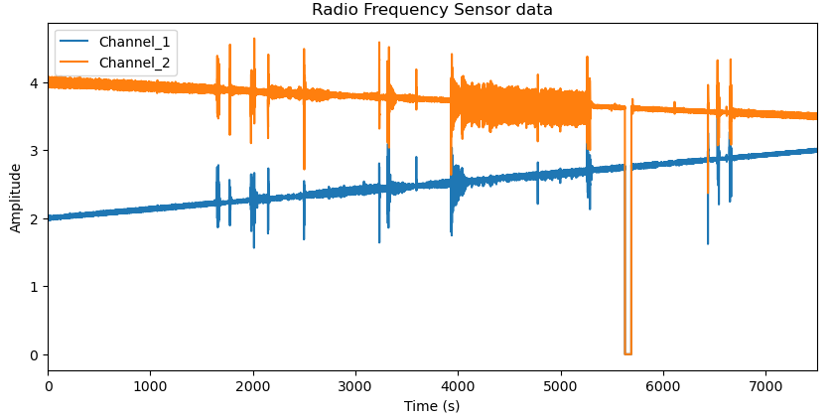
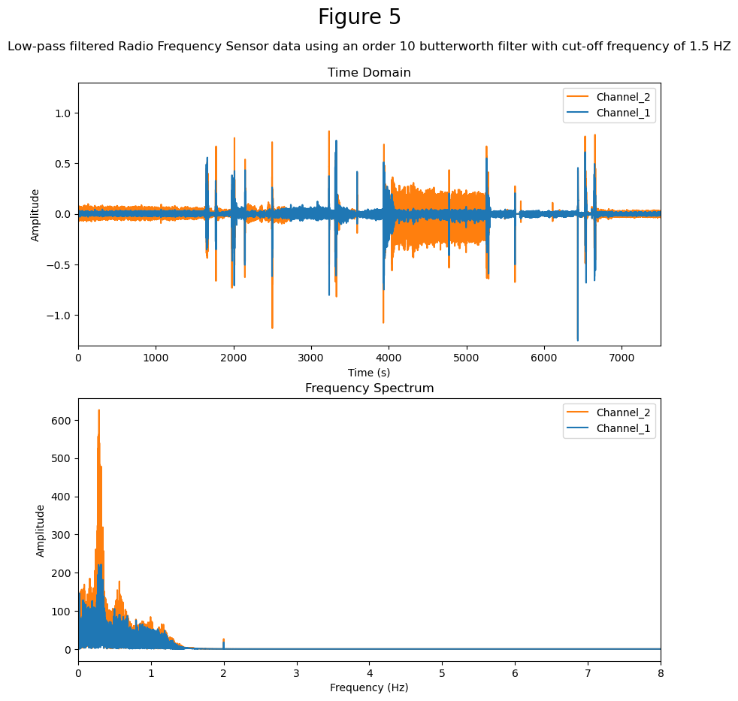
Proposed breath rate detection algorithm
Moving-average filter
(~63 seconds)
Low-pass filter
Breath peaks identified
(find_peaks() from scipy package)
Breath rate calculation
Original Signals
Breath rate (/min)

Slide 3
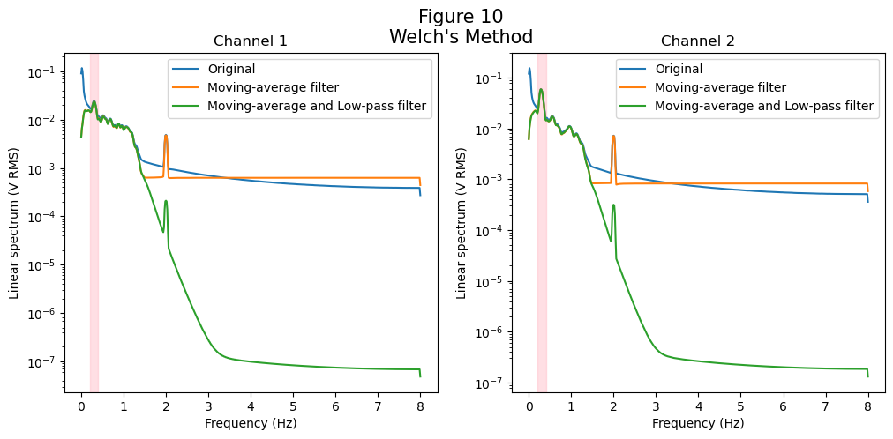
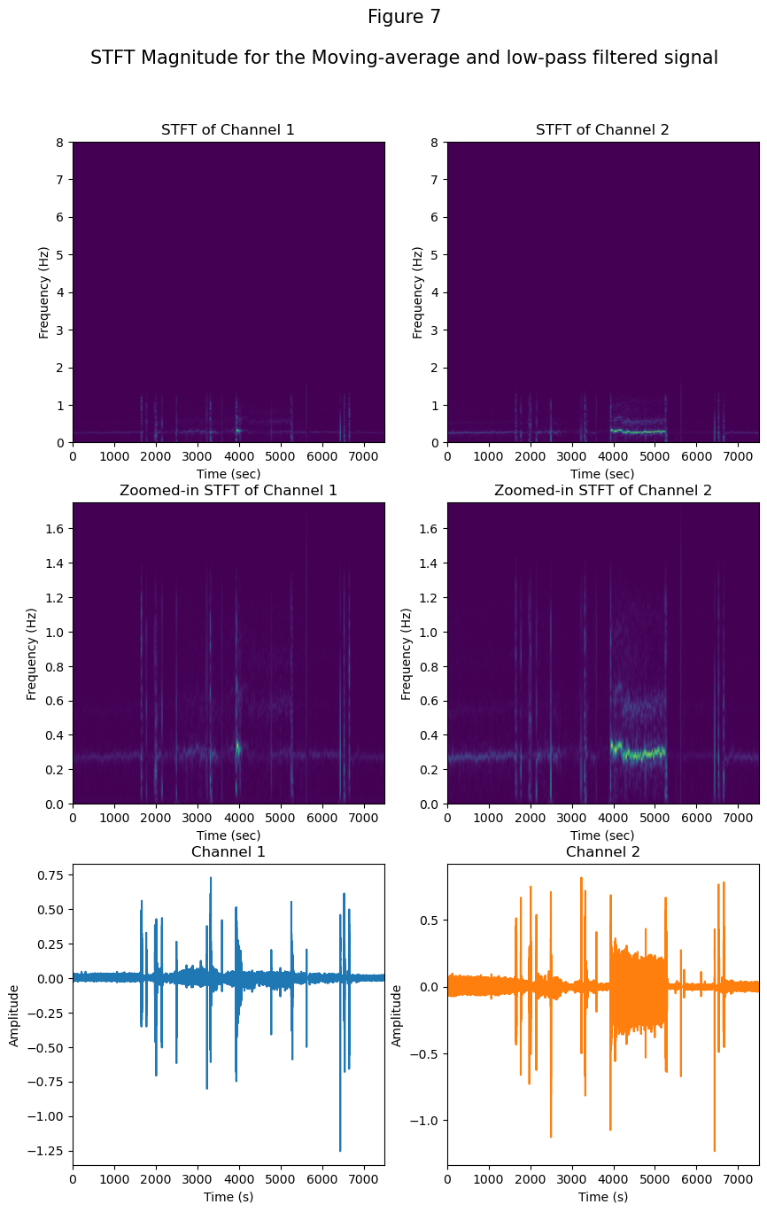
Limitations of approach
1
2
3
Low-pass filtering did not remove time-dependent noise
Noise remained in the signal
Breathing rate was inaccurate for periods of high noise/ movement artefact
Notes:
Pros or cons of the design; alternate approaches that could be taken
Sample results – respiration trace or other analyses

Slide 4
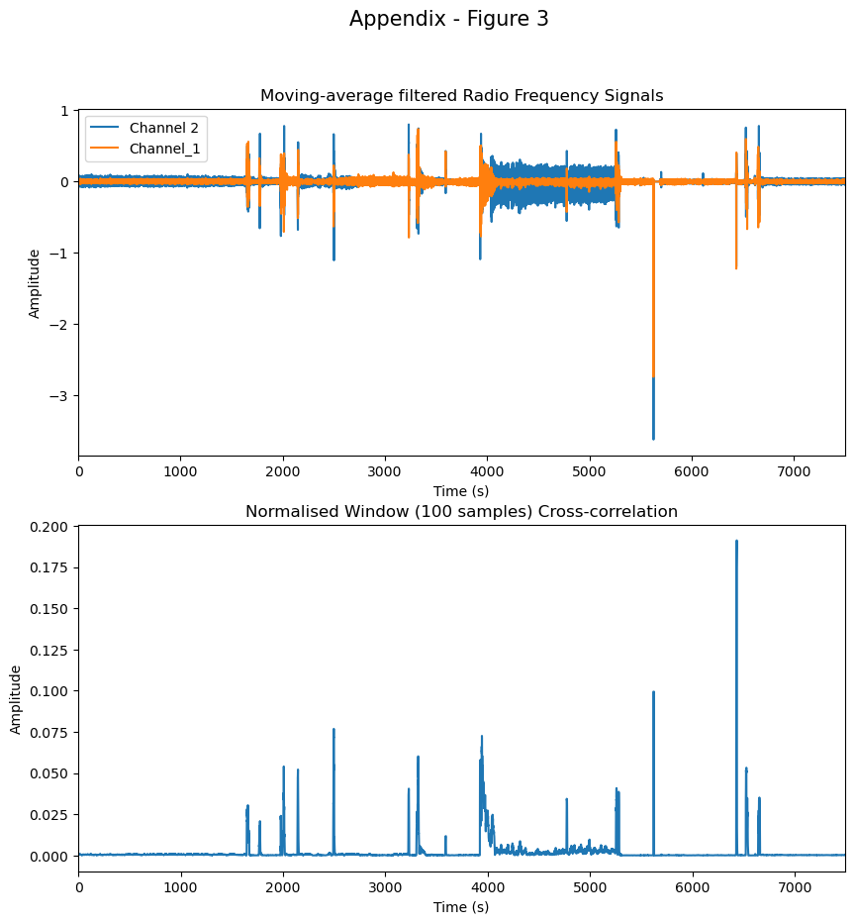
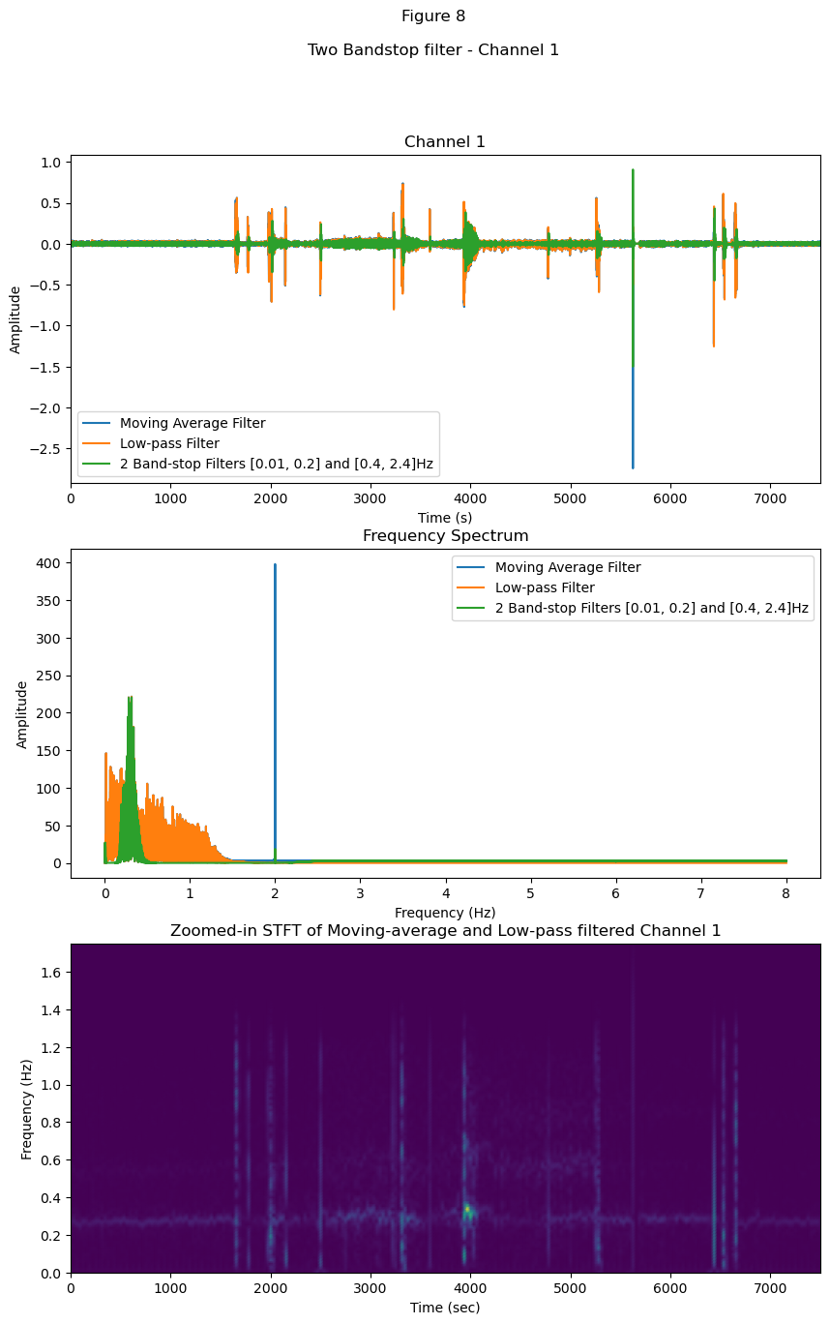
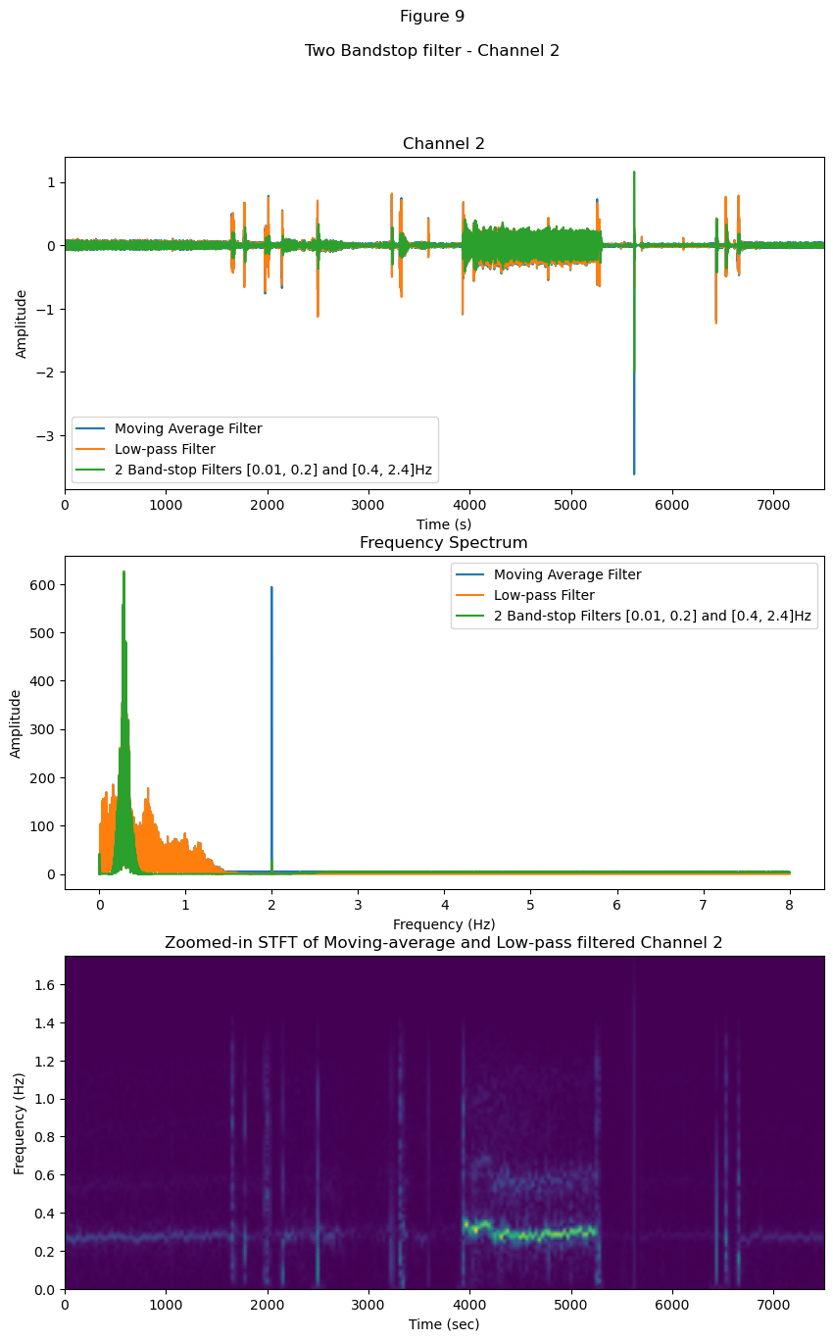
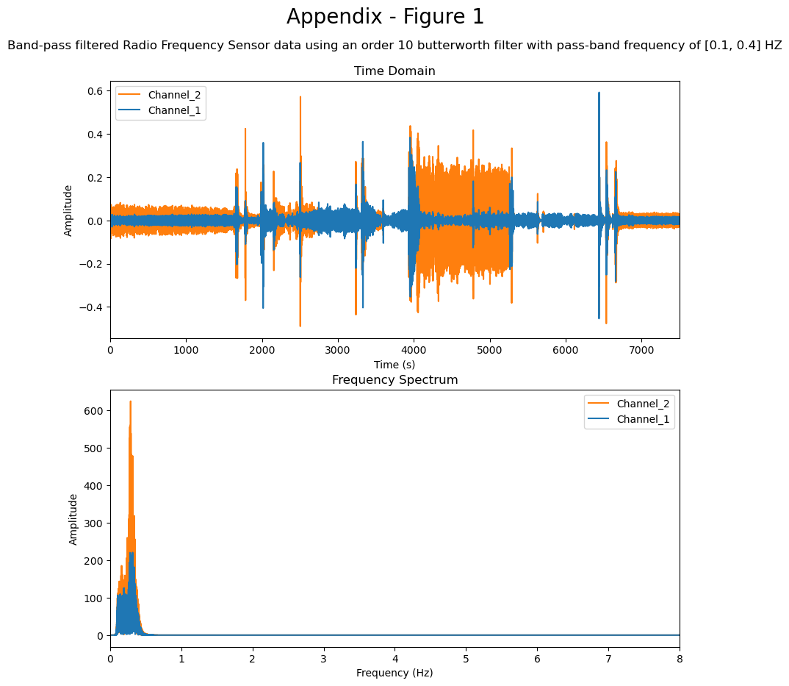
Alternative approaches
1
2
3
Use of two Butterworth bandstop filters
(0.01-0.2Hz), (0.4-2.4Hz) instead of the lowpass filter
(unsuccessful)
Use of a bandpass filter (0.1-0.4Hz)
or
inverse notch filter (0.333Hz)
(unsuccessful)
Use normalised cross-correlation to identify sections of noise, identify noisy frequencies in that section of the signal, filter them out and replace
Notes:
Challenges encountered and solution(s) identified

Slide 5
Thank you for listening
Any questions?

