Slide 1
Technical Challenge Algorithm Development, ResMed Sensor Technologies
Aoibhe Turner-Heaney

Slide 2
A description of the chosen design
Pros or cons of the design; alternate approaches that could be taken
Moving-average filter
Low-pass filter
Breath peaks identified
Breath rate calculation
Original Signals
Breath rate (/min)

Slide 3
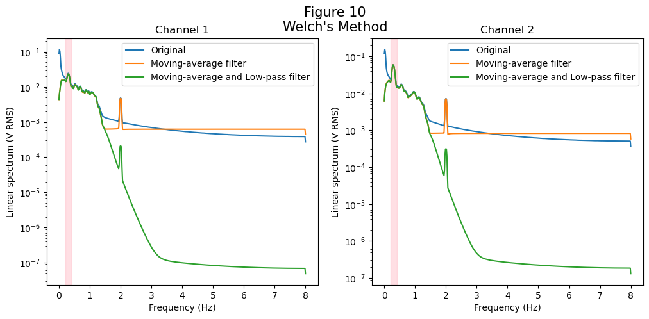
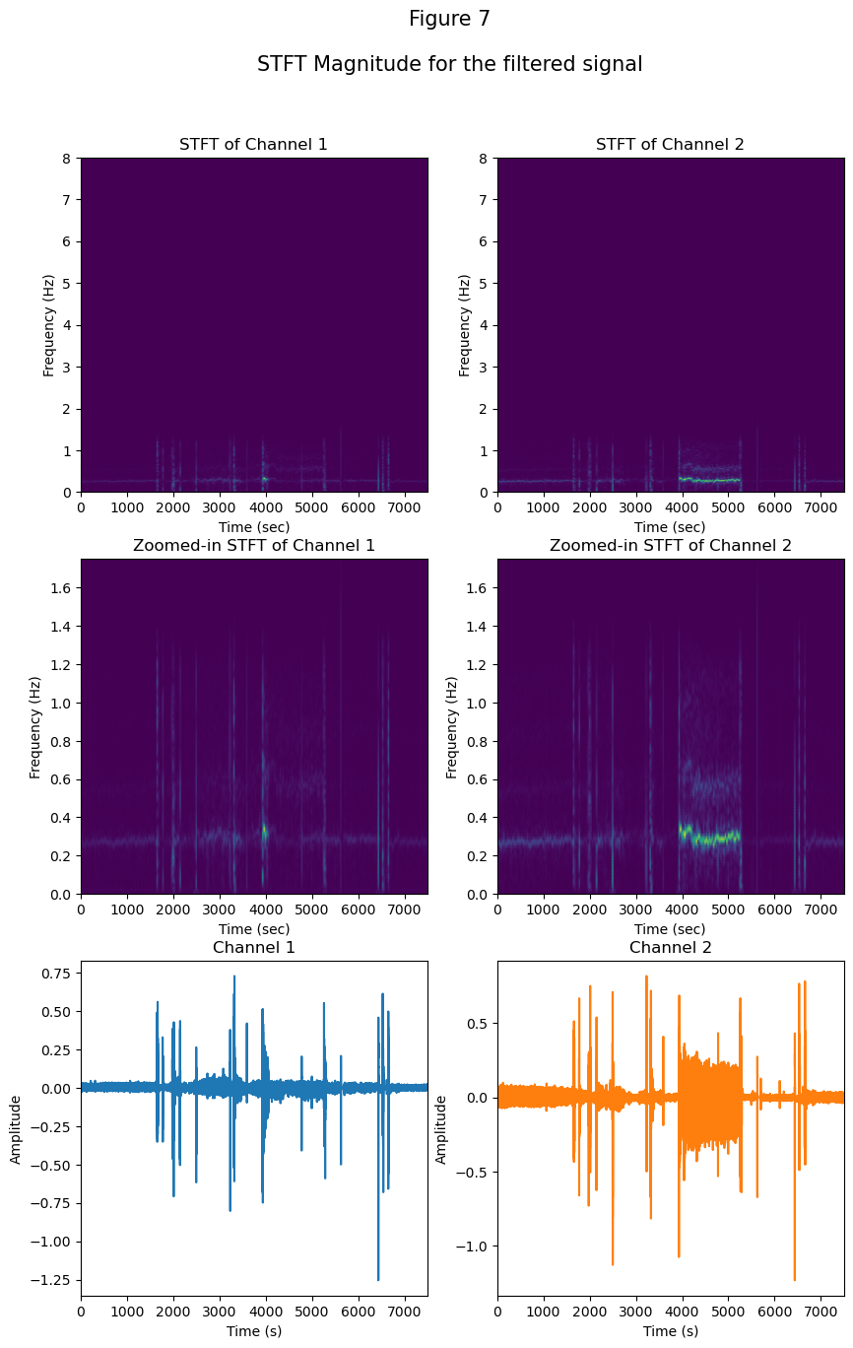
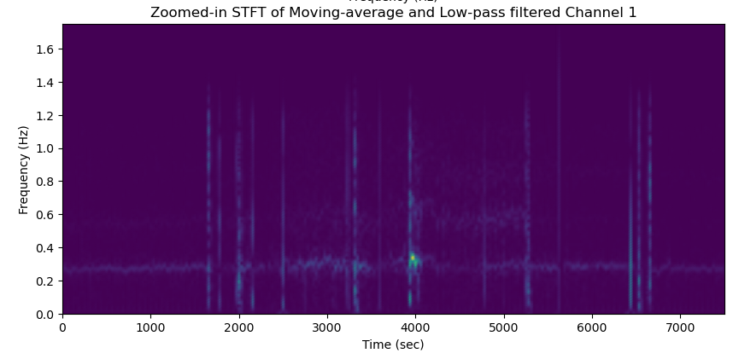
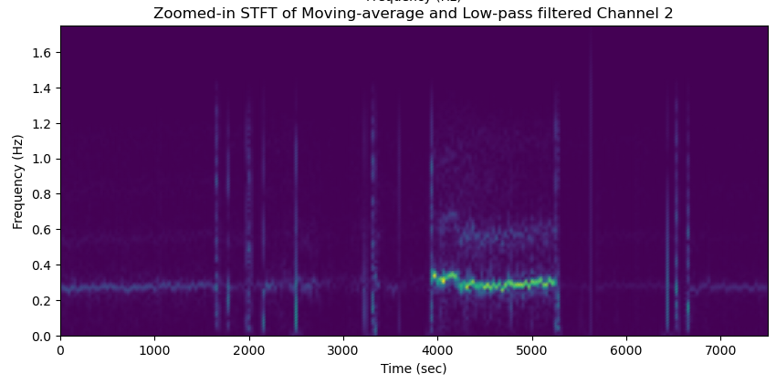
Sample results – respiration trace or other analyses

Slide 4
Challenges encountered and solution(s) identified

Slide 5
Thank you for listening
Any questions?

