Slide 1
Technical Challenge Algorithm Development, ResMed Sensor Technologies
Aoibhe Turner-Heaney

Slide 2
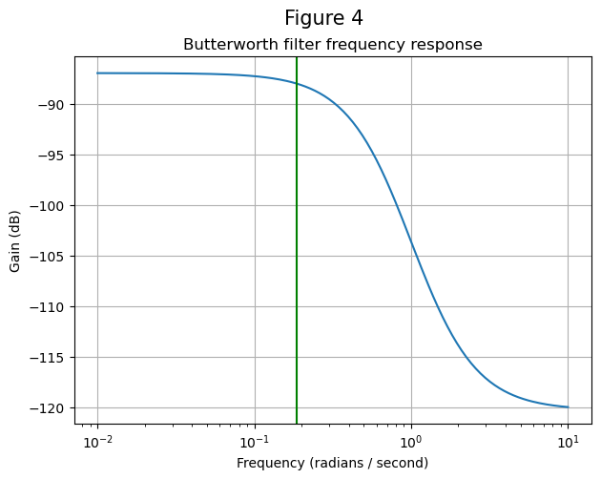
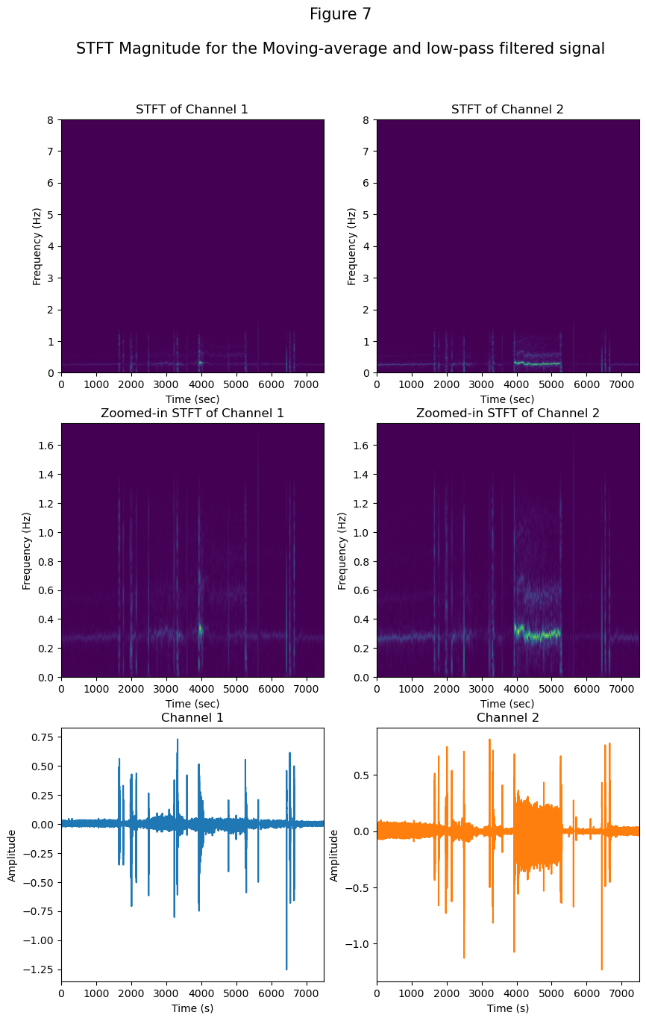
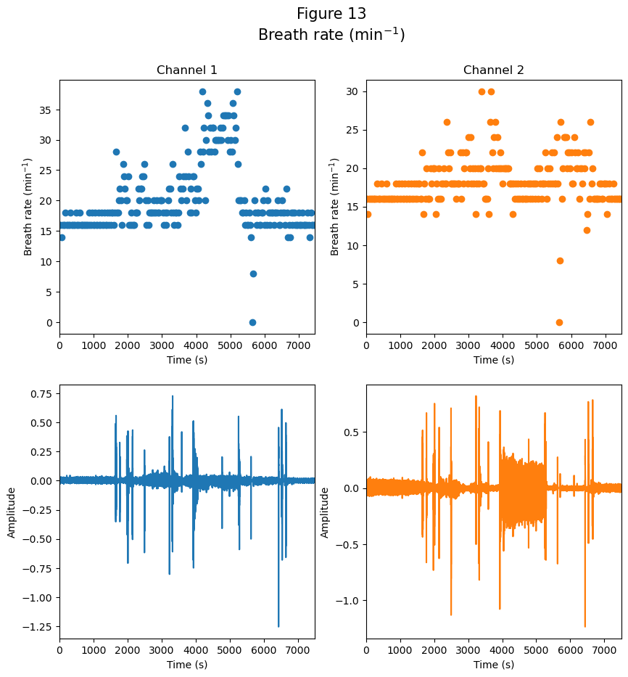
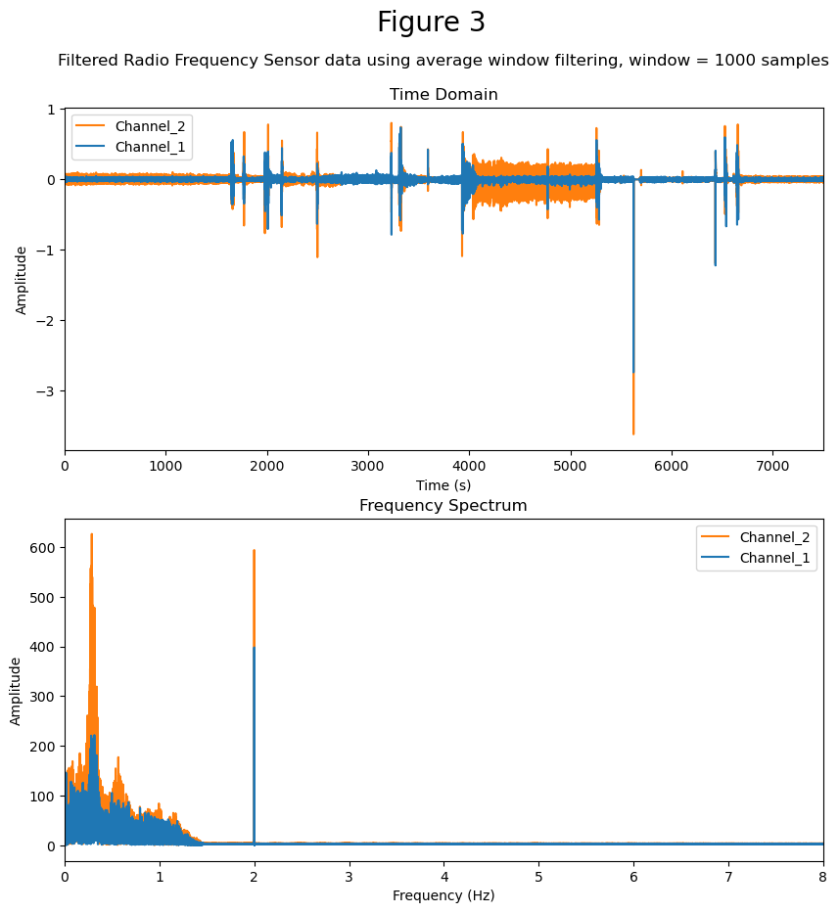
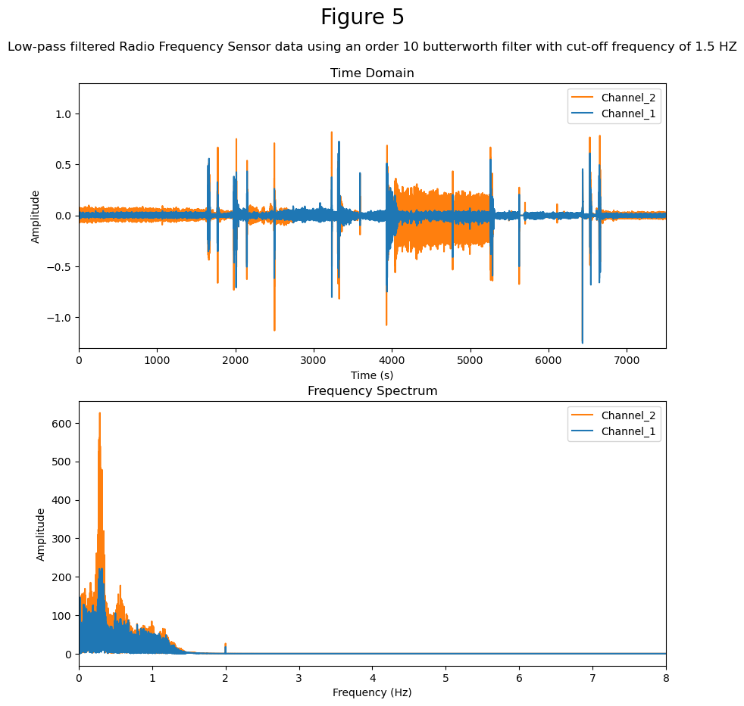
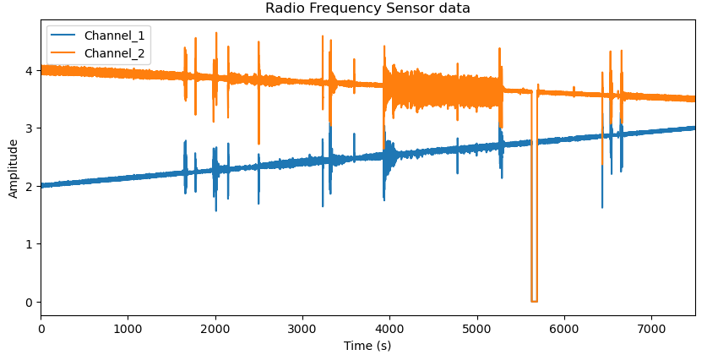
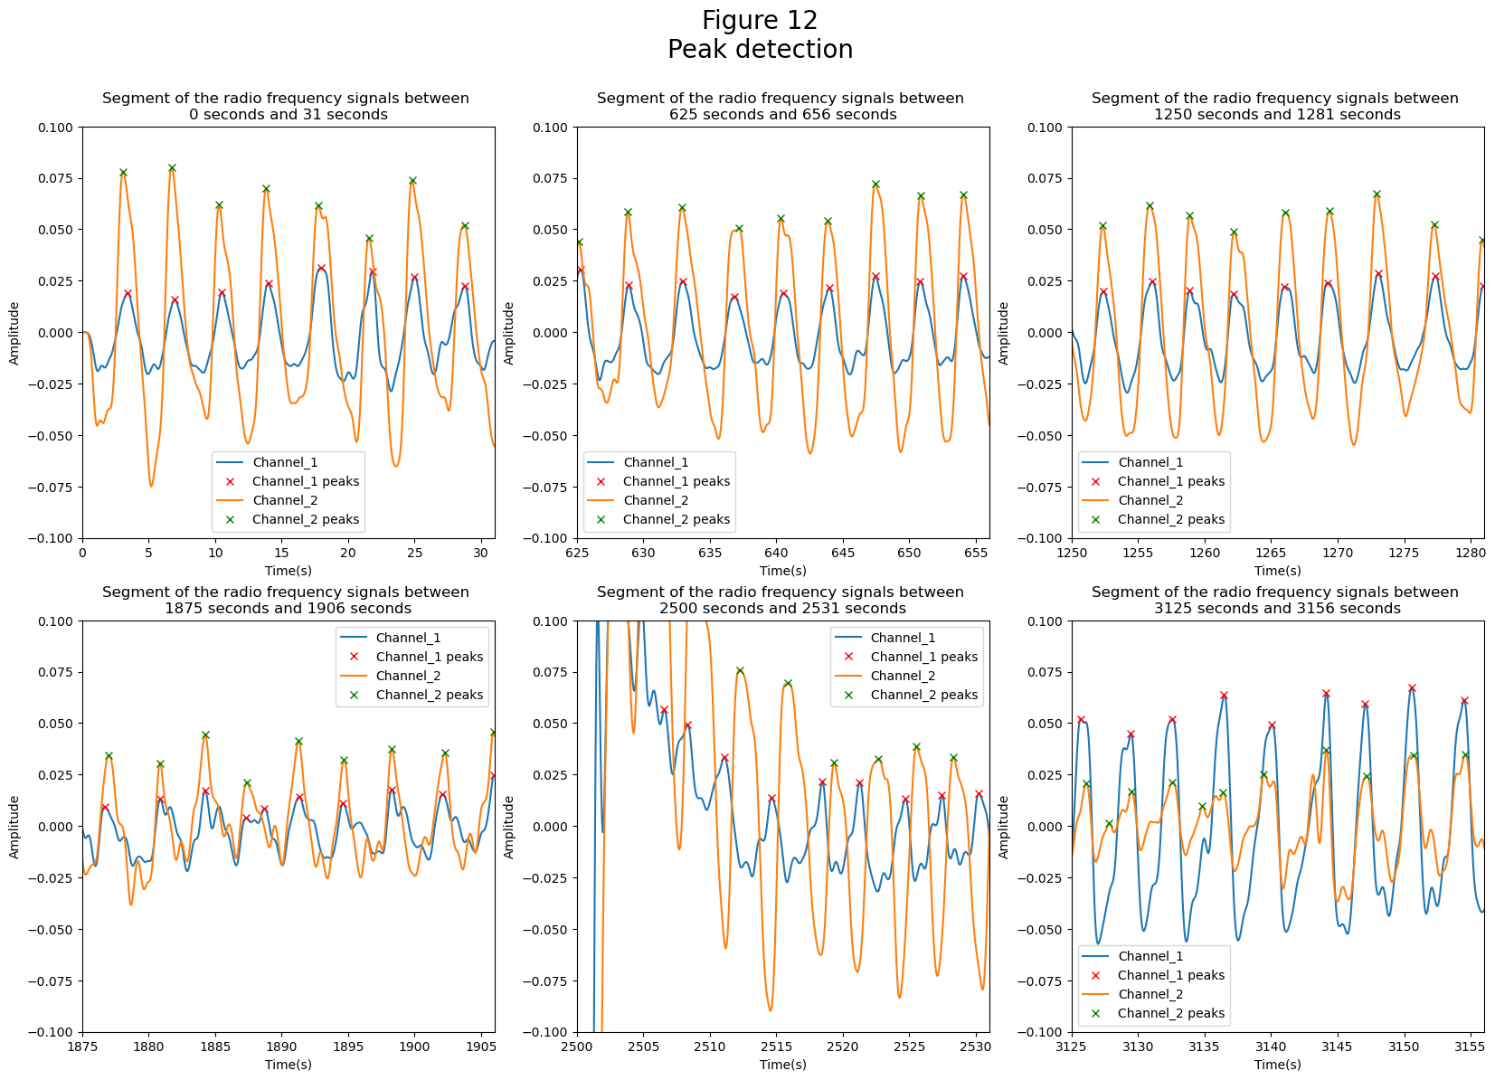
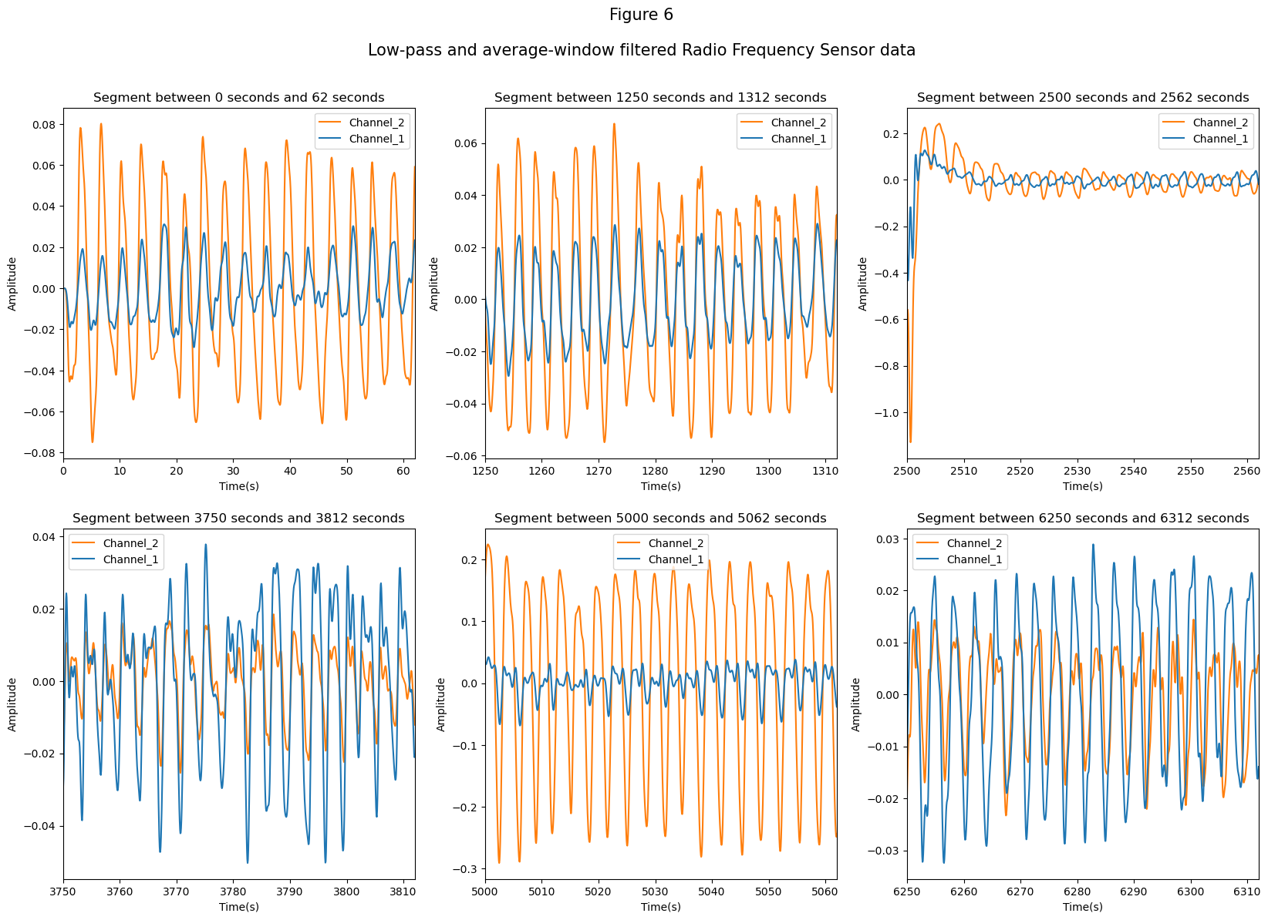
Proposed breath rate detection algorithm
Moving-average filter
(~63 seconds)
Low-pass filter
Breath peaks identified
Breath rate calculation
Original Signals
Breath rate (/min)

Slide 3
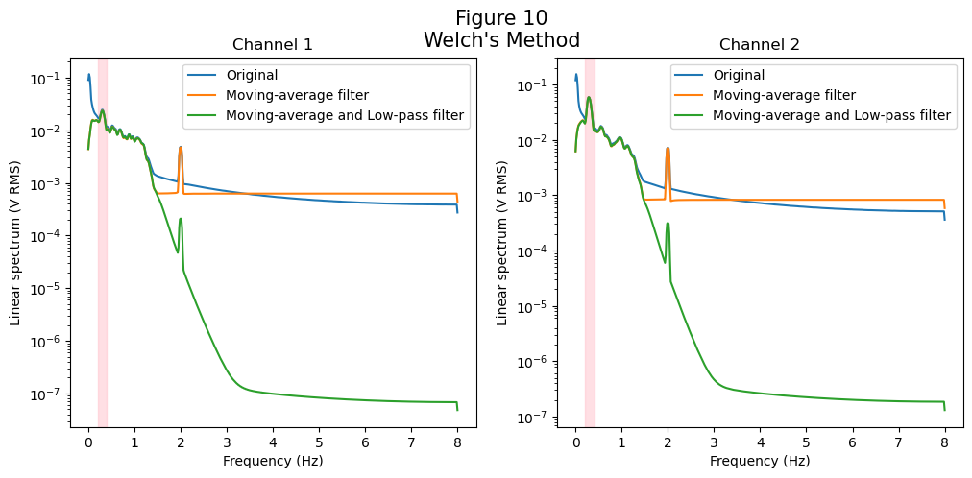
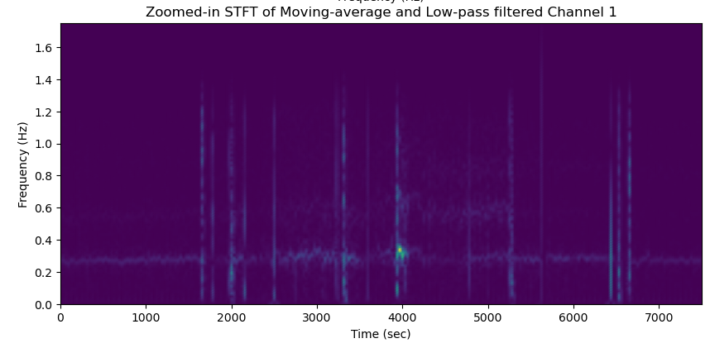
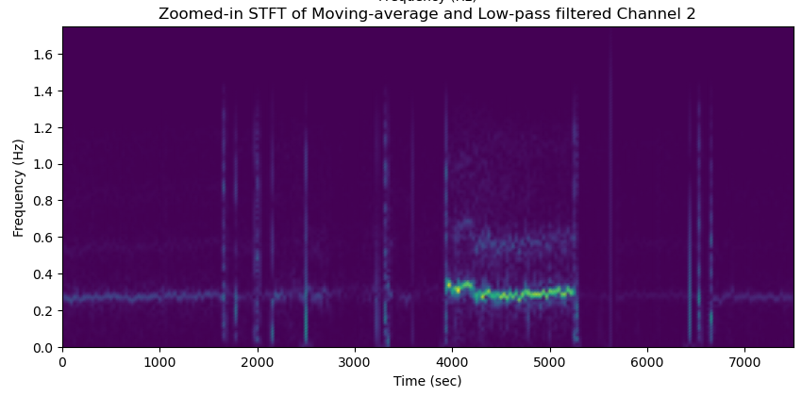
Limitations of approach
Notes:
Pros or cons of the design; alternate approaches that could be taken
Sample results – respiration trace or other analyses

Slide 4
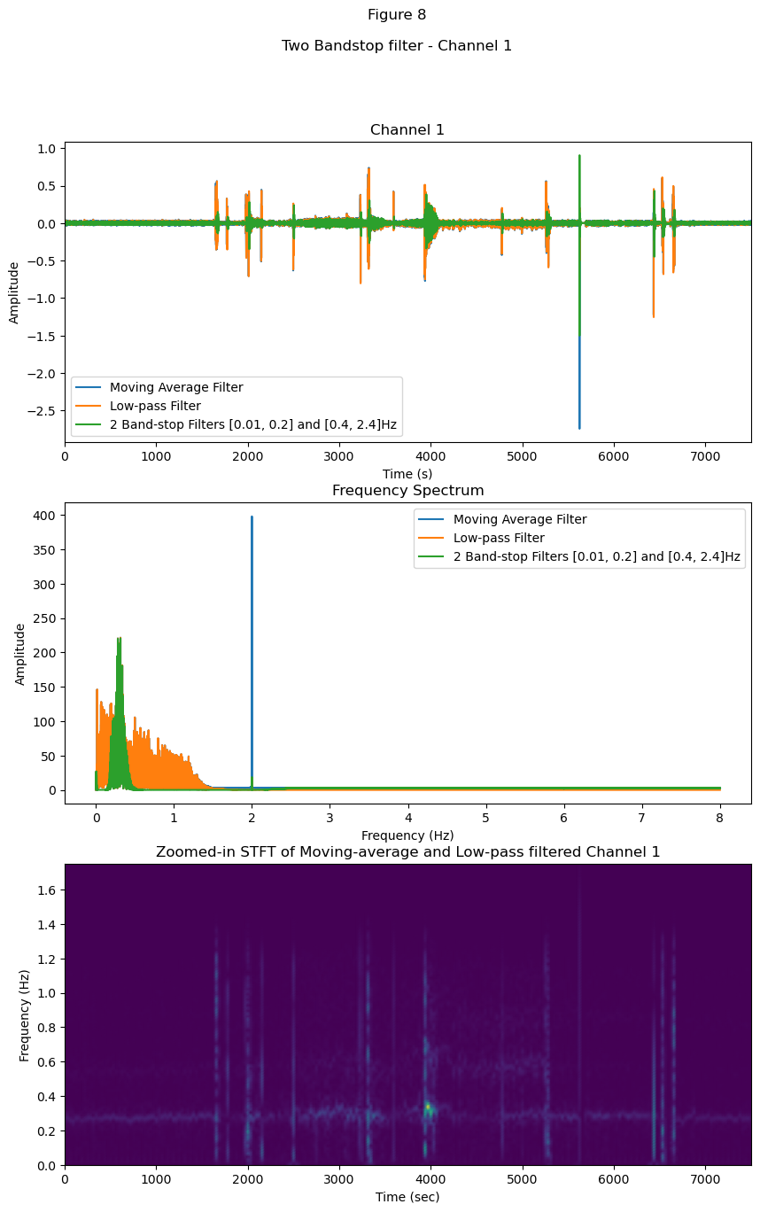
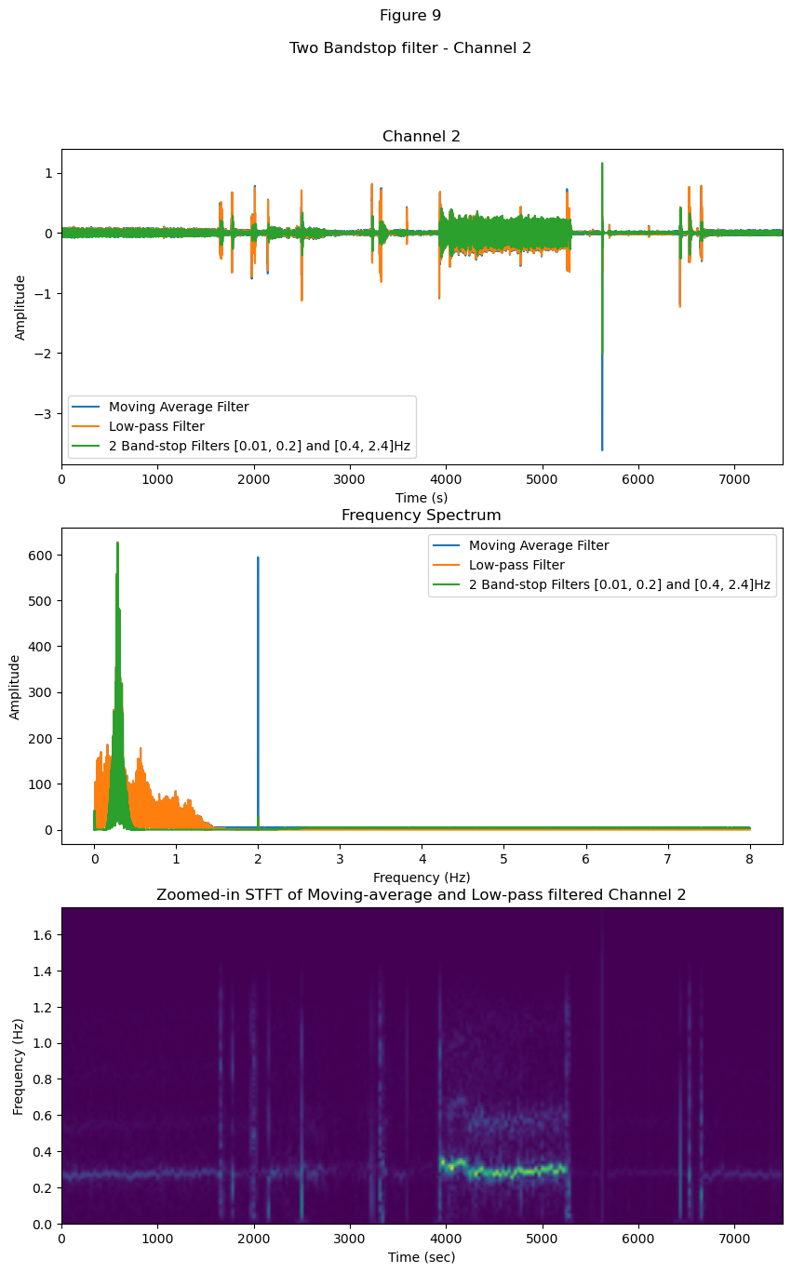
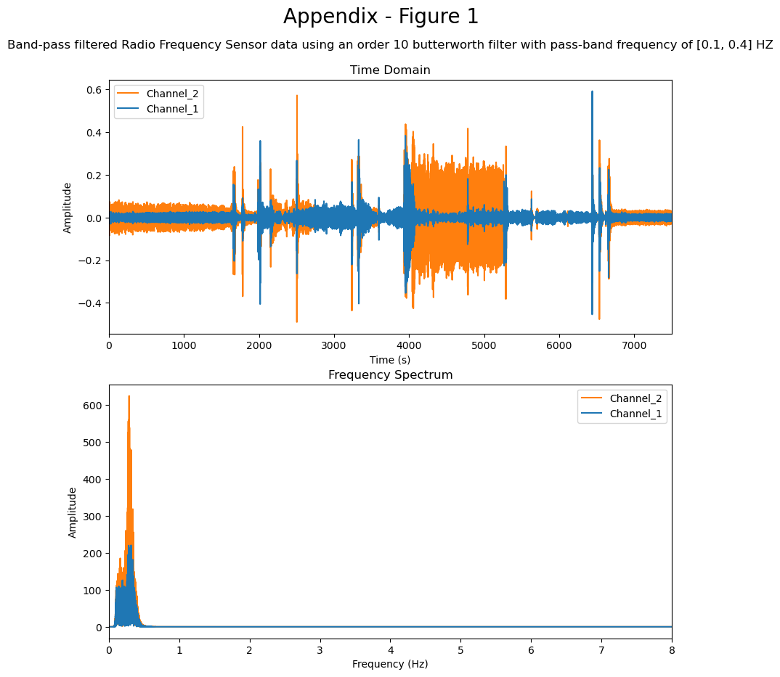
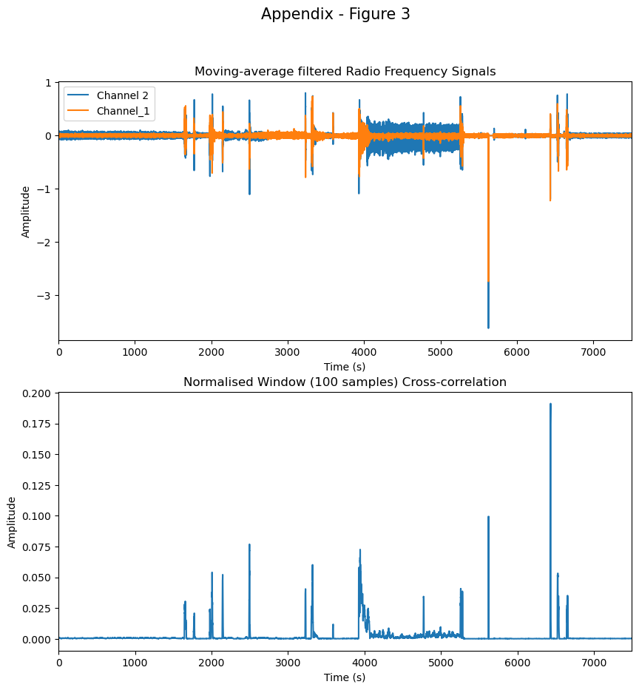
Alternative approaches
Normalised cross-correlation
+
Filter
Two bandstop filter
(0.01-0.2Hz), (0.4-2.4Hz)
A bandpass filter (0.1-0.4Hz)
Notes:
Challenges encountered and solution(s) identified

Slide 5
Thank you for listening
Any questions?

