Slide 1
A space efficient algorithm for the longest common subsequence in k-length substrings
Group13 陈雨瑶 李欣然 陈伊葶

Slide 2
Background
Definition of LCS:
Given two sequences A and B, find a subsequence of A and B whose length is the longest among all common subsequences of the two given sequences.

Slide 3
Background
Background
Basis of data comparison programs
Application
computational linguistics, bioinformatics, version-control systems(Git)……

Slide 4
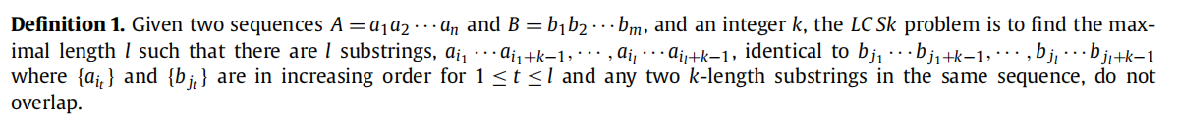
Background
Variant of LCS
Only discuss this in our report

Slide 5
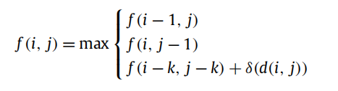


Background
Standard DP:

Slide 6
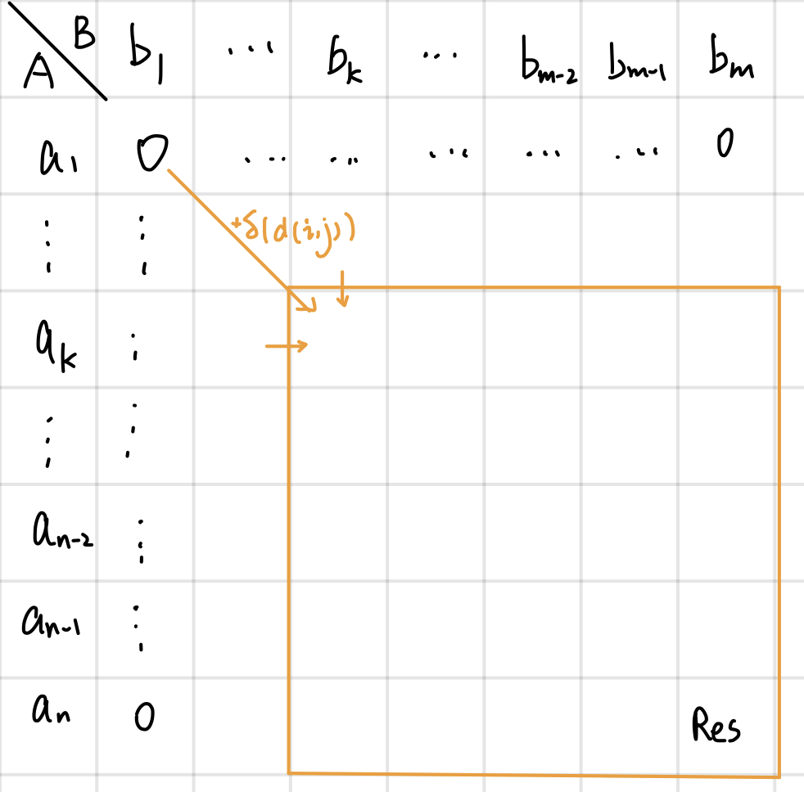
Background
Time complexity: O(mn)
Space complexity: O(mn) O(km)
Defect?

Slide 7
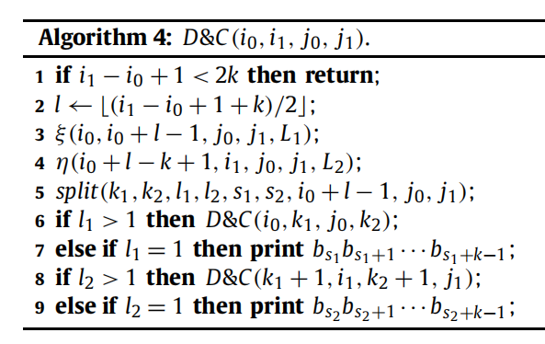
Proposed algorithm
Divide and conquer!

Slide 8
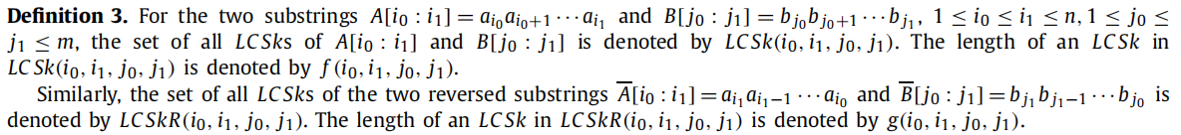
Proposed algorithm

Slide 9
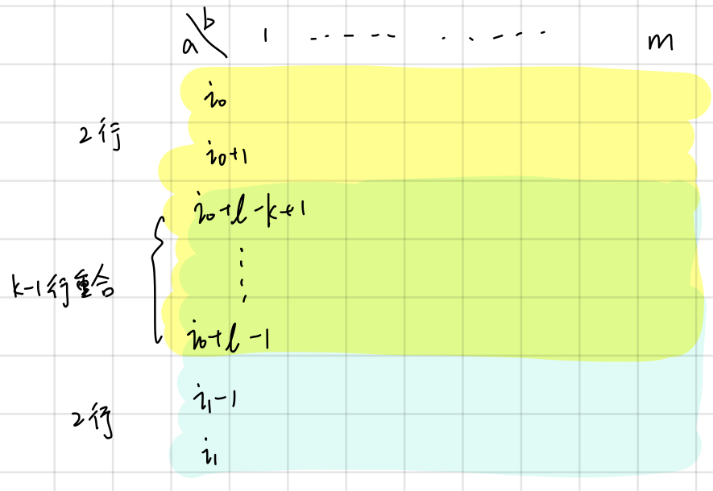
Proposed algorithm
Space efficient: only keep (k+1) rows for computing current table.
L1 keep f( · ) of LCSk, L2 keep g( · ) of LCSkR.

Slide 10
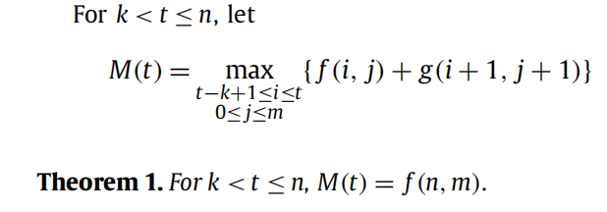
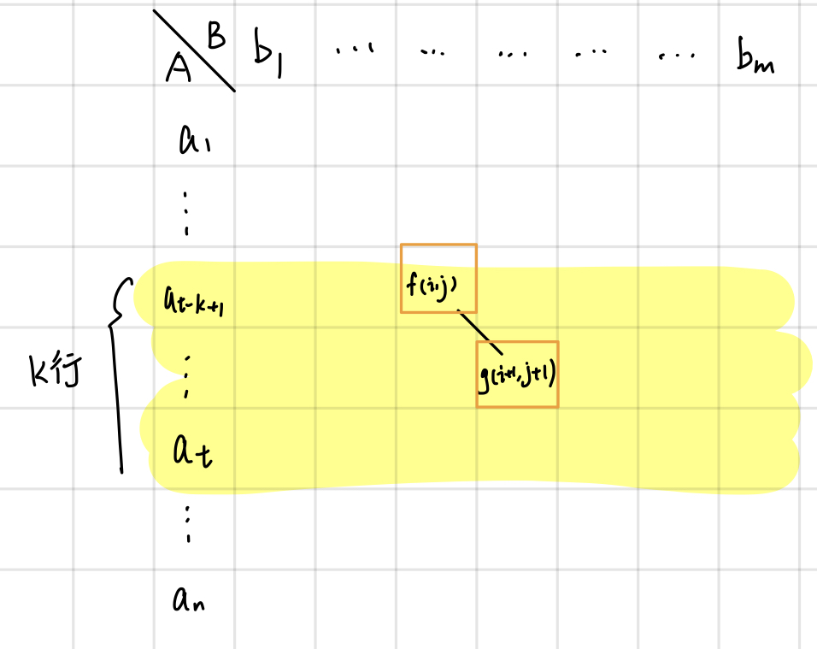
Proposed algorithm

Slide 11
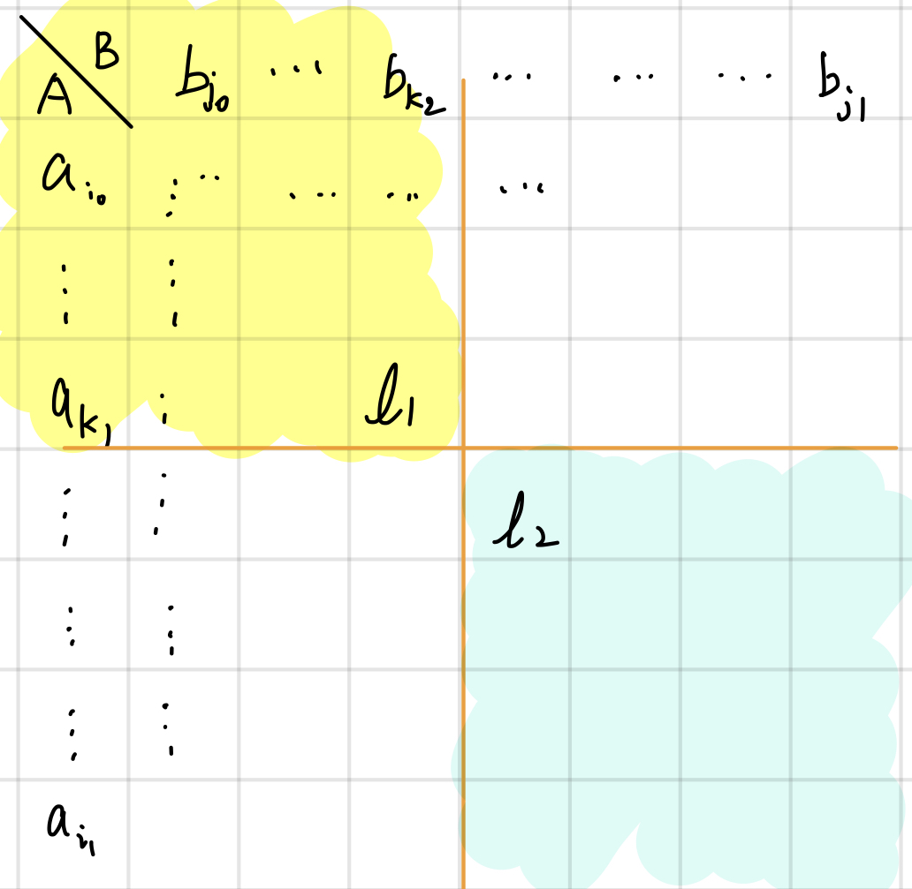
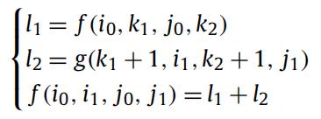
Proposed algorithm

Slide 12
Proposed algorithm

Slide 13
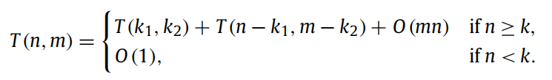
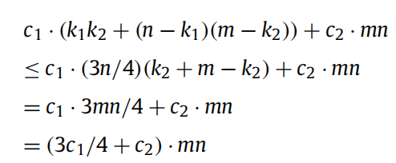

Time complexity analysis
When ,
Suppose T(n,m) is bounded by ，O(mn) is bounded by
Just let
So time complexity is O(mn)

Slide 14
Space complexity analysis
Ignore the input space for A and B.
In execution, L1 and L2 cost (k+1)m respectively. Other variables like l1,l2,k1,k2 only take O(1).
So, space complexity is O(km).

Slide 15
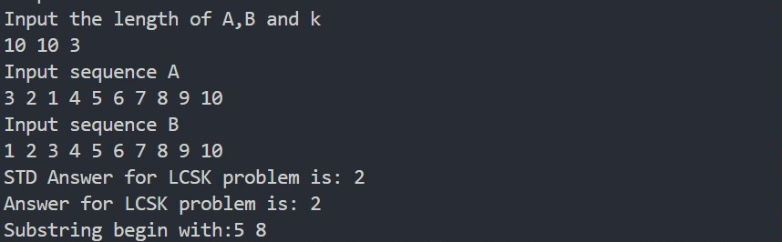
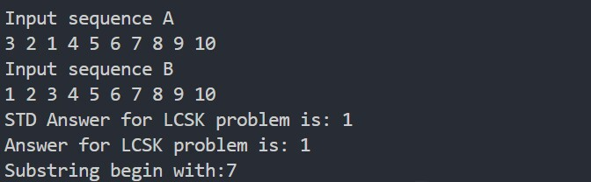
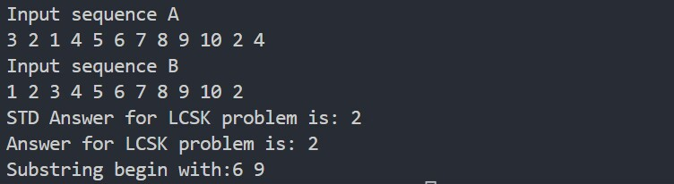
Test results

Slide 16
No further improvement.
Maybe a little…?
Labor division:
李欣然：Code
陈雨瑶、陈伊葶：Report

