Slide 1
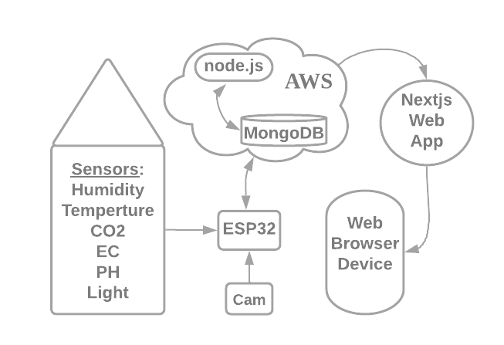
Project Grow
Summary
Aim of project is to monitor and regulate various environment variables, such as temperature, humidity, light, air and water. This is achieved by reading data from sensors on embedded system inside a grow area. Data is sent to a database where user can view via web browser.
Grow area has an automated ventilation, irrigation and artificial light system. This ensures optimum growth and allows adjusting of the environment.
Advantages:
Reduces work in grow area.
Monitors water, air and climate enabling user to control environment more effectively.
Low power system.

