Slide 1
CS 242 - CS252 Data Structures
Trees

Slide 2
Trees
One of the most important nonlinear data structures in computing.
Allow us to implement a host of algorithms much faster than when using linear data structures, such as arrays or linked lists.
Provide a natural organization for data
file systems, graphical user interfaces, databases, websites, and many other computer systems.
The relationships in a tree are hierarchical, with some objects being “above” and some “below” others (parent-child relation).

Slide 3
Tree Terminology
Root
node without parent (6)
Internal node
node with at least one child (10, 8)
Leaf (a.k.a. external node)
node without children (14, 16, 12, 32)
Ancestors of a node
parent, grandparent, grand-grandparent, etc.
Descendants of a node
child, grandchild, …
Root
6
Parent
10
8
Child
14
16
12
32
siblings
leaf

Slide 4
Tree Terminology
Depth of a node
Number of ancestors
Height of a tree
Maximum depth of any node
Subtree
Tree consisting of a node and its descendants
Degree of a node
Number of children
A
B
C
D
E
F
G
H
I
J
K

Slide 5

Tree Depth
The depth of a node $n_{i}$ is the length of the path from the root to $n_{i}$
The root node has a depth of 0
The depth of a tree is the depth of its deepest leaf
Depth= 0
6
Depth= 1
10
8
Depth= 2
14
14
12
32

Slide 6
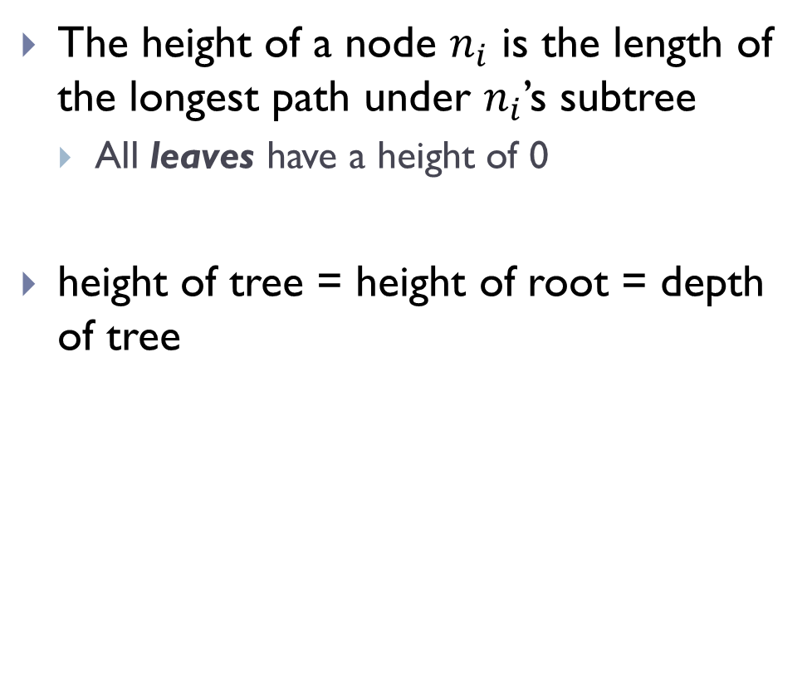
Tree Height
The height of a node $n_{i}$ is the length of the longest path under $n_{i}$’s subtree
All leaves have a height of 0
height of tree = height of root = depth of tree
Height = 3
6
Height = 1
Height = 2
10
8
Height = 1
14
14
12
32
5
Height = 0

Slide 7
Degree of a node
6
Degree = 2
Degree = 1
10
8
Degree = 3
Degree = 0
14
14
12
32

Slide 8
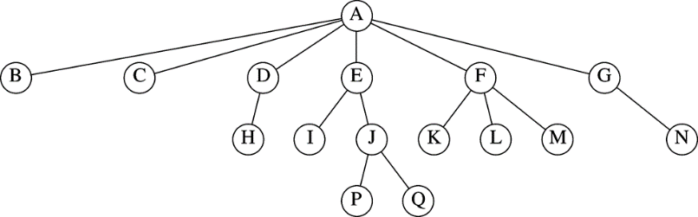
Example
Height of each node?
Height of tree?
Depth of each node?
Depth of tree?
Notes:
e.g., height(E)=2, height(L)=0
= 3 (height of longest path from root)
e.g., depth(E)=1, depth(L)=2
= 3 (length of the path to the deepest node)

Slide 9
Binary Trees

Slide 10
Binary Trees
An ordered tree with the following properties:
Each internal node has at most two children
Each child node is labeled as being either a left child or a right child.
A left child precedes a right child in the order of children of a node.
A binary tree is proper if each node has either zero or two children.
Known as full binary trees.
A
B
C
D
E
F
G
H
I

Slide 11

Binary Tree Applications
Decision Tree
Binary tree associated with a decision process
internal nodes: questions with yes/no answer
external nodes: decisions
Example
A decision tree providing investment advice.

Slide 12
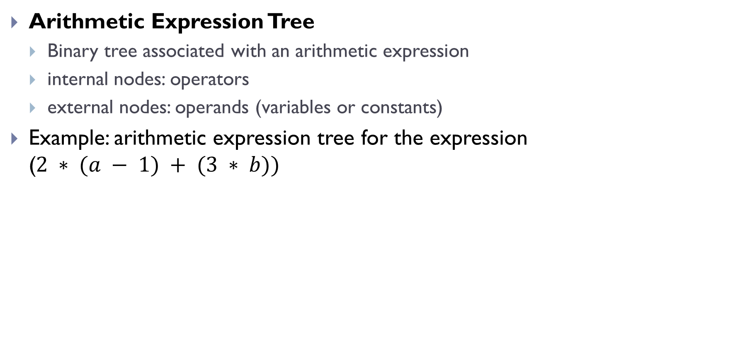
Binary Tree Applications
Arithmetic Expression Tree
Binary tree associated with an arithmetic expression
internal nodes: operators
external nodes: operands (variables or constants)
Example: arithmetic expression tree for the expression ($2 ∗ (a − 1) + (3 ∗ b))$
+
×
×
2
−
3
b
a
1

Slide 13
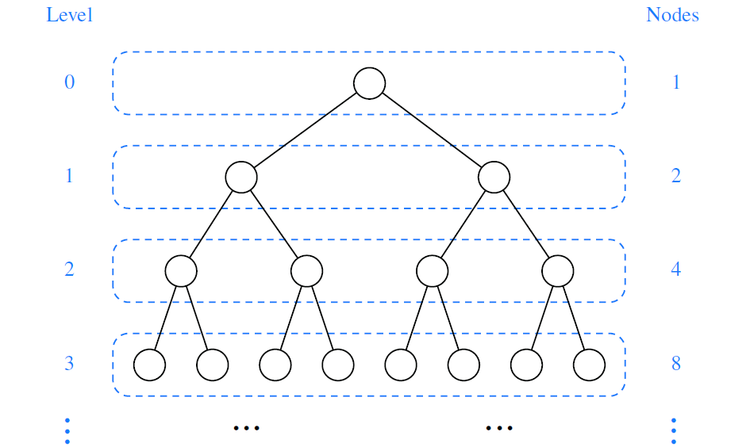

Properties of Binary Trees
Maximum number of nodes in the levels of a binary tree.
level d has at most $2^{d}$ nodes

Slide 14
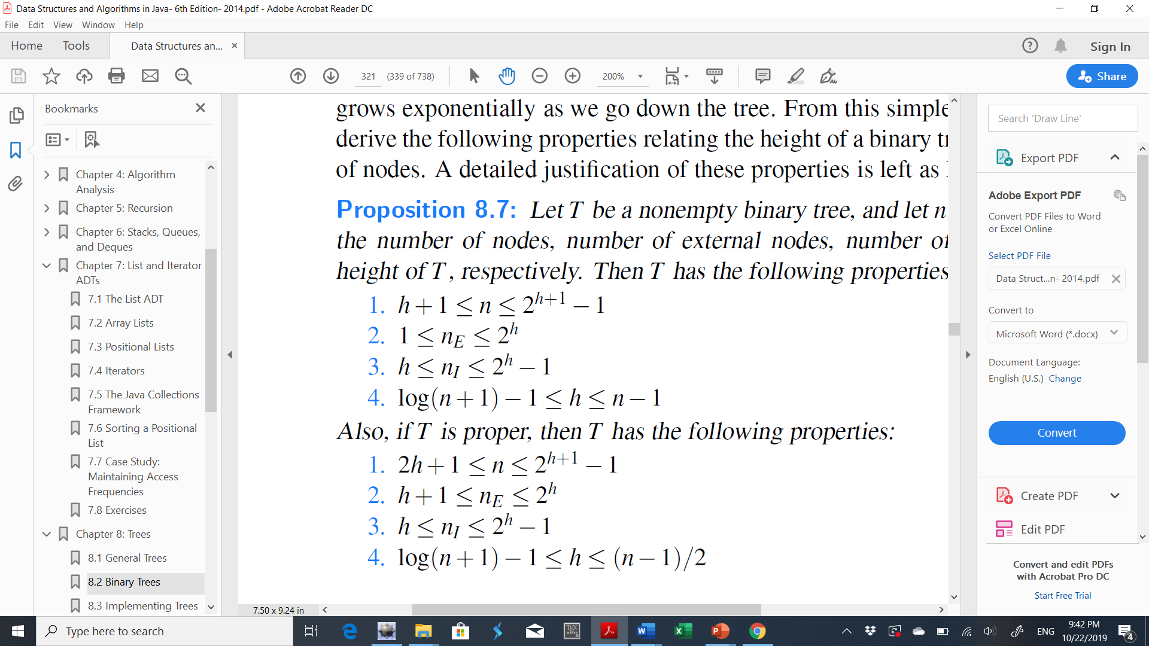
Properties of Binary Trees
Properties relating the height of a binary tree T with its number of nodes
n number of nodes
e number of external nodes
i number of internal nodes
h height

Slide 15

Properties of Proper Binary Trees
if T is proper, then T has the following properties:
In a nonempty proper binary tree T, with $n_{e}$ external nodes and $n_{i}$ internal nodes, we have $n_{e}$ = $n_{i}$ +1.

Slide 16
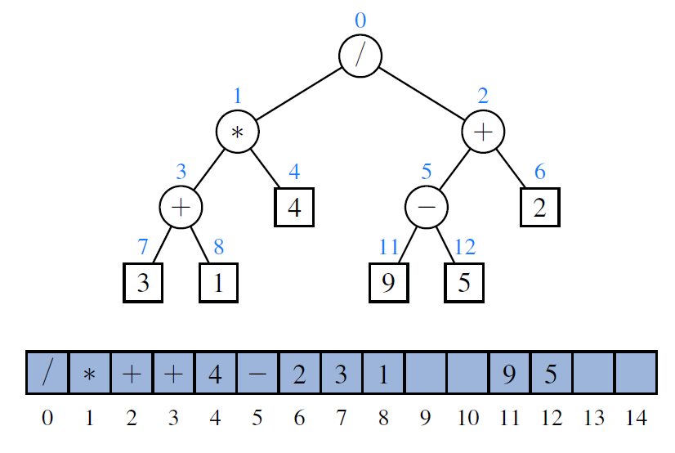
Array-Based Representation of Binary Trees
Nodes are stored in an array based on their positions in the tree.
If p is the root of the tree f (p) = 0.
If p is the left child of position q f (p) = 2 f (q)+1.
If p is the right child of position q f (p) = 2 f (q)+2.
Notes:
Drawbacks:
The space usage of an array-based representation depends greatly on the shape of the tree.
Many update operations, such as removing a node, cannot be efficiently supported.

Slide 17
Linked Binary Tree Structure
How would your store this tree?
A node is represented by an object storing
Element
Left child node
Right child node
left
element
right

Slide 18
Linked Binary Tree Structure
B
B
A
D
∅
A
∅
D
C
E
∅
C
∅
∅
E
∅

Slide 19
Linked Binary Tree Structure (Binary Tree Node)
public class BTNode<E> {
private E item;
private BTNode<E> left;
private BTNode<E> right;
public BTNode() {
item = null;
left = right = null;
}
public void setItem(E e){
item = e; }
public void setLeft(BTNode<E> n){
left = n; }
public void setRight(BTNode<E> n){
right = n;}
public E getItem(){
return item;}
public BTNode<E> getLeft(){
return left;}
public BTNode<E> getRight(){
return right;}
public boolean isLeaf() {
return (left == null && right == null);
}
}

Slide 20
Linked Binary Tree Structure (Construct Binary Tree)
BTNode<Integer> root=new BTNode<Integer>();
BTNode<Integer> l1=new BTNode<Integer>();
BTNode<Integer> r1=new BTNode<Integer>();
BTNode<Integer> l2=new BTNode<Integer>();
BTNode<Integer> r2=new BTNode<Integer>();
BTNode<Integer> r3=new BTNode<Integer>();
root.setItem(5);
l1.setItem(6);
r1.setItem(7);
l2.setItem(8);
r2.setItem(9);
r3.setItem(2);
root.setLeft(l1); root.setRight(r1);
l1.setLeft(l2); l1.setRight(r2);
r1.setRight(r3);
5
6
7
8
9
2

Slide 21
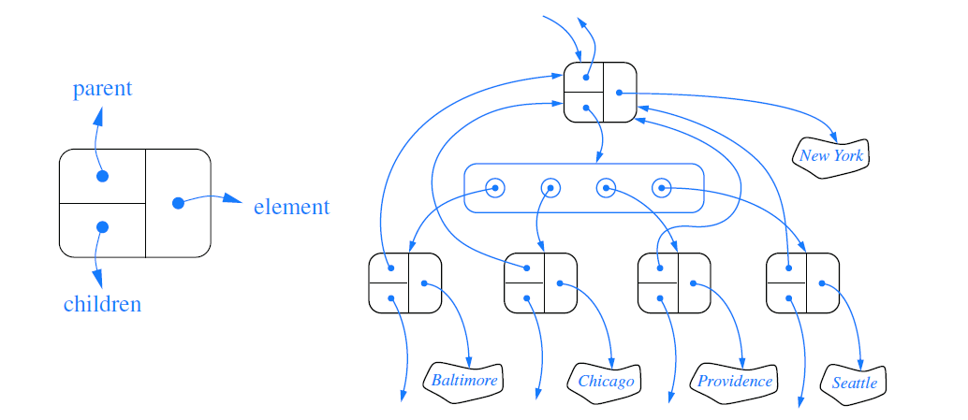
Linked Structure for General Trees
Notes:
a children field of a node can be an array or list of references to the children of the node (if any).

Slide 22
Tree Traversal

Slide 23
Traversing a Tree
Systematically visiting all tree nodes
Help find a particular node ,Help print the tree, …
Common orderings for traversals:
pre-order:
known as Depth-first Traversal
Process the node, then its left/right subtrees
in-order:
process left subtree, then the node, then right subtree
post-order:
process left/right subtrees, then root node

Slide 24
Traversal example
root
17
41
9
29
6
81
40
pre-order: 17 41 29 6 9 81 40
in-order: 29 41 6 17 81 9 40
post-order: 29 6 41 81 40 9 17

Slide 25
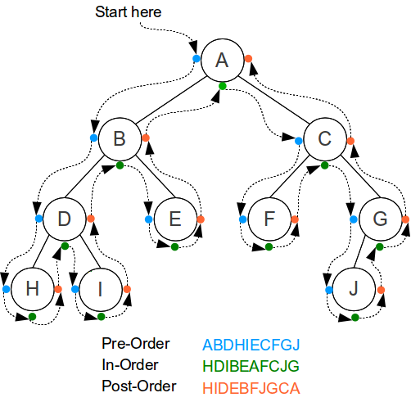
Traversal Example (Printing)
public static <E> void preOrder(BTNode<E> p) {
if (p != null) {
System.out.println(p.getItem());
preOrder(p.getLeft());
preOrder(p.getRight());
}}
public static <E> void inOrder(BTNode<E> p) {
if (p != null) {
inOrder(p.getLeft());
System.out.println(p.getItem());
inOrder(p.getRight());
}}
public static <E> void postOrder(BTNode<E> p) {
if (p != null) {
postOrder(p.getLeft());
postOrder(p.getRight());
System.out.println(p.getItem());
}}

Slide 26
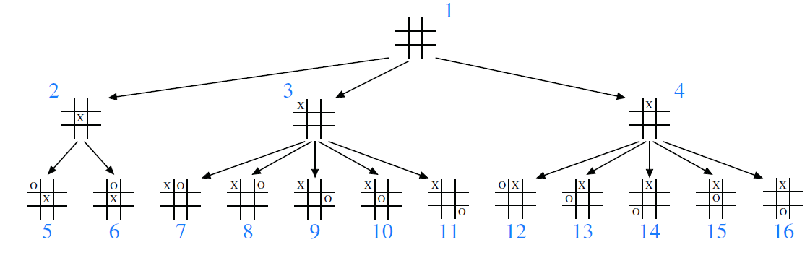
Breadth-first Traversal
Visit nodes at depth d before nodes at depth d+1
“level by level, left to right”
A common approach used in software for playing games
A game tree represents the possible choices of moves that might be made by a player (or computer) during a game
with the root of the tree being the initial configuration for the game

Slide 27
Breadth-first Traversal
Algorithm breadthfirst( ):
Initialize queue Q to contain root( )
while Q not empty do
p = Q.dequeue( ) { p is the oldest entry in the queue }
perform the “visit” action for position p
for each child c in children(p) do
Q.enqueue(c) { add p’s children to the end of the queue for later visits }

Slide 28
Expression Trees

Slide 29
Construction Expression Trees
Constructing an expression tree from postfix notation
Use a stack of pointers to trees
Read postfix expression left to right
If operand, then push on stack
If operator, then:
Create a node with operator as the element
Pop top two items off stack
Insert these items as left and right child of new node
Push pointer to node on the stack

Slide 30
Postfix To Expression Trees (Example)
E.g., a b + c d e + * *
top
top
top
top
(1)
(2)
(3)
(4)
+
+
+
c
d
e
+
c
a
b
a
b
a
b
a
b
d
e
top
top
(5)
(6)
*
+
*
+
*
a
b
c
+
a
+
b
c
d
e
d
e

Slide 31
Print Infix Arithmetic Expressions
Specialization of an inorder traversal
print “(“ before traversing left subtree
print operand or operator when visiting node
print “)“ after traversing right subtree
Algorithm printInfixExpression(n)
if isLeaf(n)
print(n.item)
else
print(“(’’)
printExpression(n.left)
print(n.item)
printExpression(n.right)
print (“)’’
End printExpression
+
×
×
2
−
3
b
a
1
((2 × (a − 1)) + (3 × b))

Slide 32
Evaluate Arithmetic Expressions
Specialization of a postorder traversal
Recursive method returning the value of a subtree
When visiting an internal node, combine the values of the subtrees
Algorithm evalExpr(n)
if isLeaf (n)
return n.item ()
else
x ← evalExpr(n.left)
y ← evalExpr(n.right)
op← n.item
return x op y
End evalExpr

Slide 33
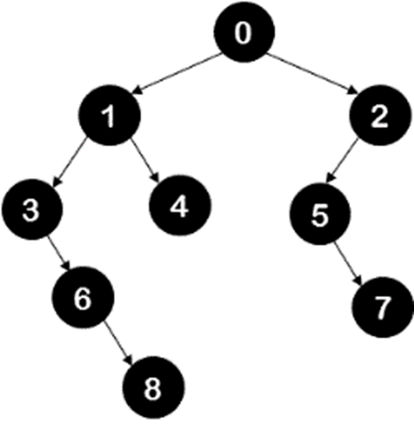
Exercises
Write an algorithm to find the sum of all nodes in a given binary tree.
Write an algorithm that counts the occurrence of a given element in a binary tree?
Write an algorithm that prints all nodes of a binary tree which do not have sibling nodes. For example in the following tree, nodes 6, 8, 5, 7 are such nodes.
Write a method that prints all the root to leaf paths of the tree. Consider the tree in Figure 1, there will be 3 paths from root to the leaves 8, 4, and 7 as given in below output: 0 1 3 6 8 0 1 4 0 2 5 7

Slide 34
Binary Search Trees

Slide 35
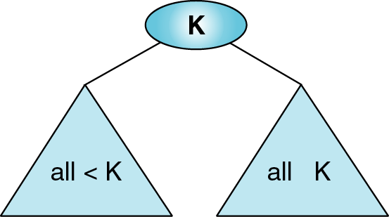
Binary Search Tree (BST)
All items in left sub-tree are less than root.
All items in right sub-tree are greater than or equal to the root.
Each sub-tree is a binary search tree.

Slide 36
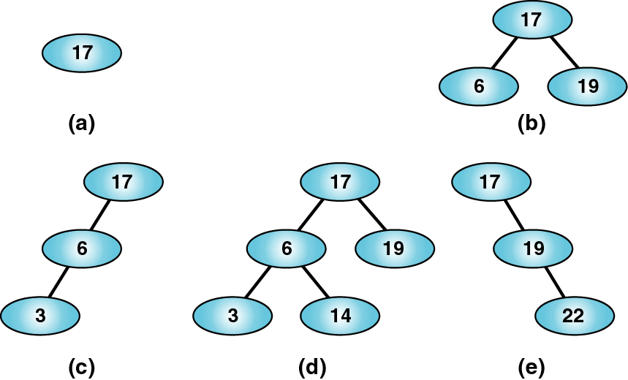
Valid BST

Slide 37
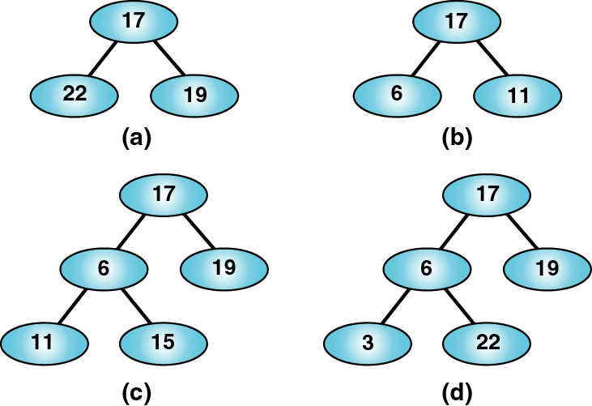
Invalid BST

Slide 38
BST Examples
Examples for BST with data integer, charecters, and string types:
26
G
Jon
15
30
E
K
Bob
Tom
4
18
32
A
F
M
Ali
Eli
Wes
38
Z

Slide 39
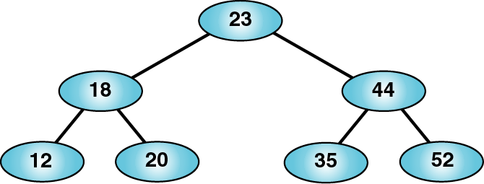
BST Traversals
A preorder traversal of the previous BST produces: 23 18 12 20 44 35 52
A postorder traversal of the previous BST produces: 12 20 18 35 52 44 23
An inorder traversal of the previous BST produces: 12 18 20 23 35 44 52
A sorted list!
An inorder traversal of a binary search trees visits the keys in increasing order.
Notes:
decreasing order

Slide 40
BST Node
public class BSTNode<K, T> {
private K key;
private T data;
private BSTNode<K,T> left;
private BSTNode<K,T> right;
/** Constructors */
public BSTNode( ) {left = right = null; }
public BSTNode(K key, T data){
this.key = key;
this.data = data;
left = right = null;
}
public BSTNode(K key, T data, BSTNode<K,T> left, BSTNode<K,T> right){
this.key = key;
this.data = data;
this.left = left;
this.right = right;
}
Key
left
right
Data

Slide 41
BST Node
/** Get and set the key value */
public K getKey() { return key; }
public void setKey(K key) { this.key = key; }
/** Get and set the data value */
public T getData() { return data; }
public void setData(T data) { this.data = data; }
/** Get and set the left child */
public BSTNode<K,T> getLeft() { return left; }
public void setLeft(BSTNode<K,T> left) {
this.left = left; }
/** Get and set the right child */
public BSTNode<K,T> getRight() { return right; }
public void setRight(BSTNode<K,T> right) {
this.right = right; }
/** return True if a leaf node, false otherwise */
public boolean isLeaf(){
return (left == null) && (right == null); }
}
Key
left
right
Data

Slide 42
Binary Search Tree ADT
Attributes:
root
Methods
search
insert
delete

Slide 43
Searching for an Item in a Binary Search Tree
Search: Algorithm for searching for an item with a key k
if k == the root node’s key, you’re done
else if k < the root node’s key, search the left subtree
else search the right subtree
20
44
55

Slide 44
Implementing Search
public class BSTree <K extends Comparable <K>, E>
{
private BSTNode<K, E> root;
public E search(K k) { // "wrapper method"
BSTNode <K,E> n = searchTree(root, k); // get Node for key
if (n == null)
return null; // no such key
else
return n.getData(); // return list of values for key
}
private BSTNode <K,E> searchTree(BSTNode<K,E> n, K key)
{
if ( )
else if ( )
else if ( )
else
}
Base cases
Recursive cases

Slide 45
Inserting an Item in a Binary Search Tree
public void insert(K key, E data)
add a new (key, data) pair to the tree
We start by searching for k.
If the tree is empty, insert the new node as the root node.
If we don’t find k, the last node seen in the search becomes the parent P of the new node N.
if k < P’s key, make N the left child of P
else make N the right child of P
Example: insert 2
26
15
30
P
4
18
32
N
2
Example:
insert 40
26
15
30
P
4
18
32
N
40

Slide 46
Implementing Tree Insertion
We will not use recursion
We will use two references:
trav: performs the traversal down to the point of insertion
parent: stays one behind trav
parent
26
trav
15
30
public void insert(K key, E data)
{
BSTNode<K,E> parent = null;
BSTNode<K,E> trav = root;
while (trav != null) {
// what should go here? }
BSTNode<K,E> newNode = new BSTNode<K,E>(key, data);
if (root == null)
root = newNode;
else if (parent.getKey().compareTo(key)>0)
parent.setLeft(newNode);
else
parent.setRight(newNode);
}
4
18
32

Slide 47
BST: Delete Node
Three Cases:
The node to be deleted has no child
The node to be deleted has only one child
The node to be deleted has two children

Slide 48
BST: Delete Node (Case 1)
Delete a node without children. Remove x from the tree by setting its parent’s reference to null.
Example: Delete 4
26
26
15
30
15
30
x
4
18
32
18
32
38
38

Slide 49
BST: Delete Node (Case 2)
Delete a node with one child. Make the parent’s reference to the child
Example: Delete 32
26
26
15
30
15
30
x
4
18
32
4
18
38
38

Slide 50
BST: Delete Node (Case 3)
Delete a node with two children. Keep the node and Replace its key and data with other node. Two options:
Smallest node in its right subtree
Largest node in its left subtree
26
26
26
15
30
Delete 15
18
30
4
30
4
18
32
4
32
18
32
38
38
38

Slide 51
BST: Delete Node cont.
Delete the node with value 6
Smallest node in its right subtree
Largest node in its left subtree
6
8
2
2
11
2
11
1
11
1
8
15
1
9
15
8
15
9
10
9
10
10

Slide 52
Implementing Deletion
public E delete(Key key) {
BSTNode<K,E> parent = null;
BSTNode<K,E> trav = root;
while (trav != null && trav.key != key) {
parent = trav;
if (key.compareTo(trav.getKey()) <0)
trav = trav.getLeft();
else
trav = trav.getRight();
}
// Delete the node (if any) and return the removed item.
if (trav == null) // no such key
return null;
else{
E removedData = trav.getData();
deleteNode(trav, parent); // call helper method
return removedData;
}
}
delete(17)
6
parent
2
25
trav
1
17
35
15
23
18
19

Slide 53
Implementing Case 3
private void deleteNode(BSTNode<K,E> toDelete, BSTNode <K,E> parent) {
if (toDelete.getLeft() != null && toDelete.getRight() != null) {
// Find a replacement – and the replacement's parent.
BSTNode <K,E> replaceParent = toDelete;
// Get the smallest item in the right subtree.
BSTNode <K,E> replace = toDelete.getRight();
// what should go here?
// Replace toDelete's key and data with those of the replacement item.
toDelete.setKey( replace.getKey());
toDelete.setData(replace.getData());
// Recursively delete the replacement item's old node. It has at most one child, so we don't have to
// worry about infinite recursion.
deleteNode(replace, replaceParent);
}
else { ... } //Case 1 & 2
}
toDelete
17
15
23
18
replace
19

Slide 54
Implementing Case 1 and 2
private void deleteNode(BSTNode <K,E> toDelete, BSTNode <K,E> parent) {
if (toDelete.getLeft() != null && toDelete.getRight() != null)
{ ... } //Case3
else {
BSTNode<K, E> toDeleteChild;
if (toDelete.getLeft() != null)
toDeleteChild = toDelete.getLeft();
else
toDeleteChild = toDelete.getRight();
// Note: in case 1, toDeleteChild will have a value of null.
if (toDelete == root)
root = toDeleteChild;
else if (toDelete.getKey().compareTo(parent.getKey())<0)
parent.setLeft(toDeleteChild);
else
parent.setRight(toDeleteChild);
}
}
18
parent
15
23
x
toDelete
18
19
toDeleteChild

Slide 55
Performance Analysis
The shape and balance of a BST is dependent on the order in which data is inserted.
Example: consider making a binary tree out of:
[35 20 55 15 60 25 40]
[55 15 35 60 25 20 40]
[60 55 40 35 25 20 15]
60
35
55
55
20
55
15
60
40
35
35
15
25
40
60
25
40
25
20
20
15

Slide 56
Performance Analysis
For a balanced tree:
search: O(logn)
insert: O(logn)
delete: O(logn)
For the most unbalanced tree (one branch has all the data):
search: O(n)
insert: O(n)
delete: O(n)
Notes:
What about traversing a BST?

Slide 57
Exercises
Write a method findMax() that returns the data with maximum key value.
Write a method findMin() that returns the data with minimum key value.
Write a method isBST() to determine if given binary tree is a binary search tree or not.

