Slide 1
Hash Tables
Chapter 10

Slide 2
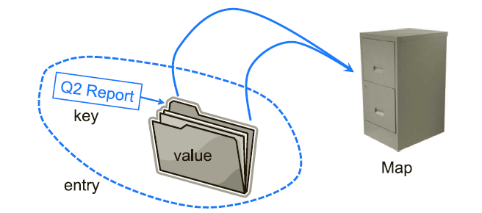
Maps
A map is an abstract data type designed to efficiently store and retrieve values using search keys.
it stores key-value (k,v) pairs
keys are unique.
Examples:
Web pages (url, page content)

Slide 3
Map ADT
size( ): Returns the number of entries in M.
isEmpty( ): Returns a boolean indicating whether M is empty.
get(k): Returns the value v associated with key k, if such an entry exists;
otherwise returns null.
put(k, v): If M does not have an entry with key equal to k, then adds entry
(k,v) to M and returns null; else, replaces with v the existing
value of the entry with key equal to k and returns the old value.
remove(k): Removes from M the entry with key equal to k, and returns its
value; if M has no such entry, then returns null.
keySet( ): Returns an iterable collection containing all the keys stored in M.
values( ): Returns an iterable collection containing all the values of entries
stored in M (with repetition if multiple keys map to the same
value).
entrySet( ): Returns an iterable collection containing all the key-value entries
in M.

Slide 4
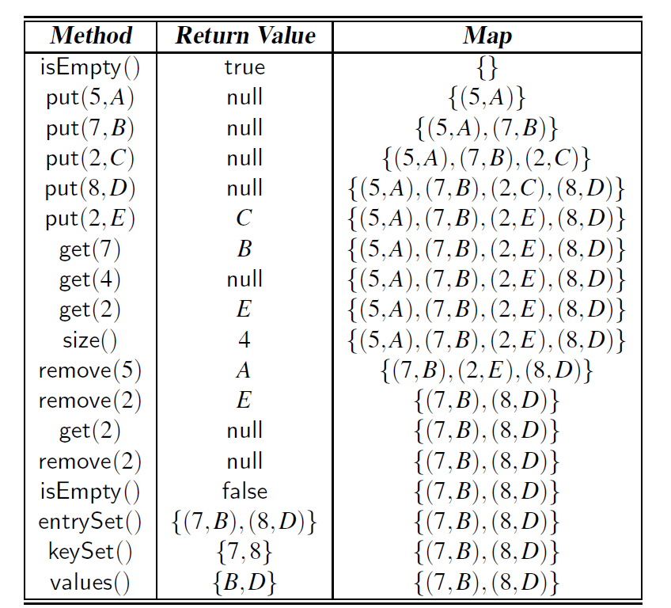
Map example

Slide 5
Map Implementations
Arrays
Not sorted get/search and remove/delete: O(n) / put/insert: O(1)
Sorted get/search O(log n) put/insert and remove/delete: O(n)
Linked-list
get/search and remove/delete: O(n) / put/insert: O(1) if not sorted and O(n) if sorted.
Binary search trees
search, insert, delete: O(n) if not balanced
O(log n) if balanced BST
Hash tables
search, insert, delete: average O(1)
No comparison of keys as in lists and BST.

Slide 6
Hashing Idea: Searching = Indexing
Use the key as an index into an array
For example: storing data about members of football team
Key= shirt number (0-99)
Class for individual player:
Store the player record in an array:
Search and insertion are O(1)
public class Player{
private int shirtNumber;
private String name;
………
}
Player [] team= new Player[100];
public Player search(int shirtNumber){
return team[shirtNumber];
}

Slide 7
Hash table
In most real word problems, indexing is not as simple as the football-team example.
To handle such problems, we need a data structure to perform hashing:
A hash function h to convert the keys into array indices.
Use techniques to handle cases in which multiple keys are assigned the same hash value
hash table
0
1
2
.
.
.
N-1
hash function
key
Hash value
Notes:
A hash function h
maps keys to integers in a fixed interval [0, N − 1]
Example: h(k) = k mod N is a hash function for integer keys
In general
h(k) = (a * k + b) mod N , where a and b are non-negative integers (in early example a=1 and b=0).
The integer h(K) is called the hash value of key x

Slide 8
Hash functions- Example 1
Insert the following integer elements to a Hash Table of size 10.
Use h(x)=x % N as a hash function.
Elements: {1, 5, 18, 24, 50}
hash table
50 | 0
1 | 1
 | 2
 | 3
24 | 4
5 | 5
 | 6
 | 7
18 | 8
 | 9
x | h(x)=x%10
1 | 1
5 | 5
18 | 8
24 | 4
50 | 0

Slide 9
Hash functions- Example 2
We design a hash table for
Storing entries as (SSN, Name)
Key: SSN (social security number) is a nine-digit positive integer
Our hash table uses
array of size N = 10,000 and
hash function: h(x) = last four digits of x
0
∅
1
025-612-0001
2
981-101-0002
3
∅
4
451-229-0004
…
9997
∅
9998
200-751-9998
9999
∅

Slide 10

Load Factor
Measures how full the hash table is.
$n$: number of entries
$N$: size of hash table
$\text{a}$ : load factor
$\text{a}= \frac{n}{N}$
Affects the performance of a hash table

Slide 11
Load factor
Example
The load factor is α = 14/16 = 0.875
0 | 1 | 2 | 3 | 4 | 5 | 6 | 7 | 8 | 9 | A | B | C | D | E | F
680 | D59 | B32 | E93 |  |  | 826 | 207 | 488 | 946 | 19A | 5BA | 74C | 3AD | ACD | C8B

Slide 12
Collisions
A collision occurs when items with different keys are assigned the same hash function.
For example
Insert 40 or 28 into hash table 1
Insert records with keys 420-000-9998 or 693-234-0002 into hash table 2
Hashtable 1
Hash table 2
50 | 0
1 | 1
 | 2
 | 3
24 | 4
5 | 5
 | 6
 | 7
18 | 8
 | 9
0
∅
1
025-612-0001
2
981-101-0002
3
∅
4
451-229-0004
…
9997
∅
9998
200-751-9998
9999
∅

Slide 13
Dealing with Collisions
Additional space (Closed addressing)
Separate Chaining
No additional space (Open addressing)
Linear probing
Quadratic probing
Double hashing

Slide 14
Dealing with Collisions 1: Separate Chaining
Each position in the hash table serve as a bucket that store multiple elements.
Linked list
Array
Simple, but requires additional memory outside the table
In separate chaining, table size equals to the number of linked lists, so α is the average length of the linked lists.
0
∅
1
025-612-0001
2
∅
3
∅
4
451-229-0004
981-101-0004

Slide 15
Dealing with Collisions 2: Open addressing
When the position assigned by the hash function is occupied, find another position.
Example: 28 has a hash code of 8, but it ends up in position 9 because position 8 is occupied.
We will consider three ways of finding an open position
Known as probing
We also perform probing when searching
50 | 0
1 | 1
 | 2
 | 3
24 | 4
5 | 5
 | 6
 | 7
18 | 8
28 | 9
Notes:
(h(x) + i) % N (i = 0, 1, 2, …)
Compute hash value and increment it until a free cell is found
If we reach the end of the array, we start at the front (bin 0)

Slide 16
Linear Probing
The probe sequence : h(key), h(key) + 1, h(key) + 2,…..
Example: h(x) = x mod 13
Insert keys 18, 41, 22, 44, 59, 32, 31, 73, in this order
Advantage: if there is an open position, linear propping will find it.
Disadvantage: get clusters of occupied position that lead to longer subsequent probes.
Probe length: the number of positions considered during a probe
k | h(k) = k mod 13 | Probes
18 | 5 | 5
41 | 2 | 2
22 | 9 | 9
44 | 5 | 5,6
59 | 7 | 7
32 | 6 | 6,7,8
31 | 5 | 5,6,7,8,9,10
73 | 8 | 8,9,10,11
41
18
44
59
32
22
31
73
0
1
2
3
4
5
6
7
8
9
10
11
12

Slide 17
Clustering problem
Primary clustering: entries being placed close together by probing, which degrades hash table's performance (find/insert/delete)
add 89, 18, 49, 58, 9
now searching for the value 28 will have to check half the hash table! no longer constant time...
0 | 49
1 | 58
2 | 9
3
4
5
6
7
8 | 18
9 | 89

Slide 18
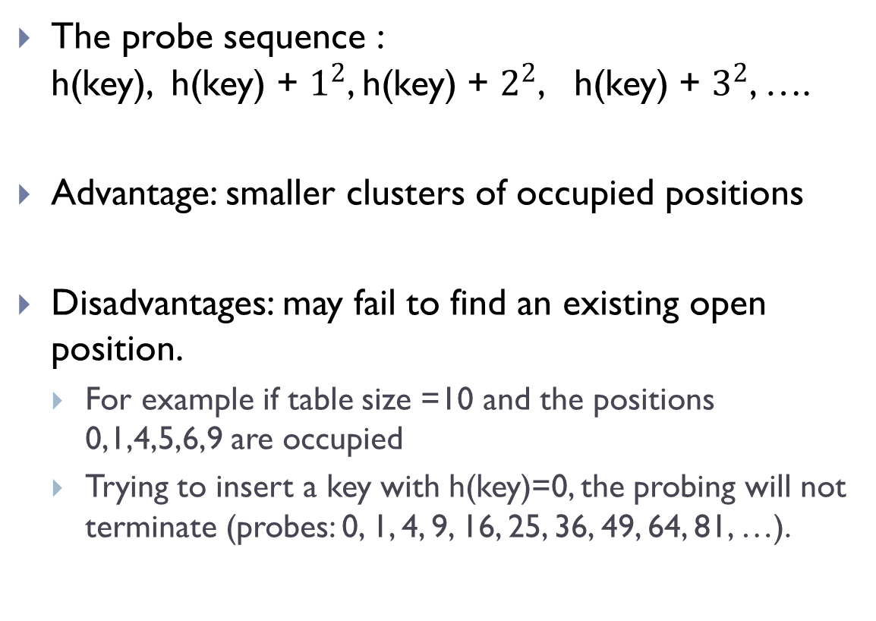
Quadratic Probing
The probe sequence : h(key), h(key) + $1^{2}$, h(key) + $2^{2}$, h(key) + $3^{2}$, ….
Advantage: smaller clusters of occupied positions
Disadvantages: may fail to find an existing open position.
For example if table size =10 and the positions 0,1,4,5,6,9 are occupied
Trying to insert a key with h(key)=0, the probing will not terminate (probes: 0, 1, 4, 9, 16, 25, 36, 49, 64, 81, …).
insert(14)
14%7 = 0
insert(8)
8%7 = 1
insert(21)
21%7 =0
insert(2)
2%7 = 2
0
14
0
14
0
14
0
14
1
1
8
1
8
1
8
2
2
2
2
2
3
3
3
3
4
4
4
21
4
21
5
5
5
5
6
6
6
6
1
1
3
1
Number of probes

Slide 19
Quadratic Probing
How can we be sure that quadratic probing always terminates?
Theorem: if a is α < 0.5, and N is prime, then we can always find an empty slot.
Reduce clustering near the key location
But it could still form “secondary clustering” along the path of probing.
But it is not as bad as primary clustering in linear probing

Slide 20
Double Hashing
To reduce secondary clustering, use two hash functions:
h: computes the hash code
d: computes the increment for probing
probe sequence: h(key), h(key) + 1 * d(key), h(key) + 2 * d(key), h(key) + 3 * d(key), ….
d(key) is called the secondary hash function
Combines good features of linear and quadratic:
reduces clustering
will find an open position if there is one, provided the table size is a prime number

Slide 21
Example of Double Hashing
Insert 18, 41, 22, 44, 59, 32, 31, 73
N = 13
h(k) = k mod 13
d(k) = 7 - k mod 7
K | h(k) | d(k) | Probes
18 | 5 |  | 5
41 | 2 |  | 2
22 | 9 |  | 9
44 | 5 | 5 | 10
59 | 7 |  | 7
32 | 6 |  | 6
31 | 5 | 4 | 5 9 0
73 | 8 |  | 8
31
41
18
32
59
73
22
44
0
1
2
3
4
5
6
7
8
9
10
11
12
Notes:
Stop

Slide 22
Delete Elements Under Open addressing
Example: Insert keys 18, 41, 22, 44, 59, 32, 31, 73
linear probing: h(x) = x mod 13
k | h(k) | New location
18 | 5
41 | 2
22 | 9
44 | 5 | 6
59 | 7
32 | 6 | 8
31 | 8 | 10
73 | 8 | 11
Remove 18
search 44
41
18
44
59
32
22
31
41
44
59
32
22
31
73
Return null
73
0
1
2
3
4
5
6
7
8
0
1
2
3
4
5
6
7
8
9
10
11
12
9
10
11
12

Slide 23
Empty vs. Removed
There are three different states at each slot
Occupied
Deleted
Empty
When a value is removed from linear probed hash table, we just mark the status of the slot as “DELETED/DEFUNCT”, instead of empty slot.
use a state array of size same as the hash table
Or, leave the Entry object in the table and set the Entry object's key and values fields to null
4000
4000
Ahmad
Ahmad
0
1
0
0
1
0
1
0
1
null
1003
1
0
1
null
2
0
2
null
Sara
2
0
2
null
3
3
remove (1003)
1
3
-1
3
4
1
4
3003
4
1
4
3003
5
5
Nora
5
Nora
1
1
5
.
.
.
.
.
.
4005
.
.
.
4005
Ali
Ali
4000
Ahmad
4000
0
Ahmad
1
null
0
1003
remove (1003)
2
null
Sara
1
null
null
3
2
null
null
4
3003
3
5
Nora
4
3003
.
.
.
Nora
4005
5
Ali
4005
Ali
Notes:
Note the difference:
• a truly empty position has a value of null in the table
• a removed position refers to an Entry object whose
key and values fields are null

Slide 24
Delete Elements Under Open addressing
remove(k)
We search for an entry with key k
If such an entry (k, o) is found, we replace it with the special item DEFUNCT and we return element o
Else, we return null

Slide 25
Insertion with Linear Probing
put(k, o)
start at cell h(k)
probe consecutive cells until one of the following occurs
A cell i is found that is either empty or DEFUNCT
We store (k, o) in cell i

Slide 26
Search/retrieve with Linear Probing
get (k):
Testing for membership is similar to insertions:
Start at the appropriate bin, and searching forward ( even through defunct value) until
The item is found,
An empty bin is found, or
We have traversed the entire array

Slide 27
Performance of Hashing
The “expected” time complexity for get/put/remove
O(1)

Slide 28
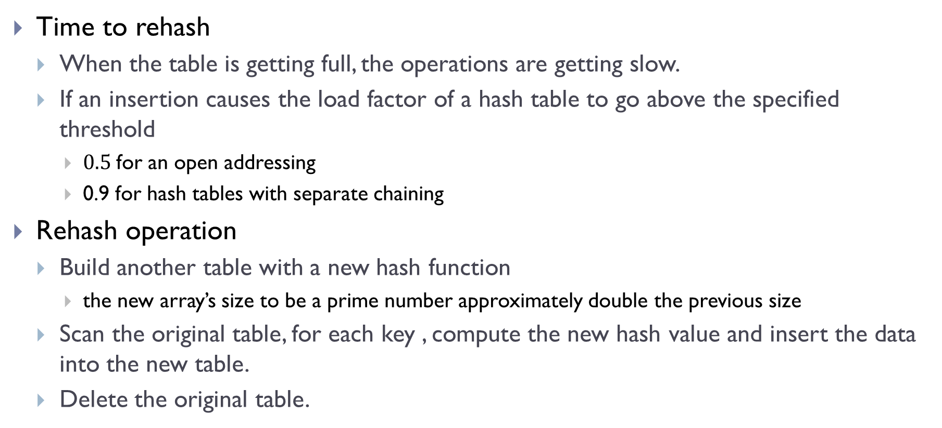
Rehash
Time to rehash
When the table is getting full, the operations are getting slow.
If an insertion causes the load factor of a hash table to go above the specified threshold
$0.5$for an open addressing
0.9 for hash tables with separate chaining
Rehash operation
Build another table with a new hash function
the new array’s size to be a prime number approximately double the previous size
Scan the original table, for each key , compute the new hash value and insert the data into the new table.
Delete the original table.

Slide 29
Drawbacks of Hash tables
Hash tables have no ordering information!
Expensive to do following:
getMin, getMax, removeMin, removeMax,
Printing items in sorted order

Slide 30
Exercise 1
Consider the following values: 78,11, 9,15, 13
Show the result of inserting these values into a hash table with 8 positions for each of the three scenarios below:
Modulo-division method. For collision use Linked list resolution.
Digit Extraction Method (right most digit). For collision use: linear probe.
0
1
17
2
3
4
5
21
6
7

Slide 31
Exercise 2
Draw the contents of a hash table given the following:
The size of the table is 11.
Open addressing and double hashing are used to resolve collisions.
The hash function used is H(k) = k mod 11
The second hash function is H2(k) = 5 – (k mod 5)
What values will be in the hash table after the following sequence of insertions?
16, 23 9, 34, 12, 56

Slide 32
Exercise 3
Assume a hash table of 10 positions with the hash function:
Show the results of inserting the following series of keys : 6, 31, 46, 66, 47. Handle collisions by Linear probe.
Calculate the Load factor α.
Show the steps of searching the key “5”.
int hash(int key)
{
int result;
result =key * key;
while(result >= 10)
result = result / 10;
return result;
}

