Slide 1

Welcome to the
Auckland

Slide 2










A BIG thank you to the 2019 Global Sponsors!

Slide 3

Another BIG thank you to local sponsors!

Slide 4
2019 GAB Auckland Information Site
Agenda, session details, lab information is available on this site:
bit.ly/aucklandgab19
Please Bookmark it!

Slide 5
2019 GAB Auckland Catering
Morning Tea: One pastry each
Light Lunch
Afternoon Tea: Not provided
All day tea and coffee.
One pastry and one lunch item per person please as there is no extra!
If you specified a dietary requirement, your food will have your name on it.
We have done our best to meet your requirements.
Catering is kindly provided by

Slide 6
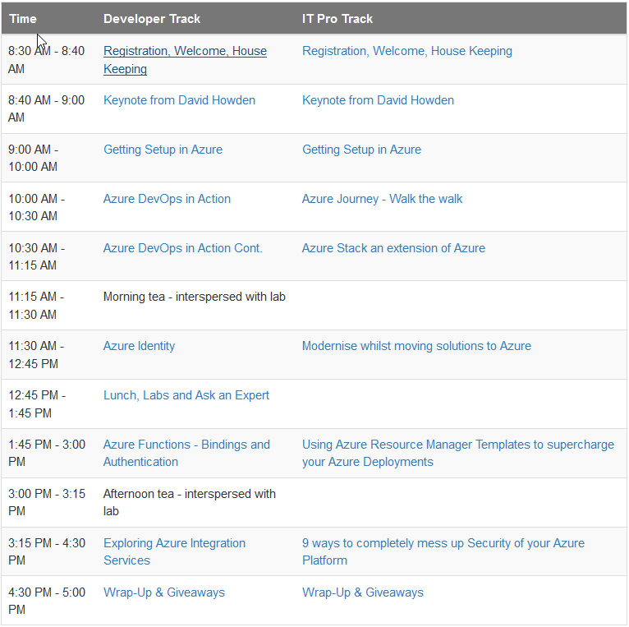
2019 GAB Auckland Agenda

