Slide 1
Computer Graphics
Lecture 01
Fasih ur Rehman

Slide 2
About Instructor
MSc in Electronics and MSc in Systems Engineering in 1994 and 1996 respectively from Quaid-e-Azam University and currently pursuing PhD from CIIT
Worked for Software Industry (developing engineering application) for 5+ years in Pakistan and abroad as well.
Joined CIIT Wah Campus in 2003 as Assistant Professor and worked at various academic and administrative positions since then
Research Interests Mathematical Modeling, Computational Electromagnetics

Slide 3
Today’s Agenda
Introduction to the Course

Slide 4
Course Contents
Overview of Computer Graphics; Uses of Computer Graphics in various fields.
Drawing Elementary Figures. Two dimensional Geometric Transformations and viewing; Three dimensional Transformations and modeling.
Graphical User Interfaces (GUI)

Slide 5
Recommended Books
Introduction to COMPUTER GRAPHICS by Anirban Mukhopadhyay , Arup Chattopadhyay
Fundamentals of Computer Graphics Third Edition by Peter Shirley and Steve Marschner

Slide 6
Learning Outcome
After successful completion a student should be able to
identify various application areas of the graphics
define basic terminology of computer graphics
differentiate various graphic areas
characterize output and input devices for their effective use in the area
understand and use various transformations
construct elementary shapes on computer
generate 3-D models on computer

Slide 7
A phrase
“A picture is worth a thousand words”
“A picture paints a thousand words”
Chinese version is
“One picture is worth ten thousand words”

Slide 8
What are Computer Graphics
The study of using computers to create and manipulate images is called Computer Graphics
In true sense the subject requires rigorous background in Linear Algebra especially Matrices.

Slide 9
Areas

Slide 10
Graphics Areas
The area of Computer graphics that deals with the mathematical specification of shape and appearance properties in a way that can be stored on the computer is called Modeling.
The creation of shaded images from 3D computer models is called Rendering.
Modeling of interaction of light with matter is called Illumination.
The technique to create an illusion of motion through sequences of images is referred to as Animation.

Slide 11
Why Computer Graphics
With emergence of usage of computers in almost every wake of life, the area of Computer Graphics has earned huge importance because of its utility and simplicity.

Slide 12
Applications

Slide 13
Entertainment
Video Games
Cartoons
Animated Films

Slide 14
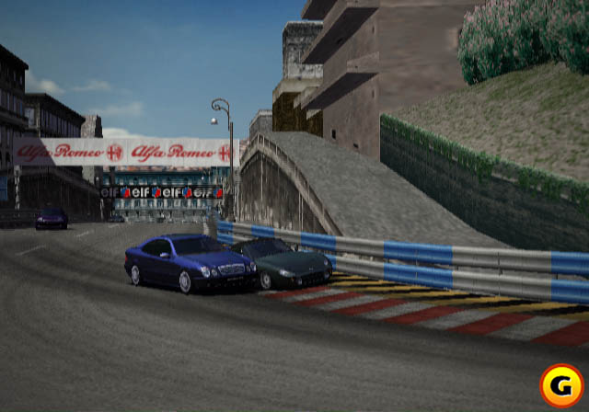
Video Games
Polyphony Digital: Gran Turismo 3, A Spec

Slide 15
Entertainment
Video Games
Cartoons
Animated Films

Slide 16


Cartoons
A Bug’s Life (Pixar)
Pixar: Monster’s Inc.

Slide 17
Entertainment
Video Games
Cartoons
Animated Films

Slide 18
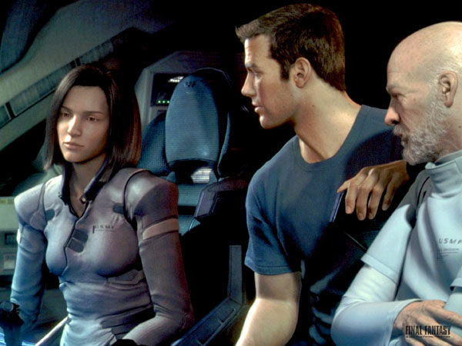
Animated Films
Final Fantasy (Square, USA)

Slide 19
Industry
CAD/CAM: These fields use computer technology to design parts and products on the computer and then, using these virtual designs, to guide the manufacturing process.
AutoCAD from AutoDesk
Microsoft Visio
Adobe’s Photoshop etc.

Slide 20
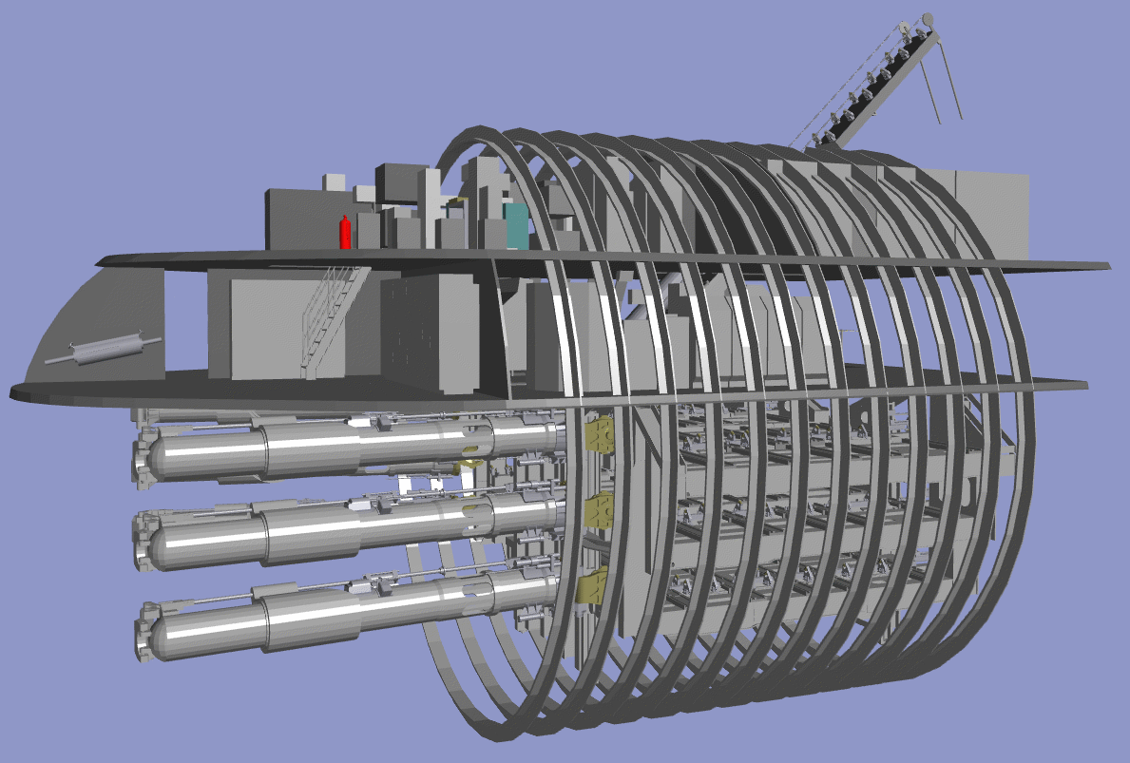
CAD/CAM

Slide 21
Simulations
Can be taken as accurate video games
Flight Simulator
Power Plant Simulator
Firefighter Simulator

Slide 22
Medicine
Medical Imaging
Meaningful images of patients scanned data
MRI
CT Scan
Guided Surgery

Slide 23
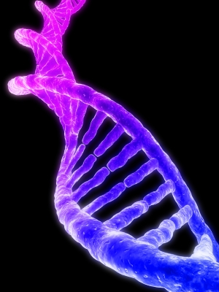
Scientific Visualization

Slide 24
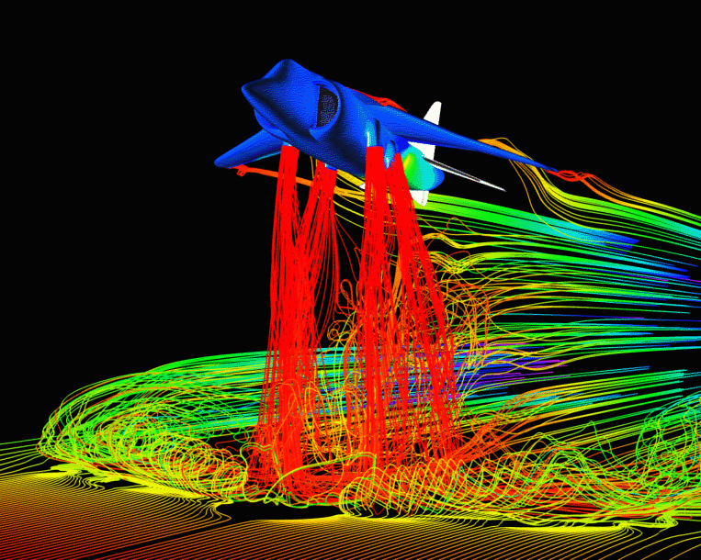
Scientific Visualization
Airflow around a Harrier Jet (NASA Ames)

Slide 25
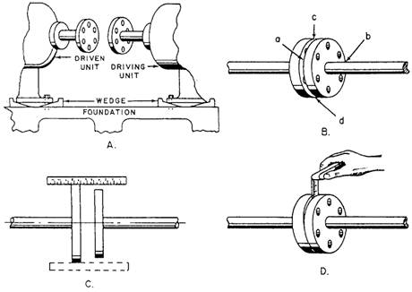
Education and Training
http://www.tpub.com/fireman/67.htm

Slide 26
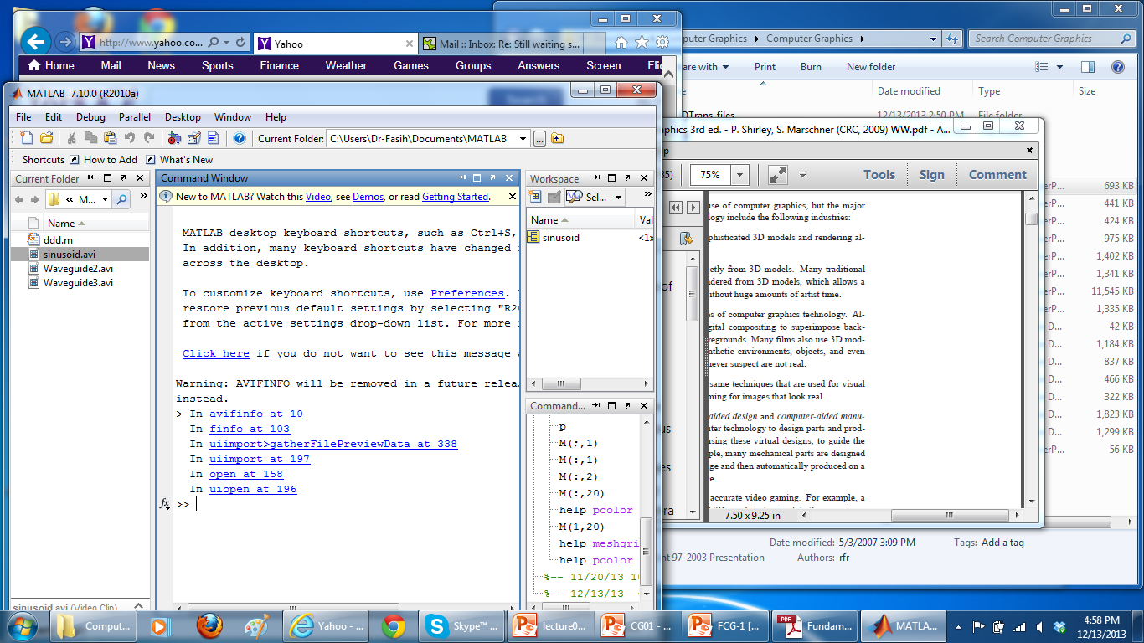
Everyday Uses

Slide 27
Summary
What is Computer Graphics
Areas
Applications

Slide 28
References
Fundamentals of Computer Graphics Third Edition by Peter Shirley and Steve Marschner

